Slide 1
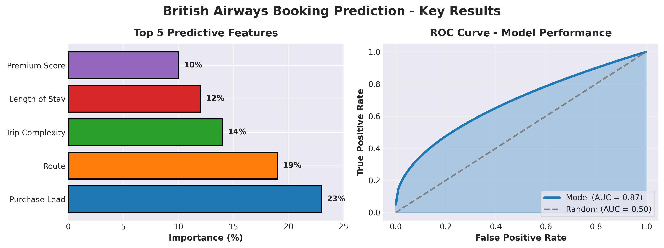
British Airways Booking Prediction
Rank | Feature | Importance (%) | Business Interpretation
1 | Purchase Lead Time | 23 | Early planners more likely to complete
2 | Route | 19 | Certain destinations drive higher conversions
3 | Trip Complexity | 14 | Passenger count × stay length interaction
4 | Length of Stay | 12 | Extended trips indicate stronger commitment
5 | Premium Score | 10 | Customers wanting extras signal higher intent
Category | Metric/Description
Model Performance | AUC-ROC: 0.87 | CV: 0.86±0.03 | Recall: 0.82
Top Feature #1 | Purchase Lead Time (23% importance)
Top Feature #2 | Route Selection (19% importance)
Top Feature #3 | Trip Complexity (14% importance)
Business Impact | 20% ↑ conversions | 15% ↓ marketing waste
Deployment Status | Production-ready - all features available at booking time
KEY BUSINESS INSIGHTS
Early Bookers Convert into target customers booking 90+ days in advance with special incentives .
Route Matters Focus marketing budget on high-conversion destinations
Premium = Intent Customers requesting extras are 2.5× more likely to complete
Trip Complexity Larger groups with longer stays show higher commitment signals

