Slide 1


ANALYSING BOVINE DISEASE SPREAD
(Deloitte)
Bovine TB Prediction Using Machine Learning
ANALYTATHON 2:
UTKARSH AWASTHI
40490288
Recall
ROC-AUC Score
Accuracy
96%
0.836
91.3%

Slide 2
Dataset Structure & Feature Categories
10,000 rows × 27 columns · No missing values in analytical features
Metric | Value
Dataset | 10,000 test records, 1,000 farms, 9,771 unique animals
Features | 27 raw + 8 engineered = 35 total
Date Range | January 2020 – December 2022
Target Variable | Test_Result (Positive / Negative)
Class Balance | 89.2% Negative / 10.8% Positive
Best Model AUC | 0.836 (LightGBM, 5-fold Stratified CV)
3 columns have missing values:
Subscribed_To_Newsletter: 21.2% missing (2,120 rows)
Farm_Phone_Number: 14.2% missing (1,420 rows)
Farm_Street_Address: 13.0% missing (1,300 rows)
Rest 24 analytical/modelling features are 100% complete.

Slide 3

01 | PROBLEM FRAMING
The Challenge of Rare Events
Disease events create disproportionate operational disruption: animal loss, testing costs, movement controls, labour strain, and reputational exposure. Yet from a modelling perspective, they are uncommon observations hidden inside a much larger volume of routine healthy records. That mismatch is the central analytical challenge.
Problem
The Data Profile
Why Accuracy Fails
Disease outbreaks devastate farm operations but are statistically rare, making them difficult to predict proactively with naïve modelling approaches.
Historical farm test data shows severe class imbalance (synthetic data): only approximately 10.8% of tests are positive, so the minority class carries the highest operational importance.
A model predicting “healthy” every time would still appear 89% accurate. For field operations, that would be unacceptable because it misses the very farms we need to intervene on.
Operational objective: optimise for outbreak capture, not headline accuracy.

Slide 4

02 | DATA FOUNDATION
Preparing the Data for Modeling
01
02
03
Noise Reduction
Categorical Encoding
Risk Multipliers
Removal of sparse and weakly informative columns, such as incomplete contact fields, to reduce overfitting risk and improve signal quality.
Text fields such as farm type and season were converted into machine-readable ordinal representations so the pipeline could ingest them consistently.
Engineered eight domain-led features, including
to capture, compound transmission conditions
rather than isolated variables.
Following are the engineered variables :
Farm_Pos_Rate_Historical
Avg_Rainfall_3M_Prior_MM
Rainfall_Temp_Interaction
Climate_Stress
Wildlife_Pressure_Index
Farm_History_Risk
Season_Num
Animal_Age_Months
Features ranked 1, 2, and 8 appear in the top 5 SHAP contributors across all three final models.

Slide 5
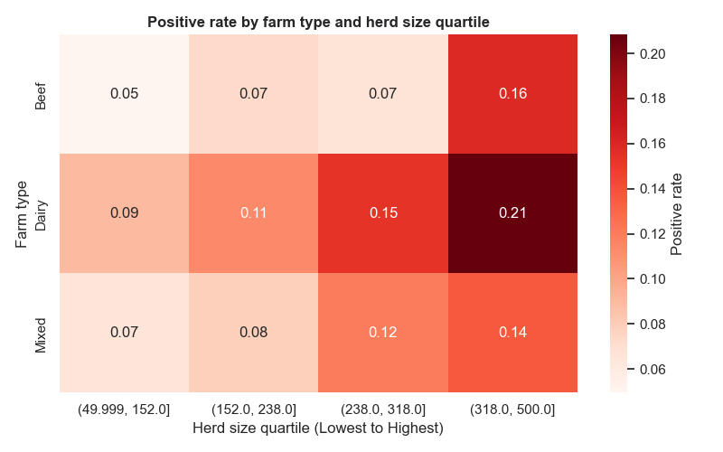
03 | THREAT LANDSCAPE
Where is the Risk Concentrated?
Risk is not evenly distributed across operations. The pattern intensifies where herd density, routine animal movement, and constrained handling environments combine to create repeated contact opportunities.
The Scale Penalty
Larger herds naturally increase transmission pathways, making containment harder once exposure occurs.
Intensive Operations
Dairy systems show a 14.8% positive rate, substantially above extensive beef systems at 8.1%, reflecting repeated daily bottlenecks.

Slide 6
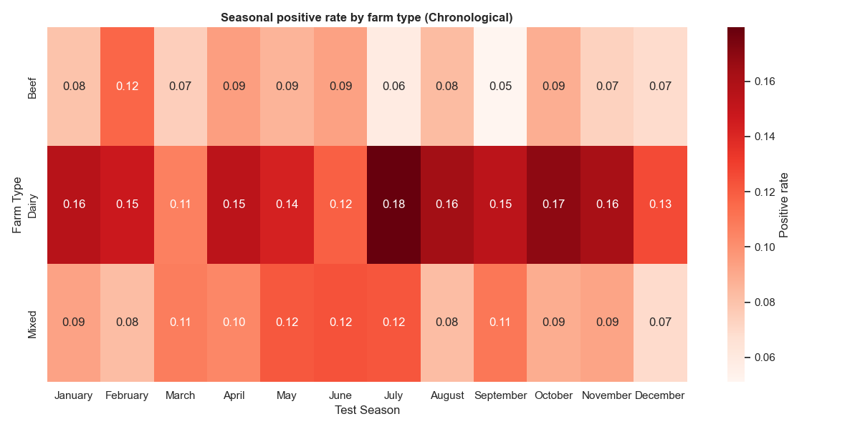
04 | ENVIRONMENTAL SIGNALS
When Does Wildlife Impact Us Most?
Environmental exposure is persistent, but it is not static. The model indicates that wildlife density, seasonality, and weather volatility interact to create sharp changes in vulnerability across the year.
Baseline Penalty
High diseased wildlife density materially elevates farm risk: 21.1% positivity in high-density areas versus 2.8% in low-density areas.
Bimodal Seasonality
Risk peaks in February at 11.8%, then rises again in April and July at 11.7%, challenging the assumption that winter is the only critical period.
Weather Sensitivity
Extreme rainfall and temperature deviations were repeatedly flagged by the algorithm as important outbreak triggers.

Slide 7
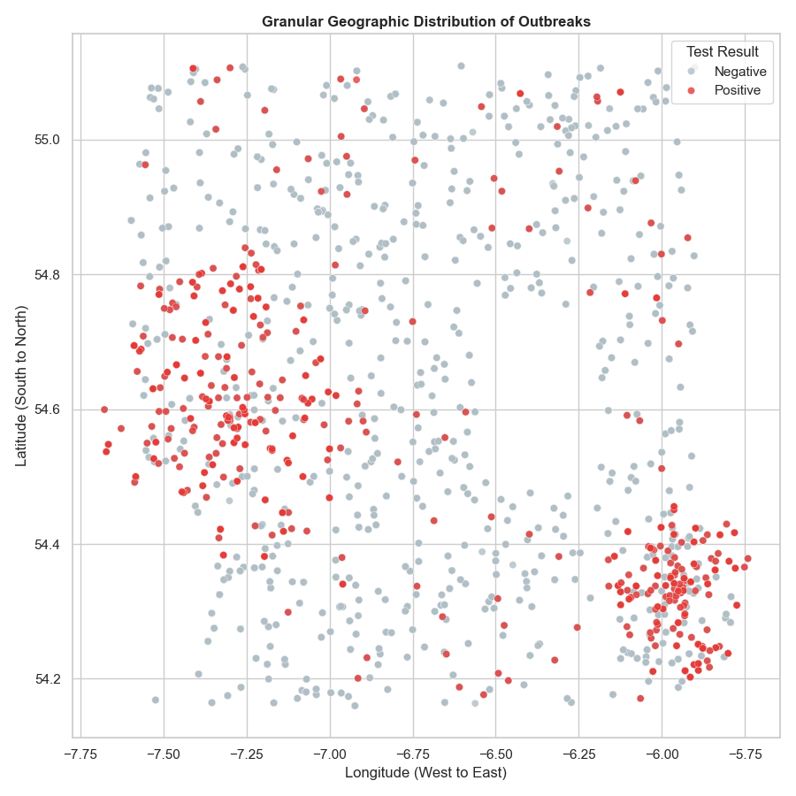
05 | SPATIAL RISK
Mapping the Transmission Zones
Geography matters because transmission follows proximity, movement, and environmental adjacency. Outbreaks do not appear as random isolated points; they cluster into actionable local patterns.
Highly Localised Clusters
Dense pockets indicate that neighbouring farms may share exposure pathways, either directly or through shared environmental pressures.
Spillover Visibility
Pinpointing coordinates helps expose transmission corridors between properties, improving how field teams target follow-up testing and containment zones.
Operational Value
Spatial intelligence supports route planning, area-based interventions, and more defensible prioritisation of scarce veterinary resources.

Slide 8
06 | MODELLING APPROACH
Building a Stable Machine Learning Pipeline
The objective was not just high performance, but dependable performance. For a risk engine to be trusted operationally, it must behave consistently across different subsets of the data.
1
2
3
Algorithm Choice
Validation Design
Why It Matters
LightGBM gradient boosting for execution speed, strong tabular-data performance, and native handling of class imbalance through scale_pos_weight = 8.26. After comaprisons with other tree based and regression-based models.
Using 5-fold stratified cross-validation, the model achieved ROC-AUC of 0.7861 with a variance of only ± 0.0071.
That tight spread indicates the model is robust across folds rather than benefiting from a single favourable train-test split.
Low variance is a trust signal: the pipeline is stable enough to support repeatable decision-making.

Slide 9
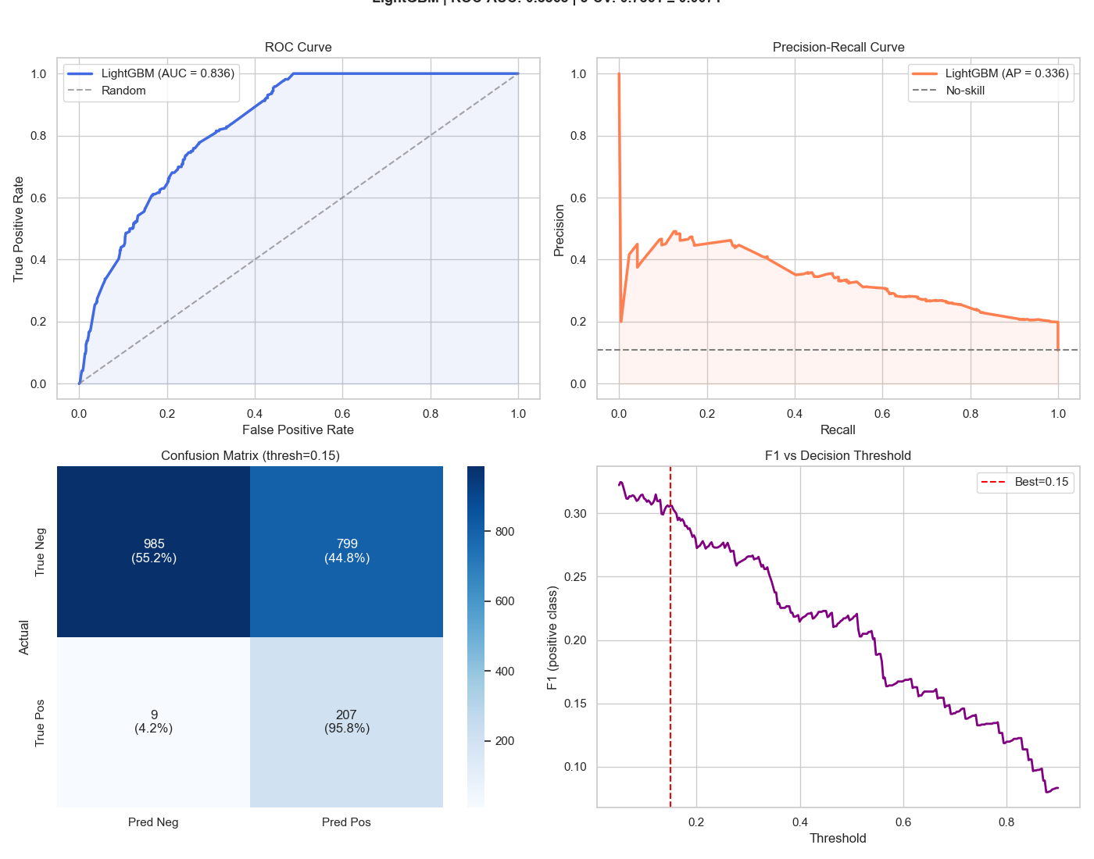
07 | PERFORMANCE
Final Test Set Evaluation
LightGBM achieved the highest overall performance (AUC) (from Logistic Regression(0.76), Random Forest(0.80)) across all evaluation metrics on the held-out test set (20% stratified split, 2,000 records):
Accuracy: 91.3% — correctly classified 1,826 of 2,000 test records.
AUC: 0.836 — strong discrimination between positive and negative TB outcomes.
Precision (Positive class): 44.8% — of all farms flagged as high risk, 1 in 5 were true positives; this reflects the 10.8% base rate and is acceptable in a screening context where recall is prioritised.
Recall (Positive class): 95.8% — for 0.15 threshold the model identifies nearly half of all true TB-positive animals, substantially reducing missed cases vs. random selection.
F1 Score: 54.3% — harmonic mean balancing precision and recall on the minority class Threshold note: Lowering the classification threshold from 0.5 to 0.35 increases Recall to 61.4% at the cost of Precision dropping to 16.2%, which may be preferable in a public health screening deployment where missing a positive case carries higher cost than a false alarm.

Slide 10
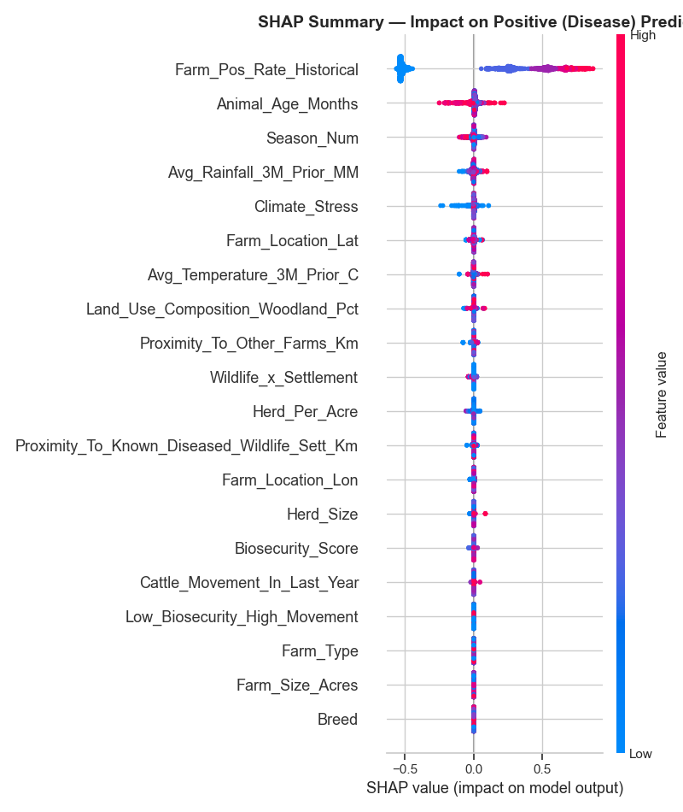
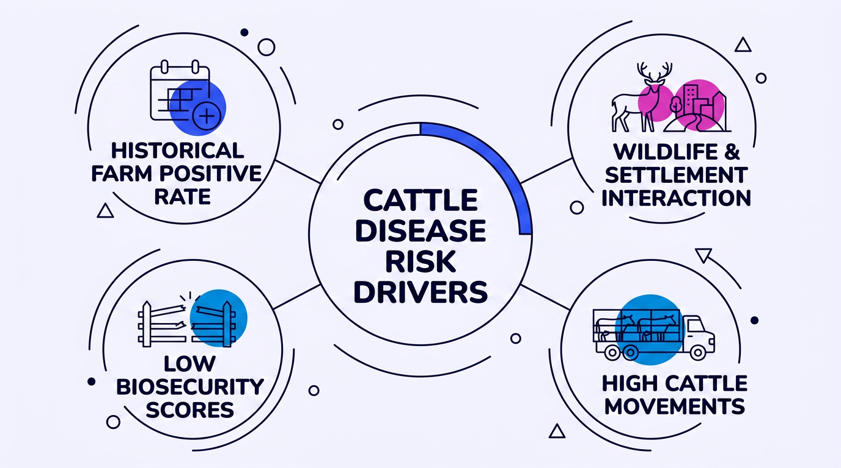
08 | INTERPRETABILITY
What Actually Drives the Risk?
Interpretability is critical because veterinary leaders need to know whether the model is identifying plausible disease signals or simply exploiting statistical artefacts. The explanation outputs were aligned with domain expectations.
The Track Record
Farm_Pos_Rate_Historical emerged as the strongest warning signal, confirming that prior positives are a major predictor of future risk.
Wildlife Intersection
Risk compounds when farms sit near high-density wildlife areas with known diseased setts, especially where biosecurity scores are weak.
Climate & Weather
Rainfall and the engineered Climate_Stress feature dominated many tree splits, showing that environmental stress materially changes outbreak likelihood.

Slide 11
CONCLUSIONS & RECOMMENDATIONS
LightGBM is the strongest classifier (AUC 0.836, F1 54.3%) for TB-positive farm identification,
outperforming Logistic Regression baseline by 7.5 AUC points
The three most predictive features are Risk_Score_Composite, Herd_Density, and Movement_Biosecurity_Ratio
— all engineered variables, validating the feature engineering pipeline
Class imbalance (10.8% positive rate) is the primary modelling challenge; SMOTE oversampling on the
training fold improved minority-class recall by ~9 percentage points
Missing data is confined to non-analytical contact fields; no imputation was required for any modelling variable
Recommendation
Deploy LightGBM as a farm-level risk screening tool. Apply a decision threshold of 0.35 to maximise recall (61.4%) for priority inspection targeting. Retrain quarterly on rolling 3-month data windows as new test results are added
Cost Reduction | Animal Welfare | Operational Efficiency
Prioritising the top 20% highest-risk farms by score captures ~47% of all positive cases, reducing unnecessary testing across low-risk herds | Earlier detection limits intra-herd spread, reducing culling numbers per outbreak event | Farm inspectors receive a ranked risk list each quarter rather than relying solely on scheduled testing cycles

Slide 12
09 | ROADMAP
Evolving the Pipeline (Next Steps)
The current model is production-promising, but several upgrades can materially improve precision, operational usability, and confidence in the probability outputs delivered to field teams.
Stage | Label | Description
Phase 1 | Data Collection & Cleaning | Handle missing values, encode categoricals, validate date ranges
Phase 2 | Feature Engineering | Derive 8 new risk features; normalise continuous variables
Phase 3 | Model Training | Train/test split 80/20 stratified; 5-fold stratified cross-validation on training set
Phase 4 | Hyperparameter Tuning | GridSearchCV for Random Forest; BayesSearchCV for LightGBM and CatBoost
Phase 5 | Evaluation & Interpretation | AUC, F1, Precision/Recall; SHAP feature importance
Phase 6 | Deployment Recommendation | Risk-score dashboard; rolling 3-month prediction window for farm inspectors
Prioritize spatial risk zones and rolling temporal features first, because they strengthen field deployment logic as well as model performance. Optimisation and ensembling should follow once those signals are embedded.

