Slide 1
Arbitrage Trading Strategy
for Irish Energy Markets
Optimizing Profit per MWh through Multi Market Price Arbitrage
Profit per MWh
Accuracy
Total Profit
€12.0
81.5%
€139,403
Presented By-
Utkarsh

Slide 2
EXECUTIVE SUMMARY
Strategy at a Glance
Main Strategy
Best Profit/MWh
Model Accuracy
Total Return
DAM-IDA1
€12.0
81.5%
€139,403
Arbitrage Trading
11,656 Trades
HistGradientBoosting
Test Period
The Problem
Key Insights
Electricity in Ireland is traded across four sequential markets (DAM, IDA1, IDA2, IDA3) before final settlement in the Balancing Market (BM). Price spreads between these markets represent arbitrage opportunities, but predicting spread direction requires cutting through significant noise.
1
Optimal Market Pair
DAM-IDA1 delivers highest accuracy (81.5%) with strong profit (€12.0/MWh)
2
Time-of-Day Patterns
Evening hours (19-23h) show peak profitability; avoid hours 6, 11-14, 16
Core Challenge
3
Threshold Optimization
To build a classification model that predicts whether the spread between markets will be positive or negative, executing trades that maximise profit per MWh while minimising risk exposure.
€50 threshold optimal for DAM-BM, €1 threshold for DAM-IDA1
4
Model Selection
HistGradientBoosting outperforms Logistic Regression, Random Forest, and LightGBM

Slide 3
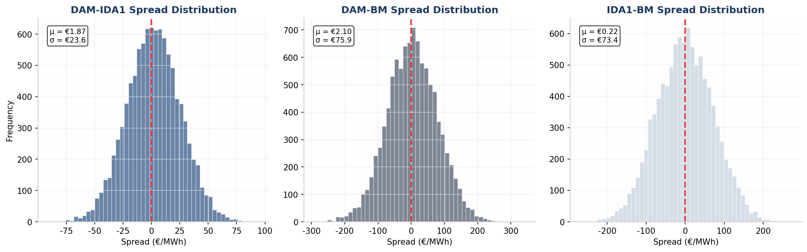
PROBLEM STATEMENT
Multi-Market Price Arbitrage
DAM
IDA1
BM
Day Ahead Market
Intraday Auction 1
Balancing Market
Price settled 24h ahead
Price settled 4h ahead
Real time settlement
Market Structure & Opportunity
Spread Distributions
The Single Electricity Market (SEM) operates as a sequential auction system where electricity is traded at progressively shorter time horizons before physical delivery. Each market closure reveals new information such as weather updates, demand revisions, plant outages which creates price discrepancies between markets.
Trading Strategy
If model predicts IDA1 price > DAM price then BUY in DAM, SELL in IDA1
Profit = Position × (IDA1 - DAM) spread
DAM-IDA1: Mean €1.87, σ €23.6 | DAM-BM: Mean €2.10, σ €75.9
Key Insight: Higher volatility in BM linked spreads (σ €73-76) vs DAM-IDA1 (σ €23.6) suggests greater profit potential but also higher risk in BM trading.

Slide 4
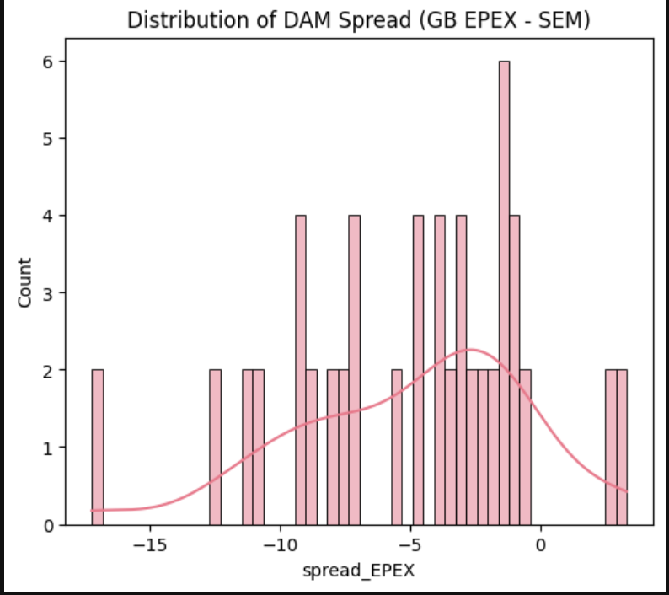
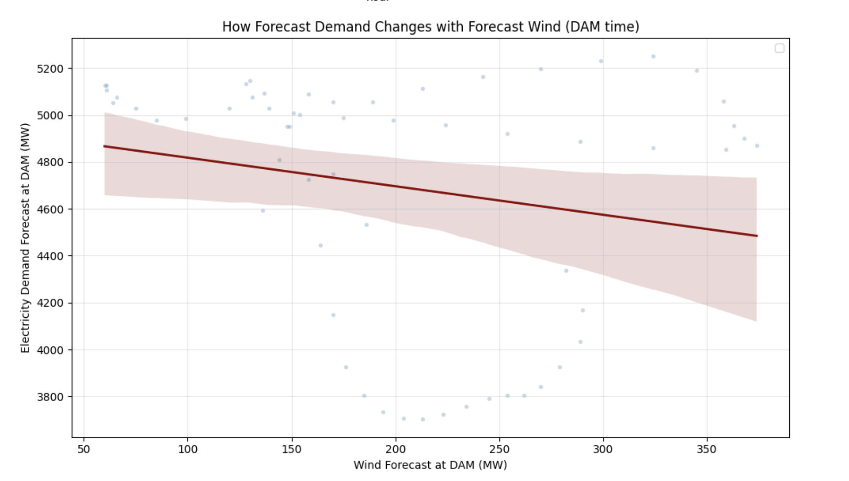
DATA FOUNDATION
Exploratory Data Analysis
Temporal Coverage
Variables
Start Date:
Jan 1, 2022
Raw Features:
104
End Date:
Dec 31, 2025
After Cleaning:
87
Frequency:
30-minute intervals
GU Outages:
15 (removed)
Total Obs:
72,945
Final Features:
22
Data Sources & Measurement
Wind Forecasts: Meteo ISEMWIND, EirGrid WindFc, EmSys C/UM Wind (DAM, IDA1-3)
Demand Forecasts: Meteo ISEMDEMAND, EirGrid DemandFc, ISEMDEMAND (DAM, IDA1-3)
GB Market Prices: EPEX, N2EX, HH EPEX (DAM, IDA1)
Interconnector Flows: IE_GB_MW, GB_IE_MW, LTS_IC_NI, LTS_IC_ROI
Generation: TotalPN, PumpStorage, 15 GU outage variables (removed due to low correlation)
Total Outages (GU): Sum of all generator units
Key Insights: Multiple forecast sources provide complementary signals, GB-SEM spreads enable arbitrage, Supply constraints drive volatility , Hourly patterns reveal systematic price variations.

Slide 5
DATA FOUNDATION
Data Cleanse
Variables
Train/Test Split
Raw Features:
104
Training:
43,688 (60%)
After Cleaning:
87
Validation:
17,588 (24%)
GU Outages:
15 (removed)
Test:
11,661 (16%)
Final Features:
22
Method:
Temporal
Data Quality Protocol
Missing Value Treatment
Columns with >50% missingness removed (ISEMSOLAR, ISEMWIND_U_M_50). Remaining NaNs handled via imputation.
Feature Selection
GU outage variables removed after correlation analysis showed r < 0.15 with price movements.
Temporal Integrity
TradeDate calculated from StartDateTime (23:00-22:30 cycle). Duplicate timestamps removed.

Slide 6
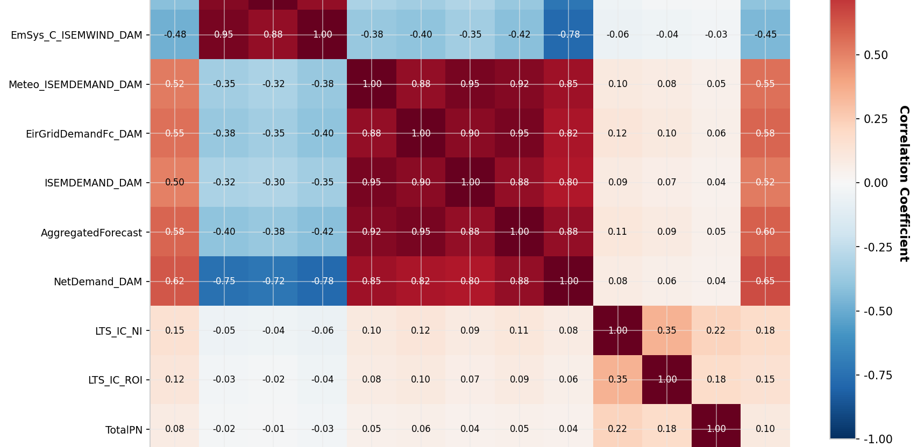
FEATURE ENGINEERING
Signal Extraction from Raw Data
Engineered Features
Feature Correlation Matrix
1. Net Demand Calculations
NetDemand_DAM = ISEMDEMAND_DAM - Meteo_ISEMWIND_DAM
Captures residual demand after wind generation
2. GB-SEM Price Spreads
spread_EPEX = GB_DAM_Epex
Interconnector arbitrage signals
3. Net Interconnector Flow
NetICFlow = IE_GB_MW + IE2_GB2_MW - GB_IE_MW - GB2_IE2_MW
Cross-border capacity utilization
4. Lag Features
spread_lag1, spread_lag24: Previous spread values
Key Finding: GB DAM Epex shows r=0.99 correlation with SEM, indicating strong market integration.
Autoregressive price patterns
Feature Importance Insight: Net demand features (r=0.65 ) and GB market prices are the strongest predictors. Wind forecasts show negative correlation (r=-0.42 to -0.48)—as wind increases, prices decrease.

Slide 7
MACHINE LEARNING FOUNDATIONS
Understanding the Models
Hist Gradient Boosting
Logistic Regression
Gradient Boosting is an ensemble technique that builds models sequentially, with each new model correcting errors made by previous ones. HistGradientBoosting (Histogram-based) is an optimised implementation that transforms continuous features into discrete feature into histogram bins for faster training.
Logistic Regression is a linear classification algorithm that predicts the probability of a binary (or multi-class) outcome. It models the relationship between input features and the log-odds of the target variable using a sigmoid function.
How It Works:
How It Works:
1. Start with a simple prediction (e.g., mean spread)
1. Calculate weighted sum: z = w₁x₁ + w₂x₂ + ... + b
2. Train a decision tree on prediction errors (residuals)
2. Apply sigmoid: P = 1 / (1 + e⁻ᶻ) → output 0 to 1
3. Update prediction: New = Old + learning_rate × Tree
3. Classify based on threshold (e.g., P > 0.5 → LONG)
4. Repeat for N iterations (300 in our model)
4. Learn weights via maximum likelihood estimation
Strengths & Limitations:
Strengths & Limitations:
Pros: Handles complex non-linear relationships in price data. Captures interactions between wind forecasts, demand, and interconnector flows that linear models miss. Regularization (L2) prevents overfitting to market noise.
Cons: Harder to interpret than Linear models such as Logistic Regression, requires careful parameter tuning and can overfit without proper regularisation
Pros: Highly interpretable (each feature has a coefficient), fast training, works well with linearly separable data. Cons: Cannot capture complex feature interactions; assumes linear decision boundary which may not fit volatile energy markets.
Model Comparison Context: HistGradientBoosting achieved 81.5% accuracy vs. Logistic Regression's 44.6% on DAM-IDA1. The 37 percentage point difference demonstrates that energy price spreads exhibit complex, non-linear patterns better captured by ensemble tree methods.

Slide 8
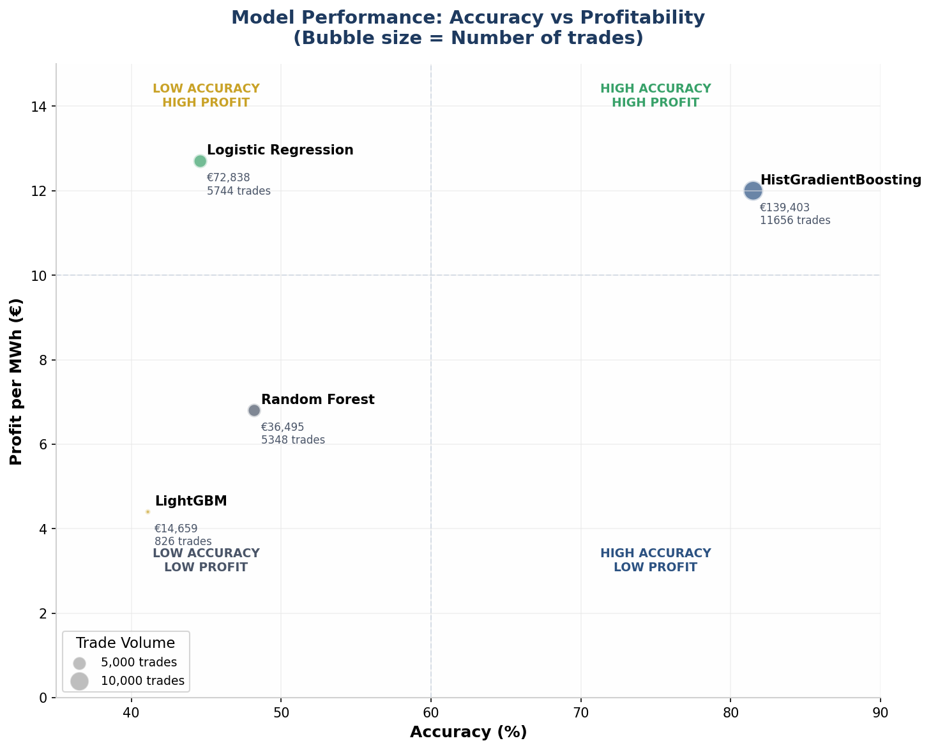
MODEL ARCHITECTURE
Ensemble Classification Approach
Classification Framework
Algorithm Comparison
Target Variable: Spread Direction
+1
0
-1
LONG
NEUTRAL
SHORT
Spread > +€50
-€50 ≤ Spread ≤ +€50
Spread < -€50
Pipeline Configuration
1. StandardScaler
Z-score normalization for feature scaling
2. HistGradientBoostingClassifier
max_iter=300, learning_rate=0.08, max_depth=7, l2_regularization=1.0
HistGradientBoosting
81.5% | €12.0/MWh
Logistic Regression
44.6% | €12.7/MWh
Random Forest
48.2% | €6.8/MWh
LightGBM
41.1% | €4.4/MWh
Model Selection Rationale: HistGradientBoosting selected for optimal balance of accuracy (81.5%) and profit per MWh (€12.0). Logistic Regression shows similar profit but with significantly lower accuracy (44.6%), indicating higher risk.

Slide 9
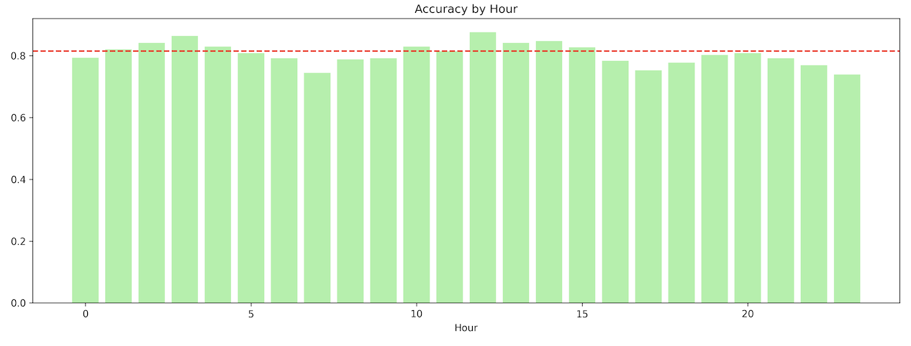
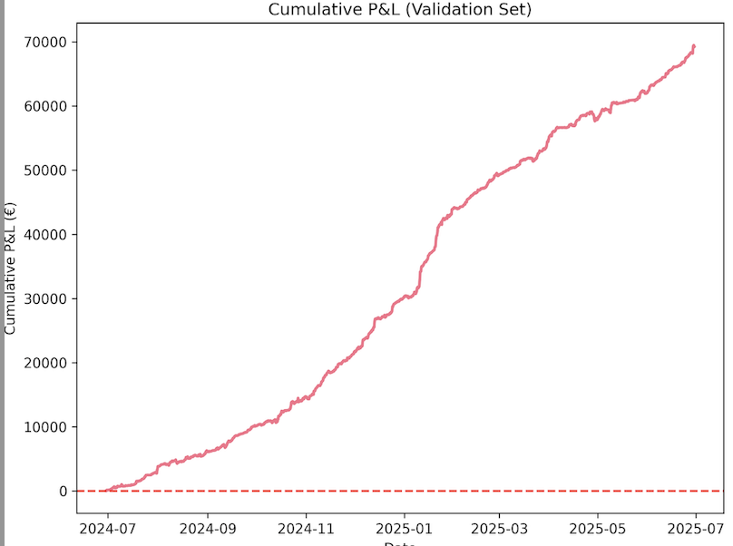
MACHINE LEARNING FOUNDATIONS
Results from HistGadient Boosting
Cumulative P&L
Cumulative P&L
Model consistently predicts between 75-90% which increases confidence levels
High accuracy during busy hours suggests high volume trading thus leading to more predictable patterns
Slight dip in accuracy for hours between 0-2 and 20-22, highlighting low volume trading
The model highlights that it works reliably 24/7
Cumulative P&L
The profit curve rises consistently from €0 to over €70,000
Smooth and consistent growth with no long or massive periods of loss
Profit spike between Jan and March suggests model worked exceptionally well
The model worked exceptionally well with low risk without compromising profits
Highlights from Validation Set: The model works reliably across different hours whilst handling complex dynamics of the energy market.

Slide 10
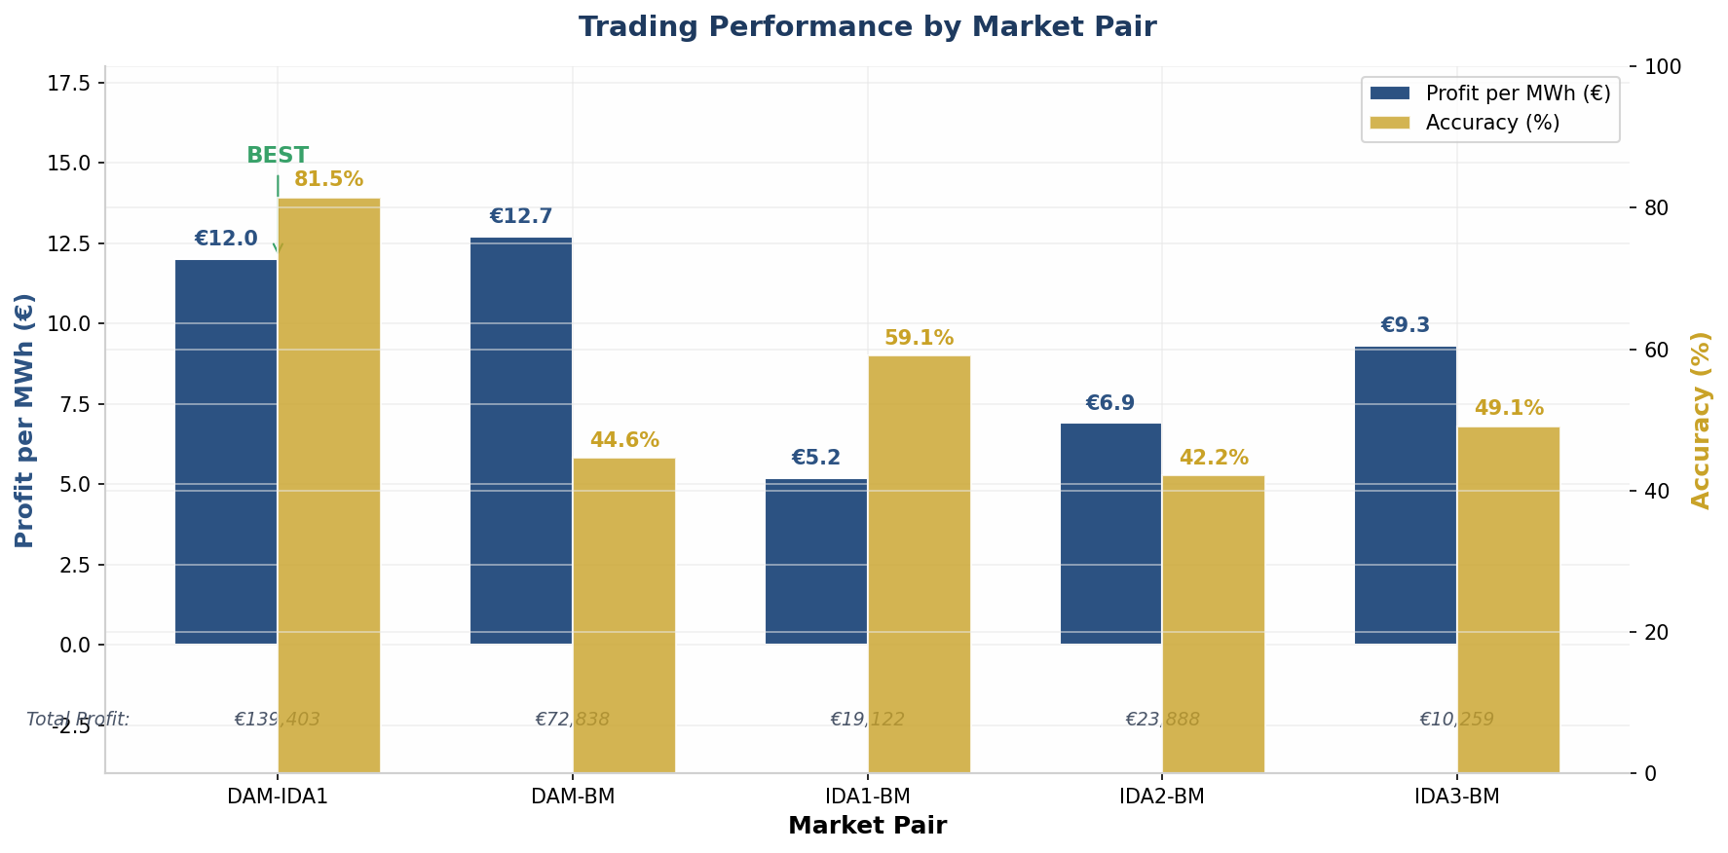
DAM-IDA1
DAM-BM
PERFORMANCE ANALYSIS
Best Overall
High Profit
Profitability by Market Pair
€12.0/MWh
€12.7/MWh
81.5% Acc
44.6% Acc
€139,403
€72,838
11,656 trades
5,744 trades
IDA1-BM
Moderate
€5.2/MWh
59.1% Acc
€19,122
3,696 trades
IDA2-BM
IDA3-BM
Moderate
Moderate
€6.9/MWh
€9.3/MWh
42.2% Acc
49.1% Acc
€23,888
€10,259
3,475 trades
1,105 trades
Market Insight: DAM-IDA1 offers the optimal risk-adjusted return with highest accuracy (81.5%) and strong profit per MWh (€12.0). DAM-BM shows higher profit per trade (€12.7) but lower accuracy (44.6%), suggesting higher variance in outcomes.

Slide 11
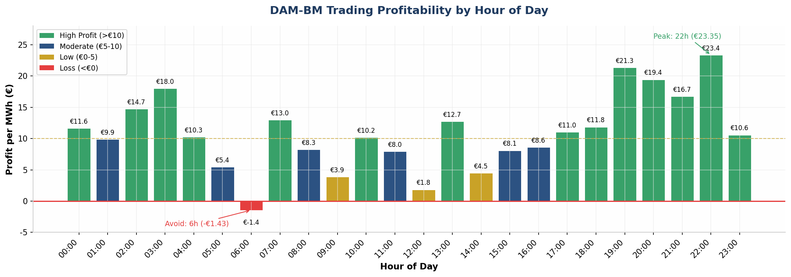
TEMPORAL ANALYSIS
Hourly Profitability Heatmap
Peak Hours (€15+)
Moderate Hours (€5-15)
Avoid Hours (<€5 or Loss)
22:00
€23.35
03:00
€18.00
06:00
-€1.43
19:00
€21.33
02:00
€14.71
12:00
€1.84
20:00
€19.43
00:00
€11.62
05:00
€5.44
21:00
€16.72
07:00
€12.99
09:00
€3.89
13:00
€12.73
14:00
€4.49
Temporal Pattern: Evening peak hours (19-23h) consistently deliver highest profitability, likely due to demand surge and increased price volatility. Early morning hours (5-6h) and midday (11-14h) show weakest performance and should be avoided.

Slide 12
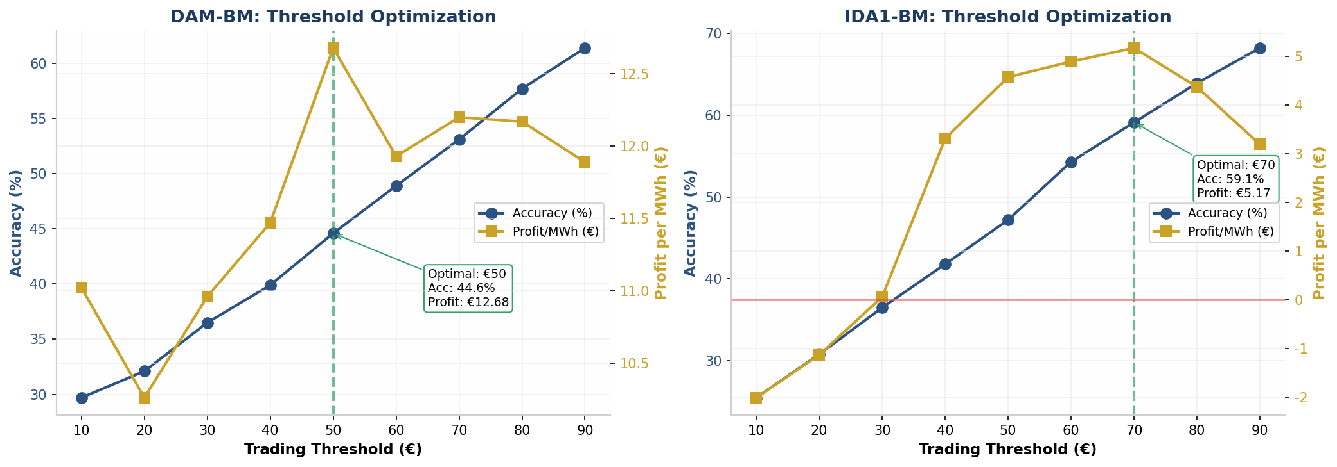
THRESHOLD OPTIMIZATION
Risk-Return Trade-offs
DAM-BM Threshold Analysis
IDA1-BM Threshold Analysis
Optimal: €50
€12.68/MWh
Optimal: €70
€5.17/MWh
44.6% accuracy | 5,744 trades
59.1% accuracy | 3,696 trades
€10 threshold:
€11.02/MWh (29.7% acc)
€30 threshold:
€0.06/MWh (36.5% acc)
€30 threshold:
€10.96/MWh (36.5% acc)
€50 threshold:
€4.57/MWh (47.2% acc)
€70 threshold:
€12.20/MWh (53.1% acc)
€90 threshold:
€3.19/MWh (68.2% acc)
Key Insight: Higher thresholds increase accuracy but reduce trade frequency. The optimal threshold balances profit per trade with sufficient volume. For DAM-BM, €50 threshold delivers maximum profit per MWh (€12.68); for IDA1-BM, €70 threshold is optimal (€5.17).

Slide 13
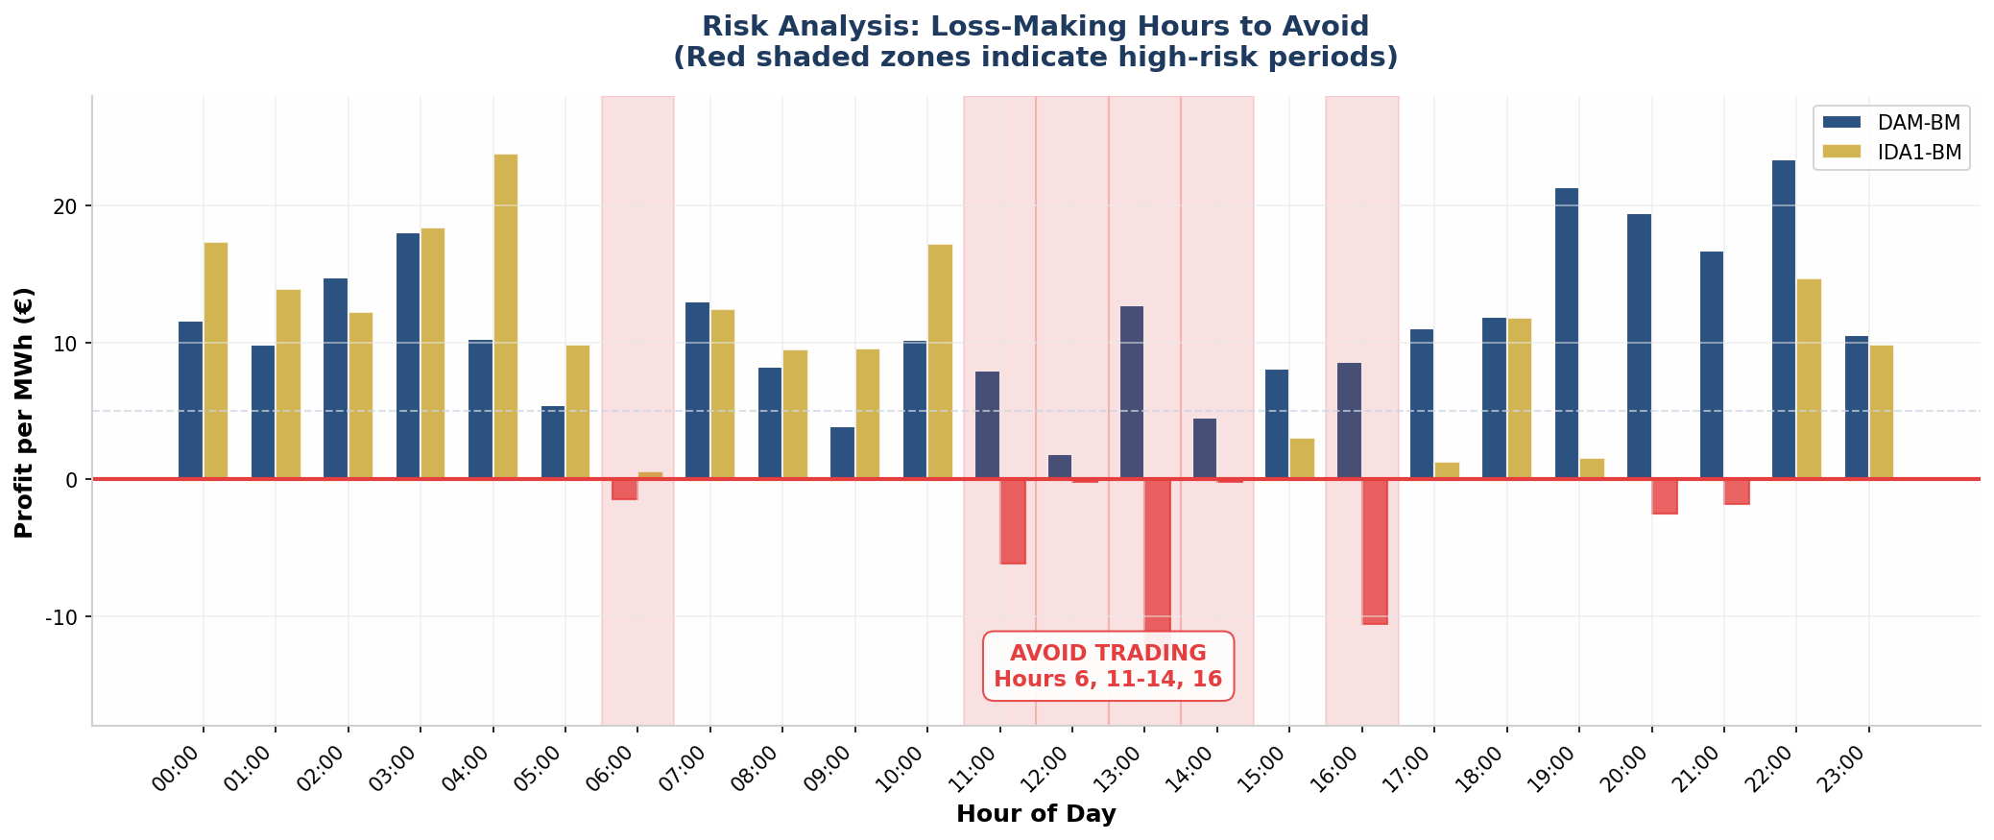
RISK MANAGEMENT
When NOT to Trade
Loss-Making Hours
Risk Mitigation Strategies
06:00 (DAM-BM)
-€1.43
1. Time-Based Filters
Early morning demand trough
Exclude trades during hours 6, 11-14, 16 to avoid systematic losses
11:00-14:00 (IDA1-BM)
-€6.16 to -€0.16
2. Volatility Thresholds
Midday solar generation peak
Skip trades when spread volatility exceeds 2 standard deviations
-€10.58
3. Confidence Scoring
16:00 (IDA1-BM)
Only execute trades when model confidence > 70%
Afternoon demand transition
Risk Warning: Loss-making hours correlate with periods of market uncertainty (demand transitions, solar peaks). Implementing time-based filters could improve overall profitability whilst reducing maximum drawdown.

Slide 14
MODEL COMPARISON
Algorithm Performance Matrix
HistGradientBoosting
Logistic Regression
Accuracy:
81.5%
Accuracy:
44.6%
Profit/MWh:
€12.0
Profit/MWh:
€12.7
Total Profit:
€139,403
Total Profit:
€72,838
Trades:
11,656
Trades:
5,744
Best for: High accuracy, balanced profit
Best for: Interpretability, baseline
Random Forest
LightGBM
Accuracy:
48.2%
Accuracy:
41.1%
Profit/MWh:
€6.8
Profit/MWh:
€4.4
Total Profit:
€36,495
Total Profit:
€14,659
Trades:
5,348
Trades:
826
Best for: Feature importance
Best for: Speed, large datasets
Selection Criteria: HistGradientBoosting selected as production model due to superior accuracy (81.5%) and highest total profit (€139,403). The 2x accuracy improvement over Logistic Regression significantly reduces downside risk while maintaining strong profitability.

Slide 15
STRATEGIC RECOMMENDATIONS
How to implement model
1
Focus on DAM-IDA1
4
Deploy HistGradientBoosting
Prioritize DAM-IDA1 trading for optimal risk-adjusted returns: 81.5% accuracy with €12.0/MWh profit.
Use HistGradientBoosting as the production model for optimal accuracy-profit balance.
2
Avoid High-Risk Hours
5
Trade Peak Hours
Implement time-based filters to exclude trading during hours 6, 11-14, and 16 to avoid systematic losses.
Concentrate trading activity during evening peak hours (19-23h) when profitability is highest.
3
Optimize Thresholds
Expected Impact
Use €50 threshold for DAM-BM trades and €1 threshold for DAM-IDA1 to maximize profit per MWh.
€12.0
81.5%
Profit/MWh
Accuracy

Slide 16
Appendix
Reference List:

