Slide 1

Lego Dataset Analysis
Presented By:
Utkarsh Awasthi

Slide 2

Data Set Overview
The LegoData dataset initially contained 16 variables with 1603 entries.
The Lego dataset contains the details about Lego sets manufactured between January 2018 and September 2020.
The dataset consists of every single Lego theme except for the mystery sets, as they have an unknown number of pieces. The data was collected from Brickset.com and BrickInstructions.com.[1]
With this dataset, our team will analyse the main factors of Lego sets and examine how these factors impact the pricing and the overall Lego sets design characteristics.
The main attributes used for the analyses are the Theme, number of Unique Pieces, the set Age recommendation, and the Prices on Retail and Amazon.

Slide 3


Proposed questions
Is there a relationship between theme and the number of unique pieces, Do Licensed sets feature more unique pieces? - Some people say licensed sets need more special parts to match the films or shows they’re based on; we want to see if the data actually supports that.
Is there a relationship between theme and price, Does this relationship change when looking at Retail Price VS Amazon Price? - Retail Shops and online sellers (Amazon) don’t always price sets the same way, especially for popular themes, so we want to check if certain themes stay expensive or get bigger discounts on Amazon.
Are there significant differences in the number of unique pieces between sets & Is this due to them being aimed at a younger or older age groups? - It’s often claimed that sets for older kids are more complex; we want to test if sets for higher age ranges really do use more different pieces.

Slide 4
Q1) Is there a relationship between theme and the number of unique pieces? Do Licensed sets feature more unique pieces?
Dataset Overview:
1,304 LEGO sets from the 2020 product range
Covering 40 themes
Variables including unique pieces, theme & licensing status (licensed vs non-licensed).
Initial Exploration: We began by comparing total pieces across licensed and non-licensed sets to identify broad differences in overall set size.
Motivation for Further Analysis: Licensed sets were found to contain more total pieces on average, raising the question of: "Do licensed sets also contain more unique pieces than non-licensed sets?".
Analytical Progression: The analysis therefore proceeds from total pieces, to unique pieces, and finally to theme-level analysis, examining how theme and licensing status jointly relate to unique piece counts.

Slide 5
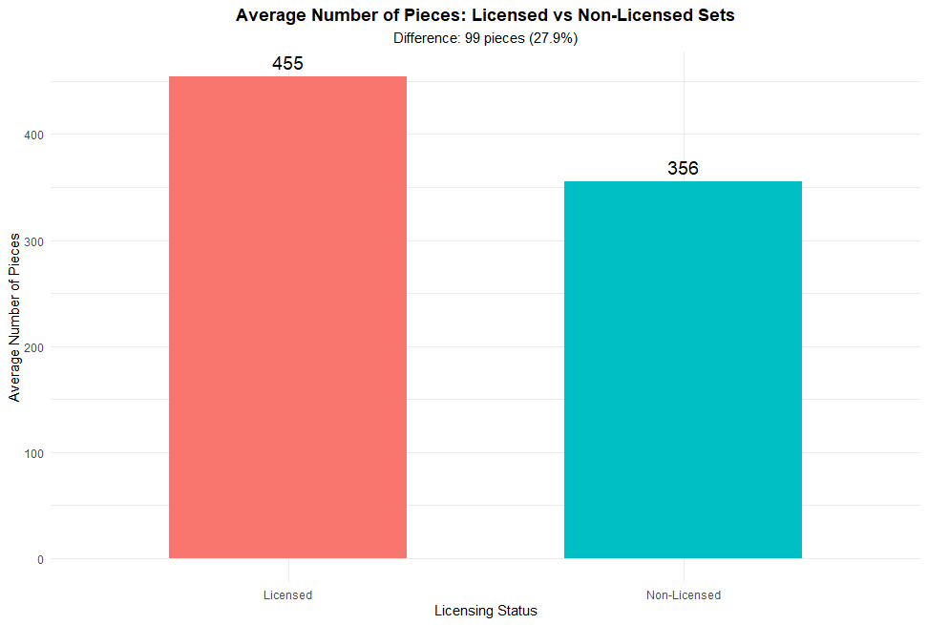
Dataset Cleaning & Categorisation
Our initial dataset required :
Theme Name Standardisation: Special characters (™, ®, !) were removed from theme names to ensure consistent naming across all themes (e.g., Star Wars™ → Star Wars, DUPLO® → DUPLO), enabling accurate matching and analysis.
Theme Categorisation: A total of 40 themes were identified and classified into two categories: 20 licensed themes (external intellectual property) and 20 non-licensed (LEGO original) themes [2]. These were categorised through a binary indicator (1 = Licensed, 0 = Non-Licensed) .
Initial Categorised Dataset Contains:
1,304 Lego sets
431 Licensed LEGO sets (33.1%)
873 Non-licensed LEGO sets (66.9%)
Figure 1: Bar-chart depicting licensed sets average 455 total pieces compared to 356 pieces for non-licensed sets, showing a clear difference of 99 pieces. This initial comparison suggests that licensed sets are generally larger and more complex products overall.

Slide 6
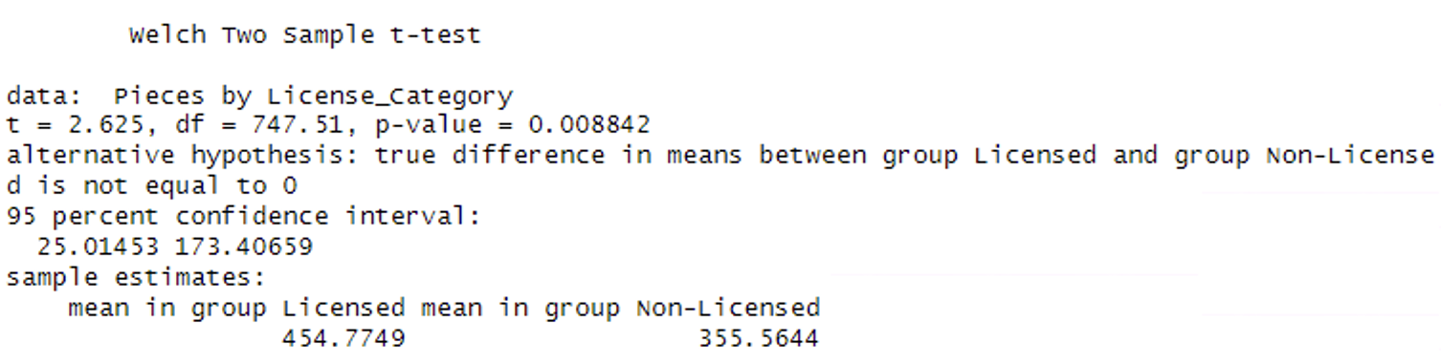
Comparing Total Pieces –
Licensed vs. Non-Licensed sets
Preliminary Analysis: Total Pieces by Licensing Status:
Licensed sets have a higher average total piece count in comparison to non-licensed sets (454.8 vs 355.6 pieces), a difference of 99 pieces (27.9%) - seen in Figure 1.
A Welch two-sample t-test confirms this difference is statistically significant (p = 0.0088 < 0.05) shown in Figure 2.
This indicates that licensed sets are generally larger than non-licensed sets.
Motivation for Further Analysis:
Larger sets may indicate greater piece variety, but could also reflect repeated pieces.
This finding motivates the next hypothesis test: "Do licensed sets also contain more unique pieces than non-licensed sets?"
Figure 2: The Welch two-sample t-test results, confirming that licensed LEGO sets contain significantly more total pieces than non-licensed sets (p < 0.05).

Slide 7
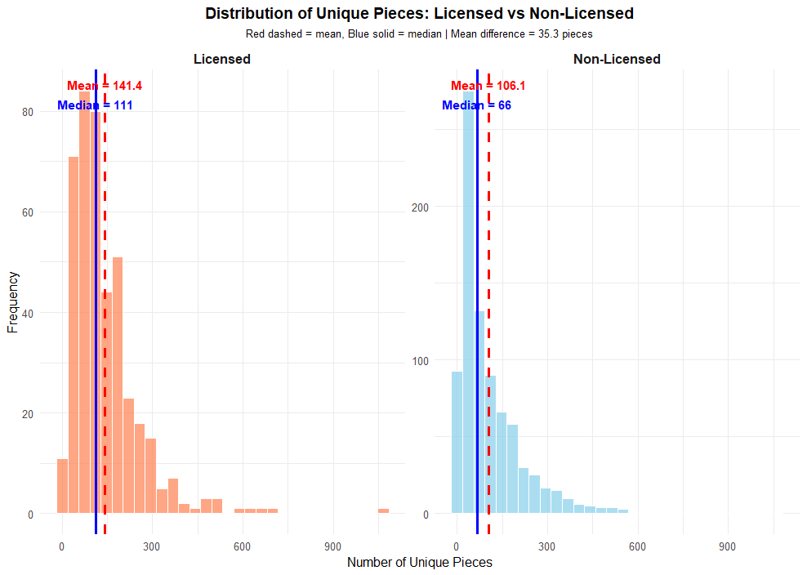
Comparing Unique Pieces – Licensed vs. Non-Licensed sets
When conducting summary statistics on Unique pieces by licensing status:
Licensed LEGO sets have a higher average number of unique pieces (141.4 vs. 106.1) compared to non-licensed sets - Difference of 35.3 pieces (33.3%).
Median values further reinforce this difference (111 vs 66), indicating consistently higher unique piece counts across licensed sets.
Licensed sets exhibit greater variability in unique piece counts (SD: 115.23 vs 106.42), reflecting a wider range of complexity levels, with both categories showing substantial spread (ranges >650).
Figure 3 shows both distributions are right-skewed, indicating the presence of high-complexity sets in both categories. Licensed sets have a smaller mean–median gap (30.4 vs 40.1), suggesting more consistent complexity at higher levels.
Figure 3: The histogram shows licensed sets skewed to the right relative to non-licensed sets, indicating higher unique piece counts overall. Mean and median reference lines are highlighted in both red and blue.

Slide 8
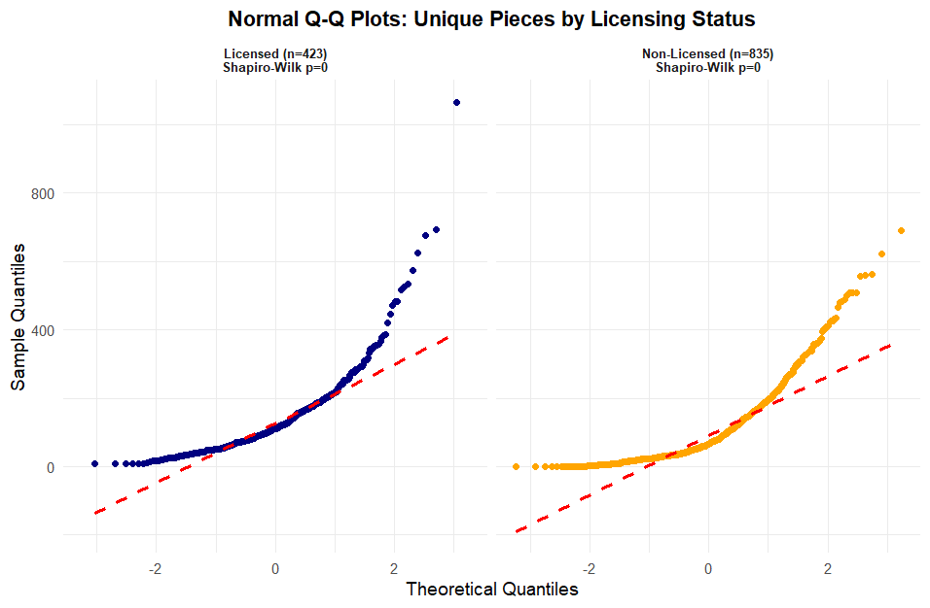
Hypothesis Testing – Assumptions
Before conducting statistical tests, key assumptions were checked to ensure the analysis was appropriate:
Hypotheses:
H₀ (Null Hypothesis): Mean unique pieces for Licensed sets = Mean unique pieces for Non-Licensed sets
μ_licensed = μ_non-licensed
H₁ (Alternative Hypothesis): Mean unique pieces for Licensed sets ≠ Mean unique pieces for Non-Licensed sets
μ_licensed ≠ μ_non-licensed
Significance Level: α = 0.05 (two-tailed test)
Each LEGO set represents a separate and independent product, meaning observations are not related to one another.
Variability in unique piece counts is similar across licensed and non-licensed sets, as confirmed by Levene’s test (p = 0.6724 > 0.05).
These checks indicate the data are suitable for reliable comparison between groups.
Figure 4: The Normal Q-Q plots for licensed (n = 423) and non-licensed (n = 835) sets. Both distributions deviate from the normal line at the upper tail, indicating right-skewness and supporting the Shapiro–Wilk test results.

Slide 9
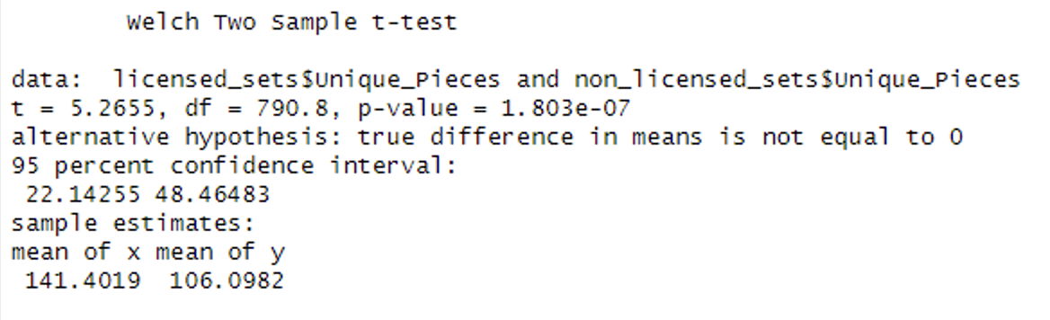
Hypothesis Testing - Results
Before comparing the average number of unique pieces, the distribution of the data was assessed for normality.
This was performed using hypothesis tests: Shapiro-Wilk & Welch – T-Test:
Shapiro–Wilk tests show that the data does not follow a normal distribution, as illustrated in Figure 4, due to the presence of very large, complex LEGO sets.
Despite this, the large sample sizes allow for reliable comparison between licensed and non-licensed sets.
As shown in Figure 5, the Welch two- sample t-test identifies a statistically significant difference between the two groups (p < 0.001).
Licensed LEGO sets contain, on average, 35 more unique pieces than non-licensed sets (141.4 vs 106.1), indicating greater overall piece variety. Therefore, there is sufficient evidence to reject the null hypothesis in favour of the alternative hypothesis (H1).
Figure 5: Welch two-sample t-test output, confirming that licensed LEGO sets have a significantly higher average number of unique pieces than non-licensed sets (p < 0.001).

Slide 10
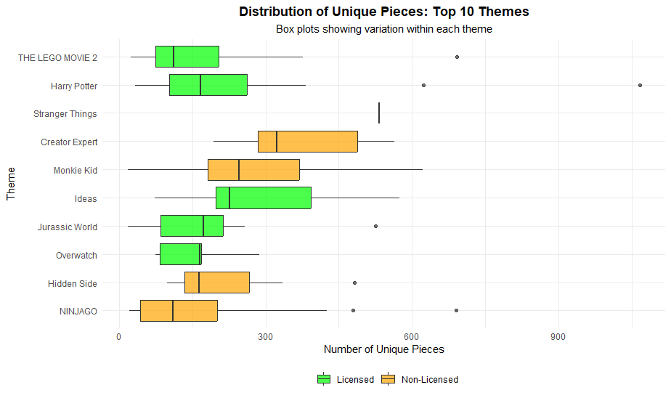
Theme Analysis – Licensed vs. Non-Licensed sets
For theme-level analysis, licensed and non- licensed themes were analysed separately:
Unique piece counts vary widely by theme:
Unique pieces range from 17.5 to 533.0 pieces across 40 themes, representing a 30× difference.
This highlights a strong relationship between theme identity and the number of unique pieces.
Highest and lowest themes differ by licensing status:
Highest overall: Stranger Things (Licensed) with 533.0 unique pieces & 1 LEGO set .
Lowest overall: Xtra (Non-licensed) with 17.5 unique pieces & 8 LEGO sets .
Non-licensed themes therefore span both the highest and lowest extremes.
Figure 6: Theme level Box-Plots display the distribution of unique pieces for the top 10 themes by mean value. Both licensed and non-licensed themes are represented, with wide variation within themes and several outliers. This highlights that theme identity plays a key role in determining unique piece counts, alongside licensing status.

Slide 11
Q1: Conclusion
Question: Is there a relationship between theme and the number of unique pieces? Do Licensed sets feature more unique pieces?
To determine whether there is a relationship between theme and the number of unique pieces, we conducted descriptive analysis and hypothesis testing comparing licensed and non-licensed LEGO sets, followed by theme-level analysis.
An initial comparison showed that licensed sets contain more unique pieces on average, with licensed sets containing 35.3 more unique pieces on average (33%) than non-licensed sets, motivating formal hypothesis testing using a Welch two-sample t-test.
The t-test revealed a statistically significant difference in mean unique pieces between licensed and non-licensed sets (p < 0.001), with the effect size suggesting practical significance as well.
Theme-level analysis reveals substantial variation across themes, with a 30× difference between the lowest and highest themes, demonstrating that theme identity strongly influences unique piece counts.
In conclusion, both theme and licensing status affect unique piece variety, with theme acting as the primary driver and licensing providing an additional, significant effect.

Slide 12
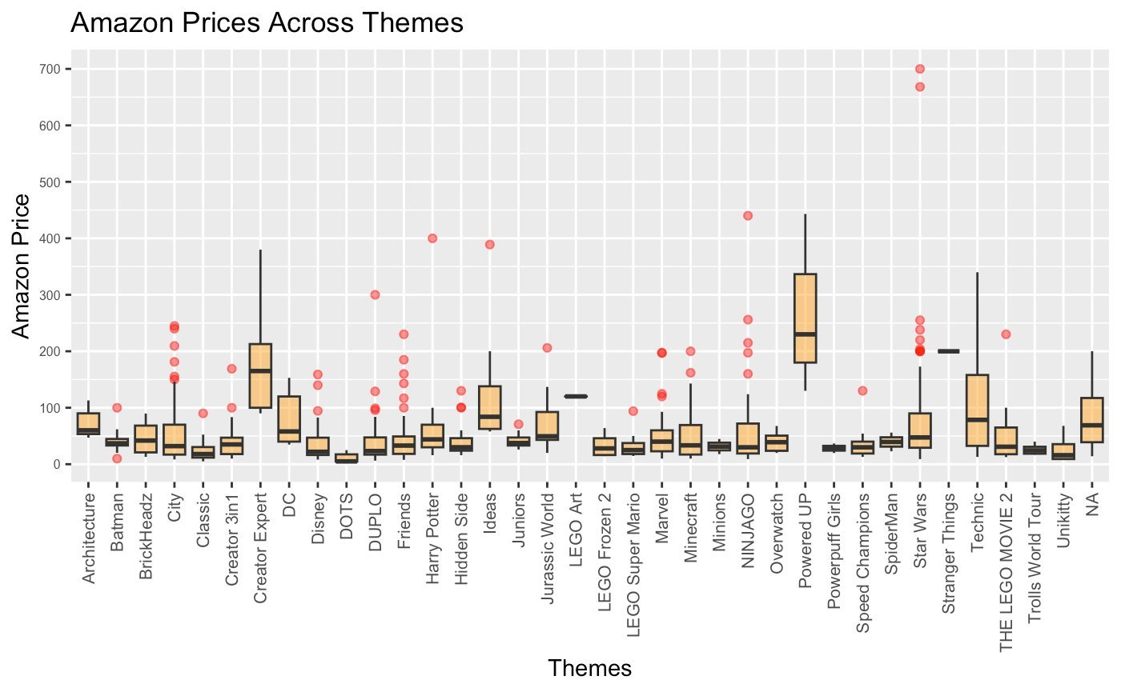
Q2: Is there a relationship between theme and price? Does this relationship change when looking at Retail Price VS Amazon Price?
The Initial analysis on the Amazon prices demonstrate the following results:
From the given dataset, there are a total of 40 Themes, with some undefined theme names.
The summary of the dataset was first calculated to analyse the Amazon prices:
The cost of Lego sets on Amazon range from $3.44 to $699.99.
The average price of Lego sets on Amazon is $57.88. However, the median price is lower at $37.33.This is because there are some Lego sets that are drastically more expensive than the average sets. The red dots on the Figure 8 highlights these particular sets that are more expensive than the average prices of the themes .
75% of the sets are priced below $69.96, which is a lot lower than the premium Lego sets.
Figure 7: Amazon Price across the themes of the data, displayed in a boxplot format.

Slide 13
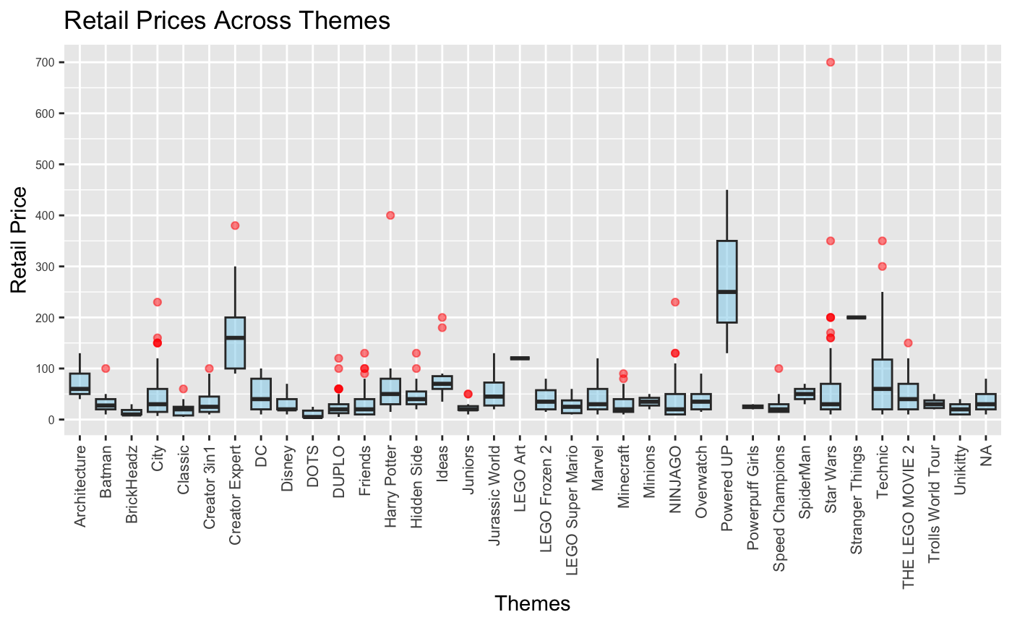
Exploratory Data Analysis Continued
The Initial analysis continued on the Retail prices demonstrate the following results:
The minimum retail price is $3.99, and 25% of sets cost $14.99 or less, indicating an entry-level segment of low-priced products.
The median is $29.99, while the mean is higher at 45.83, showing that a smaller number of expensive sets pull the average up, as shown in Figure 8.
75% of sets are priced at or below $59.99, but the maximum is $699.99, confirming the presence of a long upper tail of premium sets that are much more expensive than the typical product. This illustrates the possibility of a collector market in the brand not for the average user.
Figure 8: Retail Price across the themes , displayed in a boxplot format.

Slide 14
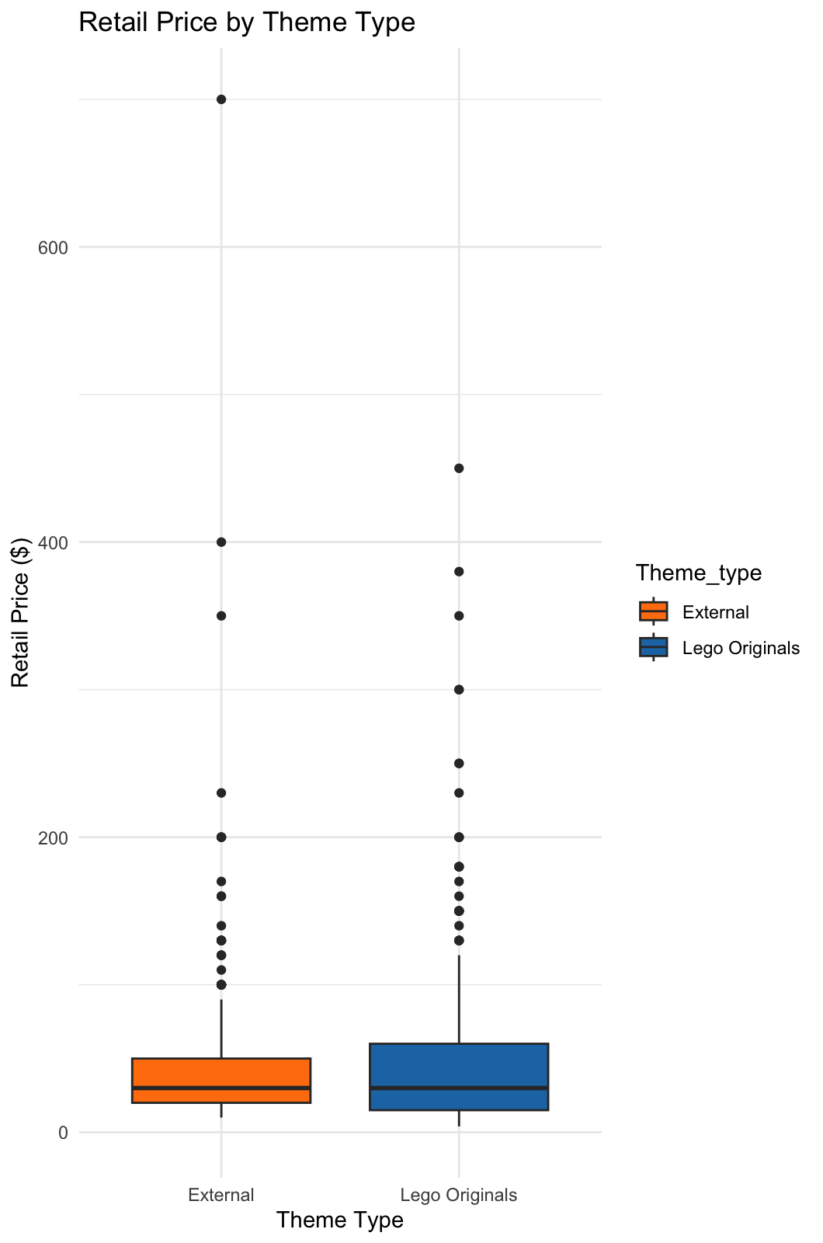
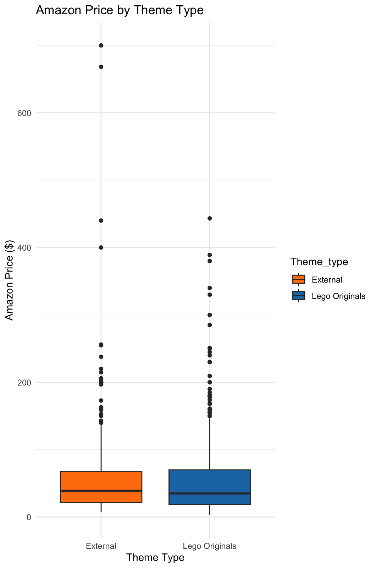
Dataset Cleaning and Categorisation
Categorisation – The original data set had 40 Themes in total which would make analysis complex, so we decided to re-categorise the theme data into Externals (licensed and trademark LEGO sets) and Lego Originals (In-house Lego themes.)[2].
The final representation of Theme vs Prices (Amazon and Retail) is as displayed in Figure 9.
Figure 9: Box plots illustrating the new variable created within Themes.
fifi

Slide 15
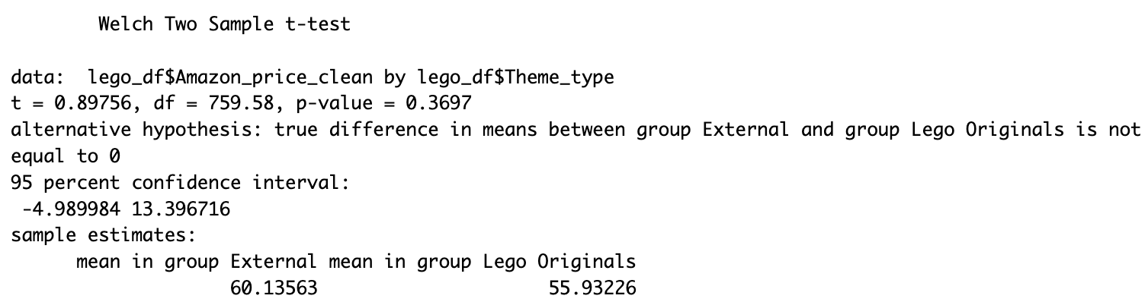
Results of Investigation Hypothesis testing : T-Test
Amazon Price
Two samples t-test is computed to compare the Mean Amazon price and Retail price of Original and External themes, the first being:
Null Hypothesis (H0): Mean Amazon price for Lego Originals is the same as the Mean price of External themes.
Alternate Hypothesis (H1): Mean Amazon price of Lego Originals is not equal to the Mean price of External themes.
Figure 10: Output from R code [see syntax] for sample t-test.
Results:
P-value = 0.3697 > 0.05. There is not enough evidence to show that the mean Amazon price of Lego-Originals is not the same as the mean price of External themes. Therefore, we fail to reject the null hypothesis.
The confidence interval is [-4.99, 13.39]. The mean price for Lego Originals could be $4.99 more expensive or $13.39 cheaper than External.
Based on the sample estimates, the External theme sets are on average $4.2 lower than Lego originals on Amazon.

Slide 16
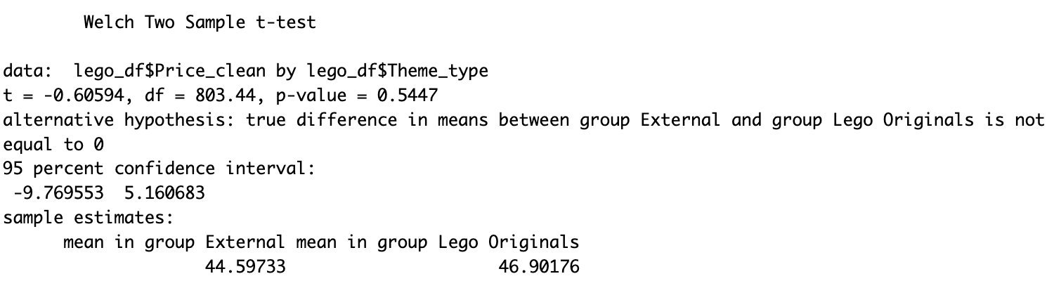
Results of Investigation Continued Hypothesis testing : T-Test
Retail Price
Null Hypothesis (H0): Mean Retail price for Lego Originals is the same as the mean price of External themes.​
Alternate Hypothesis (H1): Mean Retail price of Lego Originals is not equal to the mean price of External themes.
Figure 11: Output from R code [see syntax] for Retail t test.
Test Results:
P-value = 0.5447 > 0.05. There is not enough evidence that the mean retail price of Lego originals is the same as the mean price of external themes. Therefore, we fail to reject the null hypothesis.
The confidence interval is [-9.77, 5.16], the mean price of Lego-originals might be $9.77 more expensive or $5.16 cheaper than External themes.
Based on the sample estimates, the Lego originals are on average $2.4 lower than the External on retail.

Slide 17
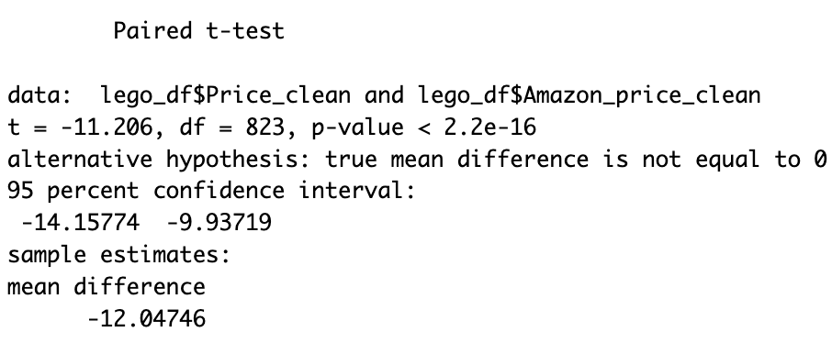
Results of Investigation Continued Hypothesis testing : Paired T-Test
Paired t-test
Comparing the Mean of Retail price and Amazon prices across theme types using paired t-test:
Null Hypothesis (H0): mean of retail price is the same as the mean of Amazon prices
Alternate hypothesis (H1): mean of retail price is not equal to the mean of Amazon prices
Figure 12: Results for the Paired t-test
Test Results:
P-value = 2.2e-16 < 0.05. There is enough evidence that the mean retail price is not equal to the mean Amazon price. Therefore, we reject the null hypothesis.
t-value of -11.2, implies that the mean retail price is lower than the mean Amazon price.
Based on the confidence interval and mean differences, the retail price is about $9-$14 lower than Amazon prices.

Slide 18
Q2: Conclusion
Question: Is there a relationship between theme and price? Does this relationship change when looking at Retail Price VS Amazon Price?
To determine if there is a relationship between theme and price, our team conducted several hypothesis tests using the t-distribution. The tests are performed based on the theme types (Lego originals and External themes) and price (Retail and Amazon).
Two-sample t-tests are computed to compare the average prices of the Lego originals and external themes. The test results show that the mean price difference is not significant for either retail or Amazon prices. However, it is found that Lego-original themes are on average, more expensive on Amazon, and that External themes are, on average more costly on Retail.
After examining the relationship between theme and retail price, the impact of Amazon's price is investigated to check if it changes the relationship. First, a paired t-test is computed to compare the mean differences of retail and Amazon prices. The finding shows that retail prices are significantly lower, approximately $12 less than Amazon prices.
Conclusively, by performing a two-tailed t-test, we found that Lego-original themes are on average more expensive on Amazon, and that External themes are more expensive in Retail stores. On performing a paired t-test, we also found that retail prices are lower than Amazon prices by approximately 21%.

Slide 19
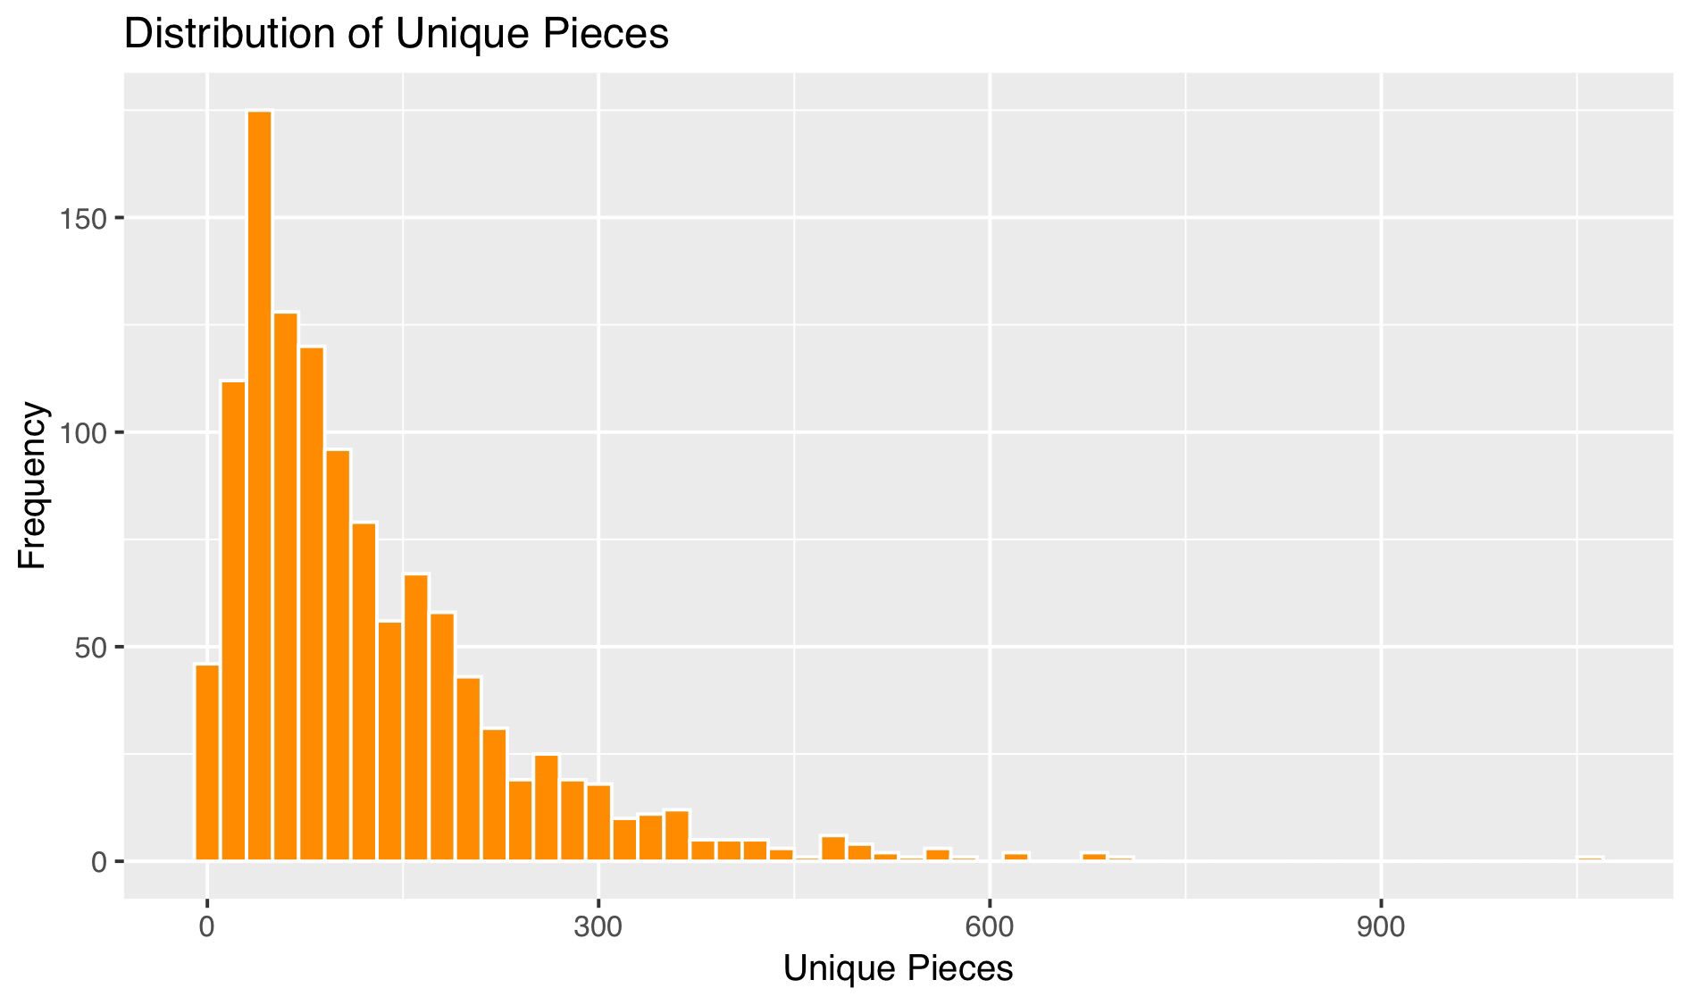
Q3) Are there significant differences in the number of unique pieces between sets that are aimed at younger or older age groups?
What is a unique piece?
On Brickset.com, a "unique piece" refers to a specific element (combination of design and colour) that, at the time the set was released, was available in that particular set only. The pieces, however, might appear in other colours or sets over time.
These pieces can add interest & value especially amongst collectors. Unique pieces can also be used as a metric for complexity.
From Figure 13 we can see that the distribution of the unique pieces is interesting with most of them being in the100-200 pieces range with a frequency of 175 at its peak.​
The data is strongly right‑skewed — most sets have relatively few unique pieces, and only a small number of sets reach very high counts. The tail does stretch out to 1000+ pieces​, while rare, some sets are highly complex.
This is to be expected as the number of unique pieces is rising every year within Lego production. We can even find new pieces being released in November 2025[3].
Figure 13: Histogram for the variable unique pieces

Slide 20
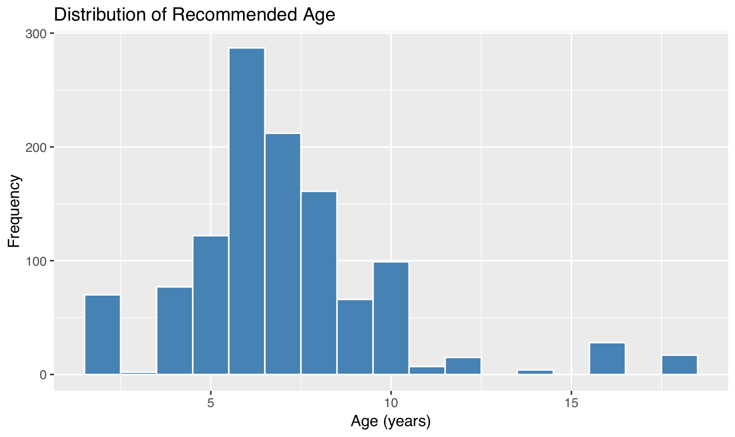
Why does recommended age matter?
Lego tailors sets to age, younger sets like Duplo avoid choking hazards and sharp edges, Friends
helps to develop fine motor control and creativity. Adult sets are now a major growth area, with
LEGO explicitly targeting 18+ builders.
Some cleaning of the Ages column had to take place. Age 1.5 was rounded up to 2, age ranges were changed to reflect the lower number as per the new policy of recommended age that Lego group are using since 2020[4].
From Figure 14 the largest number of sets around 275 come from the 6+ range. This is to be expected as Lego is targeted to children of all ages but especially those who with developing imaginations.
We can also see that the variable is slightly bimodal around the 10+ age. The long tail reflects that Lego is beginning to target an older collector market at 15-18+ although these are less frequent [5] .
This will be investigated in the testing slides with some code written to double check the hypothesis posed (see syntax).
Figure 14: Histogram for the variable Age

Slide 21
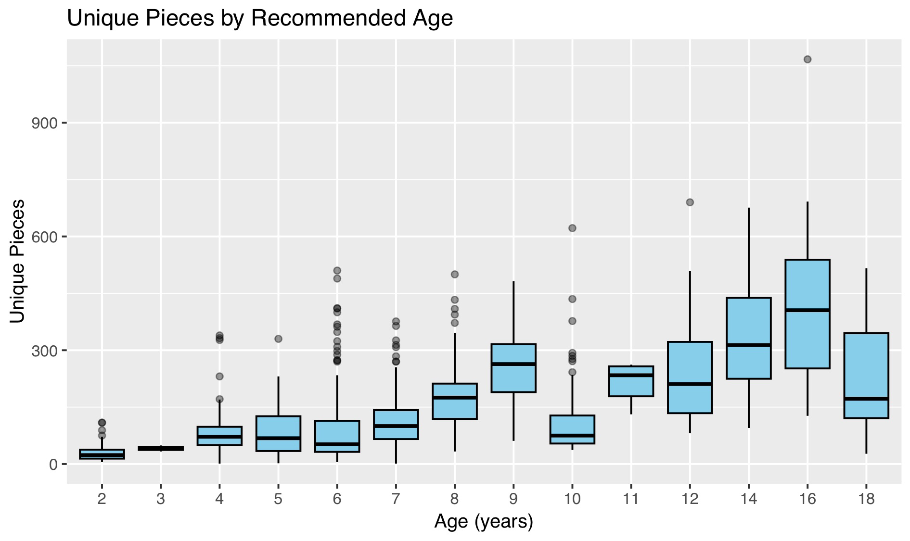
Visualisation of variable comparisons
The Initial exploratory analysis of the variables produced the following results:
For the younger age groups (2-6), the box plots are tight with low medians. It highlights a minimal spread and that the lower aged sets are consistently simple with few unique pieces.
For the middle group (7-12) the plots begin to widen with medians rising sharply. Outliers also begin to appear and illustrate that some sets are becoming more complex(more unique pieces) and variable.
For the oldest age group (14-18) the plots are very wide, and the whiskers are large. The median values are now at the highest in the graph and with that comes high variability. There also are some outliers emphasising the thesis that Lego has begun to target advanced builders/collectors at the older age.
This visually confirms that set's complexity, scales with age. It also highlights that the older age groups are more likely to have diverse designs and building techniques.
Figure 15: Boxplot showing distribution of Unique pieces by Recommended age.

Slide 22
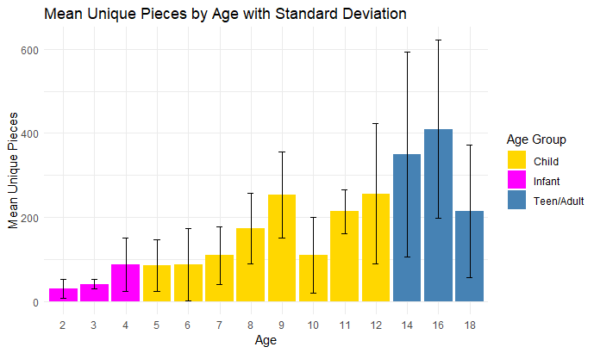
Changing the age variable into categories
This slide introduces the idea of looking at age in the categories: infant, child and teen/adult which will be used for an ANOVA. The justification for using these categories is based on the theme of sets marketed. Duplo for the infants, friends/city for the child age group and more complex themed sets for the older teen/adult age group.
Adult users cannot be looked at as its own category because we only have data for 18+ and the sample size is very small at only 17 sets(see syntax). This is why it has been combined with teen.
This barchart shows the stepwise increase in the average number of unique pieces as age also increases.
Infant sets (ages 2–4): Very low averages (~30–40 pieces), consistently simple designs.
Child sets (ages 5–12): Moderate averages (~85–250 pieces), showing more variety and complexity.
Teen/Adult sets (13+): Very high averages (~350–400 pieces), reflecting advanced themes and collector sets like Technic and Star Wars.
Variability: The error bars (standard deviation) get larger with age, meaning older sets vary much more in complexity — some are moderately complex, others extremely advanced.
Figure 16: Barchart with error bars

Slide 23
Hypothesis testing with ANOVA
An initial one-way ANOVA (Analysis of Variance) was carried out on the variables age and unique pieces relationship:
H0: There is no significant difference between the mean unique pieces for each age category.
H1: At least one mean is different.
The output from the ANOVA revealed an F-Value of 140.9, see Figure 17. From the notes we know that the F- Statistic compares between group variance (the difference in mean unique pieces across all ages) with the within group variance (variation among sets of the same age).
A value of 140.9 is extremely large meaning that the differences between age groups is far larger than the differences within each age group.
The mean number of unique pieces differs significantly across Infant, Child, and Teen/Adult groups.
The p-value (< 2e-16) is essentially zero, so the result is highly significant.
 | Df | Sum sq | Mean sq | F value | Pr(>)F
Age_group | 2 | 2834925 | 1417462 | 140.9 | <2e-16*
Residuals | 1164 | 1170987 | 10059
Signif. codes: 0 ‘***’ 0.001 ‘**’ 0.01 ‘*’ 0.05 ‘.’ 0.1 ‘ ’ 1
Figure 17 : Age categories ANOVA output.
There is sufficient evidence to reject the null hypothesis in favour of the alternate hypothesis. We are confident that at least one of the mean number of unique pieces vs age category is different.

Slide 24
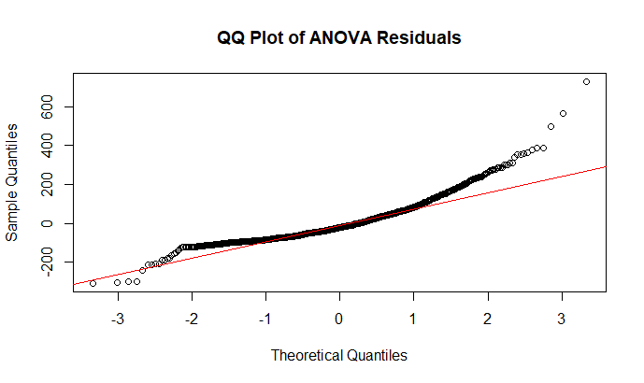
Hypothesis testing and ANOVA Continued
ANOVA assumes the residuals(errors) are normally distributed within groups. A QQplot is used to compare the residuals distribution with a normal distribution.
From Figure 18 and the results from the one-way ANOVA it is evident that there is a highly significant effect of recommended age on the number of unique pieces.
The QQPlot shows that the middle values fit well but there is some mild departure from normality in the tails of the distribution, normality assumptions do not hold for the residuals.
This drives home the hypothesis that Lego sets are designed for different age groups with the complexity of play being a key factor in both set design and marketing.
Figure 18: QQplot for Age categories ANOVA.

Slide 25
Hypothesis testing: Non-parametric test.
Because the ANOVA highlighted significance but the QQplot shows deviation from normality we decided to run a non-parametric test Kruskal-Wallis because it doesn’t require the assumption of normality.
From the notes we are given a wide range of tests to highlight significance. The one chosen for unique pieces vs age was the Kruskal-Wallis (see Figure 19).
The Kruskal-Wallis test confirms that there are significant differences in mean unique pieces across age groups.
This test confirms the findings of ANOVA even though residuals aren't perfectly normal.
Both parametric and non-parametric tests agree that complexity differs strongly across infant, child, teen/adult categories.
Test | χ² statistic | df | p-value
Kruskal-Wallis | 143.18 | 2 | <2.2e-16
Figure 19: Kruskal-Wallis Post HOC test results.
The very small p‑value means there is sufficient evidence to reject the null hypothesis. There are statistically significant differences in the number of unique pieces between at least two of the age groups.

Slide 26
Hypothesis testing: Which groups differ?
Now that parametric and non-parametric tests have confirmed that there are differences in the groups, we decided to run a post hoc test to find out which groups differ.
Comparison | p-value | Interpretation
Child vs Infant | <2e-16 | Infant sets have fewer unique pieces than child sets
Teen/Adult vs Infant | <2e-16 | Teen/Adult sets have much more unique pieces than infant sets.
Teen/Adult vs Child | 8.4e-14 | Child sets have significantly fewer unique pieces than teen/adult.
A pairwise Wilcoxon(with bonferroni correction) was chosen due to non-normal residuals.
The test confirms that all three age groups differ significantly in relation to number of unique pieces.
Infant sets are the simplest with lower numbers of unique pieces, child sets have moderate numbers of unique pieces and teen/adult sets are the most complex.
The results are still significant even after the Bonferroni correction for multiple comparisons.
Figure 20: Pairwise Wilcoxon results

Slide 27
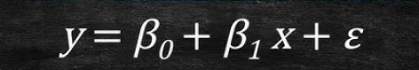
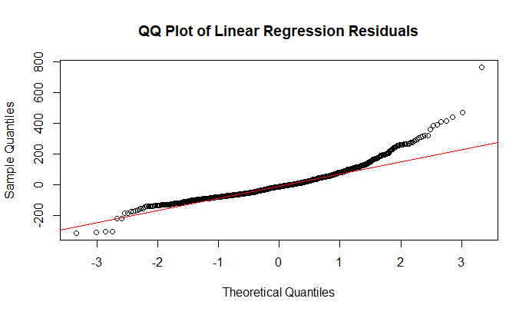
Final stage of analysis: Fitting a Linear Model
In the Final stages of the analysis, we fitted a Linear Model to the variables Unique pieces and age following the standard format of:
From the given equation here we can see that the following correspond:
Beta_0 is the intercept term in the model. Intercept = -15.99, At age 0 (not meaningful here, since data starts at 2), the expected mean unique pieces would be slightly negative.
Beta_1 is the slope parameter (Slope = 19.90: For each additional year of age, the mean number of unique pieces increases by about 20.
X_1 is the explanatory variable (age).
The p-value is highly significant (p < 2e-16): Age is a strong predictor of unique pieces overall.
#R² ≈ 0.26: Age explains about 26% of the variation. That’s decent, but it means there’s still a lot of variability not captured by a simple straight line.
Figure 21: Equation for Linear Regression model.
Figure 22: QQplot for residuals

Slide 28
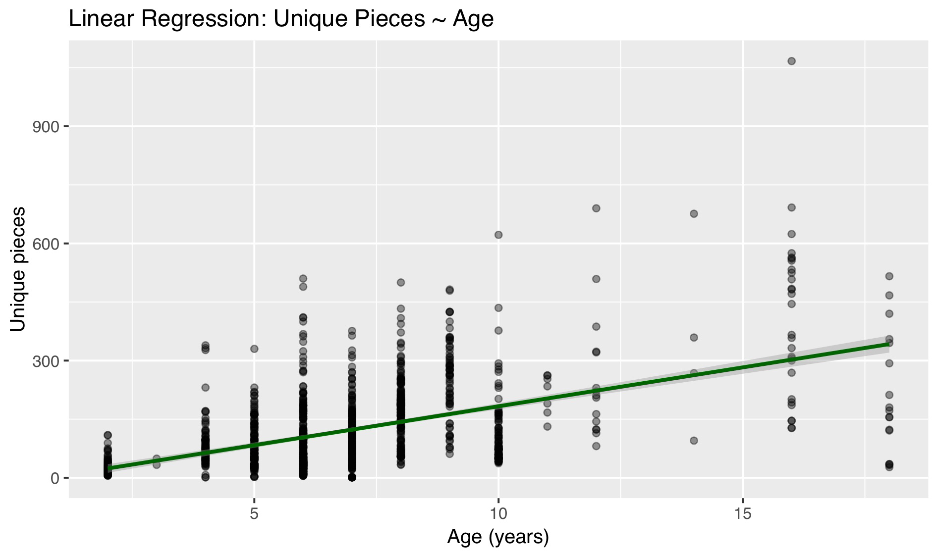
Final stage of analysis: Linear Model interpretations
In the Final stages of the analysis we fitted a Linear Model to the variables now we can interpret the graphical output below:
Figure 24 illustrates a positive linear relationship between age groups and number of unique pieces. The slope indicates that the older individuals have more unique pieces cementing the hypothesis posed in previous slides.
The plot shows that data points have substantial individual variability within their respective age groups, reinforcing the heteroscedascity seen in slide 29.
It should be noted that the wide substantial individual variability with age suggests that age alone is not a good explanatory variable for unique pieces but is an excellent foundation. For further work other variables like price and year should be considered an analysed.
Figure 23: Linear Regression graphical output.

Slide 29
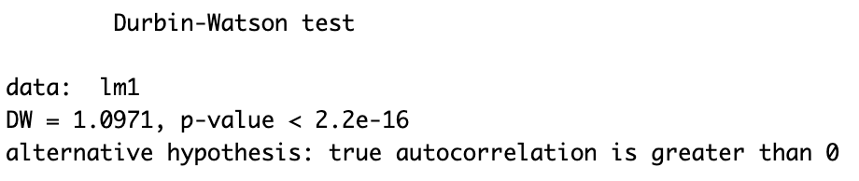
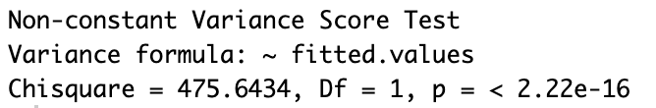
Linear Regression – Testing two-main Assumptions
Normality of Residuals
Test Results:
The Durbin-Watson test score is 1.0971, hence, the linear regression has a positive autocorrelation.
The P-values for both the Durbin-Watson and the Breusch-Pagan tests are less than 0.05, indicating that the test is significant at 5% level.
This means that as Ages recommendation for the Lego set increases, the number of unique pieces will also increase. However, there is an uneven spread of variability between ages and unique pieces present in the dataset.
Using Durbin-Watson test to check independence.
Figure 24: Durbin-Watson test output.​
Constant Variance
Breusch-Pagan test for constant Variance
Figure 25: Breusch-Pagan test output.​

Slide 30
Conclusions
Question Q3: Are there significant differences in the number of unique pieces between sets that are aimed at younger or older age groups?
Overall difference: Both ANOVA (F = 140.9, p < 0.001) and Kruskal–Wallis (χ² = 143.2, p < 0.001) show that LEGO set complexity (unique pieces) differs significantly across age categories.
Pairwise comparisons: Wilcoxon tests (Bonferroni‑adjusted) confirm that Infant, Child, and Teen/Adult sets all differ significantly from one another. Infant sets are the simplest, Child sets moderately complex, and Teen/Adult sets the most complex.
Trend across ages: Linear regression indicates that complexity increases by ~20 unique pieces per year of recommended age (R² ≈ 0.26), though variability grows with age and some advanced sets are extreme outliers.
Robustness: Results are consistent across parametric and non‑parametric methods, strengthening confidence in the conclusion.
Takeaway: LEGO deliberately scales set complexity with age — simple designs for toddlers, more variety for children, and highly complex builds for teens/adults and collectors.
We can conclude that H0 is rejected in favour of H1. There is sufficient evidence that the number of unique pieces differs with age.

Slide 31
Final Conclusions & Further Work
CONCLUSION
The more complex themes and sets for older builders generally have more unique pieces and higher prices, while younger‑age themes have fewer pieces and lower prices. Across this structure, licensed/collector themes tend to sit at the higher end of both piece count and price, and there is a statistically significant difference between Amazon and retail prices for the same sets, showing that sales channel adds its own price effect on top of theme and age.
FUTURE PROSPECTS
For future work, a more comprehensive analysis involving additional attributes could be conducted to gain further insight into how the Lego sets are designed. Having data on past Lego sets would enable a comparison analysis between the old and current Lego sets, allowing us to investigate how Lego sets have evolved over time. We could also employ data mining and machine learning techniques like random forests and cluster analysis to further the work.

Slide 32
References
[1] Lego DataSet was collected from Brickset.com and BrickInstructions.com.
[2] Lego Licensing, Brickipedia https://brickipedia.fandom.com/wiki/LEGO_licensing
[3] Lego Unique Pieces Nov. https://www.newelementary.com/2025/11/what-are-new-lego-parts-in-late.html
[4] Lego Shop by Age https://www.lego.com/en-us/categories/age
[5] Most Popular sets 2020 https://brickranker.com/investing/the-best-performing-lego-sets-of-2020

