Slide 1
ScholarSetu
AI-Powered Scholarship Assistant
Democratizing access to government scholarships with conversational AI.

Slide 2
Problem Statement
Fragmented Portals: Students face 50+ central & state schemes across different websites.
Complex Applications: Long English forms, confusing criteria, and language barriers.
Verification Bottlenecks: Manual document verification causes massive delays (months).
Lack of Awareness: 40%+ eligible students never apply due to lack of awareness.
Duplicate Applications: No cross-verification leads to fund leakage and fraud.

Slide 3
Solution / Overview
Conversational Interface: Discover and apply via a friendly WhatsApp-like chat.
Smart Matching: AI automatically matches profiles against 500+ scheme criteria.
Real-time Document Verification: Built-in OCR for auto-filling and verification.
Bilingual Support: Hindi and English voice/text capabilities.
Form Auto-filling: Instantly generates exact government forms pre-filled with data.

Slide 4
Key Features
Dynamic Data Collection: Skips irrelevant questions based on context (e.g. state domicile).
OCR & Entity Cross-Referencing: Extracts text from Aadhaar/PAN/Marksheets and checks for mismatches.
Fraud Prevention: Real-time PAN card uniqueness checks.
Multi-Modal Access: Uses Web Speech API for STT and TTS in Hindi/English.
Deterministic Matching Engine: Strict criteria evaluation + achievement-based score multipliers.
Admin Dashboard: Specialized portal for manual verification of low-confidence OCR documents.

Slide 5
Technology Stack
Frontend: React.js (Vite), Tailwind CSS (v3), Lucide React
Backend: FastAPI, Python
Database & Storage: SQLite, SQLAlchemy (Async)
Data Validation: Pydantic
AI/ML & Utilities: Tesseract OCR (pytesseract), Pillow
Integrations: Web Speech API, Google OAuth2 (@react-oauth/google)

Slide 6
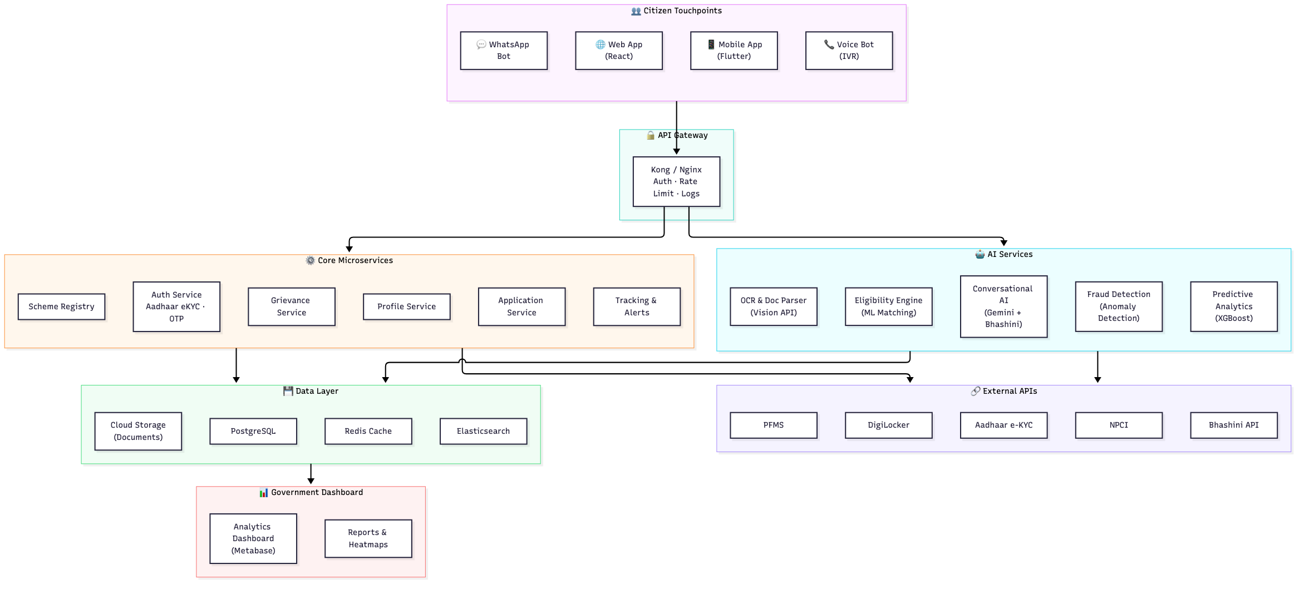

System Architecture

Slide 7
Frontend & Backend Implementation
Frontend (React/Vite): Component-based UI with responsive chat, real-time Hindi localization, and secure state management hooks.
Backend (FastAPI): Separated routes handling deterministic DAG state machines for conversational flow.
OCR & Matching Engine: Pillow+pytesseract for extraction; strict deterministic evaluator for eligibility.
Resilience: Lazy Evaluation via context maps avoids eager evaluation crashes on mismatched types.

Slide 8
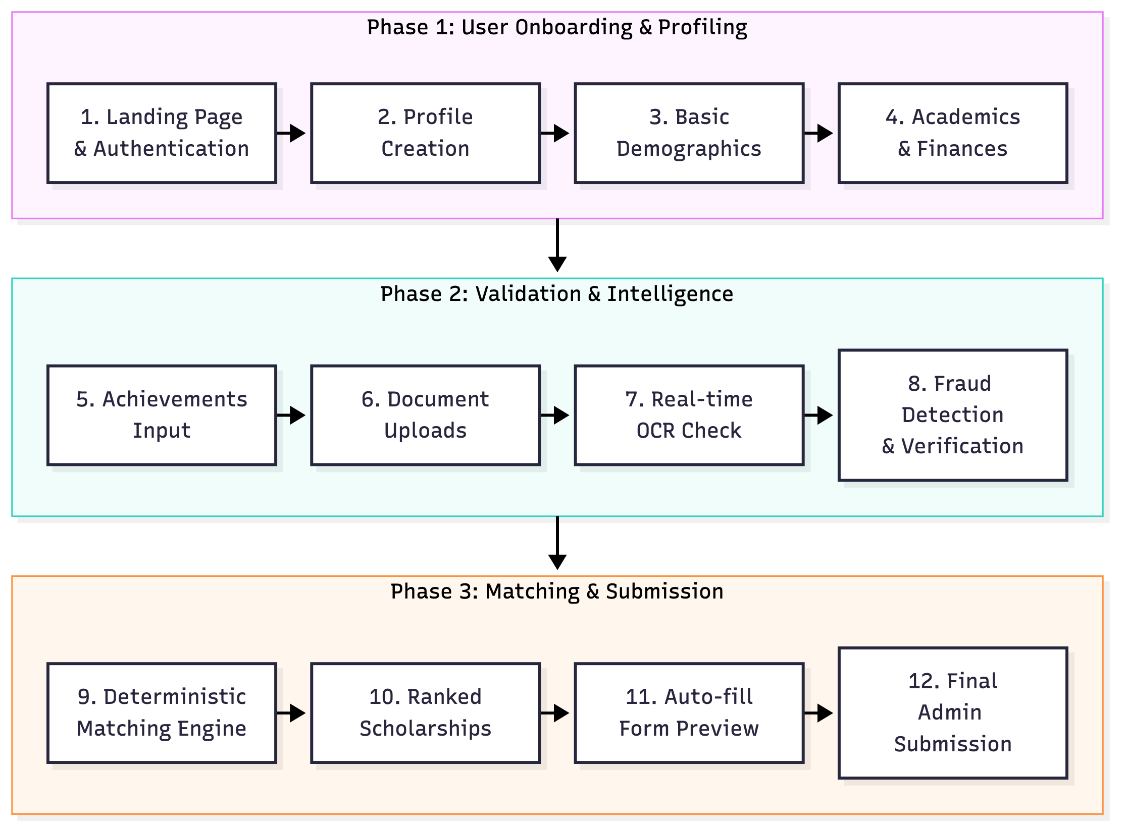
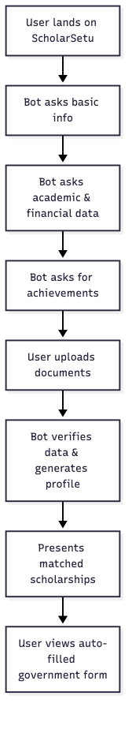
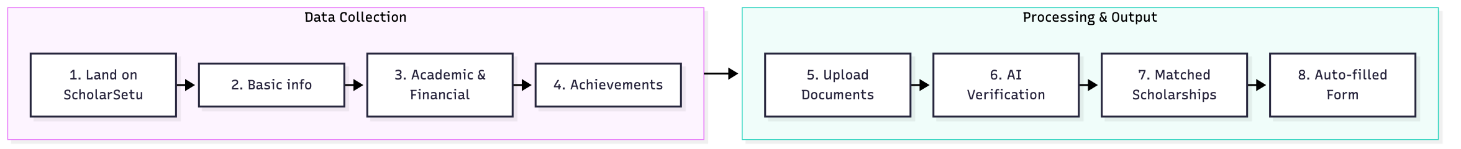
End-to-End Workflow

Slide 9
Challenges & Future Scope
Challenges Solved: Handled IPv6/IPv4 Vite proxy conflicts, state machine crashes via lazy evaluation, and strict Pydantic UI prop mapping.
Future - DigiLocker & Aadhaar: True zero-upload document verification and biometric/OTP demographic mapping.
Future - PFMS/DBT: Tracking direct benefit transfers directly in the dashboard.
Future - Scale & Analytics: Federated deployment with predictive analytics for scheme effectiveness and dropout prevention.

Slide 10
Conclusion
ScholarSetu is a fully functional, AI-driven bridge between citizens and the government.
Eliminates friction through conversational interfaces and real-time OCR.
Designed explicitly for accessibility (Hindi, Voice) and security (Fraud prevention).
"Every eligible student in India should discover, apply for, and receive scholarships — with zero friction."

