Slide 1

Introduction
🏀 March Data Crunch Madness 2025 – An Overview 🏀
Our training dataset spans March Madness data from 2002 to 2024, capturing a comprehensive history of tournament outcomes and key statistical insights
Shooting percentages, time of possession, scoring & defensive efficiency, and more.
Seed rankings, NCAA & Final Four appearances, and coaching experience.
We excluded statistically insignificant variables, utilizing Principal Component Analysis
Integrated sentiment from Reddit comments, leveraging NLP scores to refine final predictions
📊
Game & Team Performance Metrics
🏆
Team & Coaching History
🔍
Strategic Feature Selection
🗣️
Blending with NLP Insights

Slide 2

Key Sports Variables
Adjusted Efficiency
Margin
Seed Differential
Point Differential
Free Throw Rate
Turnover Margin
Coach Experience
Score
Effective Field
Goal Rate

Slide 3



Macroeconomic Data
2002-07
Economic uncertainty can affect players’ mental health and contract negotiations, leading to performance fluctuations
Financial crisis (Great Recession)
Economic expansion, social change movements
Deregulation, trade wars, economic highs
COVID-19 pandemic, social unrest, recovery efforts
Slow recovery, political polarization
Inflation, tech boom (AI), geopolitical tensions
Post-9/11 recovery, housing boom
2023-25
2008-09
Year | March Airline Inflation %
2002 | -2.3
2003 | -1.8
2004 | 0.5
. | .
. | .
2023 | 17.7
2024 | -7.1
US Main Trends help to introduce seasonality in the data, since we have yearly data with only one month March
2020-22
2010-12
2017-19
2013-16
March Airline Inflation can be a proxy to capture overall external factors influencing game outcomes

Slide 4

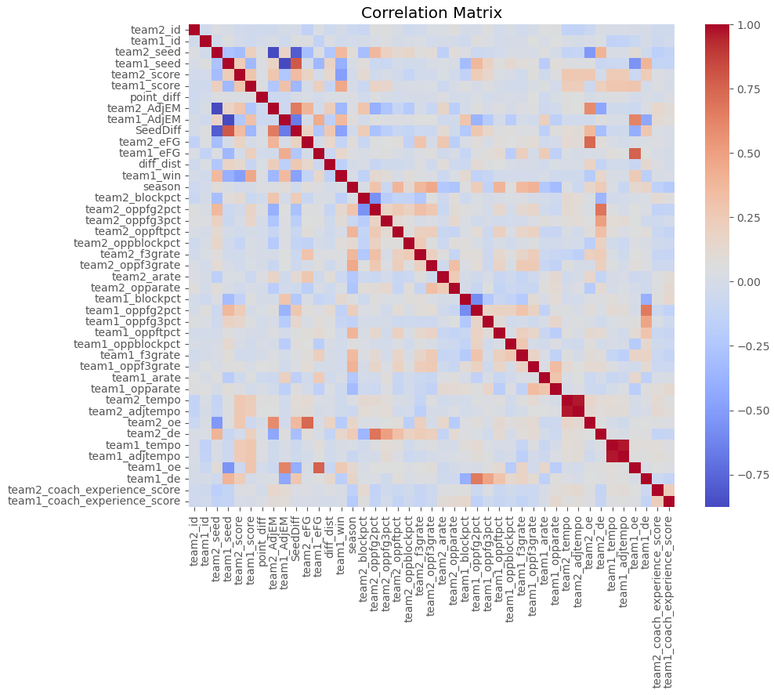

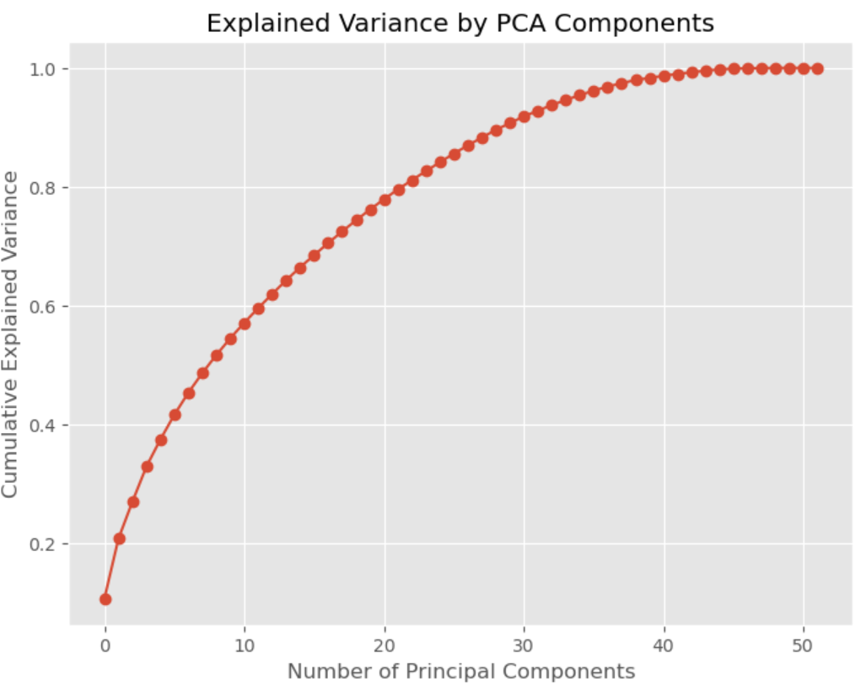
Variable Selection
Principal Component Analysis
Optimized Variable Combinations
🚀 Innovative Approach: Leveraging ChatGPT to dynamically generate unique variable combinations for model optimization
🚀 Optimizing feature selection for the best-performing models!
Count of Modeling Variable before each step
Started with 10 fixed variables
Randomly selected 3 to 7 additional variables from the remaining pool
Generated 500 unique combinations to enhance model diversity
17
Max
44
38

Slide 5

Model Building
Enhanced Model Performance
The approach led to a range of accuracy scores, demonstrating the power of dynamic feature selection in building stronger, data-driven models
Built and tested four powerful models—XGBoost, Logistic Regression, Random Forest, and Neural Networks—to evaluate predictive performance
Ran 2,000 model variations, analyzing different feature combinations to optimize accuracy, recall, and precision
70% Training
Results
Model Types | Accuracy % | Range of Accuracy % | AUC
XGBoost | 86.6 | 82.7 - 90.3 | 94.5
Logistic | 70.8 | 68.4 - 72.7 | 78.7
Random Forest | 89.5 | 86.5 - 92.5 | 96.5
Neural Network (MLP) | 51.1 | 40.4 - 59.5 | 51.1
🧠
Multi-Model Approach
📊
Extensive Model Testing
🚀
Proven Success
30% Testing
Results
Model Types | Accuracy % | Range of Accuracy % | AUC
XGBoost | 66.3 | 62.8 - 70.1 | 72.5
Logistic | 68 | 65.1 - 70.8 | 75
Random Forest | 67.2 | 63.4 - 70.8 | 73.6
Neural Network (MLP) | 50.2 | 41.1 - 59.8 | 50.9

Slide 6
Model Selection
📅
Year-Based
Model Validation
This leads to better generalization of model for 2025 predictions
⚖️
Balanced Team Seeding Approach
Yearly test data leads to a consistent distribution of team seeds
Test Year | Model Type | Random Variables | Accuracy | Precision | Recall | F Measure | AUC | Average
2005 | Logistic Regression | team2_oppf3grate', 'team2_eFG', 'team1_f3grate', 'team1_arate', 'team2_oppfg3pct'] | 75.0% | 65.8% | 89.3% | 75.8% | 82.2% | 77.6%
2010 | XGBoost Classifier | team2_eFG', 'team2_oppblockpct', 'team2_opparate', 'team1_de', 'US_Main_Trend_2022_2025', 'team2_arate', 'team1_oppblockpct'] | 75.0% | 76.5% | 76.5% | 76.5% | 75.4% | 76.0%
2019 | Logistic Regression | team1_arate', 'team1_oppftpct', 'team2_coach_experience_score', 'team2_f3grate', 'team2_AdjEM', 'team1_oppfg3pct'] | 74.6% | 73.7% | 80.0% | 76.7% | 83.8% | 77.8%
2024 | XGBoost Classifier | team2_coach_experience_score', 'team2_f3grate', 'team1_oppf3grate', 'team2_opparate', 'team1_blockpct', 'team1_oppblockpct'] | 74.6% | 73.0% | 79.4% | 76.1% | 74.8% | 75.6%
+
Fixed Variables:
['PC1', 'PC2', 'PC3', 'PC4', 'March_Airline_Inflation’,
'team1_coach_experience_score', 'team1_eFG', 'TurnoverMargin’,
'team1_FTR', 'diff_dist', 'team2_coach_experience_score', 'team2_f3grate’,
'team1_oppf3grate', 'team2_opparate', 'team1_blockpct', 'team1_oppblockpct']

Slide 7
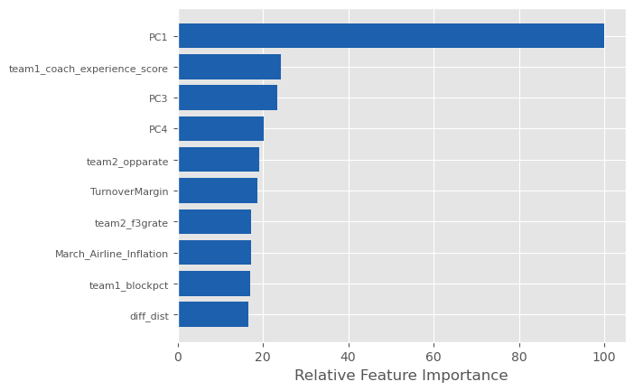
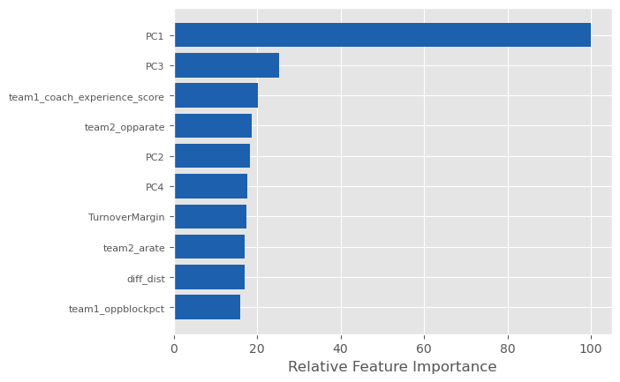
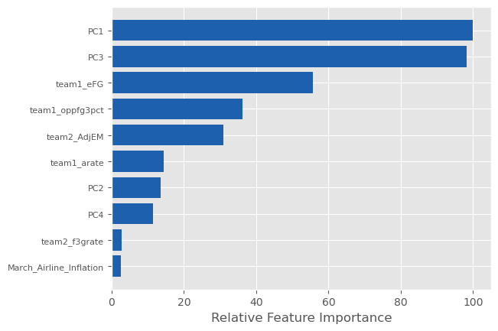
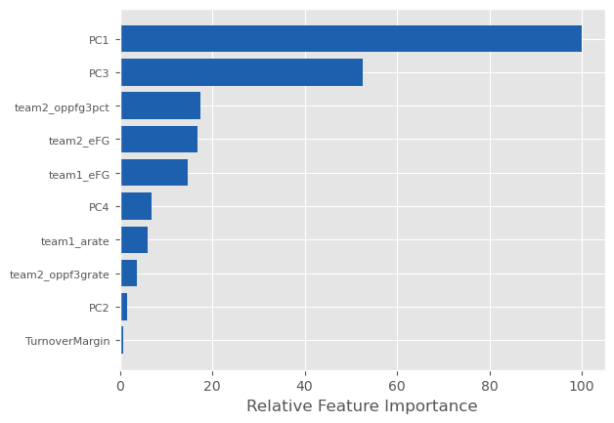
Feature Importance
XGBoost Classifier 2024
XGBoost Classifier 2010
Model Importance
for
Final Prediction
Logistic Regression 2019
30%
Logistic Regression 2005
23%
27%
20%

Slide 8
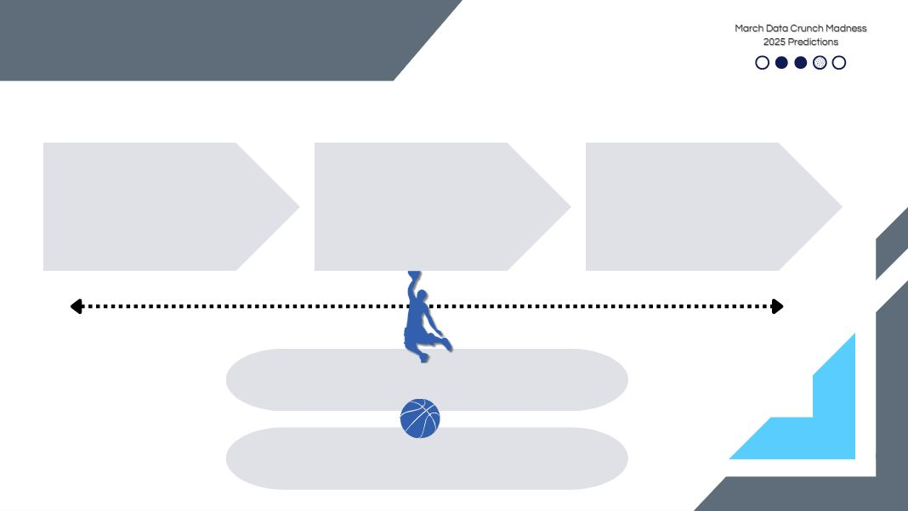
NLP Deep Dive
Extracted + Normalized
Public Hype & momentum
1700+
Reddit
Comments
Positive
Sentiment
Only
Merged buzz scores into 2025 dataset
Weighted at 15% in the final predictive model

