Slide 1
CITI BANK DEFAULTER
Help Citibank predict defaulters
-Team_6

Slide 2



A G E N D A
Objective
Data visualization
Data processing and cleaning Model Built and Evaluation Improvisation to Model

Slide 3

Objective
1
Objectives of current project is:
Predicting " Defaulter " (1:Yes) ( (target variable Y) is a classification problem
The given data set has following attributes (21600 rows and 24 features,
15120 train, 6480 Validation, 2399 test records

Slide 4
Categorical Variables
X2: Gender (1 = male; 2 = female).
X3: Education
1 = graduate school;
2 = university;
3 = high school;
0,4,5,6 = others
X4: Marital status
(1 = married; 2 = single; 3 = divorce; 0=others).
X6-X11: History of Past Payment
-2 = No consumption;
-1 = pay duly
0: The use of revolving credit;
1 = payment delay for one month;
2 = payment delay for two months and continuing

Slide 5
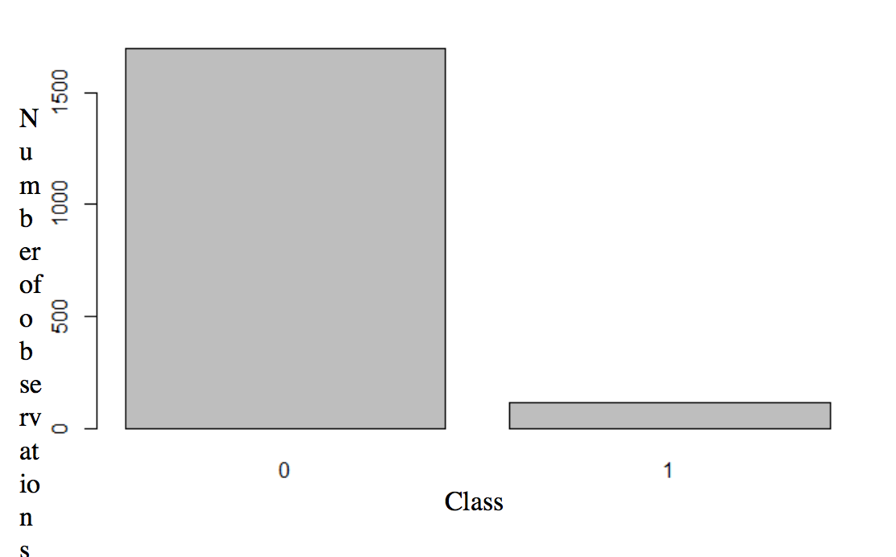
1
There are 0 missing values Zero
Heavy Class imbalance. Used "Smote" on train to prevent class imbalance # 10.04% to 40%
Scaled all features

Slide 6
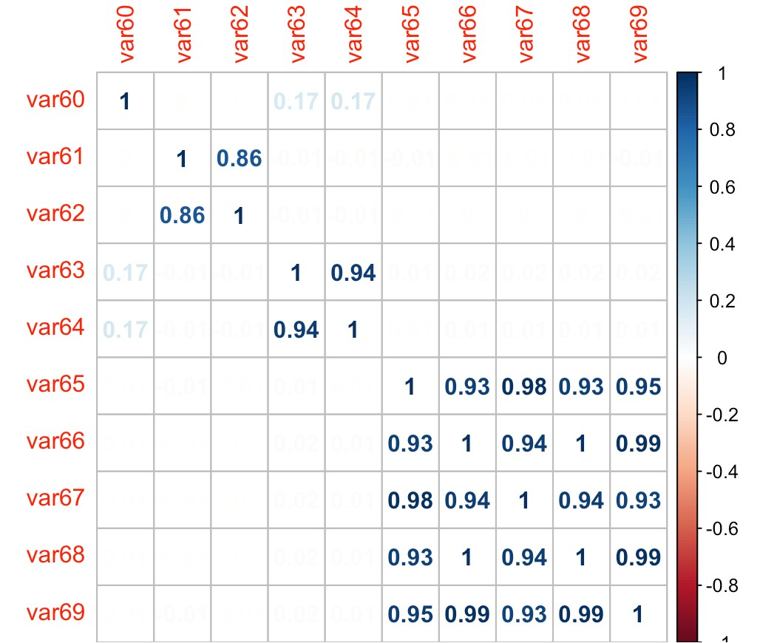
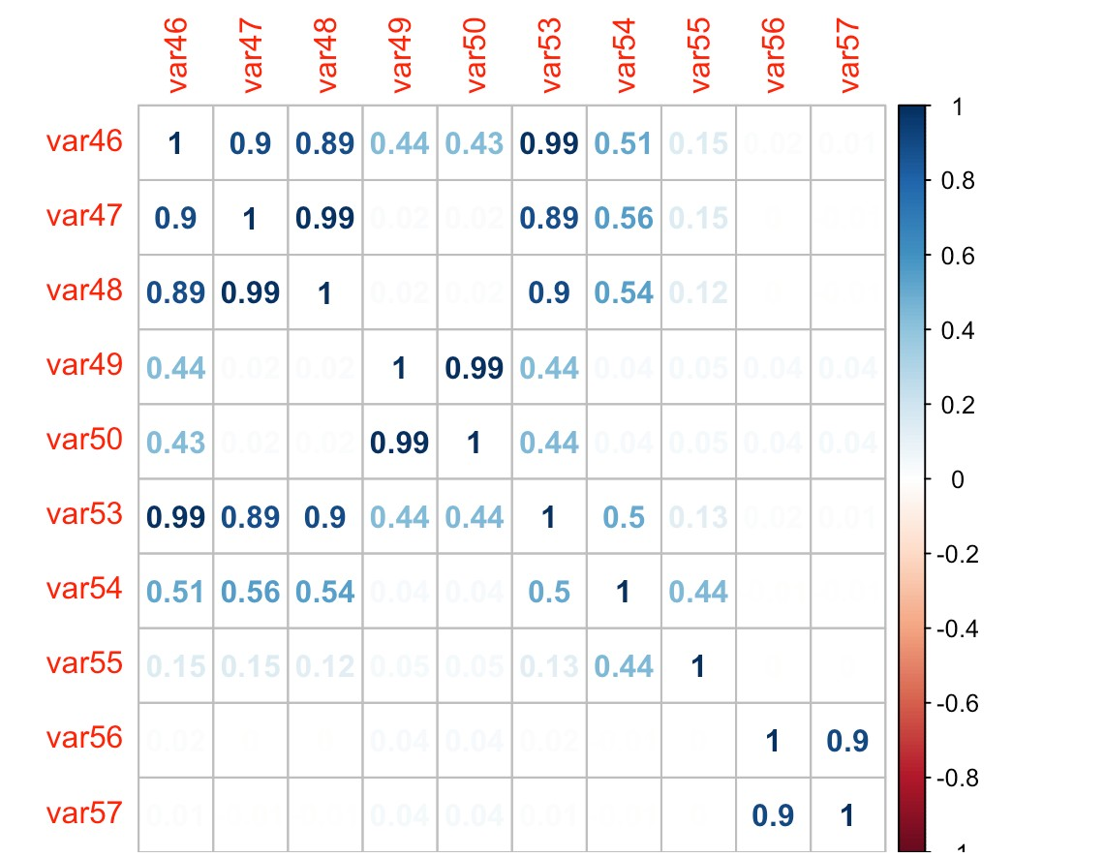
DATA VISUALIZATION
2
C O R R E L A T I O N B E T W E E N F A C T O R S
Some trends!
#var 49, var 50 have heavy correlation # var 47, var 49 have heavy correlation

Slide 7
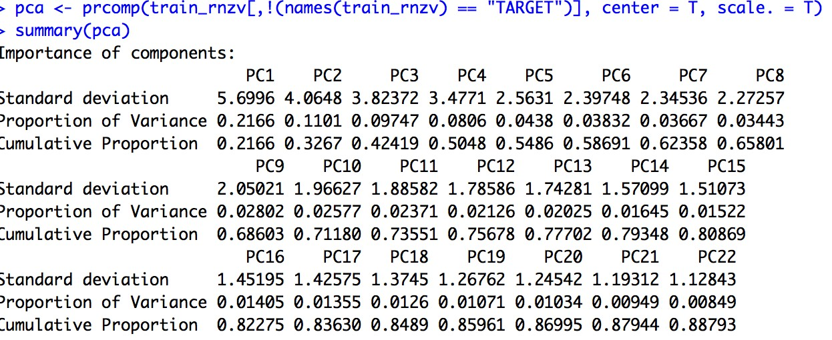
3 D A T A P R E P R O C E S S I N G
Removed Near Zero Variance and conducted PCA. Retained 15 transformed features

Slide 8
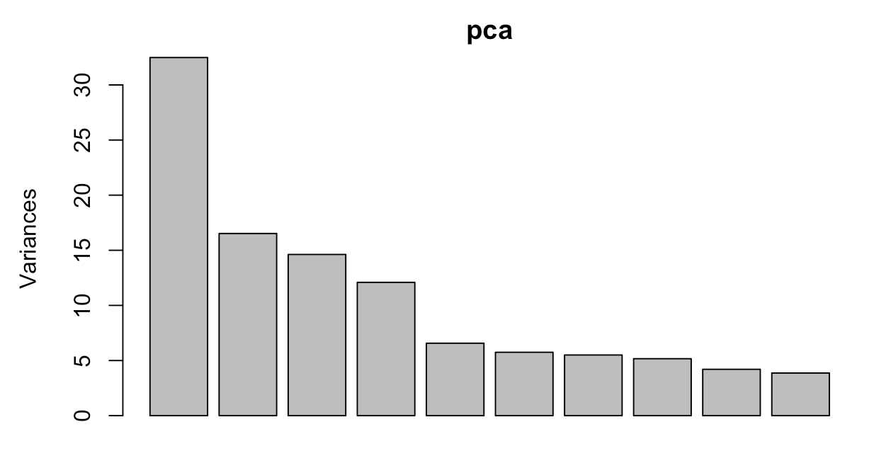
DATA PREPROCESSING
Removed Near Zero Variance and conducted PCA. Retained 15 transformed features accounted for over 80 variance

Slide 9
4 M O D E L B U I L T A N D E V A L U A T I O N
Typical Accuracy : 81% AUC value is 0.655

Slide 10
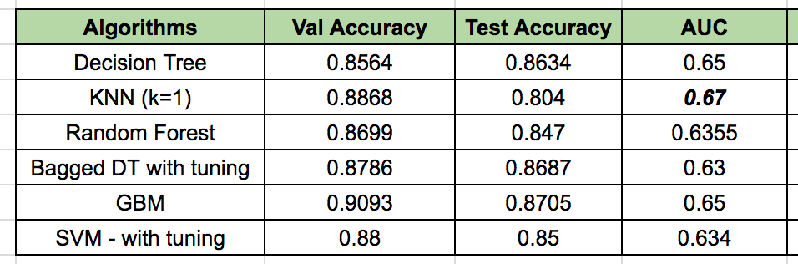
4 M O D E L B U I L T A N D E V A L U A T I O N
We realized that for this seismic domain the AUC is the important aspect. Tried the below models in the stipulated time. KNN along with GBM provided best results

Slide 11
5
IMPROVATION IN MODEL
Novel methods to Feature engineering viz. splitting looking at the patterns, binning few of the features etc into one single bin
The Domain knowledge would have made more accurate models

Slide 12
CHALLENGE
6
Understanding the precise definition of the variables, might have accomplished feature engineering
Large data set

Slide 13

THE END !

