Slide 1

Decision Trees
Jayanth Rasamsetti
Founder www.sgmoid.com
Columbia University (MS)
IIT Madras (B.Tech & M.Tech)

Slide 2
What is a decision tree?

Slide 3
Lets Play a Game: Guess the Animal
I am thinking of an Animal. You can ask a set of questions (on features of the animal)
Can you guess the animal based on my answers?
Conditions:
Only Yes/No questions or questions on a single attribute No questions based on the animal name itself
Let’s begin!

Slide 4
Lets Play a Game: Guess the Animal
Notes

Slide 5
Guess the animal
Questions
1. How many legs?
2. Does it fly?
3. Wild animal?
4. Nocturnal?
5. Fur/Feather?
6. Farm Animal?

Slide 6
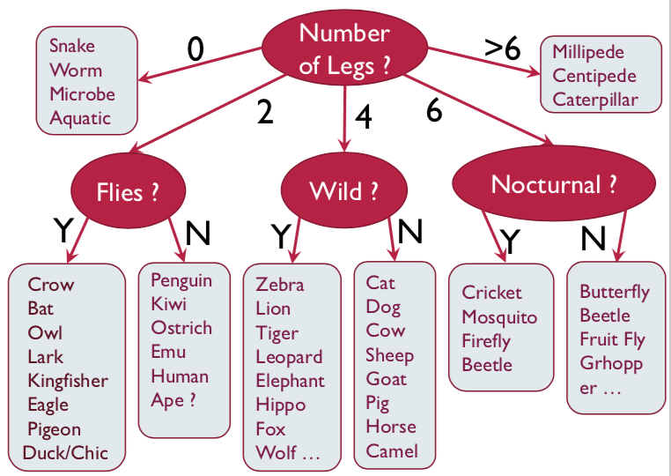
Guess the animal
Questions
1. How many legs?
2. Does it fly?
3. Wild animal?
4. Nocturnal?
5. Fur/Feather?
6. Farm Animal?

Slide 7
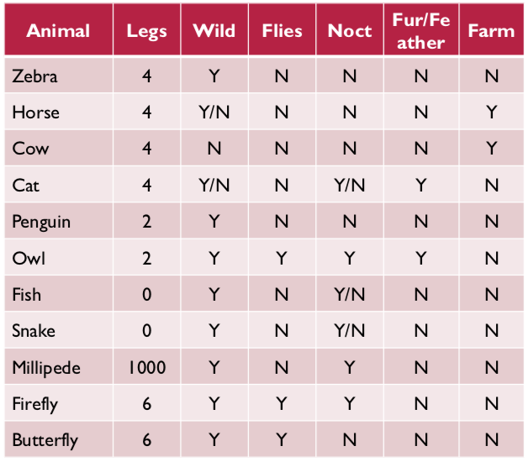
What are we doing? (Larger Picture)
1. We have lots of possible animals
2. Each has a set of attributes
3. Look at 1 attribute at a time
4. Narrow down the class label

Slide 8
What are we doing? (Larger Picture)
What is the Goal?

Slide 9
What are we doing? (Larger Picture)
Goal
Arrive at a single class label
Can we learn the tree?
“Which question to ask at any point?”

Slide 10
What is a Good Question?
Notes

Slide 11
What is a Good Question?
Which question if answered will reduce the possible number of animals the most?
More precisely, try to reduce our Uncertainty the most
Mathematically, reduce our Entropy the most
Will look at this in more detail soon

Slide 12

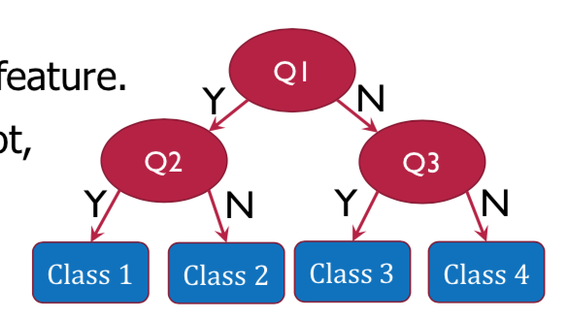
Decision Trees: Summary. Questions?
At each step, ask the question that minimizes uncertainty
Once the set contains only a single class, label it
The sequence of questions/decisions can be represented as a tree: The Decision Tree
Each question is on a single feature
Tree Terms: Node, Edge, Root, Leaf, Depth, Height, Path, Parent, Child

Slide 13
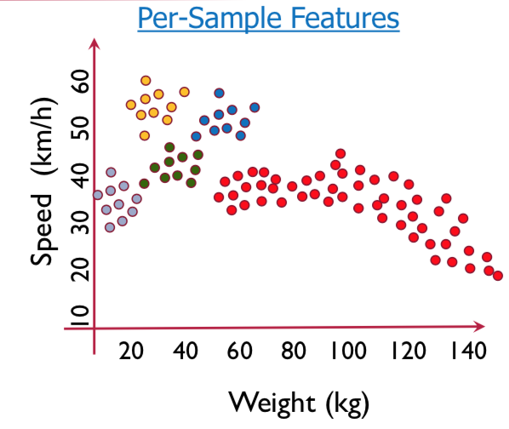
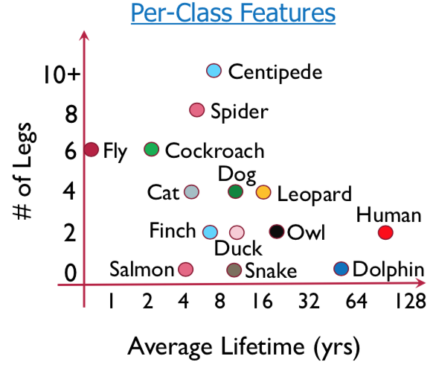
Learning from Examples

Slide 14
Decision Trees
Its loved by the industry! (Because?)
An ensemble method of Decision Trees called Random Forest can model most tabular data incredibly well so much so that some courses only teach Random Forest Source: www.fast.ai
Let’s look at all the steps once again

Slide 15
Decision Trees
Utilizes a tree structure to model relationships among the features and the potential outcomes
Decision trees consist of nodes and branches. Nodes represent a decision function while branch represents the result of the function. Thus it is a flowchart for deciding how to classify a new observation
The nodes are of three types, a) Root Node (representing the original data), b) Branch Node (representing a function), c) Leaf Node (which holds the result of all the previous functions that connect to it)

Slide 16
Decision Trees
For classification problem, the posterior probability of all the classes is reflected in the leaf node and the Leaf Node belongs to the majority class
After executing all the functions from Root Node to Leaf Node, the class of a data point is decided by the leaf node to which it reaches
For regression, the average/ median value of the target attribute is assigned to the query variable
Tree creation splits data into subsets and subsets into further smaller subsets. The algorithm stops splitting data when data within the subsets are sufficiently homogenous or some other stopping criterion is met

Slide 17
Decision Trees
The decision tree algorithm learns (i.e. creates the decision tree from the data set) through optimization of a loss function
The loss function represents the loss of impurity in the target column. The requirement here is to minimize the impurity as much as possible at the leaf nodes
Purity of a node is a measure of homogeneity in the target column at that node

Slide 18

Decision Trees: Recently Asked Interview Question
Decision tree only works for classification algorithms
True
False

Slide 19
Decision Trees: Recently Asked Interview Question
Decision tree only works for classification algorithms
True
False
Ans) False

Slide 20
Decision Trees
What is the best ways to split? (Mathematically?)

Slide 21
Decision Trees
What is the best ways to split? (Mathematically?)
Entropy

Slide 22
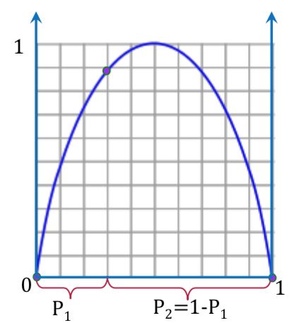


What is Entropy?
1. Is a measure of Uncertainty
2. Mathematically
3. Assume a set contains two classes
4. Is a measure of impurity
Not the only one

Slide 23

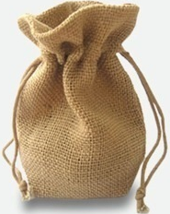
Shannon's Entropy [In Class Activity, Pen & Paper, Calculator]
Imagine a bag contains 6 RED and 4 BLACK balls
Let the two classes Red -> class 0 and Black -> class 1
Entropy of the bag (X) will be calculated as per the formula
H(X) = <Please calculate>

Slide 24
Shannon's Entropy [In Class Activity, Pen & Paper, Calculator]
Imagine a bag contains 6 RED and 4 BLACK balls
Let the two classes Red -> class 0 and Black -> class 1
Entropy of the bag (X) will be calculated as per the formula
H(X) = - (0.6 * log2( 0.6)) - (0.4 * log2(0.4)) = 0.9709506

Slide 25
Shannon's Entropy [In Class Activity, Pen & Paper, Calculator]
Imagine a bag contains 6 RED and 4 BLACK balls
Let the two classes Red -> class 0 and Black -> class 1
Entropy of the bag (X) will be calculated as per the formula
H(X) = - (0.6 * log2( 0.6)) - (0.4 * log2(0.4)) = 0.9709506
Suppose we remove all red balls from the bag and then entropy will be
H(X) = <Please calculate>

Slide 26
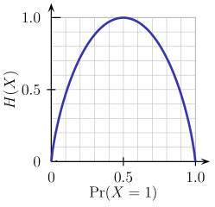
Shannon's Entropy [In Class Activity, Pen & Paper, Calculator]
Imagine a bag contains 6 RED and 4 BLACK balls.
Let the two classes Red -> class 0 and Black -> class 1
Entropy of the bag (X) will be calculated as per the formula
H(X) = - (0.6 * log2( 0.6)) - (0.4 * log2(0.4)) = 0.9709506
Suppose we remove all red balls from the bag and then entropy will be
H(X) = - 1.0 *log2(1.0) – 0.0 * log2(0) = 0 ## Entropy is 0! i.e. Information is 100%

Slide 27

Homework
Bag of 50 balls of Red, green, blue, white and yellow colour respectively
You have to pull out one ball from the bag with closed eyes. If the ball is:
Red, you lose the prize money accumulated
Green, you can quit
Blue you lose half prize money but continue
White you loose quarter prize money & continue
Yellow you can skip the question
3. Please construct a tree for the above?

Slide 28

Case Study - Logistics
Freight industry is over USD 120 Billion in the United States. You are hired as a Machine Learning Engineer by FedEx to build a model to find if there was any influence of shipping mode, order priority on customer location. Customer location is target column

Slide 29
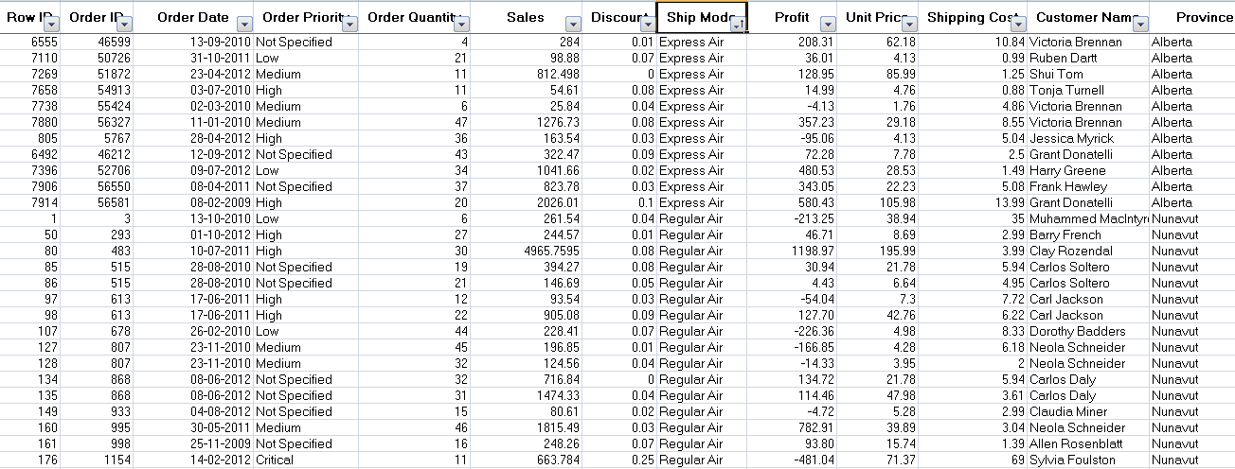
The dataset has 100,000 rows and 13 columns

Slide 30
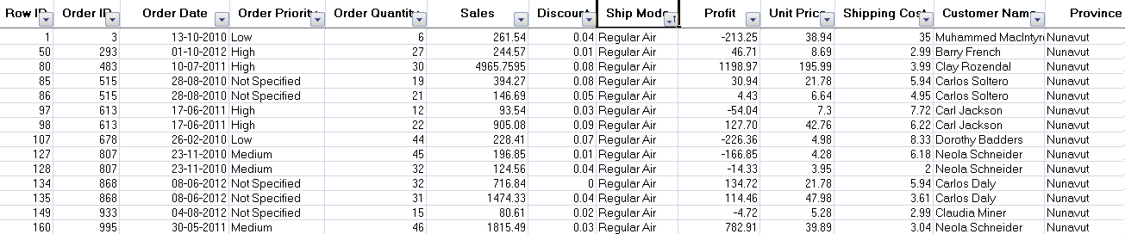
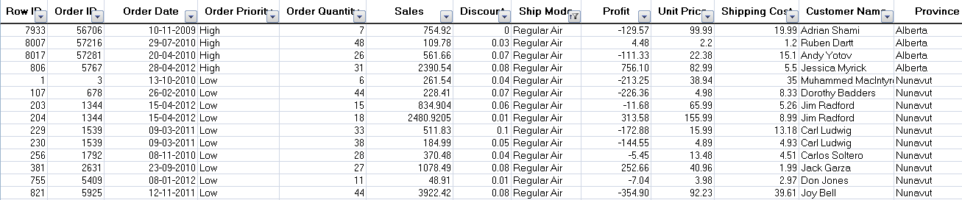
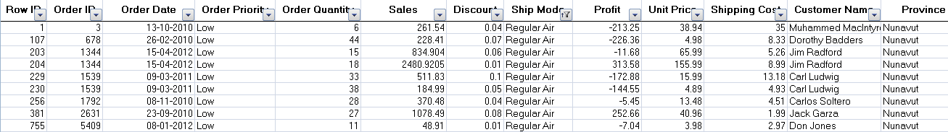
Case Study
Shipping Mode
Regular Air
ExpressAir
Low Priority
High Priority
When sub branches are created, the total entropy of the sub branches should be less than the entropy of the parent node. More the drop in entropy, more the information gained

Slide 31
Classification
Entropy | Info Gain
E0 = max entropy say 1 | 0
E1 = (E1a*700/1000) + (E1b * 300/1000) | E0 – E1
E2 = (E2a * 500/700) + (E2b * 200/700) + (E2c * 100/300) + (E2d * 200/300) | E1 – E2
Shipping
Mode (1000) E0
Regular Air (700), E1a
Express Air (300), E1b
Low Priority (500) E2a
High Priority (200) E2b
Low Priority (100) E2c
High Priority (200) E2d
Tree will stop growing when stop criterion for the splitting is reached which could be -
Tree has reached certain pre-fixed depth (longest path from root node to leaf node)
Tree has achieve maximum number of nodes (tree size)
Exhausted all attributes to split
Leaf node on split will have less than predefined number of data points

Slide 32
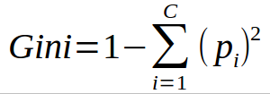
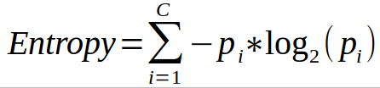
Common measures of purity
Gini index: is calculated by subtracting the sum of the squared probabilities of each class from one
Uses squared proportion of classes
Perfectly classified, Gini Index would be zero
Evenly distributed would be 1 – (1/# Classes)
You want a variable split that has a low Gini Index
Used in CART algorithm
Entropy:
Favors splits with small counts but many unique values
Weights probability of class by log(base=2) of the class probability
A smaller value of Entropy is better. That makes the difference between the parent node’s entropy larger
Information Gain is the Entropy of the parent node minus the entropy of the child nodes

Slide 33
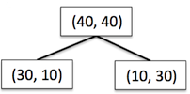
Information Gain using Entropy

Slide 34

Information Gain using Entropy

Slide 35



Information Gain using Entropy
Information Gain = reduction in entropy =

Slide 36
Information Gain using Gini index

Slide 37
Information Gain using Gini index

Slide 38



Information Gain using Gini index
Information Gain = reduction in Gini index =

Slide 39
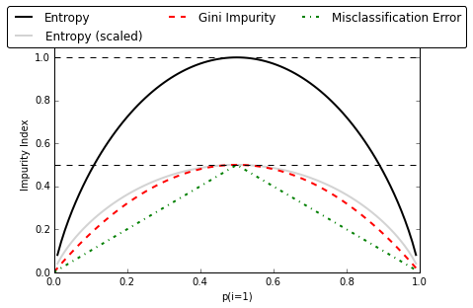
Gini, Entropy
Note: Misclassification Error is not used in Decision Trees

Slide 40
Common Algorithms (Applicable to both R and Python)
ID3 (Iterative Dicotomizer 3) (Author: Quinian) Creates a multi branch tree at each node using greedy algorithm. Trees grow to maximum size before pruning
C4.5 succeeded ID3 by overcoming limitation of features required to be categorical. It dynamically defines discrete attribute for numerical attributes. It converts the trained trees into a set of if-then rules. Accuracy of each rule is evaluated to determine the order in which they should be applied
C5.0 is Quinlan’s latest version and it uses less memory and builds smaller rulesets than C4.5 while being more accurate

Slide 41
CART (Classification & Regression Trees)
Similar to C4.5 but it supports numerical target variables and does not compute rule sets. Creates binary tree
Scikit uses CART

Slide 42
Decision Trees
Advantages:
Simple, Fast in processing and effective
Can deal with missing data
Handles numeric and categorical variables
Interpretation of results does not require mathematical or statistical knowledge
Disadvantages
Often biased towards splits or features have large number of levels
May not be optimum as modelling some relations on axis parallel basis is not optimal
Small changes in training data can result in large changes to the logic
Large trees can be difficult to interpret

Slide 43
Preventing overfitting through regularization
Decision trees do not assume a particular form of relationship between the independent and dependent variables unlike linear models
DT is a non-parametrized algorithm unlike linear models where we supply the input parameters
If left unconstrained, they can build tree structures to adapt to the training data leading to overfitting
To avoid overfitting, we need to restrict the DT’s freedom during the tree creation. This is called regularization
The regularization hyperparameters depend on the algorithms used

Slide 44
Decision trees are notorious for overfitting. Solutions:
1. Early Stopping
2. Do not split a not beyond a point (of number of items or purity)
3. Pruning Once the tree is formed, remove weakest branches. Use validation set to decide when to stop
4. Both approaches also reduces the depth and improves classification speed

Slide 45
How to handle missing values?
Why did the data go missing?
Random, but dependent on observed variables
Random, but dependent on unobserved variables
Dependent on the value itself!!
2) Throw out data with missing values
3) What are the implications?
Impute values
Impute 0
Mean/median imputation
Impute from observed values: build predictor
Impute from last observation

Slide 46
Regularization parameters
max_depth – Is the maximum length of a path from root to leaf (in terms of number of decision points. The leaf node is not split further. It could lead to a tree with leaf node containing many observations on one side of the tree, whereas on the other side, nodes containing much less observations get further split
min_sample_split - A limit to stop further splitting of nodes when the number of observations in the node is lower than this value
min_sample_leaf – Minimum number of samples a leaf node must have. When a leaf contains too few observations, further splitting will result in overfitting (modeling of noise in the data).

Slide 47
Regularization parameters
min_weight_fraction_leaf – Same as min_sample_leaf but expressed in fraction of total number of weighted instances
max_leaf_nodes – maximum number of leaf nodes in a tree
max_feature_size - max number of features that are evaluated for splitting each node

Slide 48

Actuarial Statistics is a huge industry with market potential of over ~200 Billion/year. LIC has realeased a new product (“Yuva Jeevan”) and has hired you as Machine Learning Engineer to predict the average claim per year. We have a single attribute (age). How do we go about this?
Notes:
Attribute 1: (qualitative) Status of existing checking account A11 : ... < 0 DM A12 : 0 <= ... < 200 DM A13 : ... >= 200 DM / salary assignments for at least 1 year A14 : no checking account Attribute 2: (numerical) Duration in month Attribute 3: (qualitative) Credit history A30 : no credits taken/ all credits paid back duly A31 : all credits at this bank paid back duly A32 : existing credits paid back duly till now A33 : delay in paying off in the past A34 : critical account/ other credits existing (not at this bank) Attribute 4: (qualitative) Purpose A40 : car (new) A41 : car (used) A42 : furniture/equipment A43 : radio/television A44 : domestic appliances A45 : repairs A46 : education A47 : (vacation - does not exist?) A48 : retraining A49 : business A410 : others Attribute 5: (numerical) Credit amount Attibute 6: (qualitative) Savings account/bonds A61 : ... < 100 DM A62 : 100 <= ... < 500 DM A63 : 500 <= ... < 1000 DM A64 : .. >= 1000 DM A65 : unknown/ no savings account Attribute 7: (qualitative) Present employment since A71 : unemployed A72 : ... < 1 year A73 : 1 <= ... < 4 years A74 : 4 <= ... < 7 years A75 : .. >= 7 years Attribute 8: (numerical) Installment rate in percentage of disposable income Attribute 9: (qualitative) Personal status and sex A91 : male : divorced/separated A92 : female : divorced/separated/married A93 : male : single A94 : male : married/widowed A95 : female : single Attribute 10: (qualitative) Other debtors / guarantors A101 : none A102 : co-applicant A103 : guarantor Attribute 11: (numerical) Present residence since Attribute 12: (qualitative) Property A121 : real estate A122 : if not A121 : building society savings agreement/ life insurance A123 : if not A121/A122 : car or other, not in attribute 6 A124 : unknown / no property Attribute 13: (numerical) Age in years Attribute 14: (qualitative) Other installment plans A141 : bank A142 : stores A143 : none Attribute 15: (qualitative) Housing A151 : rent A152 : own A153 : for free Attribute 16: (numerical) Number of existing credits at this bank Attribute 17: (qualitative) Job A171 : unemployed/ unskilled - non-resident A172 : unskilled - resident A173 : skilled employee / official A174 : management/ self-employed/ highly qualified employee/ officer Attribute 18: (numerical) Number of people being liable to provide maintenance for Attribute 19: (qualitative) Telephone A191 : none A192 : yes, registered under the customers name Attribute 20: (qualitative) foreign worker A201 : yes A202 : no

Slide 49
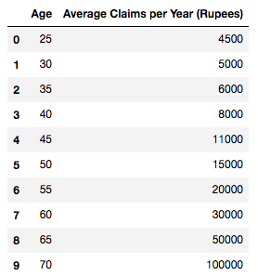
Demo
10 rows X 2 columns
No missing values
http://localhost:8888/notebooks/Downloads/DT_RF_Regression.ipynb
Notes:
Attribute 1: (qualitative) Status of existing checking account A11 : ... < 0 DM A12 : 0 <= ... < 200 DM A13 : ... >= 200 DM / salary assignments for at least 1 year A14 : no checking account Attribute 2: (numerical) Duration in month Attribute 3: (qualitative) Credit history A30 : no credits taken/ all credits paid back duly A31 : all credits at this bank paid back duly A32 : existing credits paid back duly till now A33 : delay in paying off in the past A34 : critical account/ other credits existing (not at this bank) Attribute 4: (qualitative) Purpose A40 : car (new) A41 : car (used) A42 : furniture/equipment A43 : radio/television A44 : domestic appliances A45 : repairs A46 : education A47 : (vacation - does not exist?) A48 : retraining A49 : business A410 : others Attribute 5: (numerical) Credit amount Attibute 6: (qualitative) Savings account/bonds A61 : ... < 100 DM A62 : 100 <= ... < 500 DM A63 : 500 <= ... < 1000 DM A64 : .. >= 1000 DM A65 : unknown/ no savings account Attribute 7: (qualitative) Present employment since A71 : unemployed A72 : ... < 1 year A73 : 1 <= ... < 4 years A74 : 4 <= ... < 7 years A75 : .. >= 7 years Attribute 8: (numerical) Installment rate in percentage of disposable income Attribute 9: (qualitative) Personal status and sex A91 : male : divorced/separated A92 : female : divorced/separated/married A93 : male : single A94 : male : married/widowed A95 : female : single Attribute 10: (qualitative) Other debtors / guarantors A101 : none A102 : co-applicant A103 : guarantor Attribute 11: (numerical) Present residence since Attribute 12: (qualitative) Property A121 : real estate A122 : if not A121 : building society savings agreement/ life insurance A123 : if not A121/A122 : car or other, not in attribute 6 A124 : unknown / no property Attribute 13: (numerical) Age in years Attribute 14: (qualitative) Other installment plans A141 : bank A142 : stores A143 : none Attribute 15: (qualitative) Housing A151 : rent A152 : own A153 : for free Attribute 16: (numerical) Number of existing credits at this bank Attribute 17: (qualitative) Job A171 : unemployed/ unskilled - non-resident A172 : unskilled - resident A173 : skilled employee / official A174 : management/ self-employed/ highly qualified employee/ officer Attribute 18: (numerical) Number of people being liable to provide maintenance for Attribute 19: (qualitative) Telephone A191 : none A192 : yes, registered under the customers name Attribute 20: (qualitative) foreign worker A201 : yes A202 : no

Slide 50
Decision Tree -
Lab_1 Decision Tree based model to predict class of wines
Lab_2 Build a decision tree model for Pima Diabetes dataset to predict diabetic cases
Sol: DecisionTree_Wine.ipynb
Notes:
Attribute 1: (qualitative) Status of existing checking account A11 : ... < 0 DM A12 : 0 <= ... < 200 DM A13 : ... >= 200 DM / salary assignments for at least 1 year A14 : no checking account Attribute 2: (numerical) Duration in month Attribute 3: (qualitative) Credit history A30 : no credits taken/ all credits paid back duly A31 : all credits at this bank paid back duly A32 : existing credits paid back duly till now A33 : delay in paying off in the past A34 : critical account/ other credits existing (not at this bank) Attribute 4: (qualitative) Purpose A40 : car (new) A41 : car (used) A42 : furniture/equipment A43 : radio/television A44 : domestic appliances A45 : repairs A46 : education A47 : (vacation - does not exist?) A48 : retraining A49 : business A410 : others Attribute 5: (numerical) Credit amount Attibute 6: (qualitative) Savings account/bonds A61 : ... < 100 DM A62 : 100 <= ... < 500 DM A63 : 500 <= ... < 1000 DM A64 : .. >= 1000 DM A65 : unknown/ no savings account Attribute 7: (qualitative) Present employment since A71 : unemployed A72 : ... < 1 year A73 : 1 <= ... < 4 years A74 : 4 <= ... < 7 years A75 : .. >= 7 years Attribute 8: (numerical) Installment rate in percentage of disposable income Attribute 9: (qualitative) Personal status and sex A91 : male : divorced/separated A92 : female : divorced/separated/married A93 : male : single A94 : male : married/widowed A95 : female : single Attribute 10: (qualitative) Other debtors / guarantors A101 : none A102 : co-applicant A103 : guarantor Attribute 11: (numerical) Present residence since Attribute 12: (qualitative) Property A121 : real estate A122 : if not A121 : building society savings agreement/ life insurance A123 : if not A121/A122 : car or other, not in attribute 6 A124 : unknown / no property Attribute 13: (numerical) Age in years Attribute 14: (qualitative) Other installment plans A141 : bank A142 : stores A143 : none Attribute 15: (qualitative) Housing A151 : rent A152 : own A153 : for free Attribute 16: (numerical) Number of existing credits at this bank Attribute 17: (qualitative) Job A171 : unemployed/ unskilled - non-resident A172 : unskilled - resident A173 : skilled employee / official A174 : management/ self-employed/ highly qualified employee/ officer Attribute 18: (numerical) Number of people being liable to provide maintenance for Attribute 19: (qualitative) Telephone A191 : none A192 : yes, registered under the customers name Attribute 20: (qualitative) foreign worker A201 : yes A202 : no

Slide 51
Thank you!

