Slide 1

Ensemble Methods
Jayanth Rasamsetti
Founder www.sgmoid.com
Columbia University (MS)
IIT Madras (B.Tech & M.Tech)

Slide 2
What is an ensemble?

Slide 3

What is an ensemble?

Slide 4

What is NOT an ensemble?
Image Source: www.bharatstudent.com

Slide 5
Ensembles
Combine the predictions of several base estimators (usually weak models) built with a given learning algorithm in order to improve generalizability/robustness over a single estimator
There are two types:
Average: The driving principle is to build several estimators independently and then to average / vote their predictions. On average, the combined estimator is usually better than any of the single base estimator because its variance is reduced.e.g. Bagging methods, Forests of randomized trees, etc
Boosting: base estimators are built sequentially and one tries to reduce the bias of the combined estimator. The motivation is to combine several weak models to produce a powerful ensemble. E.g. AdaBoost, Gradient Tree Boosting, etc

Slide 6
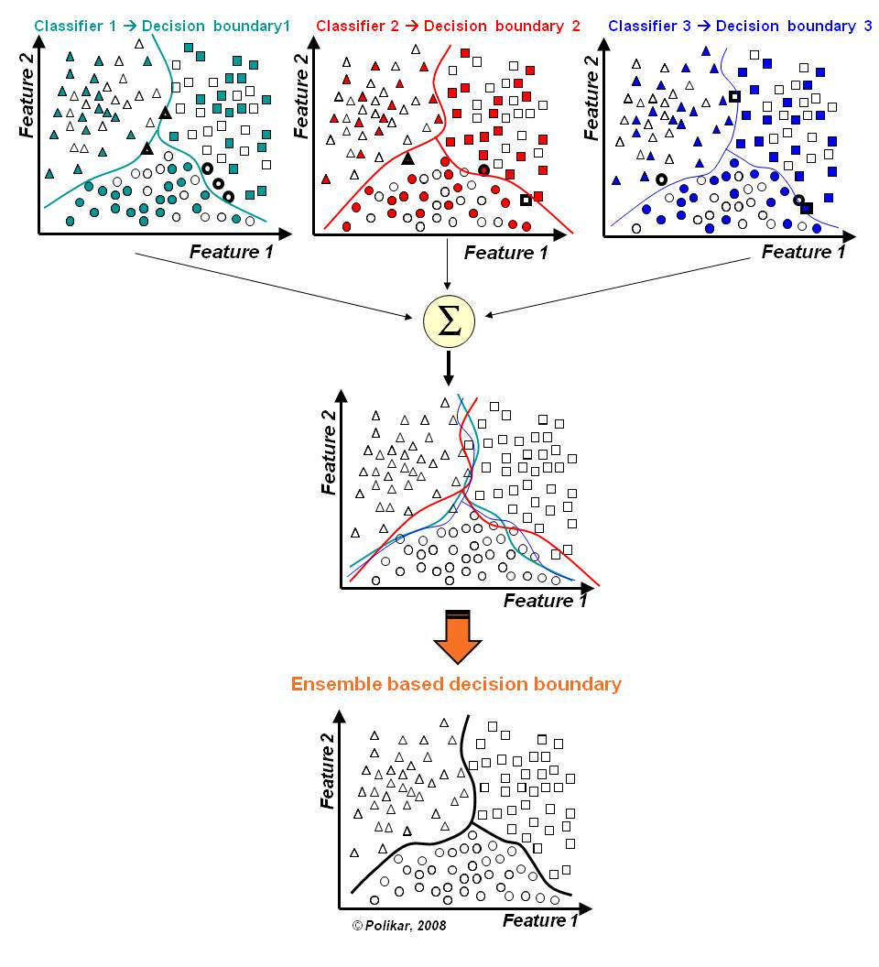
Ensembles
In the final stage of voting, we essentially have a combined surface resulting from individual surfaces
Source: https://github.com/MenuPolis/MLT/wiki/Bagging

Slide 7
What could bagging mean?

Slide 8

What could bagging mean?

Slide 9
Bagging (Bootstrap Aggregation)
Uses sampling with replacement to generate multiple samples of a given size. Sample may contain repeat data points
Reduces variance errors and helps to avoid overfitting
Can be used with any type of machine learning model, mostly used with Decision Tree
For classification bagging is used with voting to decide the class of an input while for regression average or median values are calculated
For large sample size, sample data is expected to have roughly 63.2% ( 1 – 1/e) unique data points and the rest being duplicates
Notes:
Bagging methods come in different flavours but mostly differ by the way they draw random subsets of the training set
When random subsets of the data set are drawn as random subsets of the samples, the algorithm is known as pasting
When samples are drawn with replacement, the method is known as Bagging (Bootstrap Aggregation)
When the random subsets of the dataset are drawn as random subsets of the features, then the method is known as random subspaces
When the base estimators are built on subsets of both samples and features, the method is called random patches
Source: Scikit-learn user guide, chapter 3, page 230

Slide 10
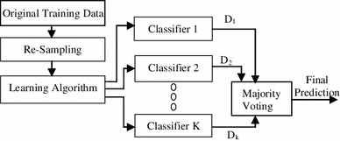
Bagging (Bootstrap Aggregation)
Re-sampling done for every classifier using a random function. For large n, 63.2% unique samples likely to be selected
Voting could be simple or weighted
Algorithm to generate classifiers. Could be Decision Tree, Naïve Bayes etc
K classifiers created in parallel and independently on respective training data
Source: https://link.springer.com/article/10.1007/s13721-013-0034-x

Slide 11
Bagging (Bootstrap Aggregation)
Lab- 6 Improve defaulter prediction of the decision tree using bagging ensemble technique
Description – Sample data is available at local file system as credit.csv
The dataset has 16 attributes described at https://archive.ics.uci.edu/ml/datasets/statlog+(german+credit+data)
or in the notes page of this slide
Sol: Bagging+Credit+Decision+Tree.ipynb
Notes:
Attribute 1: (qualitative) Status of existing checking account A11 : ... < 0 DM A12 : 0 <= ... < 200 DM A13 : ... >= 200 DM / salary assignments for at least 1 year A14 : no checking account Attribute 2: (numerical) Duration in month Attribute 3: (qualitative) Credit history A30 : no credits taken/ all credits paid back duly A31 : all credits at this bank paid back duly A32 : existing credits paid back duly till now A33 : delay in paying off in the past A34 : critical account/ other credits existing (not at this bank) Attribute 4: (qualitative) Purpose A40 : car (new) A41 : car (used) A42 : furniture/equipment A43 : radio/television A44 : domestic appliances A45 : repairs A46 : education A47 : (vacation - does not exist?) A48 : retraining A49 : business A410 : others Attribute 5: (numerical) Credit amount Attibute 6: (qualitative) Savings account/bonds A61 : ... < 100 DM A62 : 100 <= ... < 500 DM A63 : 500 <= ... < 1000 DM A64 : .. >= 1000 DM A65 : unknown/ no savings account Attribute 7: (qualitative) Present employment since A71 : unemployed A72 : ... < 1 year A73 : 1 <= ... < 4 years A74 : 4 <= ... < 7 years A75 : .. >= 7 years Attribute 8: (numerical) Installment rate in percentage of disposable income Attribute 9: (qualitative) Personal status and sex A91 : male : divorced/separated A92 : female : divorced/separated/married A93 : male : single A94 : male : married/widowed A95 : female : single Attribute 10: (qualitative) Other debtors / guarantors A101 : none A102 : co-applicant A103 : guarantor Attribute 11: (numerical) Present residence since Attribute 12: (qualitative) Property A121 : real estate A122 : if not A121 : building society savings agreement/ life insurance A123 : if not A121/A122 : car or other, not in attribute 6 A124 : unknown / no property Attribute 13: (numerical) Age in years Attribute 14: (qualitative) Other installment plans A141 : bank A142 : stores A143 : none Attribute 15: (qualitative) Housing A151 : rent A152 : own A153 : for free Attribute 16: (numerical) Number of existing credits at this bank Attribute 17: (qualitative) Job A171 : unemployed/ unskilled - non-resident A172 : unskilled - resident A173 : skilled employee / official A174 : management/ self-employed/ highly qualified employee/ officer Attribute 18: (numerical) Number of people being liable to provide maintenance for Attribute 19: (qualitative) Telephone A191 : none A192 : yes, registered under the customers name Attribute 20: (qualitative) foreign worker A201 : yes A202 : no

Slide 12
What could boost mean?
Notes:
Attribute 1: (qualitative) Status of existing checking account A11 : ... < 0 DM A12 : 0 <= ... < 200 DM A13 : ... >= 200 DM / salary assignments for at least 1 year A14 : no checking account Attribute 2: (numerical) Duration in month Attribute 3: (qualitative) Credit history A30 : no credits taken/ all credits paid back duly A31 : all credits at this bank paid back duly A32 : existing credits paid back duly till now A33 : delay in paying off in the past A34 : critical account/ other credits existing (not at this bank) Attribute 4: (qualitative) Purpose A40 : car (new) A41 : car (used) A42 : furniture/equipment A43 : radio/television A44 : domestic appliances A45 : repairs A46 : education A47 : (vacation - does not exist?) A48 : retraining A49 : business A410 : others Attribute 5: (numerical) Credit amount Attibute 6: (qualitative) Savings account/bonds A61 : ... < 100 DM A62 : 100 <= ... < 500 DM A63 : 500 <= ... < 1000 DM A64 : .. >= 1000 DM A65 : unknown/ no savings account Attribute 7: (qualitative) Present employment since A71 : unemployed A72 : ... < 1 year A73 : 1 <= ... < 4 years A74 : 4 <= ... < 7 years A75 : .. >= 7 years Attribute 8: (numerical) Installment rate in percentage of disposable income Attribute 9: (qualitative) Personal status and sex A91 : male : divorced/separated A92 : female : divorced/separated/married A93 : male : single A94 : male : married/widowed A95 : female : single Attribute 10: (qualitative) Other debtors / guarantors A101 : none A102 : co-applicant A103 : guarantor Attribute 11: (numerical) Present residence since Attribute 12: (qualitative) Property A121 : real estate A122 : if not A121 : building society savings agreement/ life insurance A123 : if not A121/A122 : car or other, not in attribute 6 A124 : unknown / no property Attribute 13: (numerical) Age in years Attribute 14: (qualitative) Other installment plans A141 : bank A142 : stores A143 : none Attribute 15: (qualitative) Housing A151 : rent A152 : own A153 : for free Attribute 16: (numerical) Number of existing credits at this bank Attribute 17: (qualitative) Job A171 : unemployed/ unskilled - non-resident A172 : unskilled - resident A173 : skilled employee / official A174 : management/ self-employed/ highly qualified employee/ officer Attribute 18: (numerical) Number of people being liable to provide maintenance for Attribute 19: (qualitative) Telephone A191 : none A192 : yes, registered under the customers name Attribute 20: (qualitative) foreign worker A201 : yes A202 : no

Slide 13

What could boost mean?
Notes:
Attribute 1: (qualitative) Status of existing checking account A11 : ... < 0 DM A12 : 0 <= ... < 200 DM A13 : ... >= 200 DM / salary assignments for at least 1 year A14 : no checking account Attribute 2: (numerical) Duration in month Attribute 3: (qualitative) Credit history A30 : no credits taken/ all credits paid back duly A31 : all credits at this bank paid back duly A32 : existing credits paid back duly till now A33 : delay in paying off in the past A34 : critical account/ other credits existing (not at this bank) Attribute 4: (qualitative) Purpose A40 : car (new) A41 : car (used) A42 : furniture/equipment A43 : radio/television A44 : domestic appliances A45 : repairs A46 : education A47 : (vacation - does not exist?) A48 : retraining A49 : business A410 : others Attribute 5: (numerical) Credit amount Attibute 6: (qualitative) Savings account/bonds A61 : ... < 100 DM A62 : 100 <= ... < 500 DM A63 : 500 <= ... < 1000 DM A64 : .. >= 1000 DM A65 : unknown/ no savings account Attribute 7: (qualitative) Present employment since A71 : unemployed A72 : ... < 1 year A73 : 1 <= ... < 4 years A74 : 4 <= ... < 7 years A75 : .. >= 7 years Attribute 8: (numerical) Installment rate in percentage of disposable income Attribute 9: (qualitative) Personal status and sex A91 : male : divorced/separated A92 : female : divorced/separated/married A93 : male : single A94 : male : married/widowed A95 : female : single Attribute 10: (qualitative) Other debtors / guarantors A101 : none A102 : co-applicant A103 : guarantor Attribute 11: (numerical) Present residence since Attribute 12: (qualitative) Property A121 : real estate A122 : if not A121 : building society savings agreement/ life insurance A123 : if not A121/A122 : car or other, not in attribute 6 A124 : unknown / no property Attribute 13: (numerical) Age in years Attribute 14: (qualitative) Other installment plans A141 : bank A142 : stores A143 : none Attribute 15: (qualitative) Housing A151 : rent A152 : own A153 : for free Attribute 16: (numerical) Number of existing credits at this bank Attribute 17: (qualitative) Job A171 : unemployed/ unskilled - non-resident A172 : unskilled - resident A173 : skilled employee / official A174 : management/ self-employed/ highly qualified employee/ officer Attribute 18: (numerical) Number of people being liable to provide maintenance for Attribute 19: (qualitative) Telephone A191 : none A192 : yes, registered under the customers name Attribute 20: (qualitative) foreign worker A201 : yes A202 : no

Slide 14
Boosting (AdaBoost)
Similar to bagging, but the learners are grown sequentially; except for the first, each subsequent learner is grown from previously grown learners
If the learner is a Decision Tree, each of the trees can be small, with just a few terminal nodes (determined by the parameter d supplied )
During voting higher weight is given to the votes of learners which perform better in respective training data unlike Bagging where all get equal weight
Boosting slows down learning (because it is sequential) but the model generally performs well

Slide 15
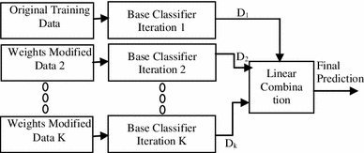
Boosting (AdaBoost)
Training data from base data with focus on instances which were incorrectly classified by earlier model (if any)
Voting could be simple or weighted
K similar classifiers created in sequence with respective training data with focus on addressing the misclassified data, not the usual cost functions
It is called Adaptive Boosting as the weights are re-assigned to each instance, with higher weights to incorrectly classified instance
Source: https://link.springer.com/article/10.1007/s13721-013-0034-x

Slide 16
Boosting (AdaBoost)
Two prominent boosting algorithms are AdaBoost, short for Adaptive Boosting and Gradient Descent Boosting
In AdaBoost, the successive learners are created with a focus on the ill fitted data of the previous learner
Each successive learner focuses more and more on the harder to fit data i.e. their residuals in the previous tree

Slide 17
Recently asked Interview Question:
Boosting is faster compared to Bagging
True
False

Slide 18

Recently asked Interview Question:
Boosting is faster compared to Bagging
True
False
Ans) False

Slide 19
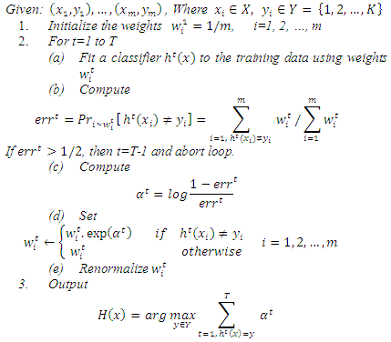
Boosting (AdaBoost)
Adapting weights with focus on erroneously classified instances
Initialize weights, equal weights to all instances
Generate first classifier with equal focus on all instances
Total up weights of all error instances, express it as a ratio to total weights
If error ratio is > 50%
Calculate predictor weights (i.e. weight of the classifier)
Assign new weights to instances misclassified, else keep the weights same
Renormalize the weights across all the instances and fit next classifier
For a test instance use weighted voting to identify the class

Slide 20
AdaBoosting:
Lab - 7 Improve defaulter prediction of the decision tree using Adaboosting
Description – Sample data is available at local file system as credit.csv
The dataset has 16 attributes described at https://archive.ics.uci.edu/ml/datasets/statlog+(german+credit+data)
or in the notes page of this slide
Sol: Adaboost+Credit+Decision+Tree.ipynb
Notes:
Attribute 1: (qualitative) Status of existing checking account A11 : ... < 0 DM A12 : 0 <= ... < 200 DM A13 : ... >= 200 DM / salary assignments for at least 1 year A14 : no checking account Attribute 2: (numerical) Duration in month Attribute 3: (qualitative) Credit history A30 : no credits taken/ all credits paid back duly A31 : all credits at this bank paid back duly A32 : existing credits paid back duly till now A33 : delay in paying off in the past A34 : critical account/ other credits existing (not at this bank) Attribute 4: (qualitative) Purpose A40 : car (new) A41 : car (used) A42 : furniture/equipment A43 : radio/television A44 : domestic appliances A45 : repairs A46 : education A47 : (vacation - does not exist?) A48 : retraining A49 : business A410 : others Attribute 5: (numerical) Credit amount Attibute 6: (qualitative) Savings account/bonds A61 : ... < 100 DM A62 : 100 <= ... < 500 DM A63 : 500 <= ... < 1000 DM A64 : .. >= 1000 DM A65 : unknown/ no savings account Attribute 7: (qualitative) Present employment since A71 : unemployed A72 : ... < 1 year A73 : 1 <= ... < 4 years A74 : 4 <= ... < 7 years A75 : .. >= 7 years Attribute 8: (numerical) Installment rate in percentage of disposable income Attribute 9: (qualitative) Personal status and sex A91 : male : divorced/separated A92 : female : divorced/separated/married A93 : male : single A94 : male : married/widowed A95 : female : single Attribute 10: (qualitative) Other debtors / guarantors A101 : none A102 : co-applicant A103 : guarantor Attribute 11: (numerical) Present residence since Attribute 12: (qualitative) Property A121 : real estate A122 : if not A121 : building society savings agreement/ life insurance A123 : if not A121/A122 : car or other, not in attribute 6 A124 : unknown / no property Attribute 13: (numerical) Age in years Attribute 14: (qualitative) Other installment plans A141 : bank A142 : stores A143 : none Attribute 15: (qualitative) Housing A151 : rent A152 : own A153 : for free Attribute 16: (numerical) Number of existing credits at this bank Attribute 17: (qualitative) Job A171 : unemployed/ unskilled - non-resident A172 : unskilled - resident A173 : skilled employee / official A174 : management/ self-employed/ highly qualified employee/ officer Attribute 18: (numerical) Number of people being liable to provide maintenance for Attribute 19: (qualitative) Telephone A191 : none A192 : yes, registered under the customers name Attribute 20: (qualitative) foreign worker A201 : yes A202 : no

Slide 21
Random Forest:
Each tree in the ensemble is built from a sample drawn with replacement (bootstrap) from the training set
In addition, when splitting a node during the construction of a tree, the split that is chosen is no longer the best split among all the features
Instead, the split picked is the best split among a random subset of the features
As a result of this randomness, the bias of the forest usually slightly increases (with respect to the bias of a single non-random tree)
Due to averaging, its variance decreases, usually more than compensating the increase in bias, hence yielding overall a better result
Source: scikit-learn user guide, Chapter 3, Page 231

Slide 22

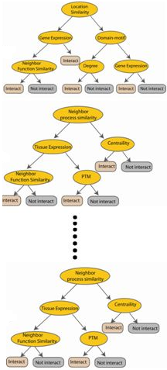



Random Forest
Used with Decision Trees. Create different trees by providing different sub-features from the feature set to the tree creating algorithm. The optimization function is Entropy or Gini index
Randomly selected sub feature set
Independent trees created in parallel
N instances
Original number of features

Slide 23
Random Forest
Lab- 9 Improve defaulter prediction of the decision tree using Random Forest
Description – Sample data is available at local file system as credit.csv
The dataset has 16 attributes described at https://archive.ics.uci.edu/ml/datasets/statlog+(german+credit+data)
or in the notes page of this slide
Sol: RF+Credit+Decision+Tree.ipynb
Notes:
Attribute 1: (qualitative) Status of existing checking account A11 : ... < 0 DM A12 : 0 <= ... < 200 DM A13 : ... >= 200 DM / salary assignments for at least 1 year A14 : no checking account Attribute 2: (numerical) Duration in month Attribute 3: (qualitative) Credit history A30 : no credits taken/ all credits paid back duly A31 : all credits at this bank paid back duly A32 : existing credits paid back duly till now A33 : delay in paying off in the past A34 : critical account/ other credits existing (not at this bank) Attribute 4: (qualitative) Purpose A40 : car (new) A41 : car (used) A42 : furniture/equipment A43 : radio/television A44 : domestic appliances A45 : repairs A46 : education A47 : (vacation - does not exist?) A48 : retraining A49 : business A410 : others Attribute 5: (numerical) Credit amount Attibute 6: (qualitative) Savings account/bonds A61 : ... < 100 DM A62 : 100 <= ... < 500 DM A63 : 500 <= ... < 1000 DM A64 : .. >= 1000 DM A65 : unknown/ no savings account Attribute 7: (qualitative) Present employment since A71 : unemployed A72 : ... < 1 year A73 : 1 <= ... < 4 years A74 : 4 <= ... < 7 years A75 : .. >= 7 years Attribute 8: (numerical) Installment rate in percentage of disposable income Attribute 9: (qualitative) Personal status and sex A91 : male : divorced/separated A92 : female : divorced/separated/married A93 : male : single A94 : male : married/widowed A95 : female : single Attribute 10: (qualitative) Other debtors / guarantors A101 : none A102 : co-applicant A103 : guarantor Attribute 11: (numerical) Present residence since Attribute 12: (qualitative) Property A121 : real estate A122 : if not A121 : building society savings agreement/ life insurance A123 : if not A121/A122 : car or other, not in attribute 6 A124 : unknown / no property Attribute 13: (numerical) Age in years Attribute 14: (qualitative) Other installment plans A141 : bank A142 : stores A143 : none Attribute 15: (qualitative) Housing A151 : rent A152 : own A153 : for free Attribute 16: (numerical) Number of existing credits at this bank Attribute 17: (qualitative) Job A171 : unemployed/ unskilled - non-resident A172 : unskilled - resident A173 : skilled employee / official A174 : management/ self-employed/ highly qualified employee/ officer Attribute 18: (numerical) Number of people being liable to provide maintenance for Attribute 19: (qualitative) Telephone A191 : none A192 : yes, registered under the customers name Attribute 20: (qualitative) foreign worker A201 : yes A202 : no

Slide 24
Stacking
Similar to bagging, but apply several different models to original data
The weights for each model is determined based on how well they perform on the given input data
Similar classifiers usually make similar errors (bagging), so forming an ensemble with similar classifiers may not improve the classification rate
Presence of a poorly performing classifier may cause performance deterioration in the overall performance
Similarly, even on presence of a classifier that performs much better than all of the other available base classifiers, may cause degradation in the overall performance
Another important factor is the amount of correlation among the incorrect classifications made by each classifier
If the consistent classifiers tend to misclassify the same instances, then combining their results will have no benefit
In contrast, a greater amount of independence among the classifiers can result in errors by individual classifiers being overlooked when the results of the ensemble are combined.

Slide 25
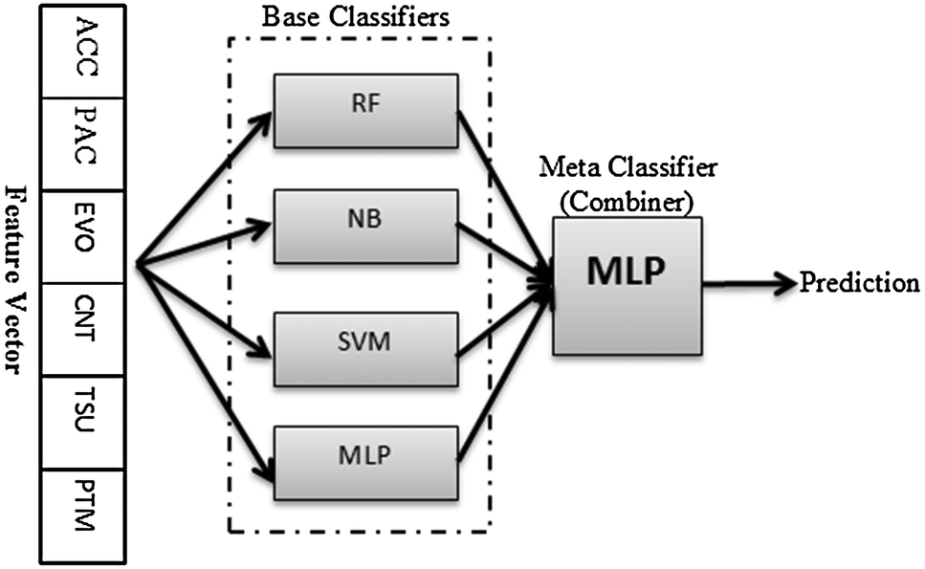
Stacking
Source: http://pubs.rsc.org/-/content/articlelanding/2014/mb/c4mb00410h/unauth#!divAbstract

Slide 26
Stacking
Lab- 10 Improve defaulter prediction of the decision tree using Stacking
Description – Sample data is available at local file system as credit.csv
The dataset has 16 attributes described at https://archive.ics.uci.edu/ml/datasets/statlog+(german+credit+data)
or in the notes page of this slide
Sol: Stacking+Credit+Decision+Tree.ipynb
Notes:
Attribute 1: (qualitative) Status of existing checking account A11 : ... < 0 DM A12 : 0 <= ... < 200 DM A13 : ... >= 200 DM / salary assignments for at least 1 year A14 : no checking account Attribute 2: (numerical) Duration in month Attribute 3: (qualitative) Credit history A30 : no credits taken/ all credits paid back duly A31 : all credits at this bank paid back duly A32 : existing credits paid back duly till now A33 : delay in paying off in the past A34 : critical account/ other credits existing (not at this bank) Attribute 4: (qualitative) Purpose A40 : car (new) A41 : car (used) A42 : furniture/equipment A43 : radio/television A44 : domestic appliances A45 : repairs A46 : education A47 : (vacation - does not exist?) A48 : retraining A49 : business A410 : others Attribute 5: (numerical) Credit amount Attibute 6: (qualitative) Savings account/bonds A61 : ... < 100 DM A62 : 100 <= ... < 500 DM A63 : 500 <= ... < 1000 DM A64 : .. >= 1000 DM A65 : unknown/ no savings account Attribute 7: (qualitative) Present employment since A71 : unemployed A72 : ... < 1 year A73 : 1 <= ... < 4 years A74 : 4 <= ... < 7 years A75 : .. >= 7 years Attribute 8: (numerical) Installment rate in percentage of disposable income Attribute 9: (qualitative) Personal status and sex A91 : male : divorced/separated A92 : female : divorced/separated/married A93 : male : single A94 : male : married/widowed A95 : female : single Attribute 10: (qualitative) Other debtors / guarantors A101 : none A102 : co-applicant A103 : guarantor Attribute 11: (numerical) Present residence since Attribute 12: (qualitative) Property A121 : real estate A122 : if not A121 : building society savings agreement/ life insurance A123 : if not A121/A122 : car or other, not in attribute 6 A124 : unknown / no property Attribute 13: (numerical) Age in years Attribute 14: (qualitative) Other installment plans A141 : bank A142 : stores A143 : none Attribute 15: (qualitative) Housing A151 : rent A152 : own A153 : for free Attribute 16: (numerical) Number of existing credits at this bank Attribute 17: (qualitative) Job A171 : unemployed/ unskilled - non-resident A172 : unskilled - resident A173 : skilled employee / official A174 : management/ self-employed/ highly qualified employee/ officer Attribute 18: (numerical) Number of people being liable to provide maintenance for Attribute 19: (qualitative) Telephone A191 : none A192 : yes, registered under the customers name Attribute 20: (qualitative) foreign worker A201 : yes A202 : no

Slide 27
End to End Kaggle Case Study:
Have a plan. How will you distribute the next 5 hours?
Make a sample submission in the first 30 minutes (familiarize yourself with Kaggle)
If stuck, debug with smallest example to get unstuck
All the best!
Sol: Stacking+Credit+Decision+Tree.ipynb
Notes:
Attribute 1: (qualitative) Status of existing checking account A11 : ... < 0 DM A12 : 0 <= ... < 200 DM A13 : ... >= 200 DM / salary assignments for at least 1 year A14 : no checking account Attribute 2: (numerical) Duration in month Attribute 3: (qualitative) Credit history A30 : no credits taken/ all credits paid back duly A31 : all credits at this bank paid back duly A32 : existing credits paid back duly till now A33 : delay in paying off in the past A34 : critical account/ other credits existing (not at this bank) Attribute 4: (qualitative) Purpose A40 : car (new) A41 : car (used) A42 : furniture/equipment A43 : radio/television A44 : domestic appliances A45 : repairs A46 : education A47 : (vacation - does not exist?) A48 : retraining A49 : business A410 : others Attribute 5: (numerical) Credit amount Attibute 6: (qualitative) Savings account/bonds A61 : ... < 100 DM A62 : 100 <= ... < 500 DM A63 : 500 <= ... < 1000 DM A64 : .. >= 1000 DM A65 : unknown/ no savings account Attribute 7: (qualitative) Present employment since A71 : unemployed A72 : ... < 1 year A73 : 1 <= ... < 4 years A74 : 4 <= ... < 7 years A75 : .. >= 7 years Attribute 8: (numerical) Installment rate in percentage of disposable income Attribute 9: (qualitative) Personal status and sex A91 : male : divorced/separated A92 : female : divorced/separated/married A93 : male : single A94 : male : married/widowed A95 : female : single Attribute 10: (qualitative) Other debtors / guarantors A101 : none A102 : co-applicant A103 : guarantor Attribute 11: (numerical) Present residence since Attribute 12: (qualitative) Property A121 : real estate A122 : if not A121 : building society savings agreement/ life insurance A123 : if not A121/A122 : car or other, not in attribute 6 A124 : unknown / no property Attribute 13: (numerical) Age in years Attribute 14: (qualitative) Other installment plans A141 : bank A142 : stores A143 : none Attribute 15: (qualitative) Housing A151 : rent A152 : own A153 : for free Attribute 16: (numerical) Number of existing credits at this bank Attribute 17: (qualitative) Job A171 : unemployed/ unskilled - non-resident A172 : unskilled - resident A173 : skilled employee / official A174 : management/ self-employed/ highly qualified employee/ officer Attribute 18: (numerical) Number of people being liable to provide maintenance for Attribute 19: (qualitative) Telephone A191 : none A192 : yes, registered under the customers name Attribute 20: (qualitative) foreign worker A201 : yes A202 : no

Slide 28
Thank you!

