Slide 1


AI-FAKE NEWS
DETECTION
By:
ARYAN VATS (RA2011003011205)
JATIN SINGHANIA (RA2011003011247)
UTKARSH SABOO (RA2011003011248)

Slide 2

ABSTRACT
In the era of social media, fake news has become a significant challenge for society. It can spread misinformation and cause panic among the public. The internet has made it easier to spread fake news, and traditional methods of fact-checking have become insufficient to counter its spread. Fortunately, artificial intelligence (AI) can play a vital role in detecting fake news.
AI has been used in various fields, including finance, healthcare, and education. It has also been used to detect fake news. AI systems can analyze large amounts of data quickly and accurately, making them ideal for detecting fake news. They can scan news articles, social media posts, and other online content to identify false information.
One of the ways AI can be used to detect fake news is through natural language processing (NLP). NLP algorithms can analyze the language used in a news article or social media post to determine its authenticity. For example, if a news article contains grammatical errors or uses sensational language, it could be an indication that the article is not trustworthy.

Slide 3
ABSTRACT
Another way AI can be used to detect fake news is through machine learning. Machine learning algorithms can be trained to recognize patterns in news articles and social media posts that are indicative of fake news. These patterns could include the use of certain keywords or the frequency of certain types of content. By training machine learning algorithms to recognize these patterns, they can quickly identify fake news.
However, the use of AI for detecting fake news is not without challenges. One challenge is the risk of bias. AI systems can be trained using biased data, leading to inaccurate results. It is essential to ensure that the training data used to develop AI systems are diverse and representative.
Another challenge is the potential for AI to be manipulated. People who spread fake news can use AI to make their content seem more authentic. For example, they could use AI-generated images or videos to support their false claims. This makes it crucial to ensure that AI systems are developed to detect such manipulations.

Slide 4
INTRODUCTION
OUR PROJECT TIMELINE
DATA COLLECTION
WORKING ON THE CODE
CREATING AN INTERFACE
OUTPUT DISPLAY
2010-20
MANIPULATION
DISPLAY
DISPLAY OF OUTPUT
Data is collected from the given years and is worked on.
The code will be created using general modules and then manipulated.
Output will be displayed after running through the given input.
Output has to be displayed using the proper interface.

Slide 5
INTRODUCTION
S
STRENGTHS
W
WEAKNESSES
Speed of computation, classification based on sciences.
Cannot be controlled Manually, instead everything is automated.
O
OPPORTUNITIES
T
THREATS
New tools can be developed for detecting the fake news for verification and aunthenticity.
Manipulations through AI in creating fake news which could be undetected.

Slide 6
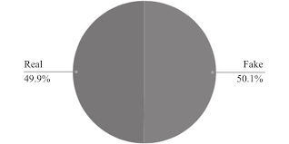
INTRODUCTION
WHAT WE FOUND
50.1%
49.9%
FAKE
NEWS
REAL
NEWS
DATA ON FAKE NEWS CREATED IN INDIA IN 2022

Slide 7
MODULES DESCRIPTION
MODULE FUNNEL
PANDAS
MATPLOTLIB
SKLEARN
NUMPY

Slide 8
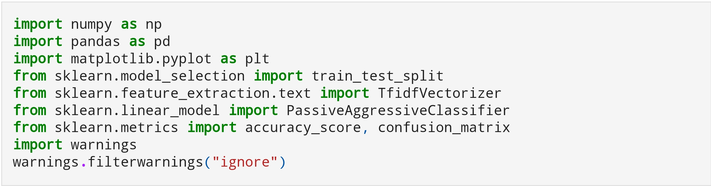
MODULES DESCRIPTION

Slide 9
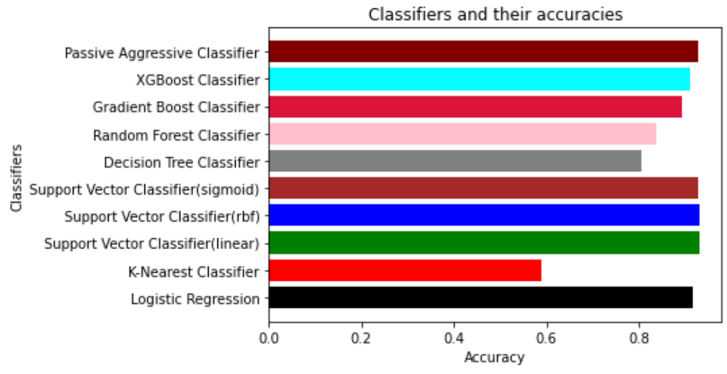
AI FAKE NEWS DETECTION-INFOGRAPHICS
1. This is an example of the output generated by the program when receiving the data and input as to what the operation has to be carried out.
2. Thus providing proof that fake news has been published and provided by the authorities for the world on demand of the government.

Slide 10
CONCLUSION
This is the conclusion of this review and some more information is given in this column.
This project was created to solve the crisis of fake news spreading throughout the media around the world.
To solve this issue, we have created Artificial Intelligence software to enhance the authenticity of the news being projected to the common citizens of our country and all around the world.
Fake news has become a significant challenge in society, but AI can play a crucial role in detecting it. By using natural language processing, machine learning, and tracking sources of information, AI can quickly and accurately identify fake news. However, it is essential to ensure that AI systems are developed without bias and can detect any manipulations. With proper development and implementation, AI can be a powerful tool in the fight against fake news.

Slide 11


