Slide 1
NutriAI - Nutrition Meets Intelligence

Slide 2
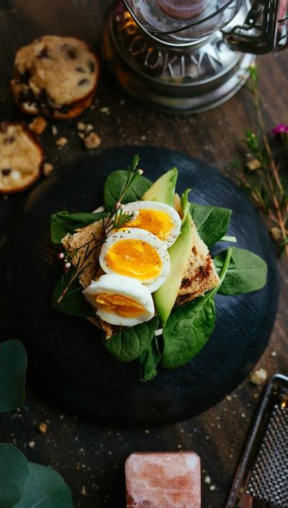
Major Problems in Nutrition
Generic Diet Plans for Everyone
Information Overload
No Continuous Monitoring
Lack of Preventive Healthcare
Unawareness of Nutrient Deficiency

Slide 3

NutriAI – Our Solution
AI-Powered Personalized Diet Plans
Preventive Health Alerts
Smart Nutrient Analysis
Adaptive Tracking & Feedback
Personalized Actionable Guidance

Slide 4

NutriAI - Key Features
AI Chat Assistant -
24/7 availability for queries & simple advice
Gamified Environment - Badges, streaks, and challenges with friends to keep users motivated.
Health Conscious Community - Share progress, recipes, and tips with peers.
Adaptive Health Tracking - Plans change as the user progresses and health data changes.
Personalized Meal Plans – AI-generated customized diet plans based on user profile.
Additional Features:
Health data integration
Food image scanner

Slide 5
Tech Stack
Frontend:(React,js)
Image Recognition (Google Vision API)
AI/ML Model
1
3
5
2
4
6
Backend (Python +Flask)
Database (MongoDB / Firebase)
Deployment

Slide 6
Impact & Benefits of NutriAI
Healthier Lifestyles – Encourages balanced eating and preventive care.
Early Risk Detection – Reduces the chances of lifestyle diseases like diabetes & obesity.
Cost-Effective Health Support – Affordable alternative to expensive dieticians.
Time-Saving Guidance – Instant AI recommendations instead of long consultations.
Community Wellbeing – Promotes a culture of fitness & shared healthy habits.
Scalable for All – Useful for students, professionals, athletes, and even rural areas.

Slide 7
Future Scope
Integration with wearables (Fitbit, smartwatches). Predictive disease risk analysis (diabetes, obesity).
AI chatbot for 24×7 diet advice.
Predictive disease risk analysis (diabetes, obesity).
Community health dashboards for schools/companies.

Slide 8
THANK YOU
TEAM: CODEX
Team Members:
RAJ MANI TIWARI(TL), UTKARSH VERMA, MD AMIN SADIK, SHEHARYAR SHARIQ KHAN

