Slide 1
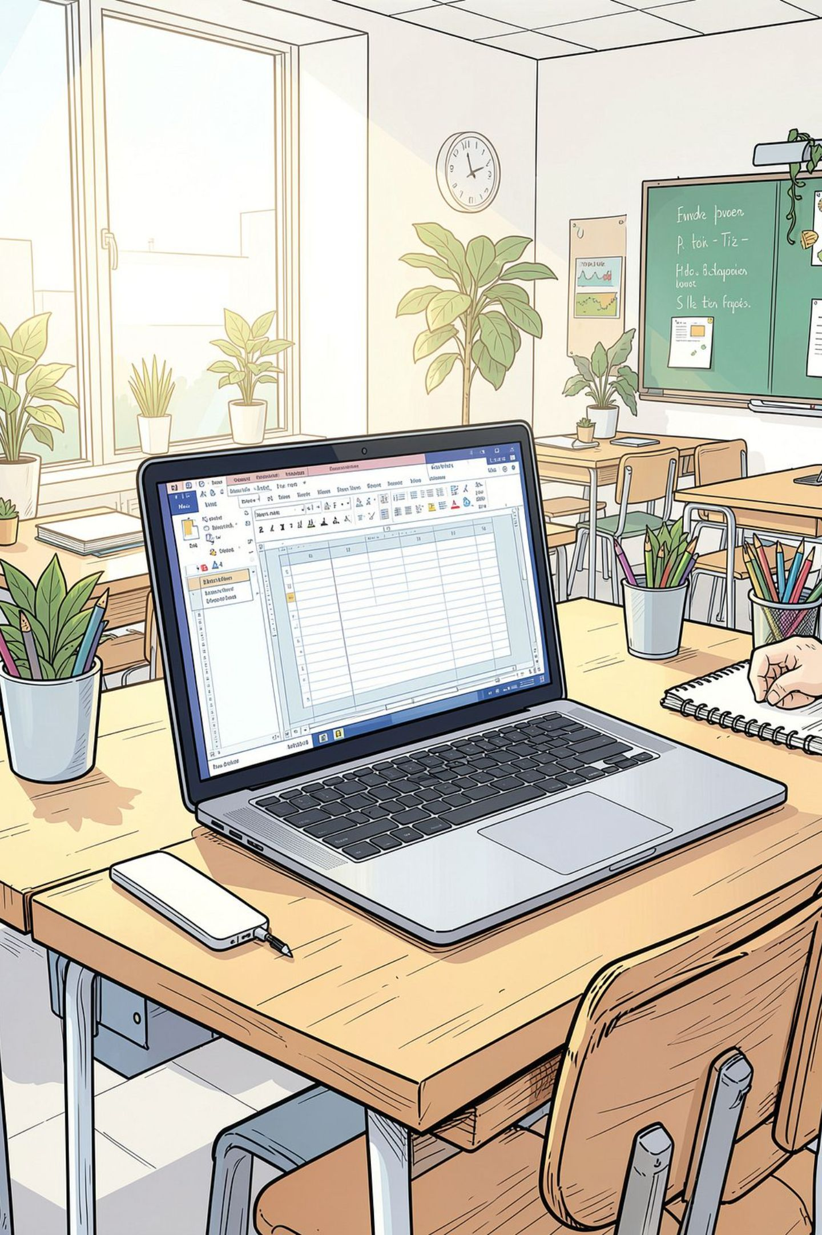
MS Word Workshop — Syllabus & Hands‑On Guide
Practical, step‑by‑step workshop for office staff: opening & saving files, editing, formatting, tables, page layout, tools, printing and shortcuts. Each module pairs short instructions with a live demo — leave space for screenshots where indicated.

Slide 2
Table of Content
Module 1
Module 2
Module 3
Files: Open, Save, Save As, Convert & Export
Editing basics: Type, Select, Cut/Copy/Paste, Undo/Redo
Find & Replace, Using Help, Toolbars & Ruler
Module 4
Module 5
Module 6
Formatting text & paragraphs, styles, bullets
Page layout, margins, headers, breaks
Tables & drawings: insert, edit, formulas
Module 7
Module 8
Tools: Spell check, Mail Merge, Track Changes, Security
Printing, export, shortcuts & wrap‑up

Slide 3
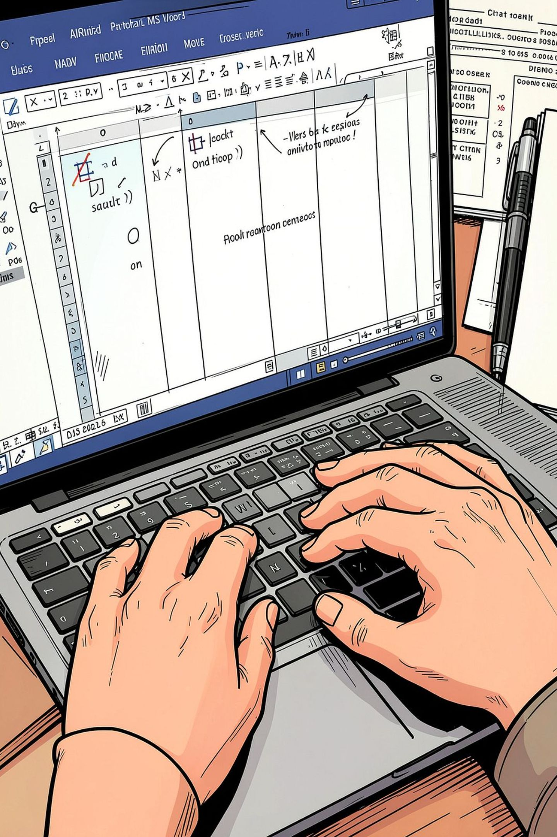

Module 1 — Opening, Saving & File Formats
Quick steps:
Open: File → Open → Browse or Recent files; pin frequently used files.
Save vs Save As: Save updates current file; Save As creates a new copy (choose location & format).
Convert/Export: File → Save As → choose .docx, .pdf, .rtf or older .doc; use Export → Create PDF/XPS for distribution.
Demo: leave space for screenshot of File menu (insert screenshot here).

Slide 4

Module 2 — Editing Essentials
Core editing actions with shortcuts (practice each):
Select text: click + drag, double‑click (word), triple‑click (paragraph).
Cut / Copy / Paste: Ctrl+X, Ctrl+C, Ctrl+V. Use Paste Options to keep source or match destination formatting.
Undo / Redo: Ctrl+Z and Ctrl+Y (or use the toolbar arrows).
Demo: leave space for screenshot of Home ribbon with clipboard (insert screenshot here).

Slide 5
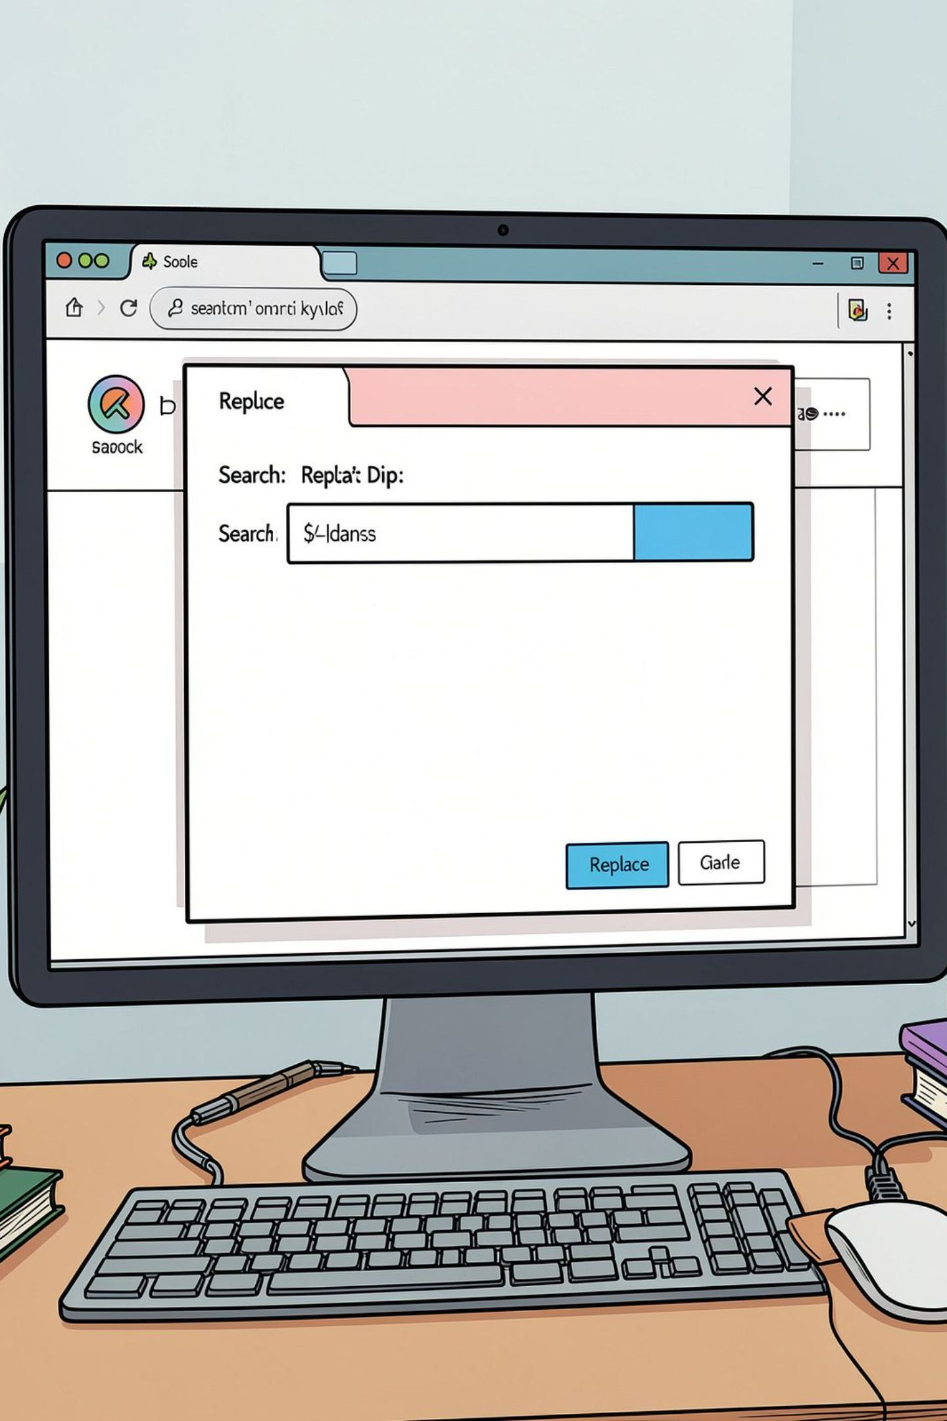

Module 3 — Find, Search & Replace; Toolbars & Help
Practical tips:
Find (Ctrl+F): jump to words, use match case or whole word.
Replace (Ctrl+H): replace single or all instances; use wildcards for patterns.
Toolbars & Ruler: show/hide Ruler from View → Ruler; customise Quick Access Toolbar for frequent commands.
Help: Press F1 or use the Tell me… box for context help and built‑in tutorials.
Demo: leave space for screenshot of Replace dialog and Ruler (insert two screenshots).

Slide 6
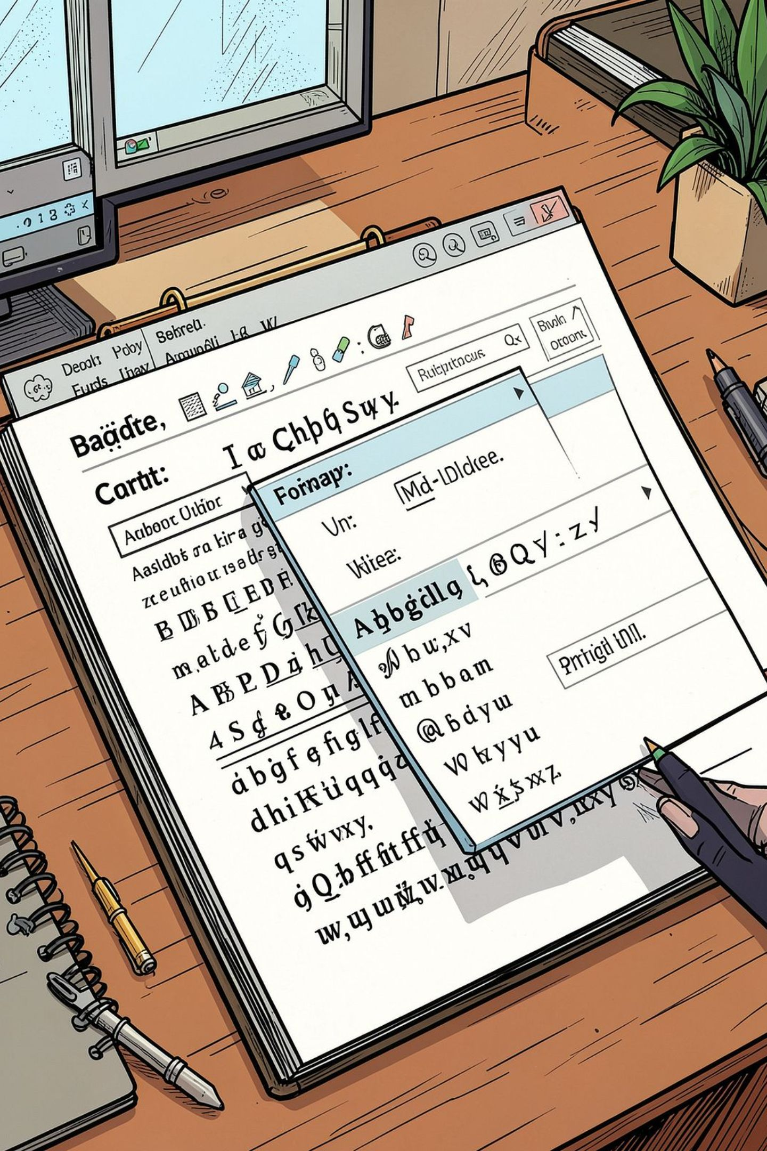
Module 4 — Formatting Text & Paragraphs
Stepwise guidance:
Fonts: select face, size, colour and style from Home → Font. Use theme fonts for consistency.
Emphasis: Bold Ctrl+B, Italic Ctrl+I, Underline Ctrl+U. Change case with Shift+F3.
Highlighting & special symbols: Home → Text Highlight; Insert → Symbol for ©, ®, em dash etc.
Paragraphs: alignment (Left, Centre, Right, Justify), indents, line spacing and spacing before/after. Use the Ruler or Paragraph dialog for precise control.
Styles: Apply and modify Styles for headings and body text — mandatory for consistent documents and TOC generation.

Slide 7
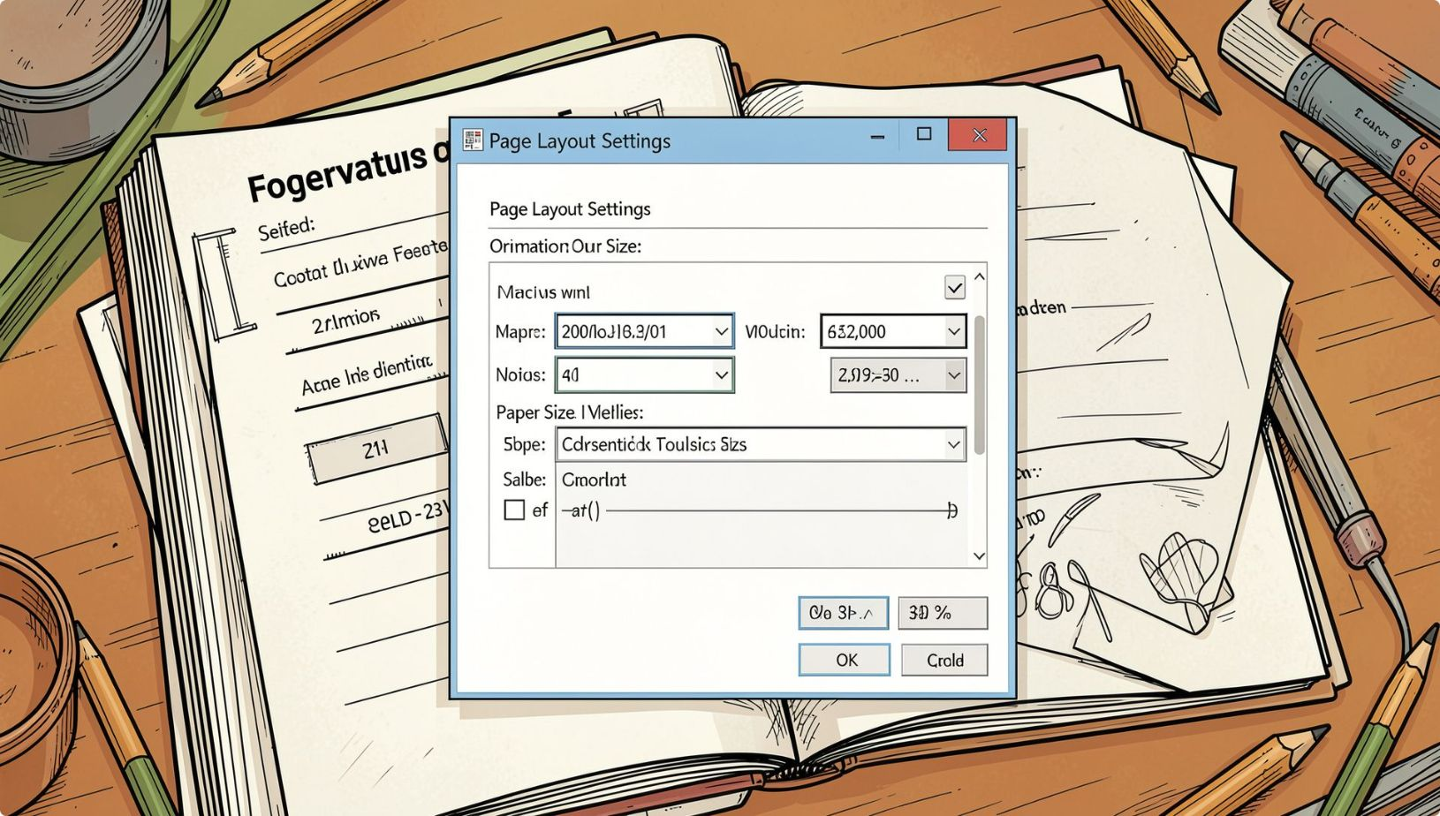

Module 5 — Page & Layout Settings
Essential settings:
Page Setup: Layout → Margins, Orientation, Size. Use custom margins for print requirements.
Headers & Footers: Insert → Header/Footer; add page numbers and document title.
Breaks: Page Break (Ctrl+Enter), Column Break, Section Breaks for differing headers or page orientation.
Border & Shading: Home → Borders or Design → Page Borders for framed documents.
Demo: leave space for screenshot of Page Setup and Breaks menu.

Slide 8
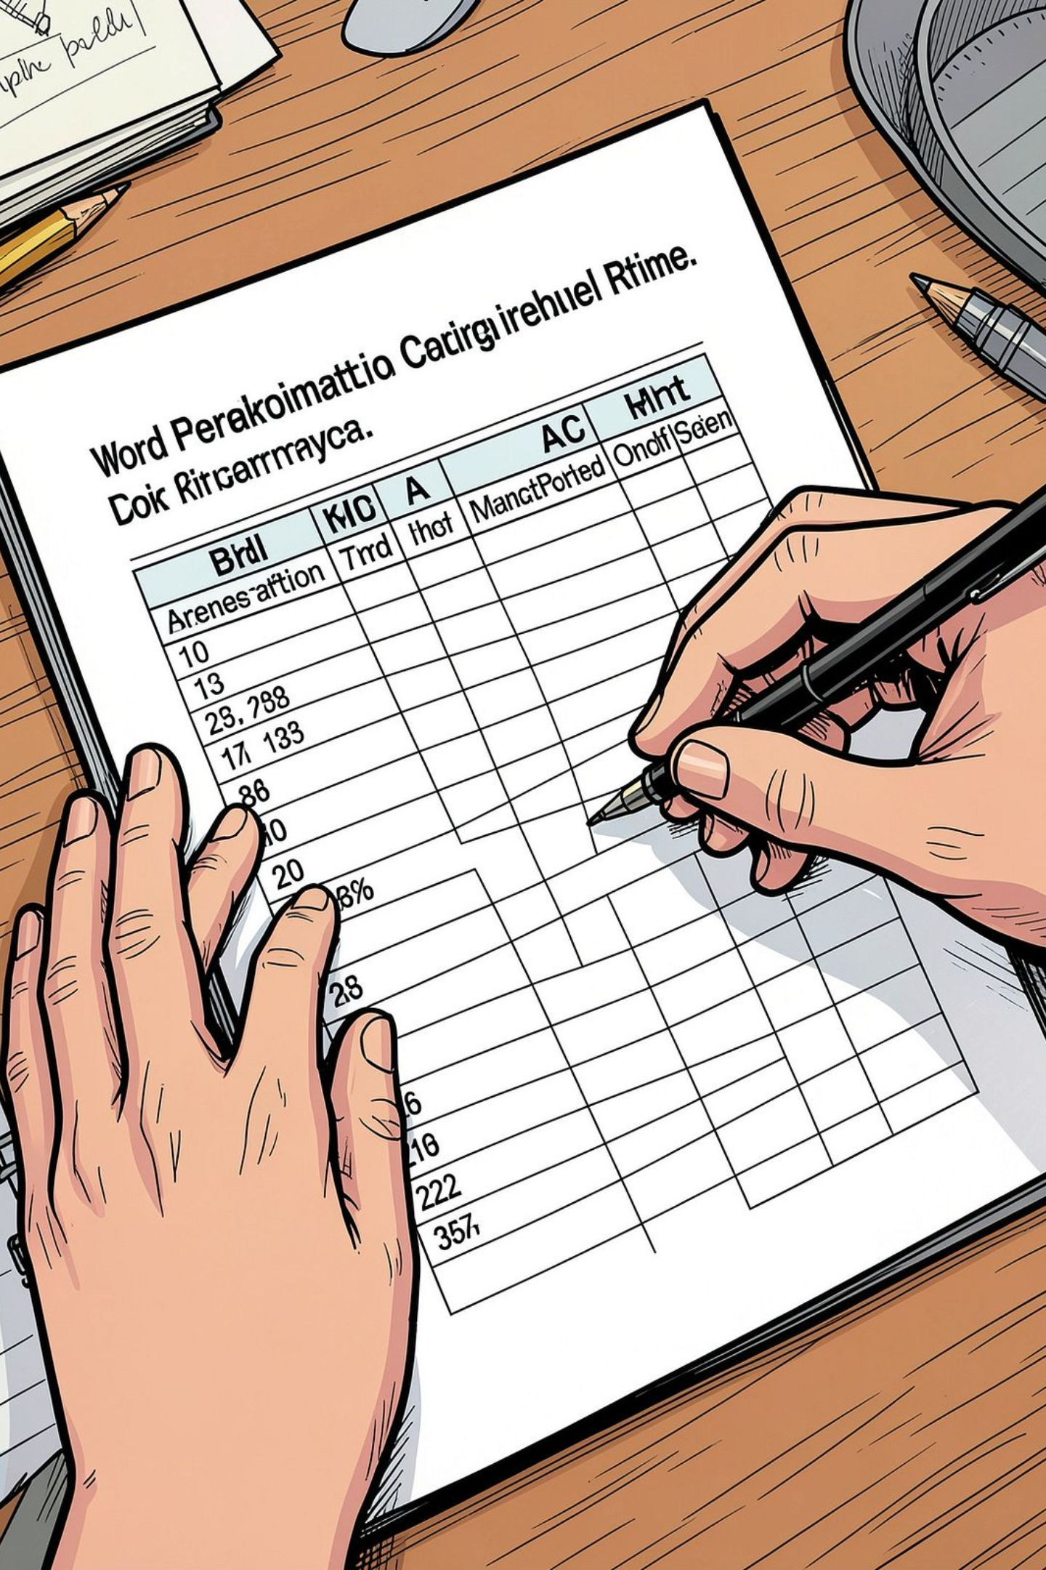

Module 6 — Tables & Drawing
Key tasks for tables:
Demo: leave space for screenshot of Table Design ribbon and sample table (insert screenshot).
Insert table: Insert → Table → drag grid or Insert Table (specify rows/columns).
Editing: insert/delete rows or columns, merge & split cells, adjust column width and alignment.
Borders & Shading: Table Design → choose styles, apply or remove borders for cleaner presentation.
Sorting & Formula: Table Layout → Sort; Formula supports SUM, AVERAGE and simple calculations (use proper cell references).
Drawing & media: Insert → Pictures, Online Pictures, Icons, Shapes; use Wrap Text to position images.

Slide 9
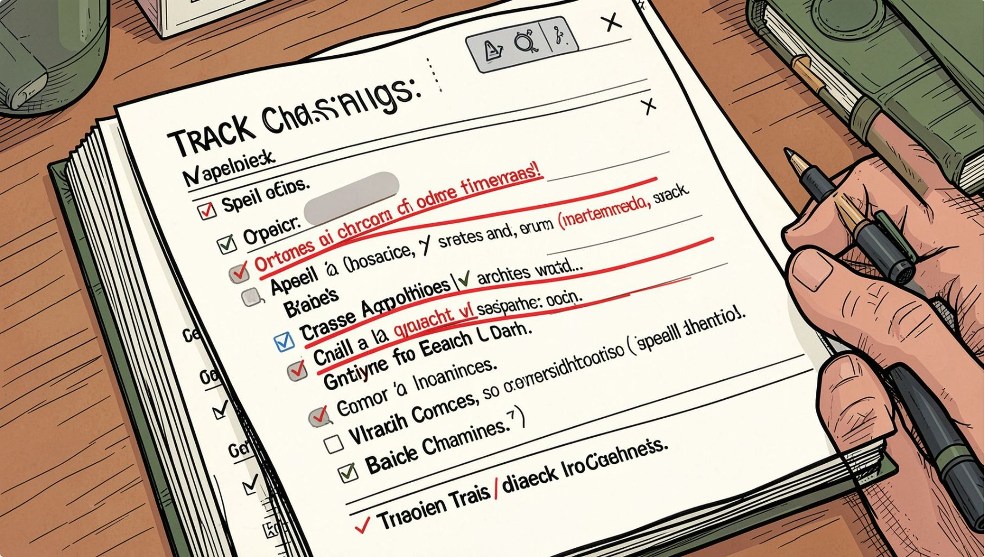

Module 7 — Tools: Proofing, Mail Merge, Track Changes & Security
Practical steps:
Spell & Grammar: Review → Spelling & Grammar or press F7; accept suggestions or add to dictionary.
Track Changes: Review → Track Changes — useful for collaborative edits; accept/reject changes and add comments.
Mail Merge: Mailings → Start Mail Merge → Letters/Emails; select recipients, insert merge fields, preview and finish.
Templates & Security: File → New → choose templates; File → Info → Protect Document to set passwords or restrict editing.
Demo: leave space for screenshot of Track Changes and Mail Merge steps.

Slide 10
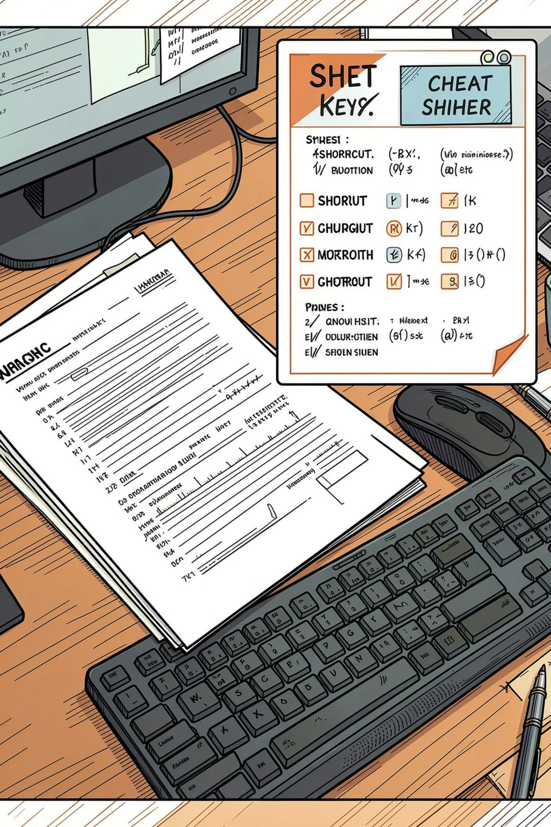

Module 8 — Printing, Shortcuts & Workshop Wrap
Final essentials & cheat sheet:
Print: File → Print — choose printer, pages, copies, print one or multiple pages per sheet; use Print Preview to check layout.
Shortcuts to remember: Ctrl+S Save, Ctrl+P Print, Ctrl+F Find, Ctrl+Z Undo, Ctrl+Y Redo, Ctrl+K Insert hyperlink.
Export & Backup: Save as PDF for final distribution; back up using OneDrive or external drives.
Next steps: practice exercises, deliverables (sample document), Q&A and support resources.
Leave space for final screenshots: Print preview, shortcuts cheat sheet, and sample completed document.

