Slide 1
E-Commerce Product Return Analysis
Who returns products, how often, and which products come
back most
5,000 orders · 2,447 customers · Jan 2024 – Aug 2025

Slide 2
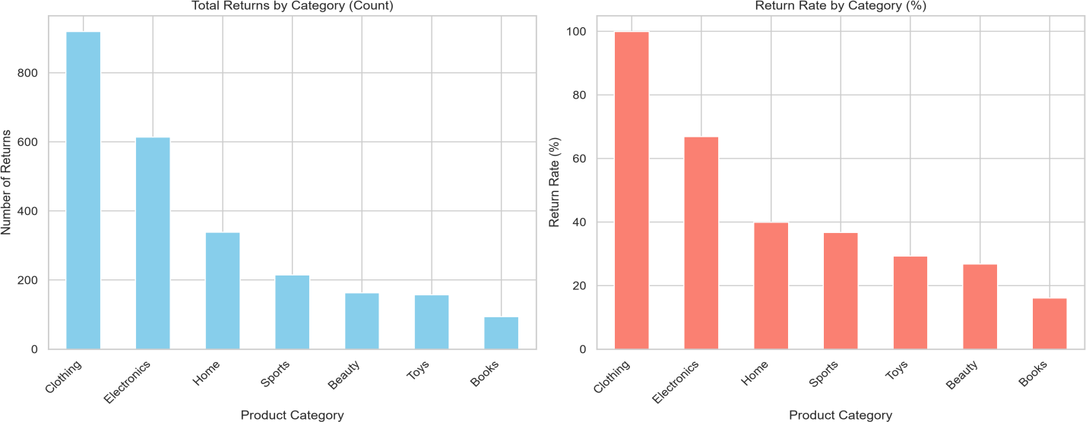
Clothing and repeat returners drive returns
Clothing + Electronics = 61% of all returns. Customers with 3+ earlier returns returned every order (129 of 129).

Slide 3
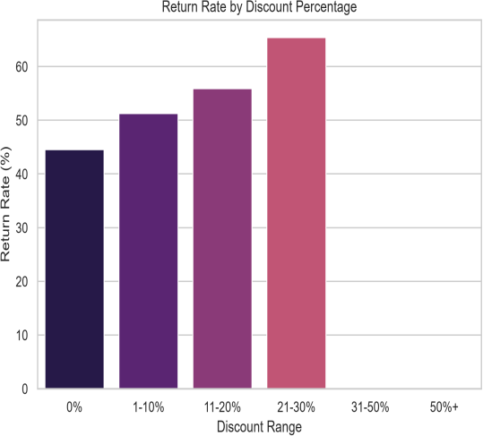
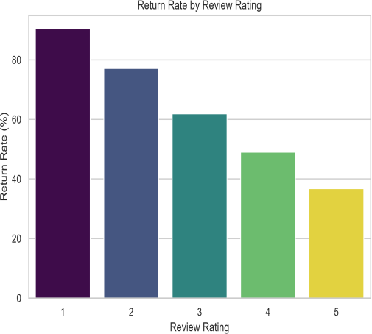
What raises return risk
64%
returned when delivery takes 7+ days
62%
returned for sellers rated ≤3.5 (39% above 4.5)
54%
non-Prime returns vs
45% for Prime
~50%
shipping type, payment, weekday: no effect

Slide 4
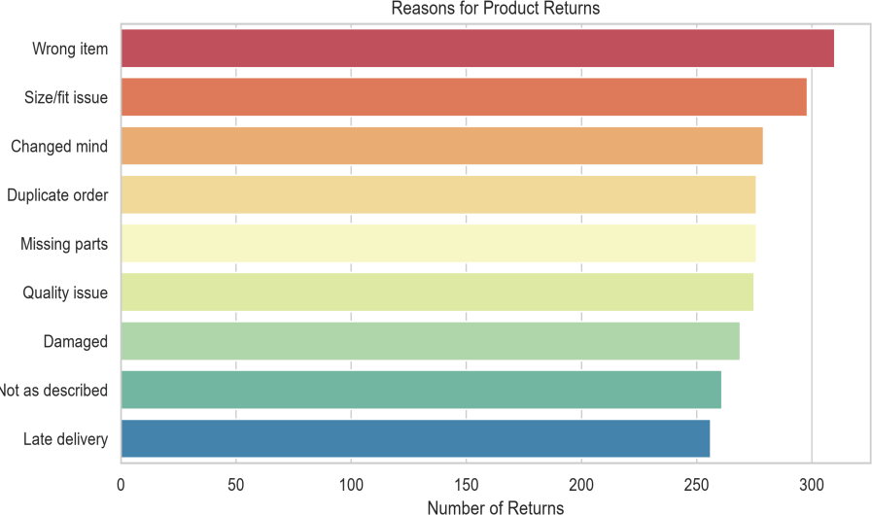
Predictable returns, clear actions
Audit Clothing and Electronics
listings, sizing and quality
Flag repeat returners
2+ past returns: 92–100% return
Rethink deep discounts
63–70% return at 25–30% off
Fix slow delivery and weak sellers
64% at 7+ days; 62% for ≤3.5 rating
r

