Slide 1
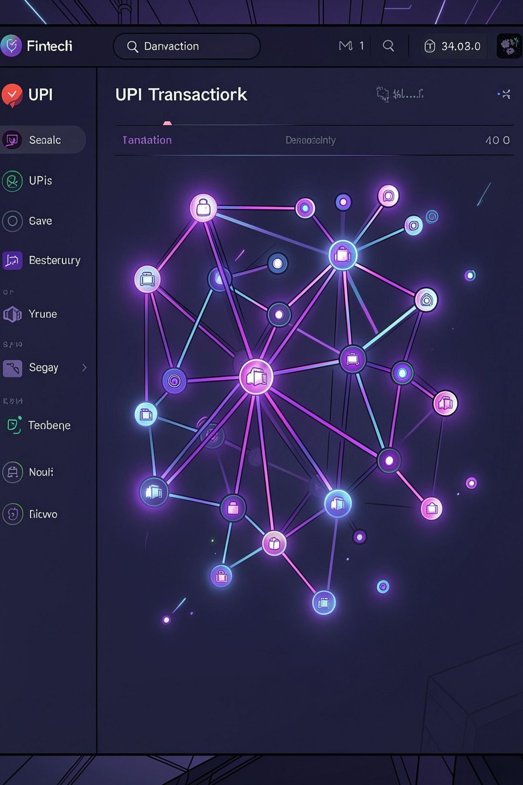

UPI SENTINEL
Intelligent UPI Transaction Fraud Detection & Risk Analytics Platform
Team: DataNexus

Slide 2
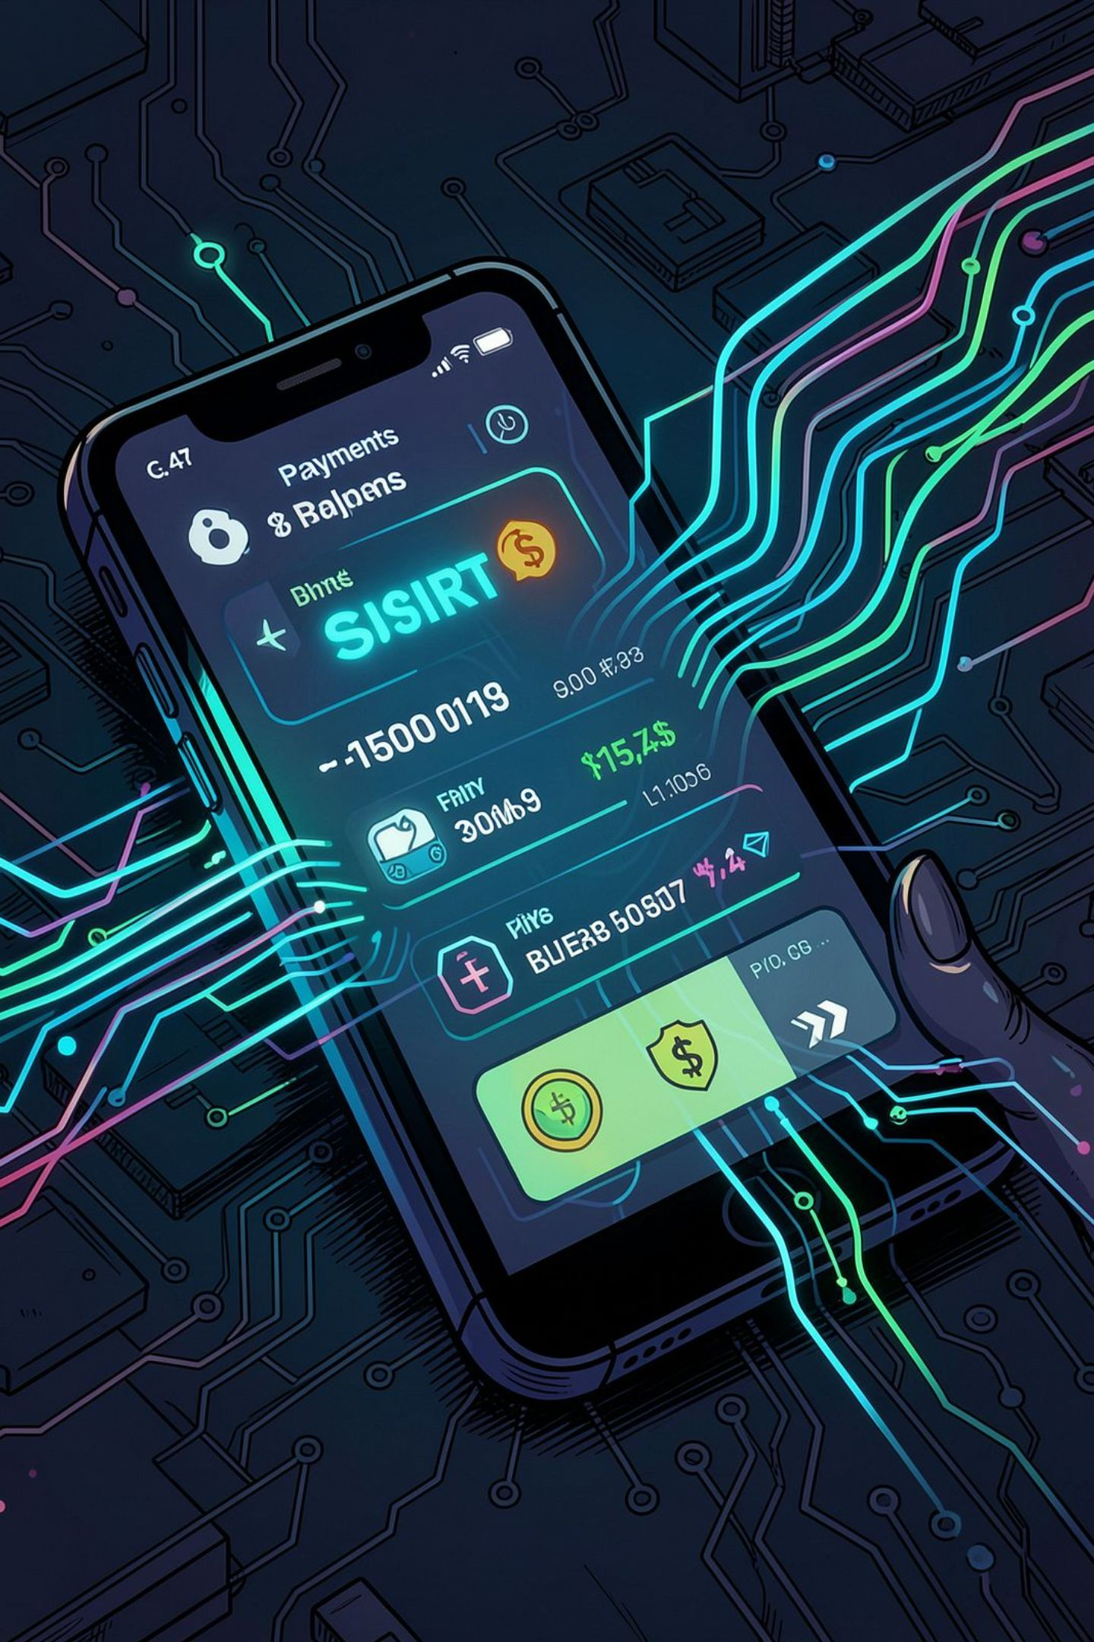
Problem Statement
Digital payments through UPI generate very large volumes of transactions. Manual monitoring cannot scale to the velocity and variety of activity, and fraud can closely resemble legitimate behavior. Investigators need automated risk identification and concise investigative context to prioritize and resolve suspicious transactions quickly.
Rapid growth of UPI transactions creates scale and velocity challenges
Large volumes make manual monitoring impractical
Fraud can mimic normal behavior — detection needs multidimensional context
Investigators require fast, consolidated views to make decisions

Slide 3
Project Objectives
Detect suspicious UPI transactions
Analyze transaction behavior
Identify high-risk users & merchants
Feature-based behavioral analysis across accounts and merchants.
Automated identification of anomalous or high-risk transactions.
Combine signals to flag risky entities for review.
Fuse multiple datasets
Support fraud investigation
Interactive analytics & insights
Transaction, KYC, merchant, and chargeback data used together.
Investigator workflows to examine evidence quickly.
Dashboard-driven exploration and actionable risk outputs.

Slide 4
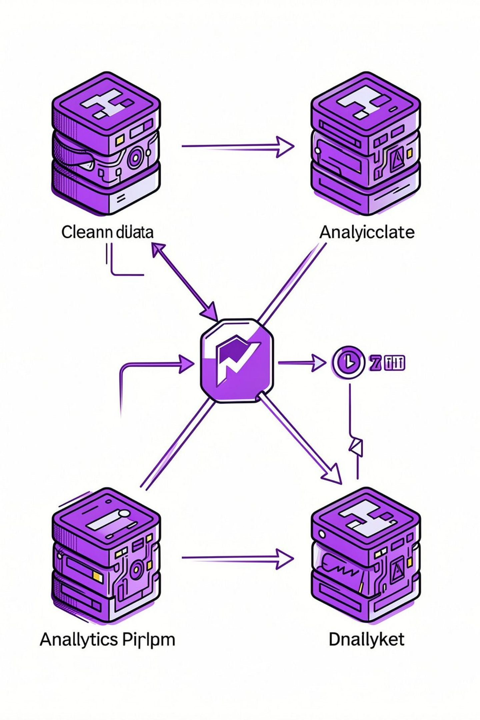
Datasets — Inputs to the Pipeline
UPI Transactions
Primary event stream of payments used for behavioral and pattern analysis. Source file: track1_upi_transactions.csv
Merchant Master
Merchant identity and attributes to contextualize transactions. Source file: track1_merchants_master.csv
KYC Records
User identity and verification details to link behavior to verified profiles. Source file: track1_kyc_records.csv
Chargeback Records
Historical disputes and confirmed fraud signals used as labels and investigative evidence. Source file: track1_chargebacks.json
These sources are joined and validated during preprocessing to create enriched features for risk analysis.

Slide 5

System Architecture — End to End
Data Ingestion
Cleaning & Validation
Feature Engineering
Detection & Investigation
Clear, modular stages allow repeatable preprocessing, explainable feature pipelines, and a separation between detection and human-led investigation.

Slide 6
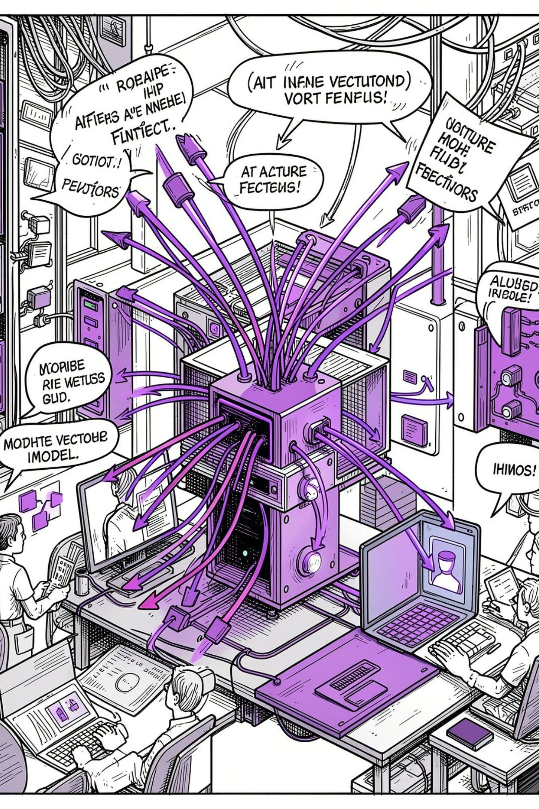

Machine Learning & Risk Detection
01
Feature-based transaction analysis
Engineered features from transactions, KYC, merchant and chargeback signals to represent risk.
02
Suspicious behavior detection
Patterns and outliers identified using supervised and unsupervised approaches where applicable.
03
Risk scoring & classification
Transactions receive risk scores or class labels used for prioritization.
04
Model prediction & evaluation
Model outputs feed investigations. Represented as “Model evaluation metrics” (no fabricated numbers).
Use domain signals (chargebacks, merchant patterns, KYC flags) to improve detection and reduce false positives.

Slide 7
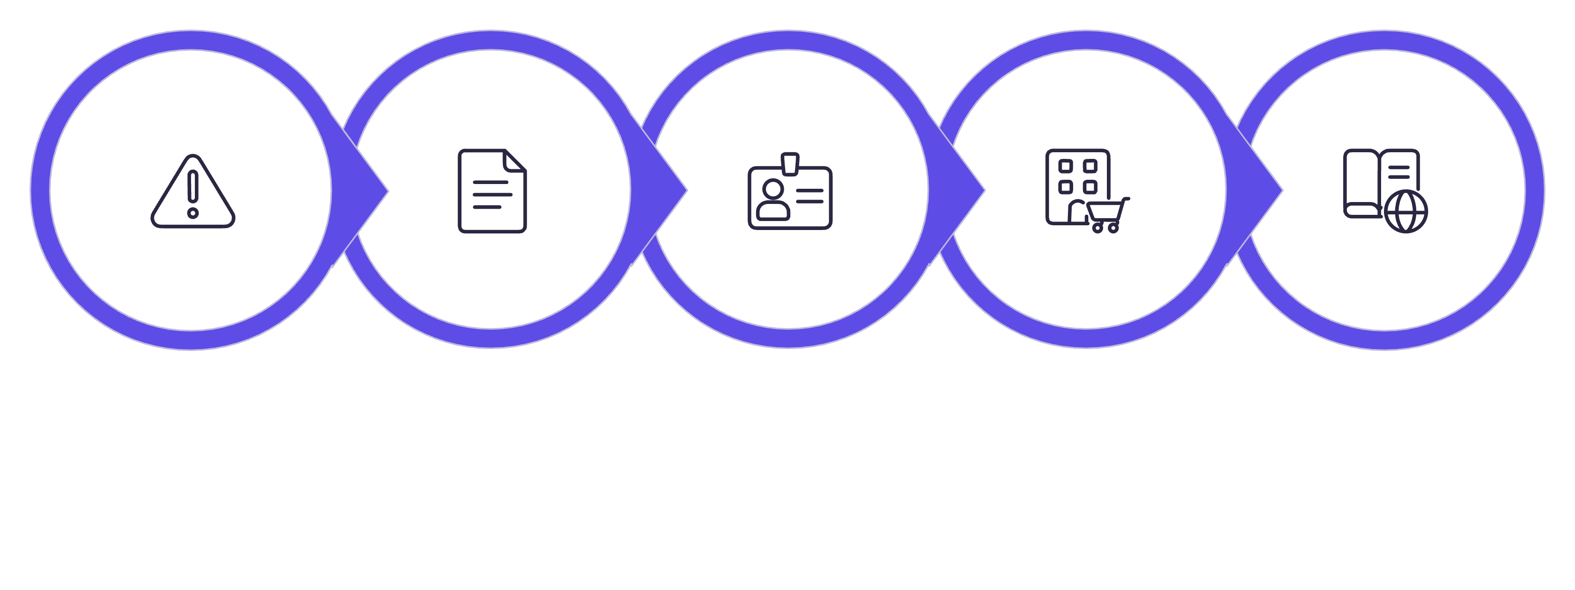
Fraud Investigation Flow
Suspicious Txn
Merchant Info
Txn Details
User / KYC
Hist Behavior
Investigators use a combined view: transaction drill-down, linked KYC profile, merchant context, and past chargebacks. This multi-source evidence reduces ambiguity and accelerates decision-making.

Slide 8
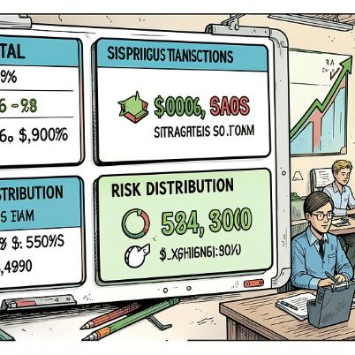
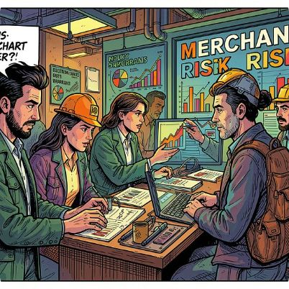
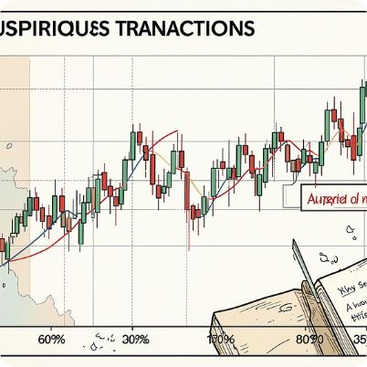
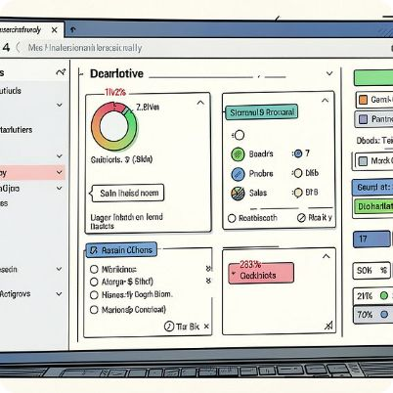
Dashboard & Analytics — Decision Support
Investigation Interface
Case list with priority sorting
Transaction drill-down with linked KYC & merchant tabs
Chargeback evidence and historical behavior panels
Exportable reports and investigator notes
Total transactions
Merchant risk
Transaction trends
Overview of processed volume and throughput.
Heatmap and sortable merchant risk scores for prioritization.
Temporal views for spikes, trends, and seasonality.
Interactive filters
Filter by date, merchant, risk score, KYC flags, geography.

Slide 9


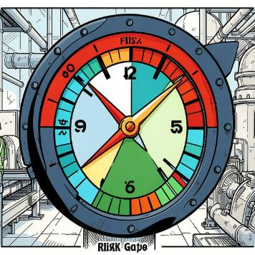
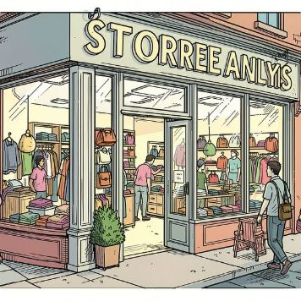
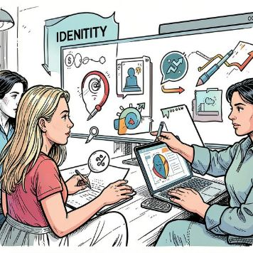

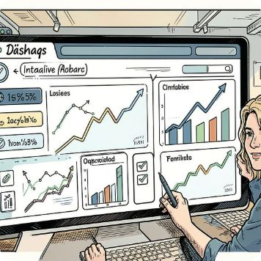

Key Features
Transaction Monitoring
Fraud Detection
Risk Analysis
Merchant Analysis
Continuous ingestion and baseline monitoring of UPI flows.
Automated detection of anomalous and suspicious transactions.
Risk scoring and prioritization for triage.
Merchant-level risk profiling and historical patterns.
KYC Analysis
Chargeback Analysis
Interactive Dashboard
Fraud Investigation
Linking transaction behavior to verified identity records.
Use chargeback history as confirmed fraud signals and labels.
Exploration, filtering, and investigator workflows in one UI.
Case management, evidence aggregation, and decision logging.

Slide 10

Technology Stack
Programming
Data & ML
Application
Python
Pandas · NumPy · Scikit-learn · Machine learning
Streamlit (interactive dashboard & investigator interface)
Visualization
Development
Plotly / Matplotlib (visual analysis and charts)
Git · GitHub
Only technologies actually used in the project are listed above.

