Slide 1


Introduction to XML DTD
XML DTD (Document Type Definition) is a set of rules that define the structure and content of an XML document. It specifies the elements, attributes, and relationships within the XML file, ensuring consistency and validity.

Slide 2
Purpose and Importance of DTD
1
Structural Validation
2
Data Integrity
3
Interoperability
DTD helps maintain the integrity of data by defining the permitted elements, attributes, and their relationships.
DTD facilitates the exchange of XML data between different systems and applications by establishing a common understanding of the document structure.
DTD ensures that the XML document adheres to the defined structure, preventing errors and inconsistencies.

Slide 3
Structure of a DTD
Elements
Attributes
Entities
DTD defines the elements that can be used in the XML document and their hierarchical relationships.
DTD specifies the attributes that can be associated with each element, including their data types and default values.
DTD allows the definition of special characters and symbols that can be used within the XML document.

Slide 4
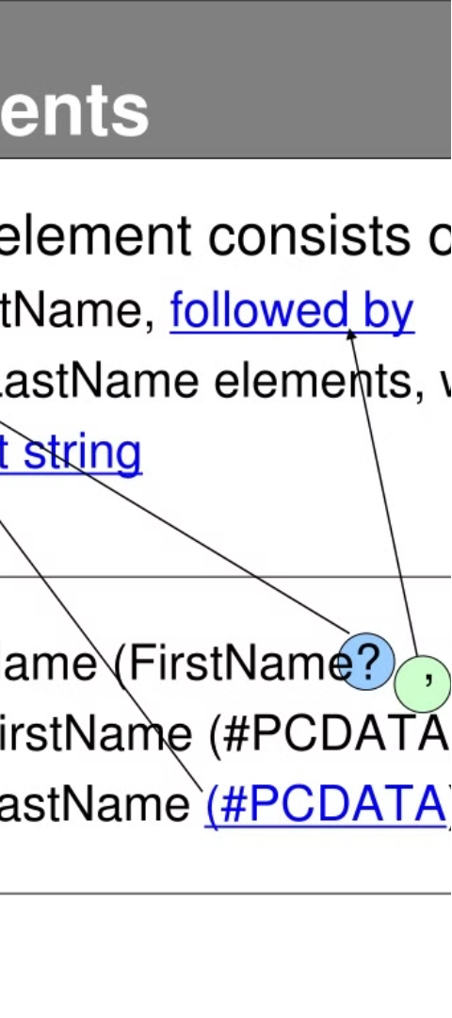
Elements and Attributes in DTD
1
Element Declarations
DTD defines the allowed elements and their content models, specifying whether they are empty, contain text, or other elements.
2
Attribute Declarations
DTD declares the attributes associated with each element, including their data types, default values, and whether they are required or optional.
3
Element Hierarchies
DTD establishes the relationships between elements, defining the parent-child and sibling-sibling connections.

Slide 5
Entities and Notations in DTD
Entities
Notations
DTD allows the definition of special characters and symbols that can be used within the XML document, such as reserved characters like < and >.
DTD can define notations to represent non-XML data types, such as images or audio files, that can be included in the XML document.
Character References
External Entities
DTD enables the use of character references to represent special characters that cannot be directly included in the XML document.
DTD allows the inclusion of external data sources, such as other XML files or external data types, within the XML document.

Slide 6
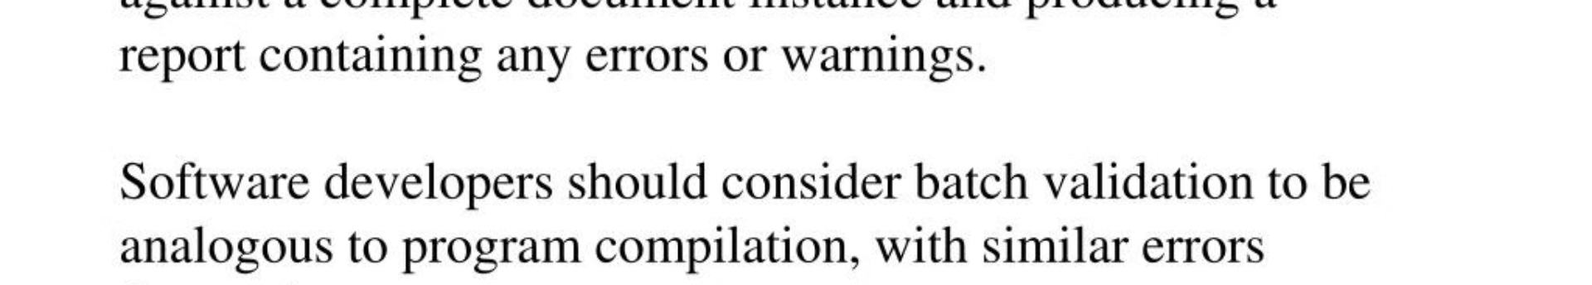



Validation with DTD
Parse DTD
Validate XML
Report Errors
The XML parser reads and interprets the DTD, understanding the structure and rules defined for the XML document.
The XML document is checked against the DTD to ensure that it adheres to the defined structure, elements, and attributes.
If the XML document does not conform to the DTD, the parser will report any errors or inconsistencies.

Slide 7
Advantages and Limitations of DTD
Advantages
Limitations
Ensures data consistency and integrity
Limited support for data types and constraints
Facilitates document exchange and interoperability
Complexity in defining large or complex document structures
Simplifies parsing and processing of XML documents
Lack of namespace support and namespace-based validation
Provides a clear and standardized way to define document structure
Difficulty in maintaining and updating DTDs over time

Slide 8




Conclusion and Future Trends
Evolving Standards
Schema-based Validation
Cloud-based Validation
Continuous Development
XML and DTD standards continue to evolve, addressing limitations and introducing new capabilities.
XML Schemas (XSD) are gaining prominence as a more powerful alternative to DTD for defining XML document structure.
Online XML validation services and cloud-based tools are making it easier to validate XML documents against DTDs.
The XML ecosystem continues to evolve, with new technologies and approaches emerging to enhance XML data management and processing.

