Slide 1

IPL DATA ANALYSIS
using MySQL
Royal Challengers Bangalore — Performance, Strategy & Insights
Presented by: Utkarsh Chandra
PLAY BOLD

Slide 2
INTRO
Introduction & Objectives
Project Overview
Key Objectives
This project involves an in-depth SQL-based analysis of Indian Premier League (IPL) cricket data focused on Royal Challengers Bangalore (RCB).
The database spans multiple seasons and captures ball-by-ball data, player statistics, match outcomes, and venue information.
Both objective and subjective questions are answered using advanced SQL techniques including CTEs, Window Functions, JOINs, and Subqueries.
Analyse batting, bowling & team performance
Calculate KPIs: Strike Rate, Avg Runs, Win %
Build RCB win-loss record across venues
Identify all-rounders & consistent performers
Evaluate toss impact on match outcomes
Recommend players for the mega auction
Suggest strategy improvements for RCB

Slide 3
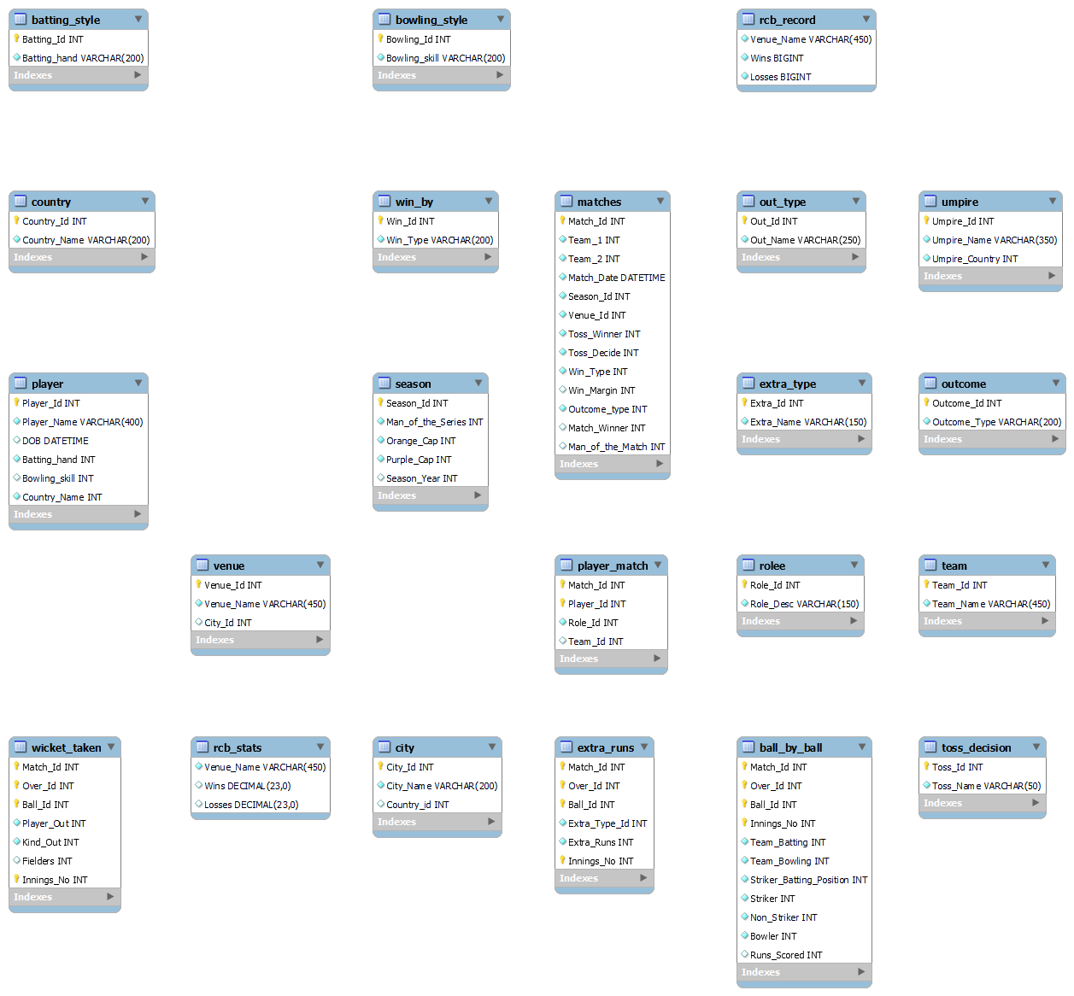
DATABASE
Database Schema
RCB

Slide 4
METHOD
Methodology & SQL Approach
01
Data Extraction
Used SELECT + JOINs to combine Ball_by_Ball, Matches, Player, Season, Venue, Wicket_Taken, and Extra_Runs tables for comprehensive analysis.
02
Aggregation with CTEs
Common Table Expressions (CTEs) used to break down complex queries — computing runs, wickets, innings counts, and seasonal data step-by-step.
03
Window Functions
LAG() used for year-over-year performance comparison. ROW_NUMBER() / DENSE_RANK() used to rank players by wickets, runs, or strike rate.
04
Conditional Logic
CASE statements used to classify performance as Improved / Declined / Same and to calculate wins, losses, and no-results per venue.

Slide 5
BATTING
Key Analysis — Batting Performance
RCB Total Runs Scored
21,547
Indian Top Scorer
Virat Kohli
Overseas Top Scorer
Chris Gayle
Win % (Overall)
12.15%
★ Strike rate, batting average & total runs are primary selection parameters for batsmen

Slide 6
BOWLING
Key Analysis — Bowling Performance
RCB Total Wickets Taken
770
Indian Top Wicket-Taker
YS Chahal
Overseas Top Wicket-Taker
DW Steyn
Top Death Over Bowlers
D Christian, M Tiwary
★ Right-arm fast bowlers take the most wickets across all seasons in the IPL dataset

Slide 7
TEAM
Team Performance — RCB Season-Wise
Home: 32 matches, 16 wins (50%) | Away: 31 matches, 14 wins (45%) | RCB: 9 wins in 2013 season

Slide 8
KPIs
Visual Insights — RCB Phase-Wise KPIs
Phase Breakdown
Powerplay
Runs: 6,056 Wickets: 201
Middle Overs
Runs: 9,463 Wickets: 293
Death Overs
TOTAL RUNS: 21,547 WICKETS: 770
Runs: 6,460 Wickets: 276

Slide 9
PLAYERS
Key Players: All-Rounders & Top Performers
Top All-Rounders (Runs & Wickets across all Seasons)
SR Watson
RA Jadeja
KA Pollard
Elite All-Rounder
Wicket Machine
Power Hitter
Runs: 1,315 | Wickets: 91
Runs: 670 | Wickets: 101
Runs: 1,320 | Wickets: 44
AD Russell
SK Raina
DR Smith
Match Winner
Run Machine
Batting Anchor
Runs: 527 | Wickets: 66
Runs: 1,844 | Wickets: 16
Runs: 1,707 | Wickets: 25

Slide 10
Player All Rounder
All Rounder

Slide 11
STRATEGY
Strategic Insights — Toss & Venue Impact
Key Findings
▶ Toss gives moderate advantage not decisive
▶ Fielding first preferred at most venues (dew factor)
▶ Feroz Shah Kotla favors batting first
▶ Chinnaswamy: field first wins 55% of the time
▶ No universal optimal toss strategy across venues
▶ Team performance still drives outcomes more than toss

Slide 12
Strategic Insights — Mega Auction Recommendations
AUCTION
Strategic Insights — Mega Auction Recommendations
AUCTION
1
Strengthen the Bowling Attack
4
Reduce Dependency on Big Names
Prioritize death-over specialists with low economy. Target wicket-taking spinners suited to Indian pitches.
Avoid overspending on overseas stars with inconsistent IPL records. Prioritize proven Indian condition performers.
2
Invest in All-Rounders
Focus on young Indian all-rounders who contribute with both bat & ball. Add power hitters in lower order.
5
Smart & Cost-Effective Buys
Target undervalued players with high potential. Maintain budget flexibility for auction bidding wars.
3
Build a Strong Middle Order
Address collapse vulnerability. Look at domestic SMAT performers with consistency and good strike rates.
IPL Data Analysis | Utkarsh Chandra | MySQL Project
RCB

Slide 13
Conclusions & Key Takeaways
Bowling Weakness
Over-Reliance on Key Players
RCB's recurring issue is death-over bowling — this is the primary area requiring immediate attention and investment.
Heavy dependence on Kohli & de Villiers historically hurt the team. Squad depth and balance are critical.
Home vs Away
Toss is not Destiny
RCB performs marginally better at home (50%) vs away (45%), indicating the home advantage is not strongly capitalized.
Toss provides a contextual edge but does not guarantee victory. Execution and adaptability matter more.
All-Rounders are Assets
Data-Driven Auctions
Players like Watson, Jadeja, and Russell provide dual-value. More all-rounders improve strategic flexibility.
Combining SQL analytics with contextual cricket knowledge leads to smarter, balanced squad selection.

