Slide 1
Upcycle Compass
One by-product batch, one protein target: Go, No-go or Test-first, and what to test next
TEAM [Team name]
PROBLEM STATEMENT 02 · Upcycling India's By-products for Alternative Proteins
MEMBERS [Member names]
Notes:
About 10 s. "We are [team]. Upcycle Compass takes one food by-product batch and one protein target, and answers Go, No-go or Test-first, with the evidence behind it and the test to run next."

Slide 2
The Problem
A mill owner or plant-protein R&D head cannot quickly tell whether one oilseed-cake batch is safe for food, what processing it needs, what a kg of its protein would cost against imported pea isolate, and what to test first.
~90%
47%
₹518
of plant-protein ingredients used in India are imported
of 118 Indian groundnut-cake samples met ≤ 20 ppb aflatoxin B1 (feed grade)
per kg protein: modelled landed cost of imported pea isolate (range ₹431 to ₹619)
PBFIA via Agron Food Processing · published
Murugeswari 2023 · published
Our pea scenario · assumed, grade D
Why it hasn't been solved
AI food platforms chase novel molecules, not commodity by-products
Safety, processing and cost are studied separately, often per kg product, not per kg protein
Lot data is scarce: most numbers are literature ranges, not this batch
Impact if solved
Mills can offer cake to food buyers, not only as feed
Brands get a local protein option priced per kg protein against pea
Labs test in the right order: safety first, failing lots diverted early
Notes:
About 25 s. "Indian plant-protein brands import roughly nine-tenths of their protein ingredients, mostly pea isolate, exposed to the exchange rate and to anti-dumping action in the EU and Canada. Oilseed cake, the solid left after pressing oil, is sold as feed. In one Indian survey fewer than half of 118 groundnut-cake samples met 20 ppb aflatoxin. The problem is not a lack of protein; nobody can quickly tell a mill owner whether this batch is safe, what it would cost, and what to test first." Do not quote '>25 Mt oilseed cake' unless checked on FAOSTAT.

Slide 3
Our Solution
1
What it does
2
Target customers
In: one batch (lab values, lot records) + one protein target
Out: GO / NO-GO / TEST-FIRST, with safety, technical, cost and evidence shown separately
Plus candidate routes, ₹/kg protein vs imported pea, and the test to run next
Oil mills selling cake at feed prices
R&D heads at Indian plant-protein brands hedging pea imports
Labs, institutes and incubators choosing which pilots to fund
3
Scale-up in the next 6 months
4
Resources we need
Month 0–1: safety assays on 3–5 food-grade lots
Month 1–4: bench trials of 2 routes; sensory and functional tests
Month 4–6: ≈10 t pilot run; re-run on measured data; customer samples
A food-grade oil mill and an accredited (NABL) lab
A brand willing to test samples, and a pilot-plant slot
Budget set from lab quotes (the tool will not guess it)
Notes:
About 25 s. "Upcycle Compass takes one by-product batch and one protein target (Protein Rich Flour, Concentrate or Isolate) and says Go, No-go or Test-first. Safety, technical fit, cost and evidence quality are shown separately, so a good price can never hide a safety gap. We answer Problem Statement 2: higher-value food use for Indian by-products. Our users are mills, plant-protein brands and the labs and incubators that fund pilots. In six months we want safety assays on real lots, bench and sensory trials, then a pilot run."

Slide 4
The Model
Batch + target
lab values, lot records, protein target
Safety gates
G1–G7, measured evidence only
Diagnosis
what blocks this use
Candidate routes
extrusion, phytase, alkaline extraction
Mass balance + cost
₹/kg protein vs landed pea
Decision
verdict, readiness, next test, 6-month plan
Data used
36 cited sources; 75 research records; 8 functional properties
Every value tagged measured, published, assumed or synthetic, with grade and source
Inputs as ranges, sampled 8,192 times (Sobol quasi-Monte Carlo)
AI and what makes it different
A probabilistic decision engine, not a chatbot
The LLM (Amazon Bedrock) only parses text and explains; a verifier rejects any number not in the engine output
Safety first, priced per kg protein, and says what it does not know
Results
5 presets, each analysed in about 0.2 s
170 automated tests pass
Offline: 10 stamped snapshots, English and Hindi
One lab value changes the verdict (lead 1.6 mg/kg → NO-GO)
Built with Python, NumPy, SciPy, FastAPI, Pydantic, React + TypeScript and SQLite; Amazon Bedrock as the optional LLM, with a fixed template as fallback.
Notes:
About 25 s. "Under the hood is a Python engine, not a chatbot. It applies safety gates first, then looks at which treatment routes the evidence supports for this material, then computes protein mass balance and cost per kg of protein. Every number carries a tag (measured, published, assumed or synthetic) with its source. The language model on Amazon Bedrock only turns your description into a form and writes a plain summary; a verifier rejects any sentence with a number the engine didn't produce, and a fixed template is the fallback."

Slide 5
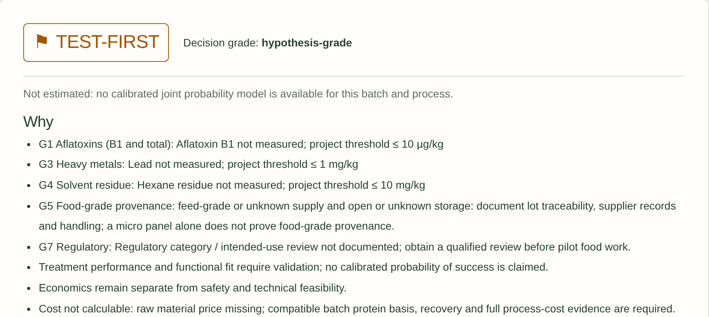
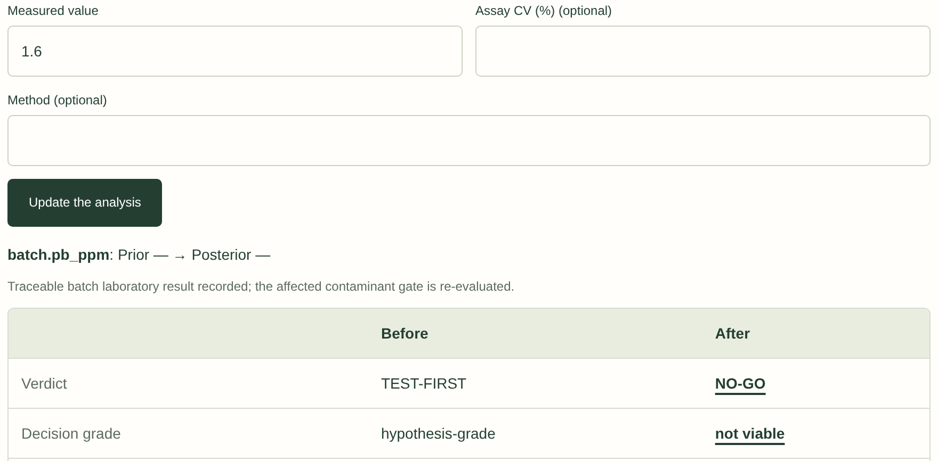
Prototype Demo
1
Sunflower → Protein Rich Flour: TEST-FIRST
2
One lab result (lead 1.6 mg/kg) turns it into NO-GO
Run a preset
7 contaminant checks unmeasured, so no bars are drawn and nothing is invented
Read the evidence
8 functional properties vs the pea study; pea lands ≈ ₹518/kg protein; our cost stays 'not calculable'
Enter a lab result
Lead 1.6 mg/kg (limit 1.0) → NO-GO, before and after; 0.4 keeps TEST-FIRST
Real screenshots from the running prototype (engine 0.8.0), not mock-ups. Live demo on the team laptop; stamped offline snapshots if Wi-Fi fails. Demo video: [attach the ≤ 2-minute video here].
Notes:
About 90 s live (the template suggests 35 s; we use the spare time from the 4 minutes). Driver follows docs/pitch/DEMO_SCRIPT.md. "Here is a real use: sunflower cake, to make a protein-rich flour. The answer is Test-first, and the screen says why: aflatoxin, metals, hexane, food-grade records and regulatory review are unmeasured. It doesn't draw a bar for a number it doesn't have. Imported pea isolate lands at about 518 rupees per kg of protein in our scenario; we don't claim to beat it until yields and quotes are measured. Now the lab sends one result: lead at 1.6 mg/kg. The verdict flips to No-go, before and after side by side. Measure, update, decide." If the live demo fails, play the video.

Slide 6
Data and Assumptions
Source | Label
Team final oilseed-cake review (composition, treatments, functionality) | Published · 30 values, 40 rows
Qi et al. 2025, pea protein isolate (80.2% protein) | Published · reference
Murugeswari 2023, aflatoxin B1 survey (118 groundnut-cake samples) | Published
Pea isolate prices (Tridge, IndiaMART), USD/INR, HS 3504 tariff | Published · ranges
Project contaminant limits (7 analytes) | Assumed · internal settings
Freight, duty mode and price scenarios | Assumed · scenario switches
Batch and lab results entered by the user | Measured · none in presets yet
Demo and test values | Synthetic · cannot clear a gate
Organiser datasets: FAOSTAT, IFCT 2017, USDA FDC, FooDB, Open Food Facts, AGMARKNET, data.gov.in | Listed · no values drawn yet
Key results
Sunflower → Protein Rich Flour: TEST-FIRST, 9 candidate routes
Pea isolate landed ≈ ₹518/kg protein (₹431–619)
Lead 1.6 mg/kg → NO-GO
Limits of our data
Ledger: 161 missing, 41 assumed, 37 to verify
Many values are review-reported (secondary)
PhD proximate report withheld pending permission
Error and uncertainty
Inputs carry P10–P90 ranges
P(GO), P(spec) and value of information withheld until calibrated
Missing yield → cost 'not calculable', never guessed
Notes:
About 20 s. "Every value is tagged. Our published values come from the team's oilseed review, the pea isolate paper and cited price sources; contaminant limits and scenarios are assumptions we show openly. The organiser datasets are listed but no value has been drawn from them yet. The ledger lists 161 missing values, which is why most answers today are Test-first. Uncalibrated probabilities are withheld rather than shown."

Slide 7
Projected Impact
1
Aims to replace
Part of the ~90% imported plant protein in Indian products, starting with flour- and concentrate-tier uses
2
Optimises
The testing order: safety assays first, so failing lots are diverted before money goes into trials
3
Market
Plant-protein ingredient market expected to grow from ₹4,500 to ₹9,000 crore in five years (PBFIA)
4
No new harm
Only measured values clear safety gates; failed lots stay in the feed chain
The bar a local oilseed protein must beat. Scenario model (tagged assumed, grade D) from Tridge prices, USD/INR and the HS 3504 duty.
Projection, not a result: no cost saving is claimed until yield and process costs are measured in the pilot.
Notes:
About 20 s. "Today the bar to beat is imported pea isolate at about 518 rupees per kg of protein, rising to around 650 if the pea price goes up 25%. We aim to replace part of that import, starting with flour and concentrate uses, and to make testing cheaper by putting safety assays first so failing lots are diverted early. It causes no new harm: only measured values clear safety gates, and failed lots stay in the feed chain. We claim no saving until the pilot measures yield and cost."

Slide 8
Limitations and Next Steps
What the prototype cannot do yet
Predict yield, protein recovery or our own ₹/kg protein: no measured process data yet
Give calibrated probabilities (P(GO), P(spec)) or value of information
Approve food safety or regulation: limits are project settings to be reviewed
Draw on the organiser datasets yet; Hindi and voice need real-user review
If the model is wrong
Safety gates accept only measured values; assumed or synthetic data cannot clear them
The LLM cannot change numbers; a fixed template is the fallback
The first test we will run
3–5 lots of sunflower cake from food-grade mills:
Aflatoxin B1 and total aflatoxins (HPLC)
Lead, cadmium, arsenic and mercury (ICP-MS)
Hexane residue, if any solvent route was used
Measured ingredient yield and protein recovery
Then check how often the measurements fall inside the engine's predicted ranges (calibration coverage).
What we need: a food-grade oil mill, an accredited (NABL) lab and a brand to test samples.
Notes:
About 15 s. "We know where the tool stops: it cannot yet predict yield or our own cost, give calibrated probabilities, or approve safety. If it is wrong, the safety gates still need measured values, and the AI cannot change a number. Our first experiment: three to five food-grade sunflower-cake lots, assayed for aflatoxins, metals and hexane, with measured yield, then we check the engine's ranges against the results." Close: "We need a food-grade mill, an accredited lab and a brand to test samples. Thank you."

Slide 9
References (1/2)
Team documents (unpublished; cited, not shared)
Team review, cold-pressed oilseed cakes (final draft) [P · secondary]
Team research plan, 5 Aug 2026 [P]
Team research evidence matrix, 25 Oct 2026 (75 records) [cited]
Project contaminant acceptance limits, 24 Oct 2026 [A]
R. O. Mathur, PhD progress report (LoR, proximate) [withheld]
Papers and reviews
Qi et al. 2025, functional properties of pea protein isolate [P]
Murugeswari 2023, aflatoxin B1 in Indian feed materials [P]
Singh et al. 2022, protein from oilseed cakes [context]
Detoxification of groundnut meals, Nature 1966 [context]
El-Kady & Farghaly, aflatoxin inactivation by heat [context]
Market, trade and prices
PBFIA via Agron: ~90% imported; ₹4,500 → 9,000 crore [P]
GFI India orphan-crops whitepaper (vegconomist) [context]
Tridge: pea protein export prices, China [P]
USD/INR quotes (banklive.net) [P]
India tariff HS 35040099 (eximpe.com) [P]
IndiaMART pea protein isolate listings [P]
IndiaMART oilseed-cake trader listing [A]
EU provisional anti-dumping duties, Chinese pea protein [cited]
Canada CBSA pea protein measures [context]
Expana Plant-Based Protein Report, March 2026 [context]
Labels
P published · A assumed · M measured · S synthetic. Organiser datasets: next slide.
Notes:
Not presented; the jury checks it. Labels: P published, A assumed, M measured, S synthetic. Click every link in the exported PDF before submitting.

Slide 10
References (2/2)
Organiser datasets (listed; no values drawn yet)
FAOSTAT
IFCT 2017 via @nodef/ifct2017
USDA FoodData Central
USDA FoodData Central downloads
FooDB
Open Food Facts
AGMARKNET
data.gov.in: mandi daily prices
data.gov.in: variety-wise daily prices
Code and data
Upcycle Compass repository [make public first]
Open data pack: linked in the app footer
AI tools
Amazon Bedrock, model [fill in BEDROCK_MODEL_ID] [optional LLM]
Groq [optional alternative]
Claude Code (Anthropic), AI coding assistant [built the code]
Web Speech API (browser speech input)
BHASHINI [not used]
Software
FastAPI, Starlette, Uvicorn, Pydantic
NumPy, SciPy, pandas
boto3 (AWS SDK for Python)
React 18, TypeScript, Vite
Tailwind CSS
TanStack Query, Zustand, React Hook Form, Zod
Radix UI, i18next
pytest, Hypothesis, Vitest, Playwright, axe-core
Notes:
Not presented; the jury checks it. Fill in the Bedrock model id from the demo laptop's .env. The repository is private: make it public or remove the link.

Slide 11
Thank You
Notes:
Keep on screen during questions. Q&A answers: docs/pitch/QA.md. Export the deck as PDF and submit between 6:00 and 8:00 AM on 25 October.

