Slide 1
Evaluation of MAC Protocols for Intra-Satellite Optical Communication Using OMNeT++
Utkarsh Maurya

Slide 2
Agenda:
Introduction
Related Work
Implementation & Evaluation
Simulations
References

Slide 3
Introduction

Slide 4
Motivation: Intra-Satellite Communication
Complex Interconnections: Satellites require networks to link sensors, On-Board Computers (OBC), and payload subsystems.
Wired Bus Limitations (SpaceWire, CAN, MIL-STD-1553):
Significant mass penalty: Cable harness ≈ 7–10% of total dry mass.
High integration complexity and connector failure risks during AIT.
Susceptibility to Electromagnetic Interference (EMI).
Why Wireless Optical Communication (LiFi)?
LiFi offers reduced mass (no cables), immunity to EMI, and enhanced security by confining signals within the spacecraft structure.

Slide 5
Related Work

Slide 6
SatelLight LiFi Transceiver [1]
Why It Was Chosen:
Most recent work on LiFi hardware for satellites—cutting-edge research
Conducted by TUHH Smart Sensors Group (your seminar instructor's lab)—directly relevant to course context
Provides realistic, validated parameters (data rates, power consumption, distances) needed for the simulation
Key Findings: [1]
Achieved 77.6 kbit/s with Reed-Solomon coding—proves LiFi bandwidth is sufficient for satellite TMTC requirements
Hardware is miniaturized (<9.2 × 9.6 mm) and energy-efficient (38.7 mW)—but multiple node coordination (MAC layer) not addressed

Slide 7
MAC Protocols for Satellite IoT [2]
Why It Was Chosen:
Directly addresses MAC protocol trade-offs (reliability vs. energy) [2] under satellite constraints—matches the simulation focus
Provides theoretical framework and performance metrics [2] applicable to the evaluation methodology
Key Findings: [2]
No universal best MAC protocol—TDMA offers reliability but high overhead; ALOHA has low overhead but high collisions; CSMA balances both
Focused on satellite-to-ground IoT links, not intra-satellite optical mesh—leaves the specific application as research gap

Slide 8
CAN-bus Communication Over Optical Wireless [3]
Why It Was Chosen:
Recent experimental work (2024) proving optical wireless can replace satellite buses—real hardware validation beyond theory
Demonstrated in realistic Avionics Integration Test (AIT) facility—shows practical feasibility in actual satellite testing environment
Addresses standard satellite protocols (CAN, MIL-STD-1553B)—directly relevant to satellite bus replacement scenarios
Key Findings: [3]
Successfully transmitted CAN-bus signals over optical links—validates cable harness replacement concept with actual satellite protocols
Identified multi-device coordination challenge—motivates need for systematic MAC protocol comparison (which the paper did not perform)

Slide 9
MAC Protocols

Slide 10
Why MAC Protocols Matter
Shared Optical Broadcast Medium:
Unlike point-to-point wired links, the optical channel creates a shared domain where signals can overlap.
Contention Challenges:
Multiple uncoordinated nodes lead to collisions, forced retransmissions, and variable packet delay.
Satellite TMTC Requirements:
Telemetry, Tracking, and Command (TMTC) traffic demands high reliability and deterministic timing behavior.
MAC design directly impacts critical system parameters: latency, bandwidth efficiency, and energy consumption.

Slide 11
MAC Protocols Considered
TDMA (Deterministic)
Time Division Multiple Access assigns fixed transmission slots to each node within a repeating frame.
Intuition: "Wait for your turn" — collision-free but requires precise synchronization.
CSMA (Simplified) (Optimistic)
Carrier Sense Multiple Access listens to the medium; transmits immediately if idle, backs off if busy.
Intuition: "Listen before talking" — reduces collisions but vulnerable to hidden nodes.
Pure ALOHA (Random Access)
Uncoordinated access where nodes transmit immediately upon packet generation; retransmits after random delay if collision occurs.
Intuition: "Talk anytime" — simple but inefficient under high traffic load.

Slide 12
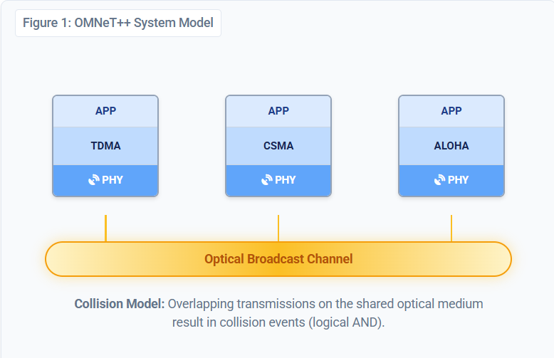
Simulation Overview
Environment: OMNeT++ discrete-event simulator with INET Framework.
Node Architecture:
• Application: Packet generation (exponential inter-arrival)
• MAC Layer: TDMA, Simplified CSMA, Pure ALOHA
• Channel Interface: Abstracts physical light medium
Channel Model: Single shared Line-of-Sight (LOS) optical medium.
Note: No multipath (confined metallic interior assumption).
Topology & Scope:
• Static ring connectivity logic
ACK = acknowledgement

Slide 13
System Model
Optical LiFi Channel:
Strict Line-of-Sight (LOS) propagation model.
Max communication range: 3 m (conservative spacecraft interior).
Network Topology:
Static ring topology connecting 4, 6, or 8 nodes.
Nodes forward packets hop-by-hop to destination.
Traffic Generation (Poisson Process):
Inter-arrival times: 0.2s (Low), 0.1s (Medium), 0.05s (High Load).
Note: Per-hop forwarding means total MAC transmissions > total generated packets.

Slide 14
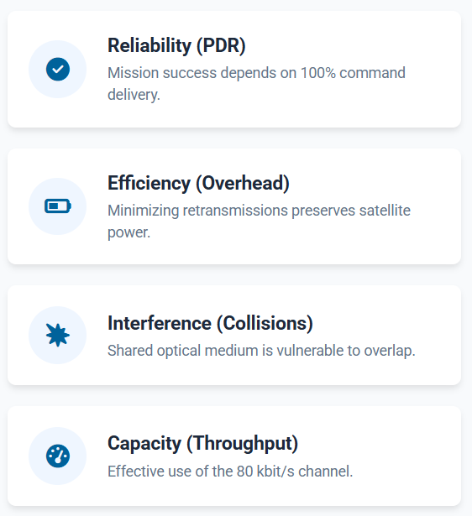
Performance Metrics
Packet Delivery Ratio (PDR):
Primary reliability metric: N_{delivered} / N_{generated}
Critical for command & control (TMTC) traffic.
Collision Count:
Number of packets lost due to overlapping optical signals on the shared channel.
Transmission Overhead:
Ratio of MAC transmission attempts to generated packets.
Indicates energy efficiency; retransmissions waste power.
Throughput & Fairness:
Successful data rate and distribution of access among nodes.

Slide 15
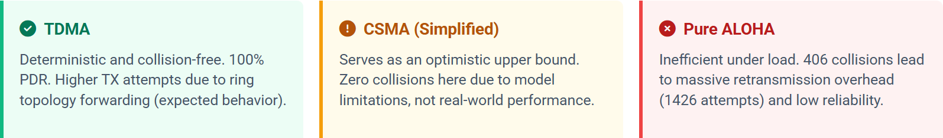
Baseline High-Load Results (4 Nodes)
Protocol | Generated Packets | TX Attempts | Collisions | PDR (%)
TDMA | 798 | 996 | 0 | 100%
CSMA (simpl.) | 798 | 798 | 0* | 100%*
Pure ALOHA | 800 | 1426 | 406 | 71%
Note: Simplified CSMA results are optimistic (no ACK/retransmission overhead modeled here).

Slide 16
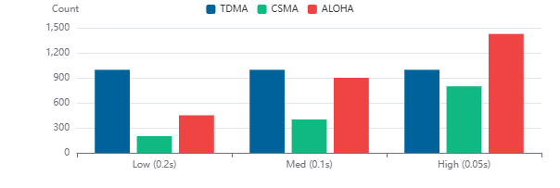
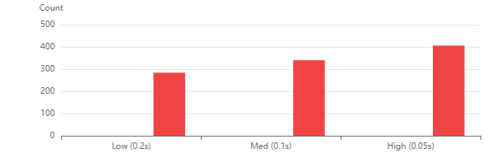
Traffic Load Variation
TDMA Stability: Overhead is constant across loads.
Slots are fixed by schedule; unaffected by traffic spikes, ensuring predictable behavior.
ALOHA Instability: Collisions explode as load increases.
Even at low load (0.2s), >200 collisions occur. High retransmission overhead wastes energy.
CSMA Baseline: Optimistic model shows ideal scaling.
In reality, hidden nodes would degrade this performance (see next slides).

Slide 17
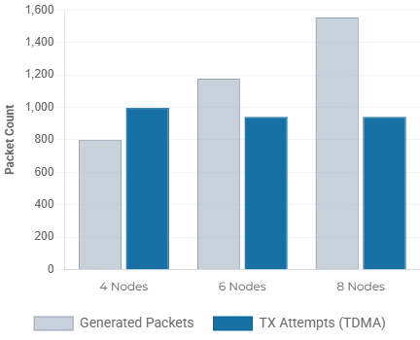
TDMA Node Scaling
Evaluation Scenario: Tested scalability by increasing node count from 4 → 6 → 8 under high traffic load.
Traffic Growth:
Total generated packets scale linearly (798 → 1554).
Bounded Overhead:
Transmission attempts remain bounded (~940) by the fixed frame schedule, regardless of increased demand.
Perfect Reliability:
Maintained Zero Collisions and 100% PDR across all configurations.

Slide 18
Hidden Node Problem: Intuition
What is a Hidden Node?
Two transmitters (A & B) are out of range of each other but share a common receiver (C).
The Core Conflict:
Carrier Sensing (CSMA) fails because A cannot "hear" B transmitting.
Both transmit simultaneously, leading to destructive interference at C.
Relevance to Satellites:
Even in confined spacecraft, internal structures or component placement can block Line-of-Sight (LOS).

Slide 19
Hidden Node Topology
The Scenario:
Nodes A and B are transmitters targeting a common receiver C.
Nodes are physically separated such that A and B cannot detect each other's optical signals.
CSMA Failure Mode:
Node A checks channel: "IDLE" (cannot see B).
Node B checks channel: "IDLE" (cannot see A).
Both transmit Signals overlap at C.
Impact:
Destructive collision at Receiver C.
High packet loss despite "Carrier Sensing".
TDMA Advantage: Deterministic slots prevent A and B from ever transmitting in the same time window, regardless of visibility.

Slide 20
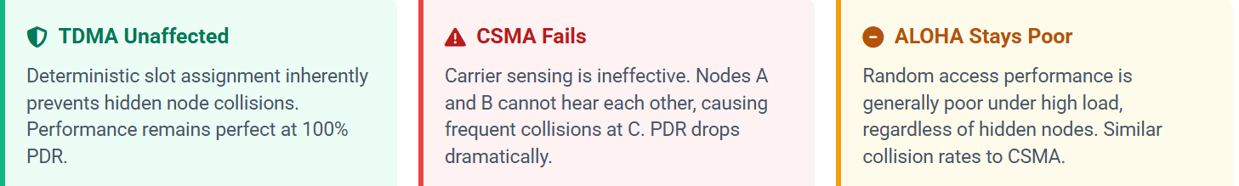
Hidden Node Results (High Load, 4 Nodes)
Protocol | Collisions | PDR (%)
TDMA | 0 | 100%
CSMA (no RTS/CTS) | 387 | 52% ▼ (was 100%)
Pure ALOHA | 406 | 71%
Note: "Hidden node" scenario involves two transmitters (A, B) out of sensing range, transmitting to a common receiver (C).

Slide 21
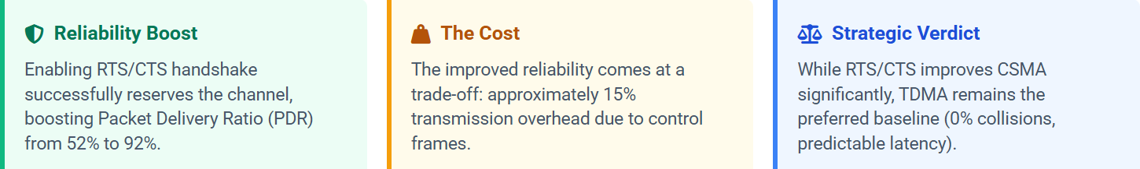
RTS/CTS Mitigation (CSMA)
Variant | PDR (%) | Overhead (%) | Impact
CSMA (Hidden Node) | 52% | 0% | Severe Collisions
CSMA + RTS/CTS | 92% | 15% | Reliability Restored
* Comparison under high-load hidden-node scenario (Nodes A & B hidden from each other).

Slide 22
Conclusion & Takeaways
TDMA is the Preferred Baseline
Provides predictable, collision-free operation essential for mission-critical TMTC traffic.
Robust scaling with node count despite synchronization overhead.
Pure ALOHA
Inefficient under moderate-to-high load due to cascading retransmissions and energy waste.
CSMA Limitations
Hidden-node collisions severly impact reliability (52% PDR) in confined spaces.
RTS/CTS mitigates this (92% PDR) but adds significant control overhead.
Even in static, confined spacecraft environments, hidden-node effects are significant, validating the need for deterministic MACs like TDMA.

Slide 23
References
[1] N. Abramson, “The ALOHA system—Another alternative for computer communications,” in Proc. AFIPS Fall Joint Computer Conf., 1970, pp. 281–285.
[2] L. Kleinrock and F. A. Tobagi, “Packet switching in radio channels: Part I—Carrier sense multiple-access modes and their throughput-delay characteristics,” IEEE Transactions on Communications, vol. 23, no. 12, pp. 1400–1416, Dec. 1975, doi: 10.1109/TCOM.1975.1092769.
[3] M. Jahnke, B. Palmer, and U. Kulau, “Development and evaluation of a LiFi-transceiver module for TMTC intra-satellite communication,” Engineering Proceedings, vol. 90, no. 16, 2025.
https://doi.org/10.3390/engproc2025090016
[4] T. T. T. Le, N. U. Hassan, X. Chen, M.-S. Alouini, Z. Han, and C. Yuen, “A survey on random access protocols in direct-access LEO satellite-based IoT communication,” IEEE Communications Surveys & Tutorials, vol. 27, no. 1, pp. 426–462, Feb. 2025, doi: 10.1109/COMST.2024.3385347.
[5] G. Cossu, O. Ertunc, A. Sturniolo et al., “CAN-bus communication over optical wireless,” in Proc. SPIE, vol. 13699, 2024, p. 136995G, doi: 10.1117/12.3006235.
[6] I. Arruego et al., “OWLS: A ten-year history in optical wireless links for intra-satellite communications,” IEEE Journal on Selected Areas in Communications, vol. 27, no. 9, pp. 1599–1611, 2009, doi: 10.1109/JSAC.2009.091215.
[7] A. Varga and R. Hornig, “An overview of the OMNeT++ simulation environment,” in Proc. ICST International Conference on Simulation Tools and Techniques (SIMUTools), 2008.
[8] INET Framework Documentation, “The Hidden Node Problem,” OMNeT++, 2024.
Available: https://inet.omnetpp.org/docs/showcases/wireless/hiddennode/doc/

Slide 24
Thank You!
Technische Universität Hamburg (TUHH)
Utkarsh Maurya
ICS
Am Schwarzenberg-Campus 1
21073 Hamburg
Tel.: +49 40 42878-3330
www.tuhh.de

