Slide 1
Final course project
Comparison of various algorithms
Nikhil D Kamath
Utkarsh Behre
Introduction to Reinforcement Learning
May 06 2020

Slide 2
topics
Background
Implementation
Results
Summary

Slide 3
DESCRIPTION
The focus of this project was to learn the behavior of various algorithms on different environments.

Slide 4
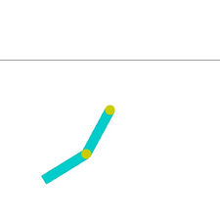
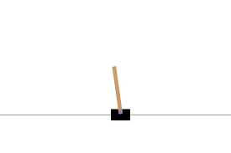
Environments
Acrobot v1
CartPole v1

Slide 5
ALGORITHM
DQN
Double DQN
Advantage Actor Critic
Reinforce
PPO

Slide 6
Implementation
All the mentioned algorithms are implemented on the two environments specified.
The results are compared based on the reward versus the episodes graphs.
The performance of the algorithms is discussed.

Slide 7
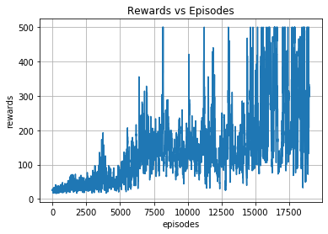
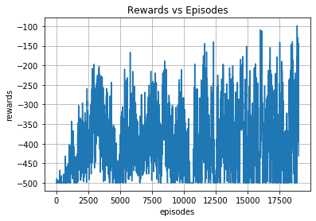
RESULTS DQN
Cartpole
Acrobot

Slide 8
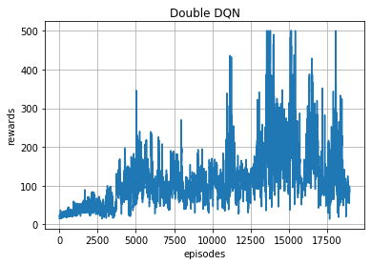
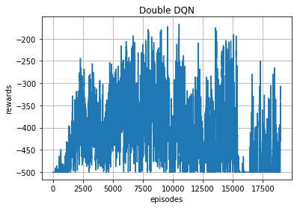
RESULTS DOUBLE DQN
Cartpole
Acrobot

Slide 9
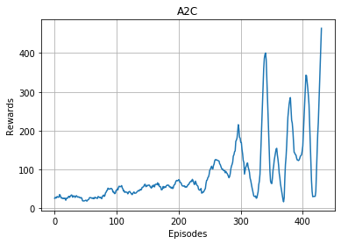
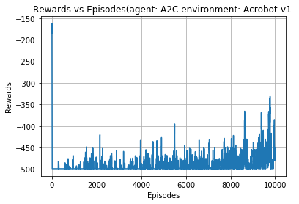
RESULTS A2C
Cartpole
Acrobot

Slide 10
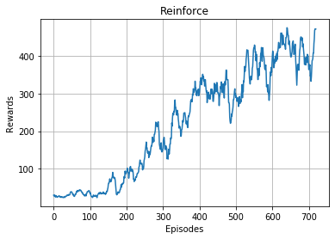
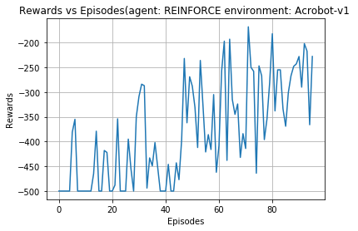
RESULTS REINFORCE
Cartpole
Acrobot

Slide 11
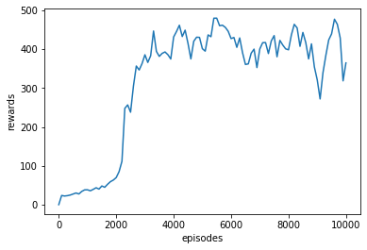
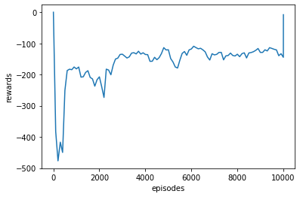
RESULTS PPO
Cartpole
Acrobot

Slide 12
Observations
All the algorithms implemented reached the peak rewards
Algorithms worked better on CartPole than on Acrobot.
PPO was the best performing algorithm.

Slide 13
Thank You
Note: neque digni and in aliquet nisl et a umis varius.

