Slide 1

Distributed Graded System
A FINAL year Project by:
Utkarsh bist (20140653)
POONAM MORE (20140627)
Department of computer engg
UNDER THE GUIDANCE OF Dr. Arvind Kiwelekar

Slide 2
CONTENTS
Why Blockchain?
Blockchain Technology
Chains of Blocks
Hyperledger
Problem Statement
Demostration
Why Blockchain excites us?
Advantages
Limitations
Conclusions
References

Slide 3
WHY BLOCKCHAIN?
Functioning of World changing.
Flow of assets.
Short coming of Transaction.
Homecoming of Blockchain

Slide 4
Distributed ledger
type of data structure
residing across multiple computer devices
Distributed Ledger Technology includes: 1. Blockchain Technology 2. Smart Contract
consists of : 1. Data Models 2. Language of Transaction 3. Protocol

Slide 5
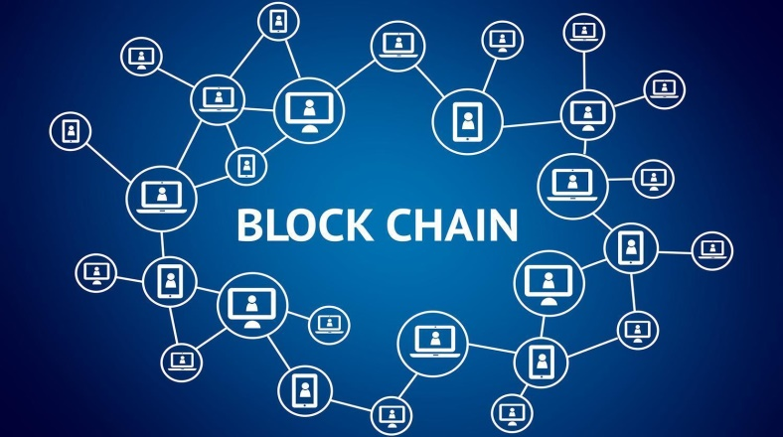
Blockchain technology
Shared, Distributed ledger of transaction
backbone of a new type of internet
Records are efficiently stored in a verifiable and permanent way.

Slide 6
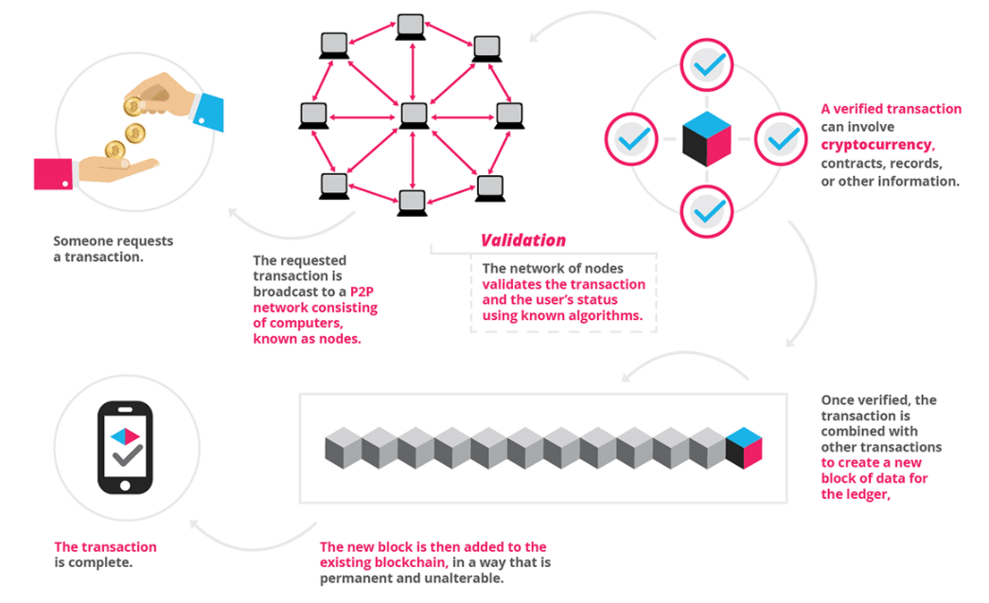
HoW BLOCKchain works
Credit: https://blockgeeks.com/guides/blockchain/

Slide 7
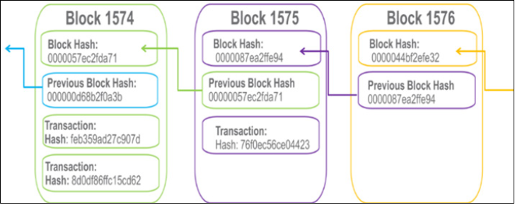
Chains of Blocks
credit: Blockchain for Dummies- IBM limited Edition- edition 2017, Page 19.
Hashing prevents any block being altered.
Making It Tamper-free.

Slide 8
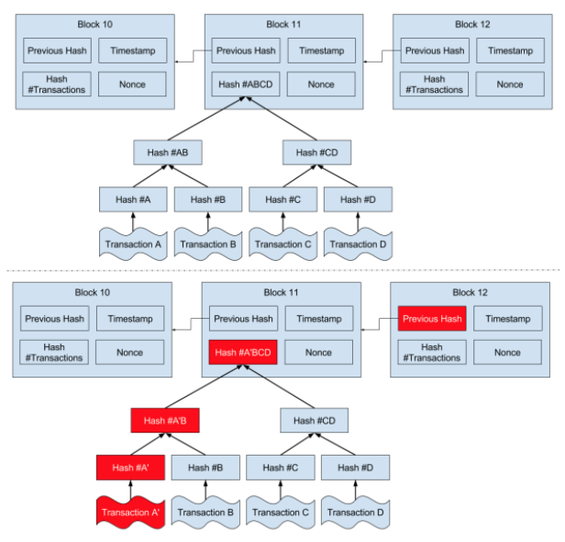
Blockchain immutability
Credit: courses.edx.org/courses/course-v1:LinuxFoundation

Slide 9
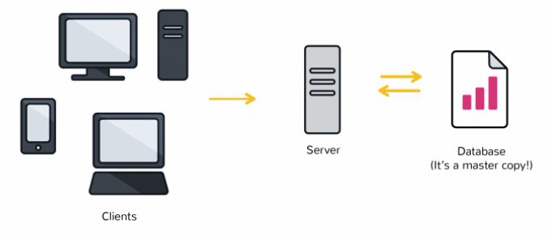
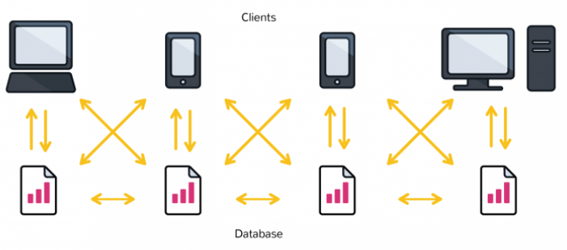
THE IDEA OF DECENTRALISED

Slide 10
common features of Dapps
Open Source
Decentralized
Incentivized
Protocol

Slide 11
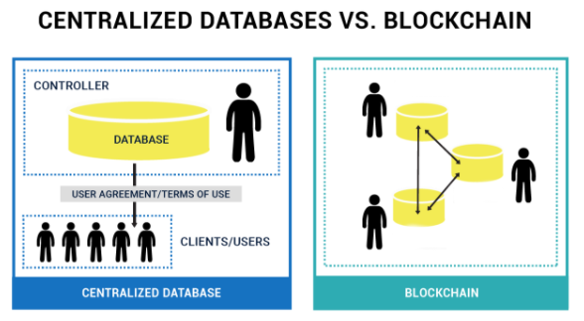
BLOCKCHAIN vs DATABASE
data structure
administrator permissions
Placement of new data
Credit: courses.edx.org/courses/course-v1:LinuxFoundation

Slide 12
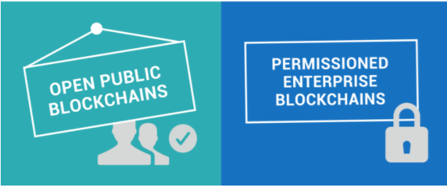
TYPES OF BLOCKCHAIN
Permissionless
Permissioned

Slide 13


Hyperledger
“Umbrella” for developer communities building open- source blockchain.
Global Collaboration, hosted by Linux Foundation
Founded in December 2015, first meeting in March 2016 and released its beta version in August 2017.

Slide 14
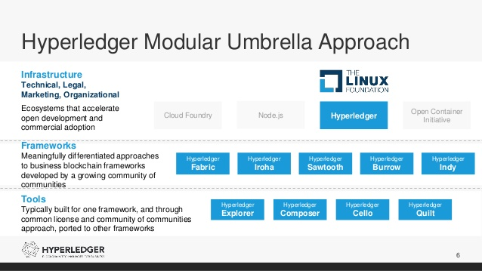
PROJECTS ON HYPERLEDGER
Credit: hyperledger.org

Slide 15
HYPERLEDGER COMPOSER
Programming Model
Easy way to deploy business Network
Constructs Business Network Archive (.bna)
Entities: 1. Participant(s) 2. Asset(s) 3. Transaction(s)

Slide 16
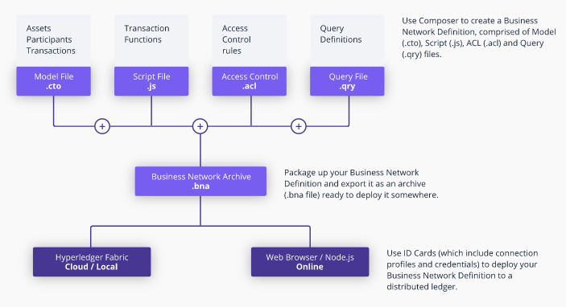
Composer Components
Credit: hyperledger.org/composer/introduction

Slide 17
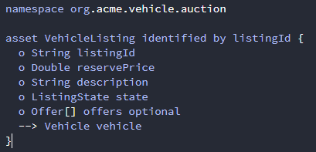
CTO file
Composer Modelling Language
Closely related to Object Oriented Language
Comprises of: 1. A single namespace 2. Set of resources 3. import declarations (optional)
Extension of .cto

Slide 18
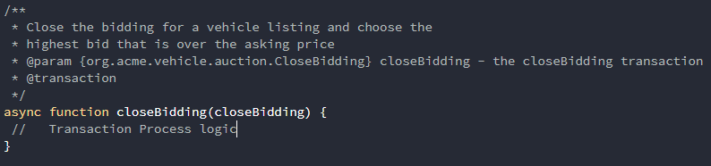
Transaction Processor Function
Smart Contract of Hyperledger Composer
Structure of TPF includes decorators and metadata followed by javascript
*First Line : Human readable Comment *Second line: parameter defination *Third line: Transaction tag

Slide 19
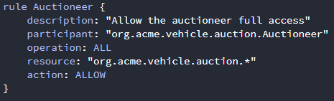
ACL Permission File
Access Control Language
Provides declarative access control over elements of domain model
Determines user/roles to CREATE, READ, UPDATE, DELETE
Extension of .acl

Slide 20
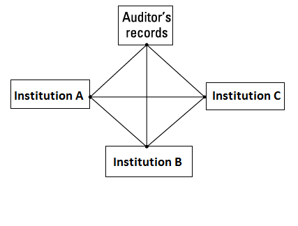
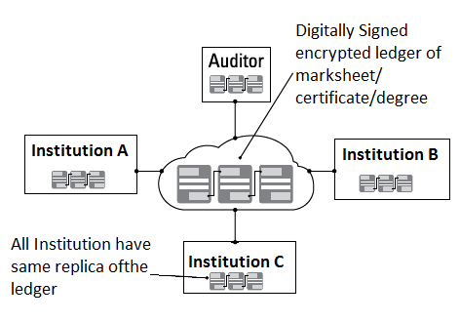
Problem statement
Conventional Grading System
What’s “Distributed in it”.

Slide 21
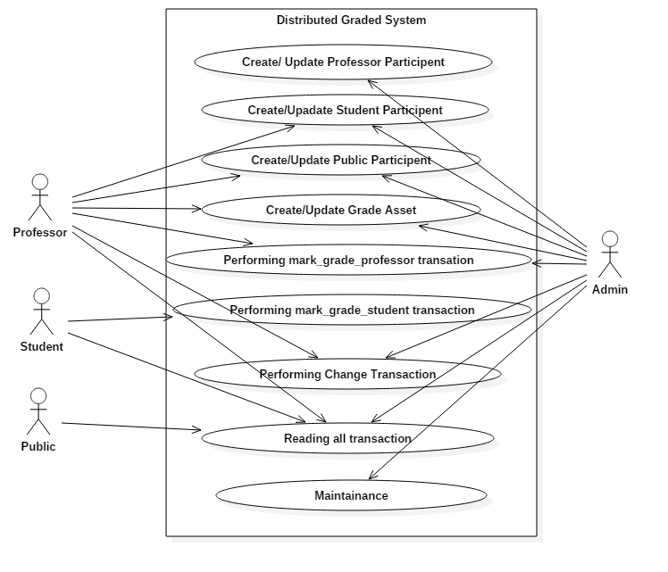
USE case diagram

Slide 22
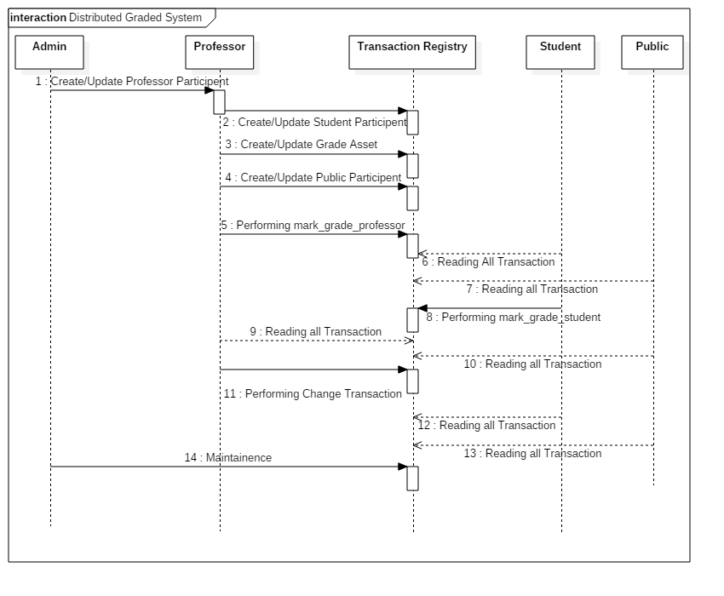
SEQUENCE DIAGRAM

Slide 23
DEMOSTRATION

Slide 24
Why Blockchain Excites US!
Transparency
Trust
Smart Contract

Slide 25
ADVANTAGES
Consensus
Provenance
Immutability
Finality

Slide 26
Limitations
Large Energy Consumption
Cultural Adoption
Capital Cost
Integration Concerns

Slide 27
ConCLUSION
Whole new opportunity
This is Future
What Internet did for communication, Blockchain will do for transaction!

Slide 28
References
https://developer.ibm.com/courses/all/blockchain-essentials/
Blockchain For Dummies by Laurence
Online Course On: "Blockchain for Business - An Introduction to Hyperledger Technologies“ https://courses.edx.org/
https://hyperledger.github.io/composer/installing/getting-started-with-playground.html/

Slide 29
Thank you!

