Slide 1

sbmlutils:
Python utilities for SBML
Matthias König
@konigmatt
https://livermetabolism.com

Slide 2
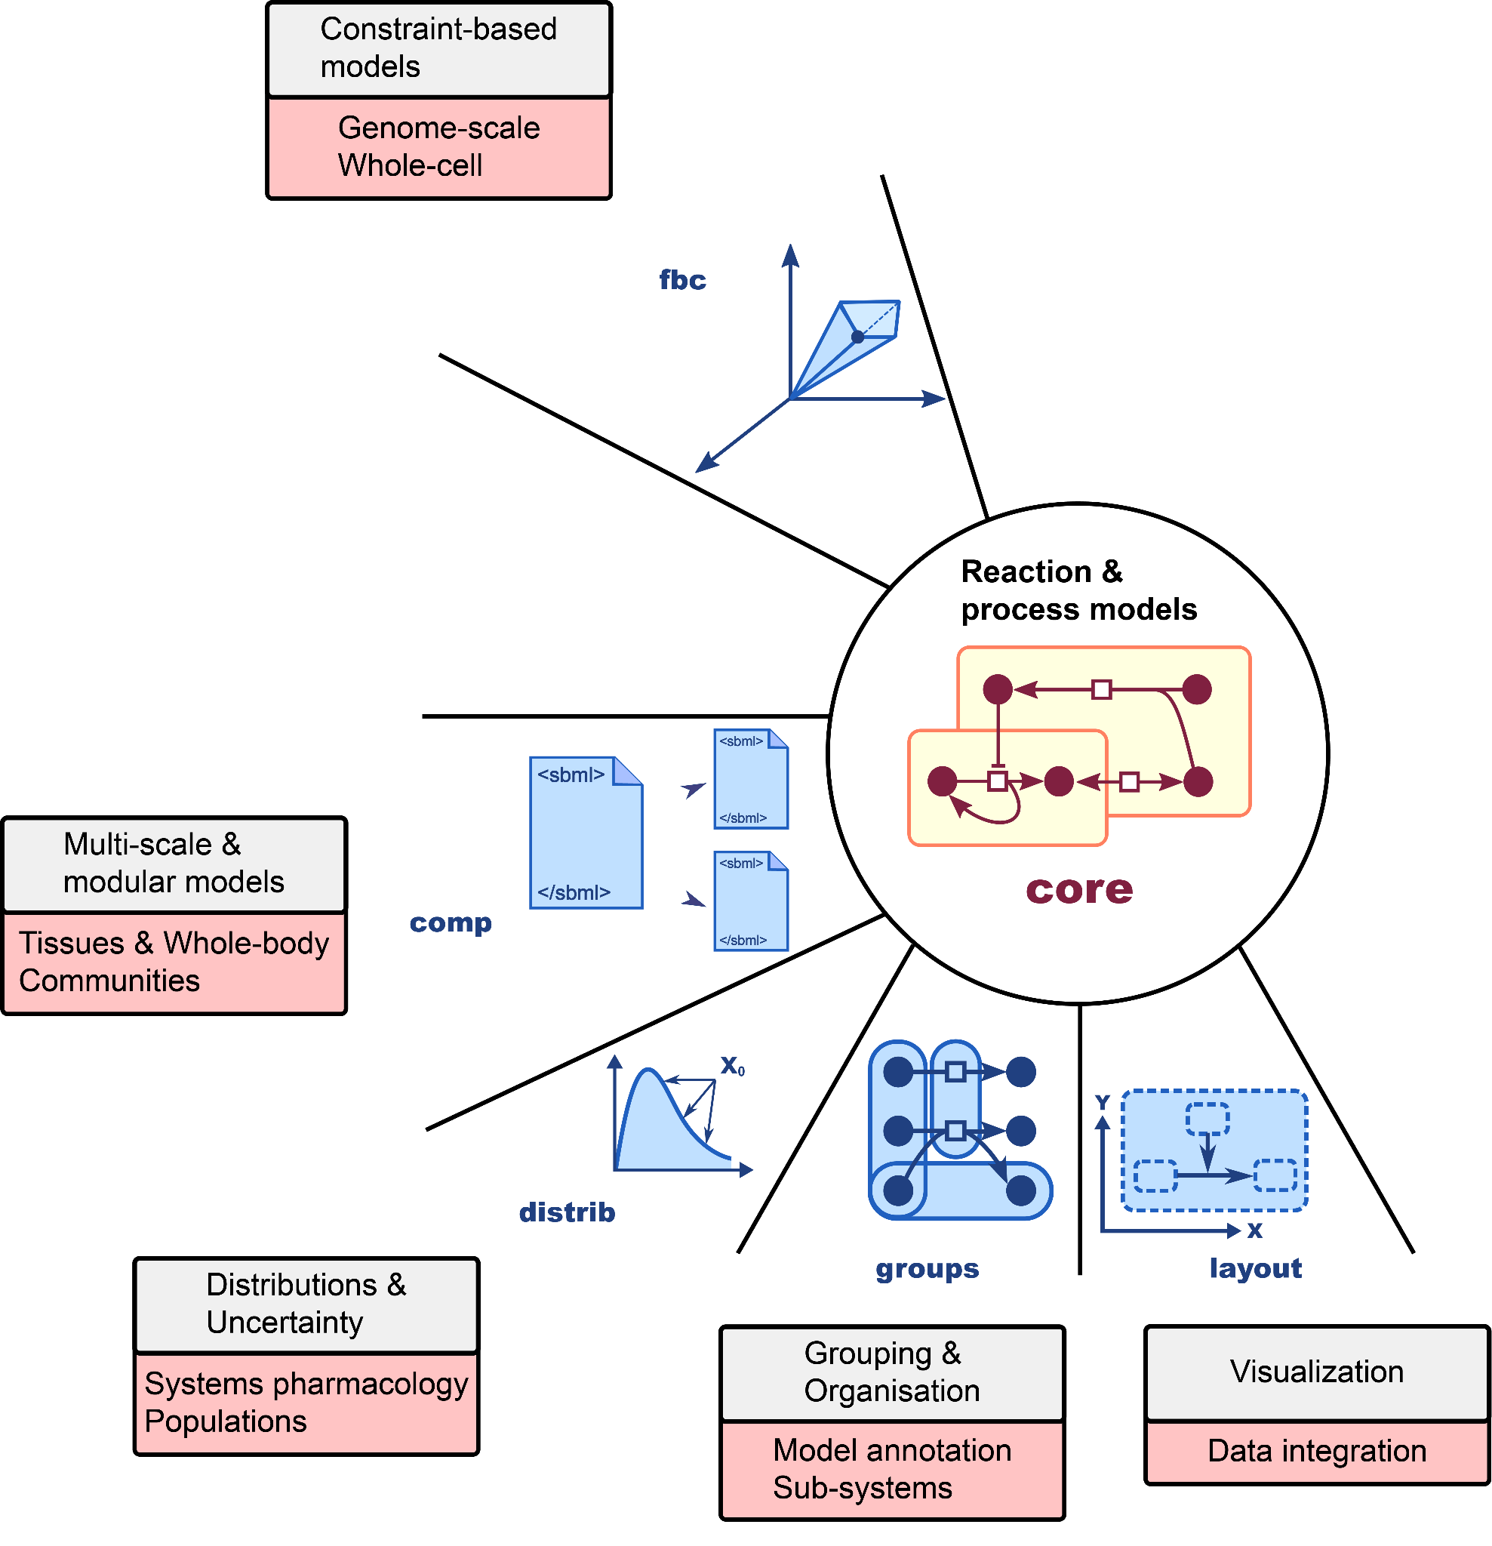

What is SBML?
Systems Biology Markup Language
core language
packages for additional functionality
Standard exchange format for computational models in biology
> 300 tools support
large ecosystem: model building, visualization, simulation, …
http://sbml.org
SBML Level 3: an extensible format for the exchange and reuse of biological models.
Keating SM, Waltemath D, König M, Zhang F, ... Hucka M; SBML Level 3 Community members.
Mol Syst Biol. 2020 Aug;16(8):e9110. doi: 10.15252/msb.20199110. PMID: 32845085.
The Systems Biology Markup Language (SBML): Language Specification for Level 3 Version 2 Core Release 2.
Hucka M, Bergmann FT, Chaouiya C, Dräger A, Hoops S, Keating SM, König M, Novère NL, Myers CJ, Olivier BG, Sahle S, Schaff JC, Sheriff R, Smith LP, Waltemath D, Wilkinson DJ, Zhang F.
J Integr Bioinform. 2019 Jun 20;16(2):20190021. doi: 10.1515/jib-2019-0021. PMID: 31219795; PMCID: PMC6798823.

Slide 3
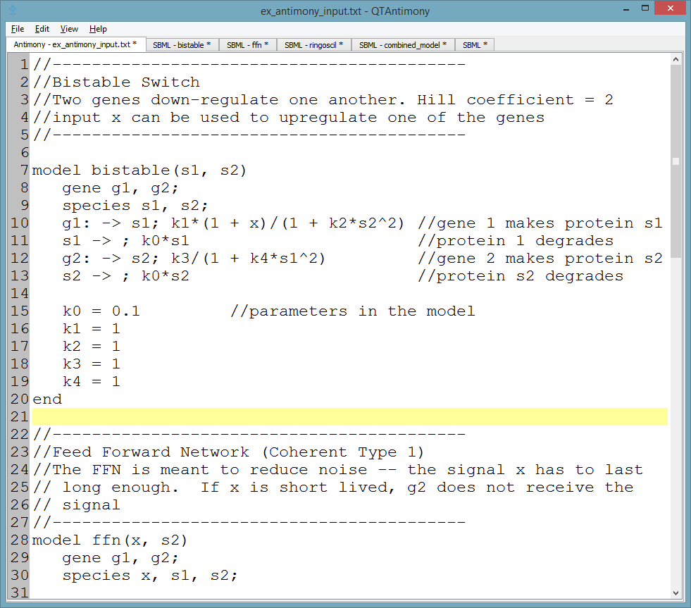
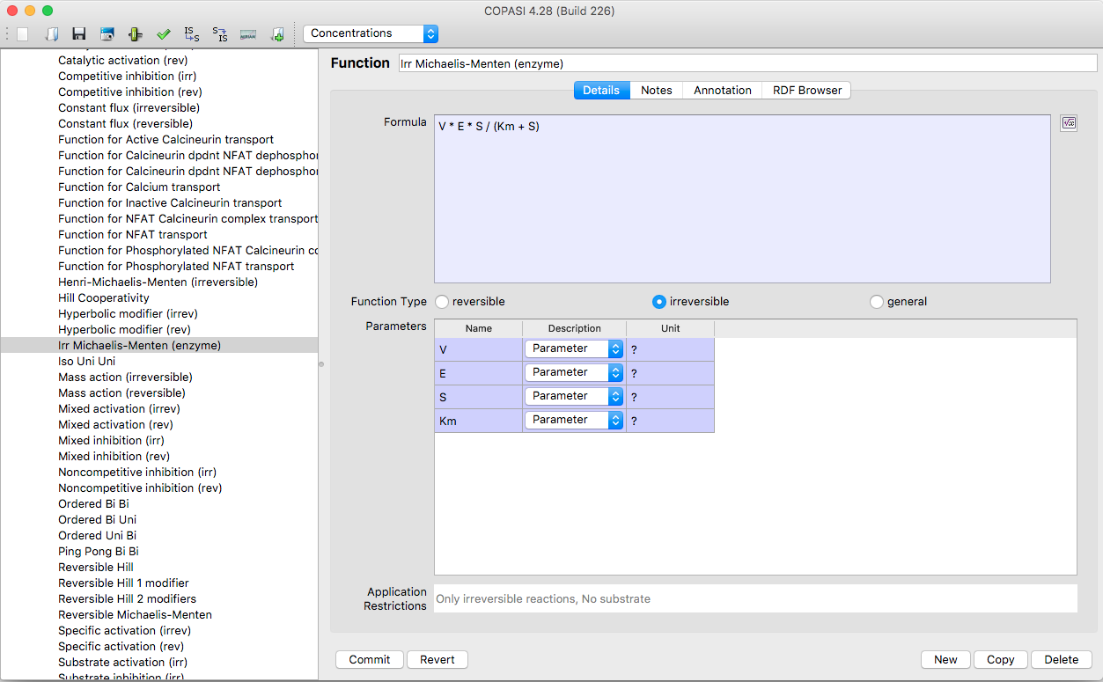
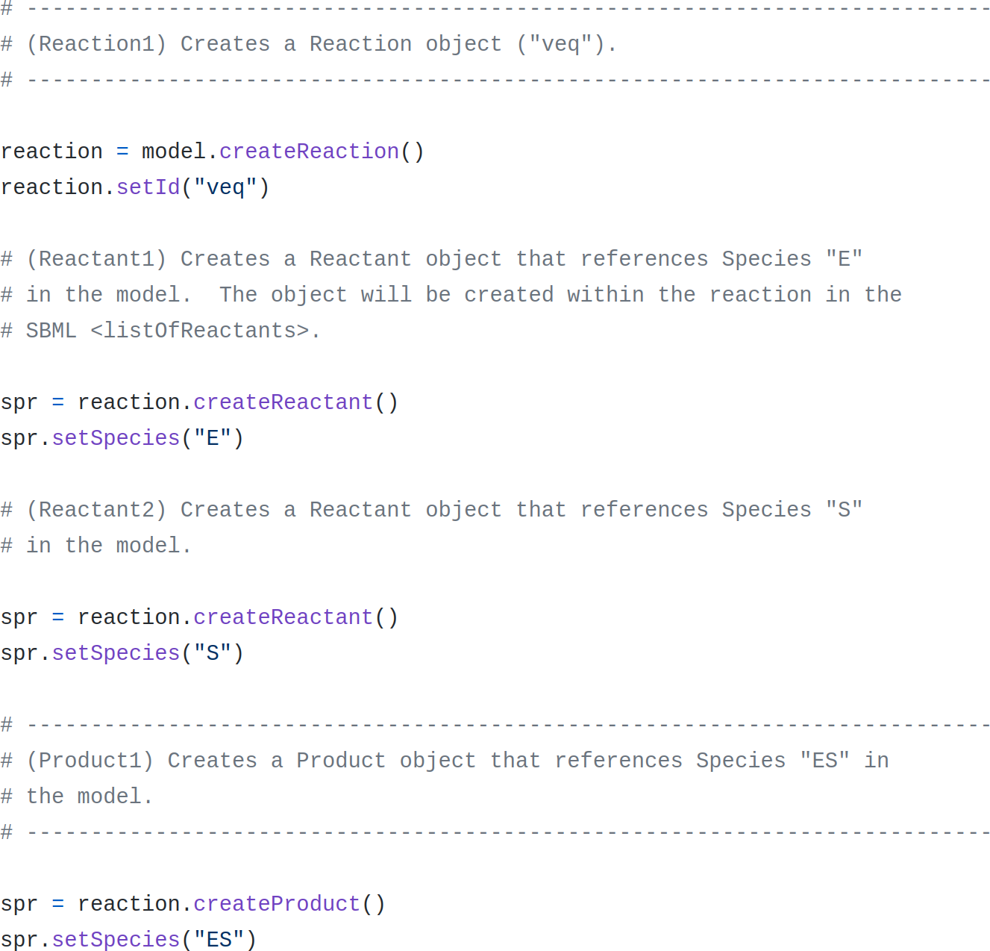
How to create an SBML model?
antimony
text-based format
no validation
no type hinting
SBML core & distrib
COPASI (CellDesigner)
GUI-based
no/difficult programmatic interaction
libSBML (JSBML)
very low level
many silent failures (return code handling)

Slide 4
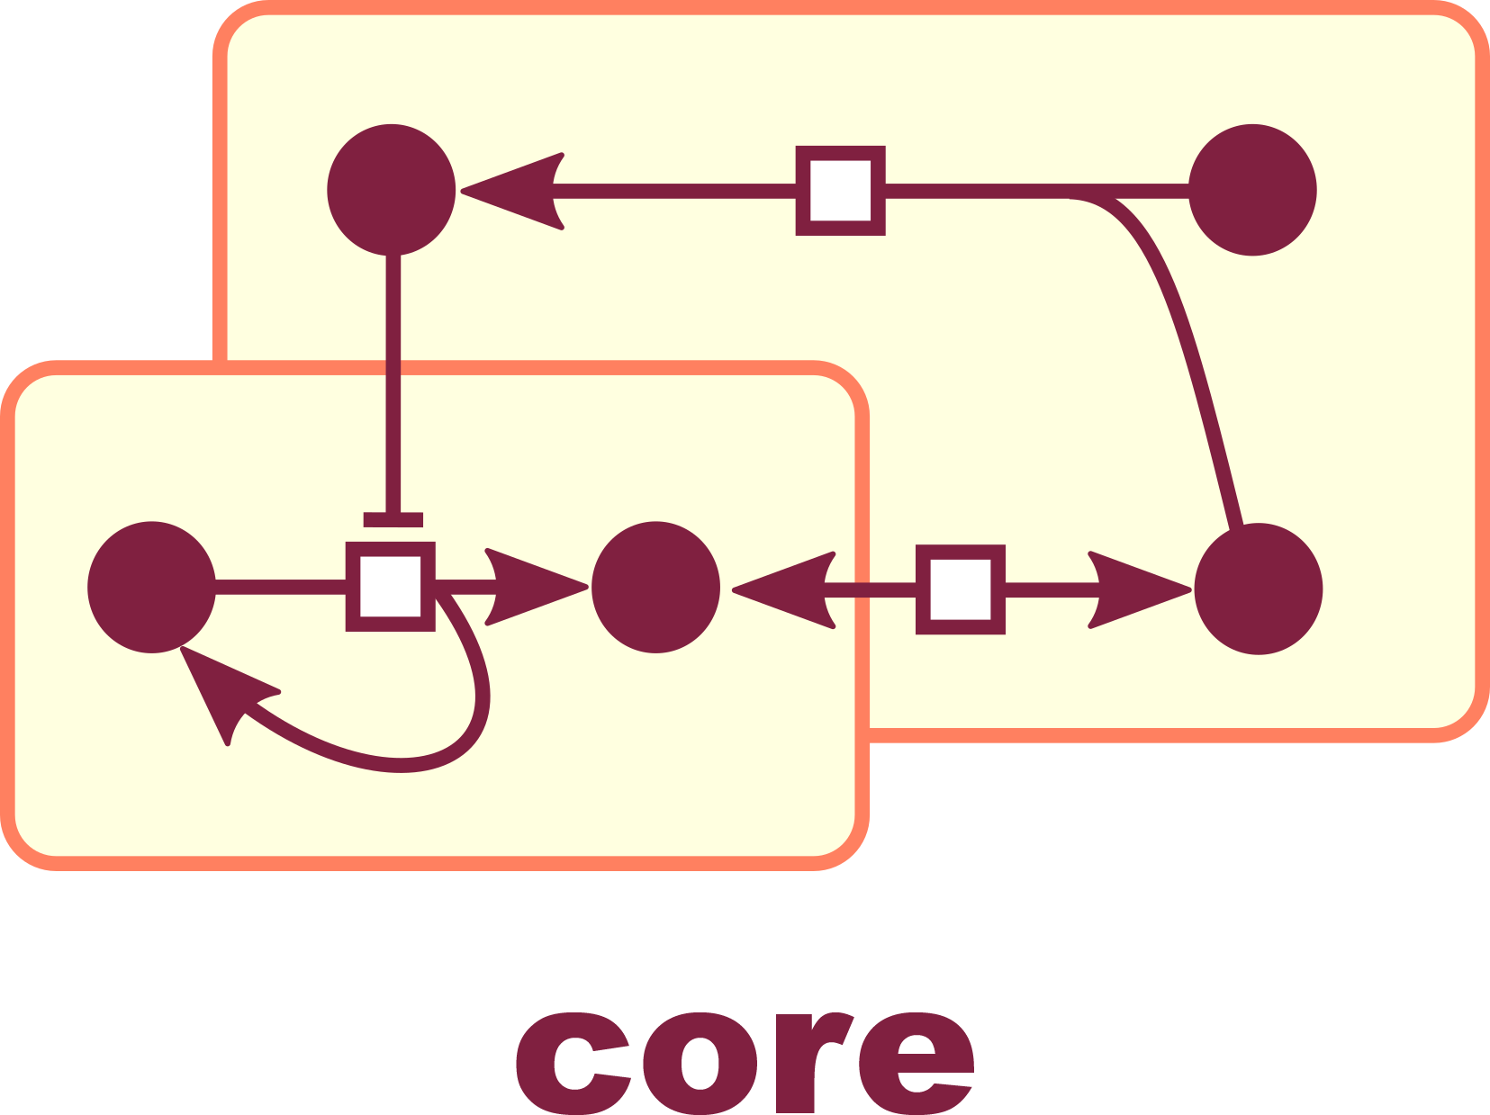
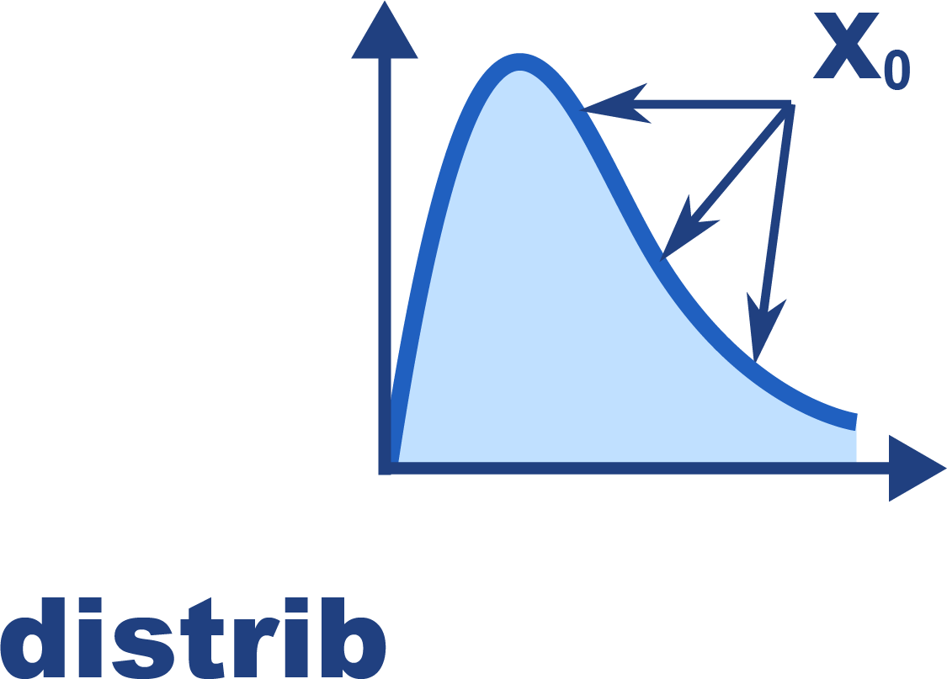
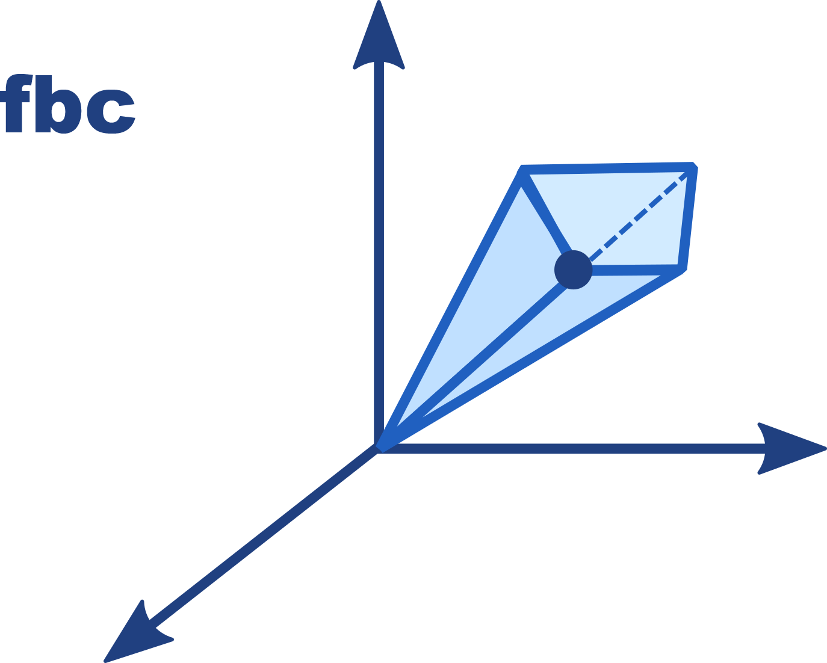
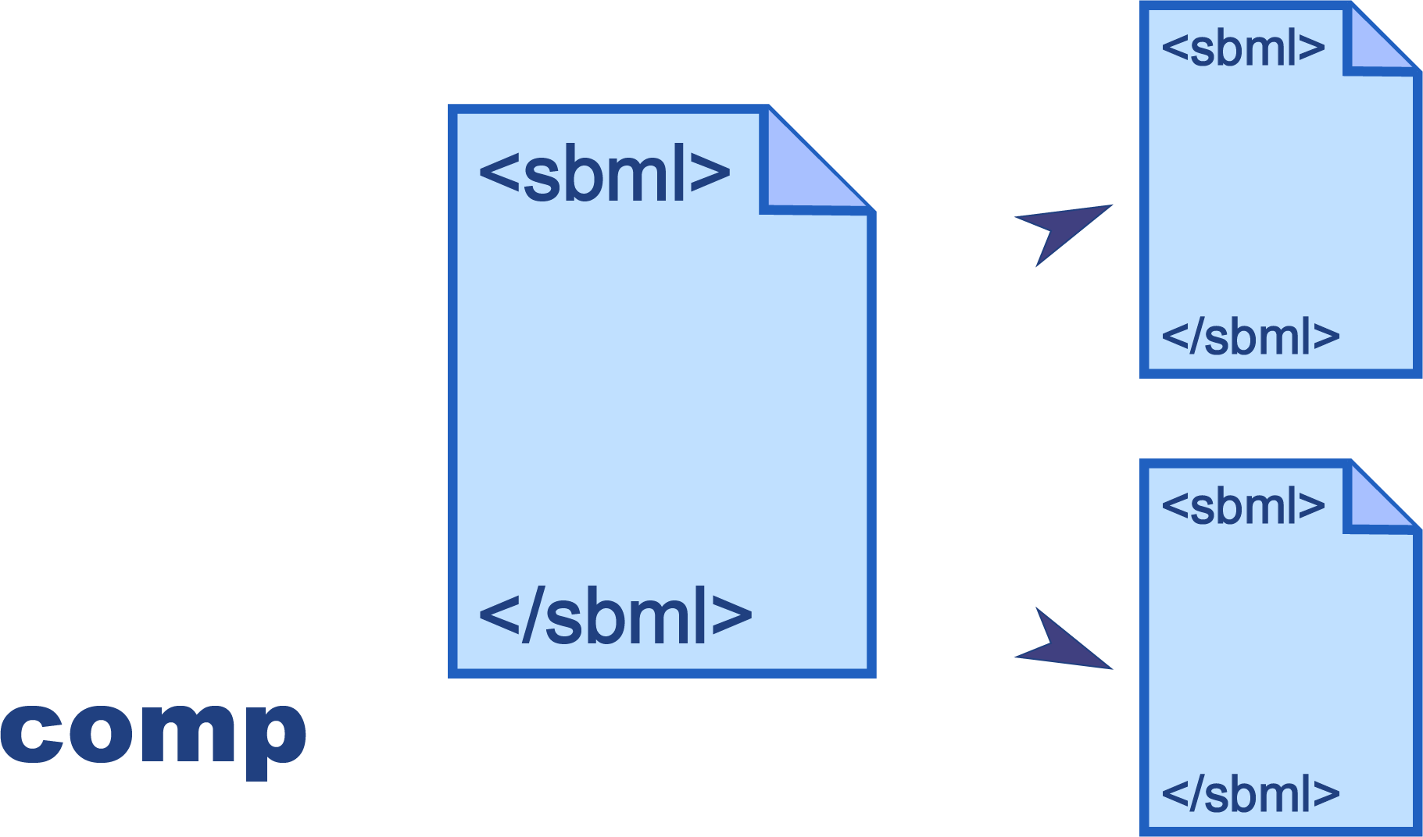
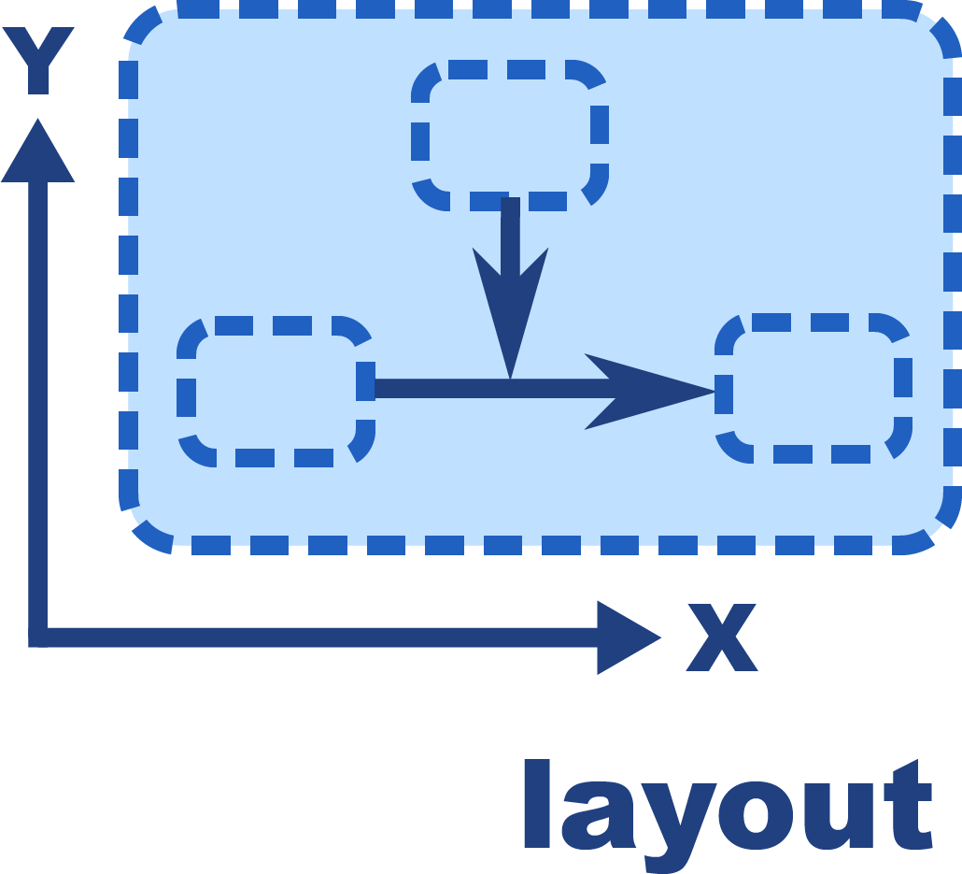
What is sbmlutils?
Collection of python utilities for programmatically developing SBML models https://github.com/matthiaskoenig/sbmlutils/ https://sbmlutils.readthedocs.io
Features
model creation, manipulation & merging
unit support
type annotations
annotation support
model reports
interpolations
file converters (XPP)
Packages
core, fbc, comp, distrib, layout

Slide 5
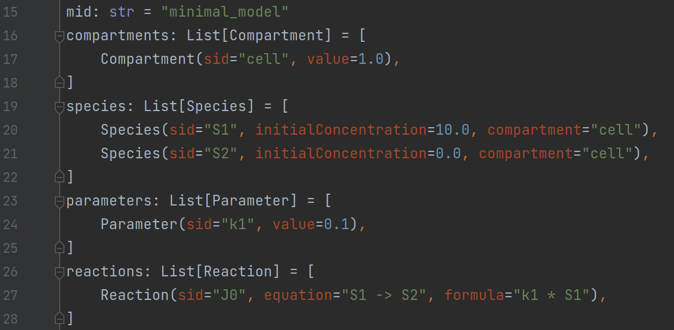
Model creation with sbmlutils
layer around libsbml
programmatic generation (Python)
type annotations, type hinting, auto-completion, documentation
validation with warnings/errors
model reports

Slide 6
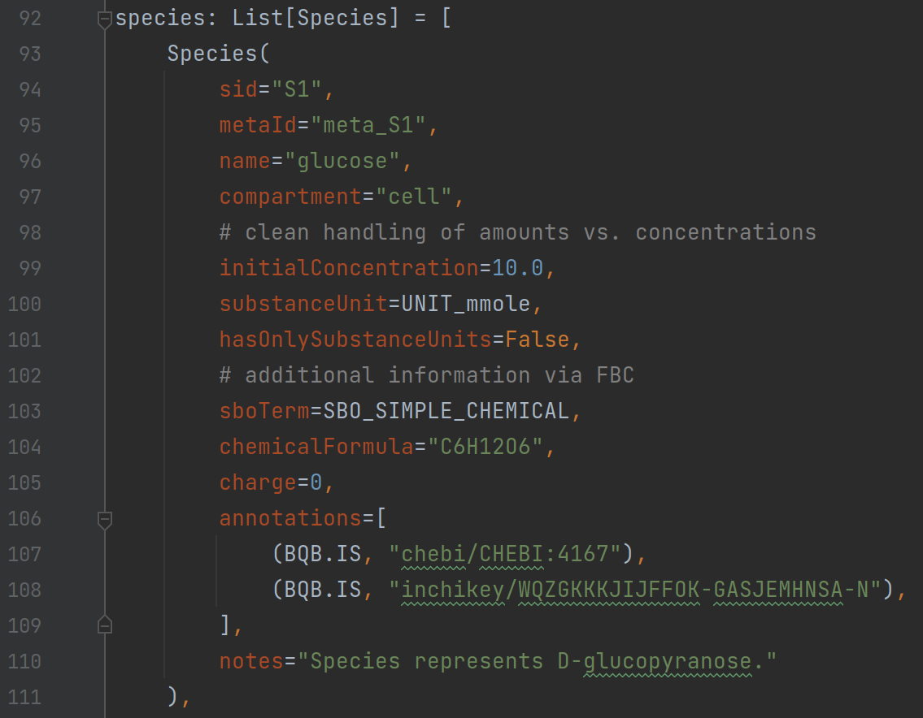
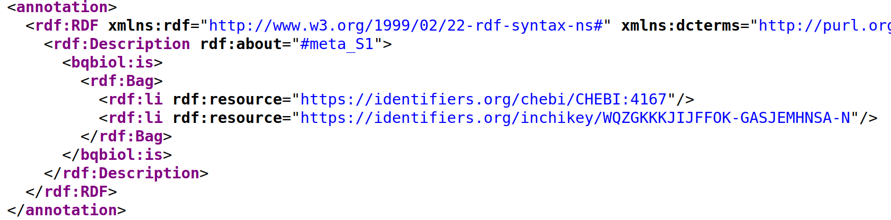
Model annotations
object level annotations
every SBase can be annotation
restricted set of MIRIAM qualifiers
pattern based annotations
match objects based on regular expressions
validation against identifiers.org resources
regular expressions patterns

Slide 7
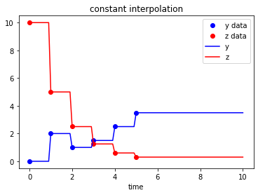
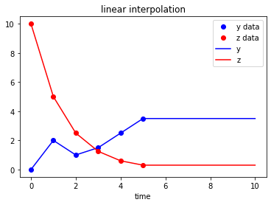
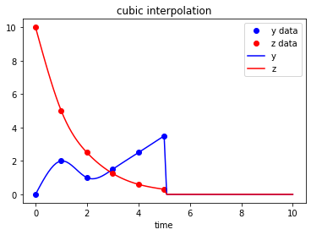
Data interpolation
use data to add spline functions to models
driving model by input; clamping

Slide 8

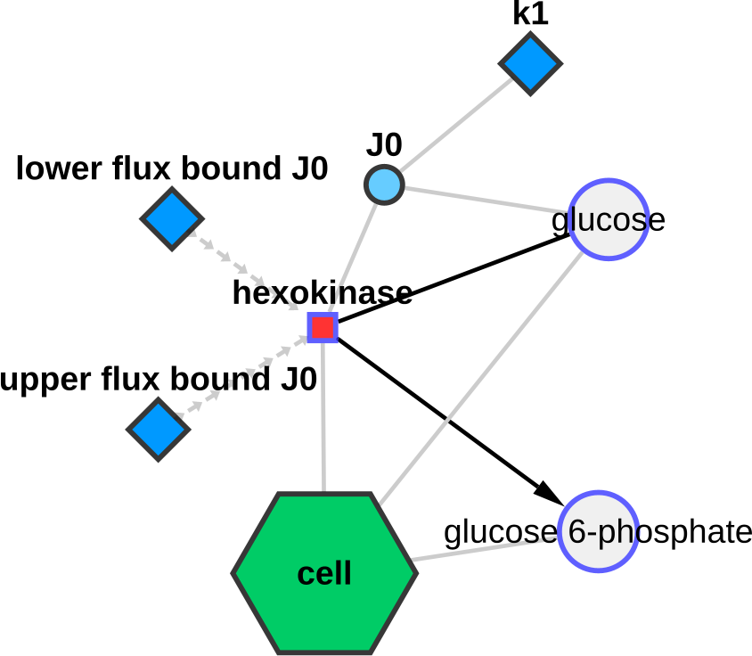
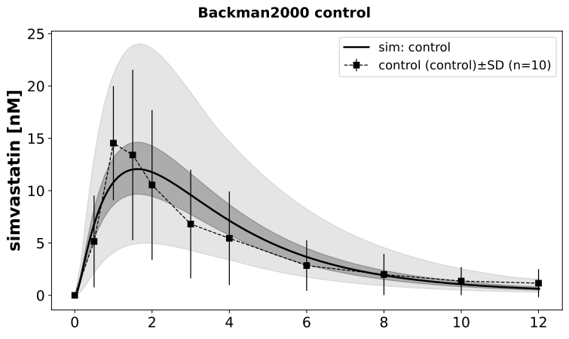
sbmlutils
Model development
cysbml
Model visualization
sf
sbmlsim
Model simulation & analysis

Slide 9
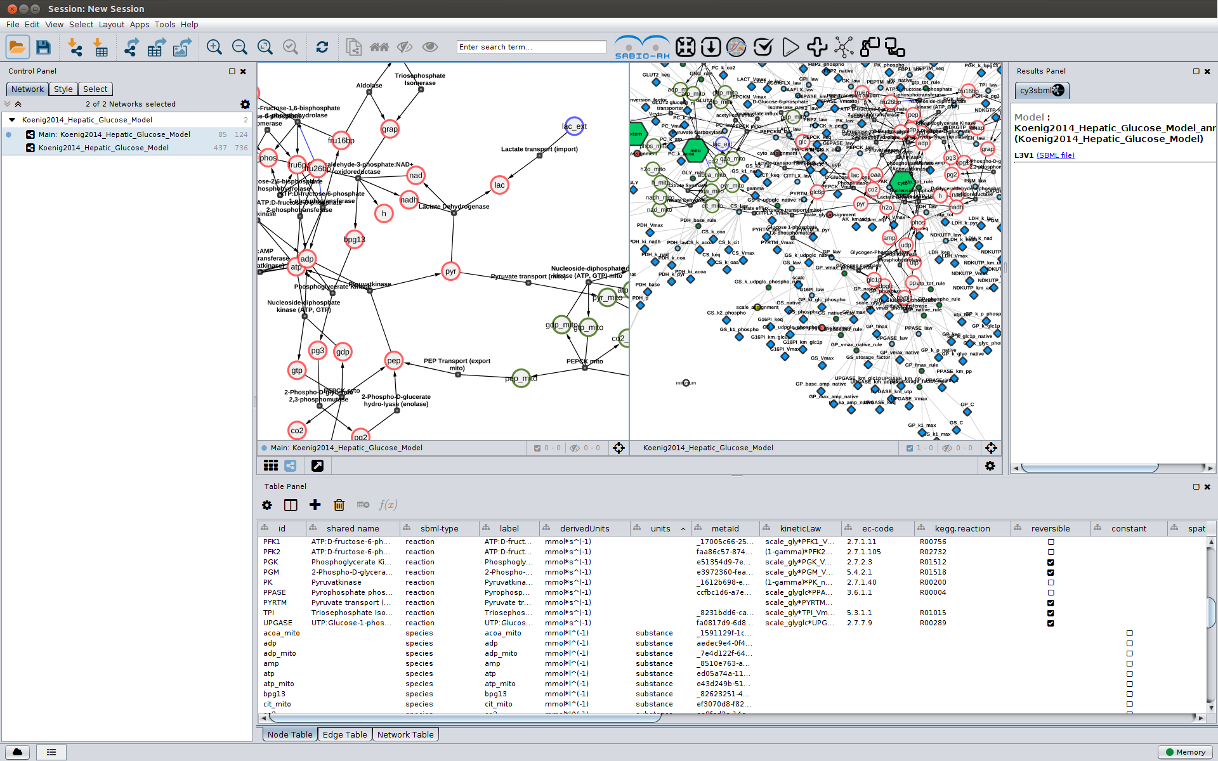
What is cysbml?
Cytoscape app for visualizing SBML models (ODE) https://github.com/matthiaskoenig/cysbml
Features
subgraphs & filtering
kinetic & reaction-species view
annotation support

Slide 10
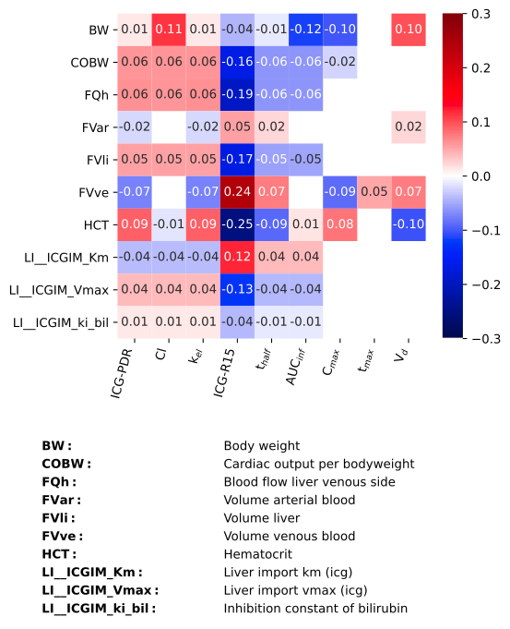
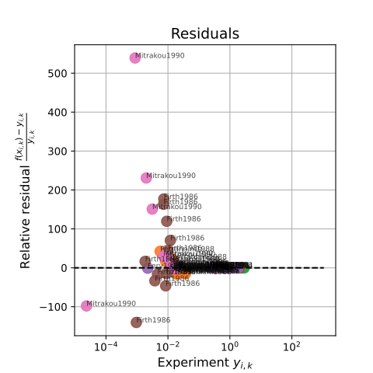
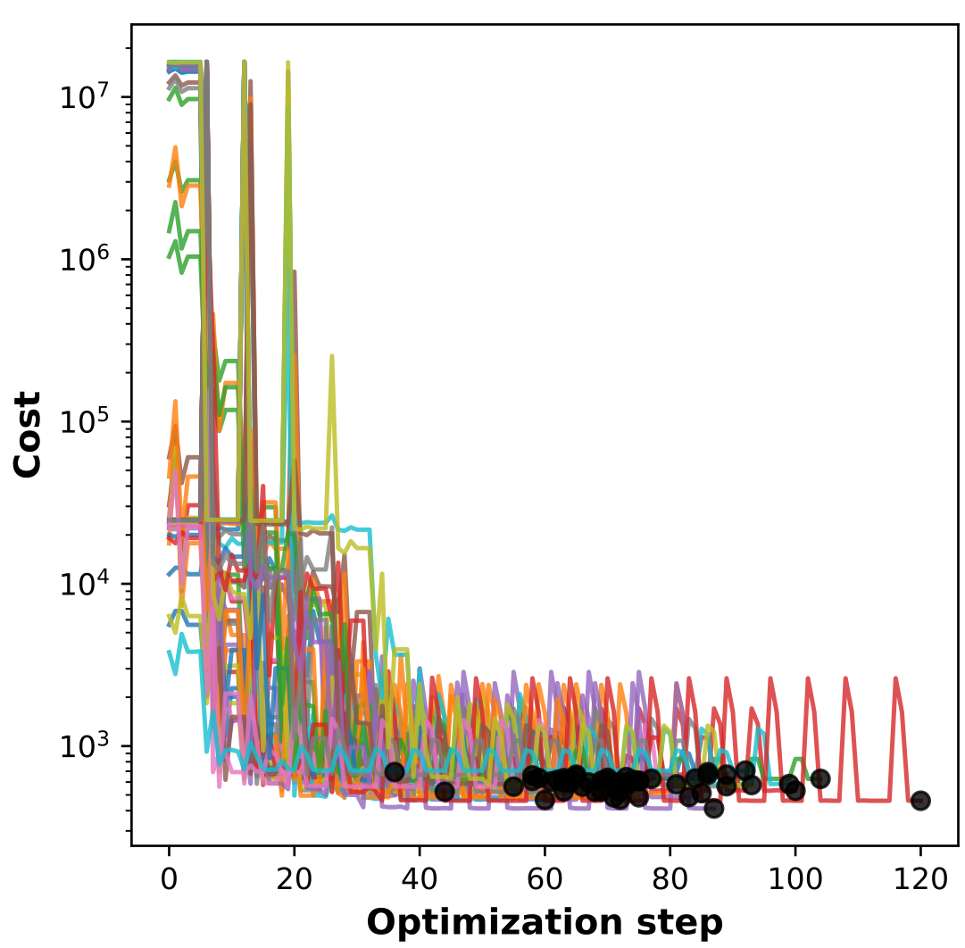
What is sbmlsim?
Collection of python utilities for simulating SBML models (ODE) https://github.com/matthiaskoenig/sbmlsim https://sbmlsim.readthedocs.io
Features
model simulation
data support
unit support (& conversion)
multi-core execution (ray)
simulation experiments (publications)
parameter scans
parameter fitting

