Slide 1

sbmlutils
Python utilities for SBML

Slide 2
SBML

Slide 3
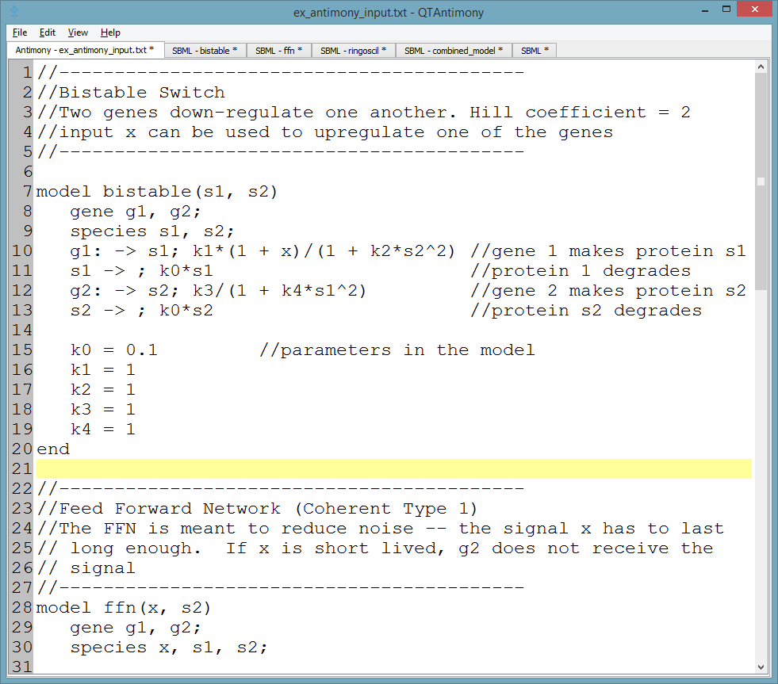
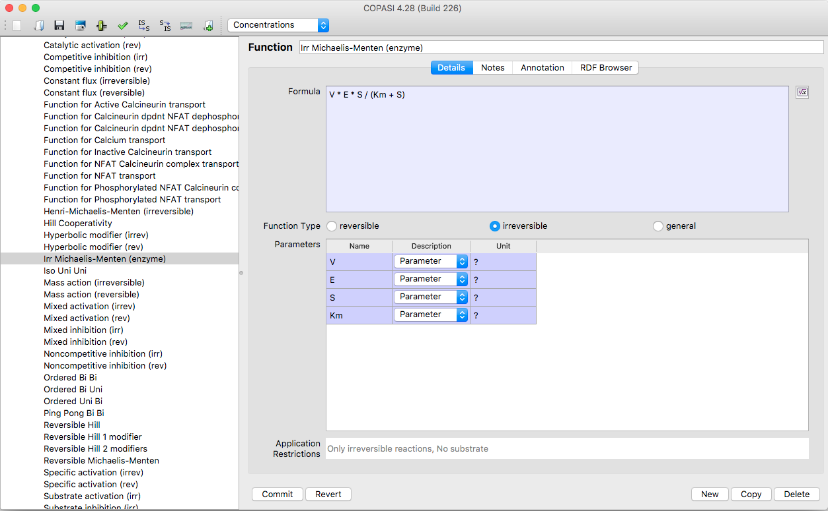
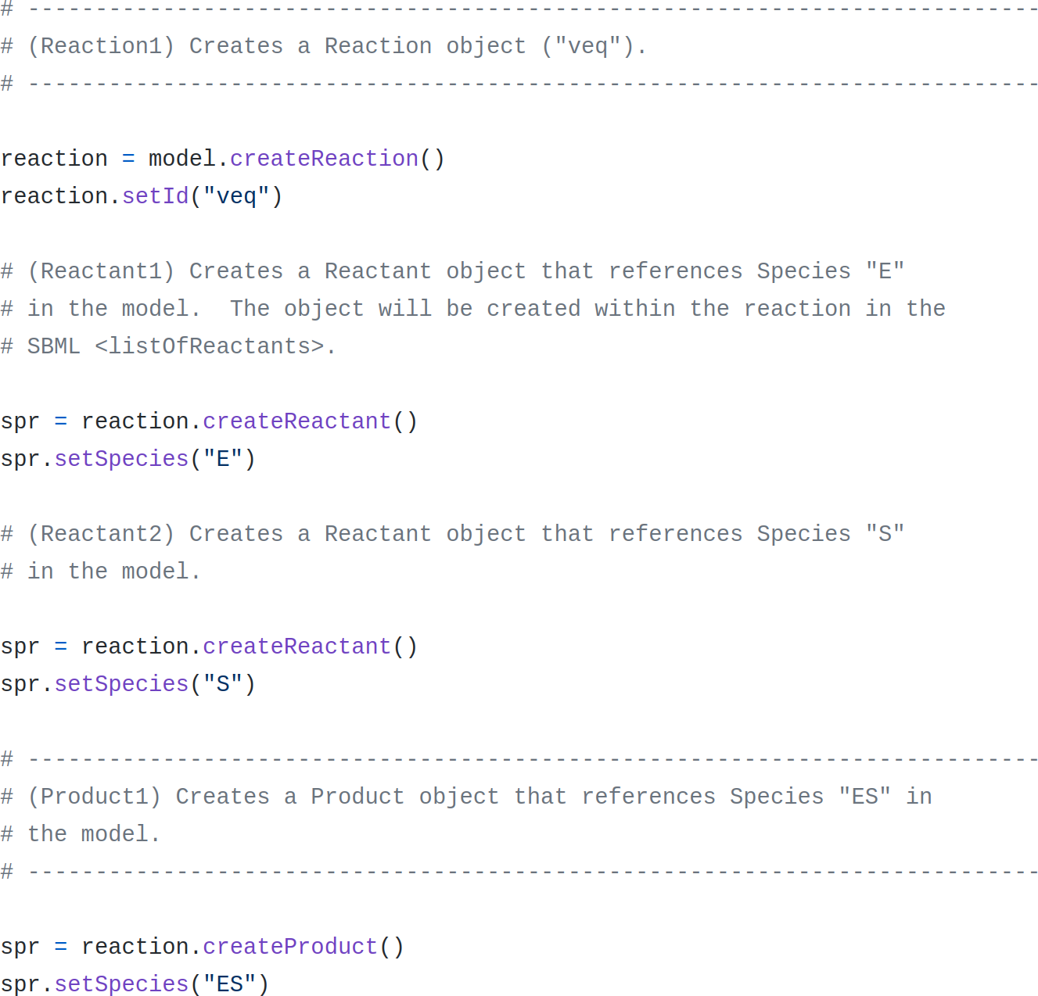
How to create SBML models?
antimony
text-based format
no validation
no type hinting
SBML core & distrib
COPASI (CellDesigner)
GUI-based
no/difficult programmatic interaction
libSBML (JSBML)
very low level
many silent failures (return code handling)

Slide 4
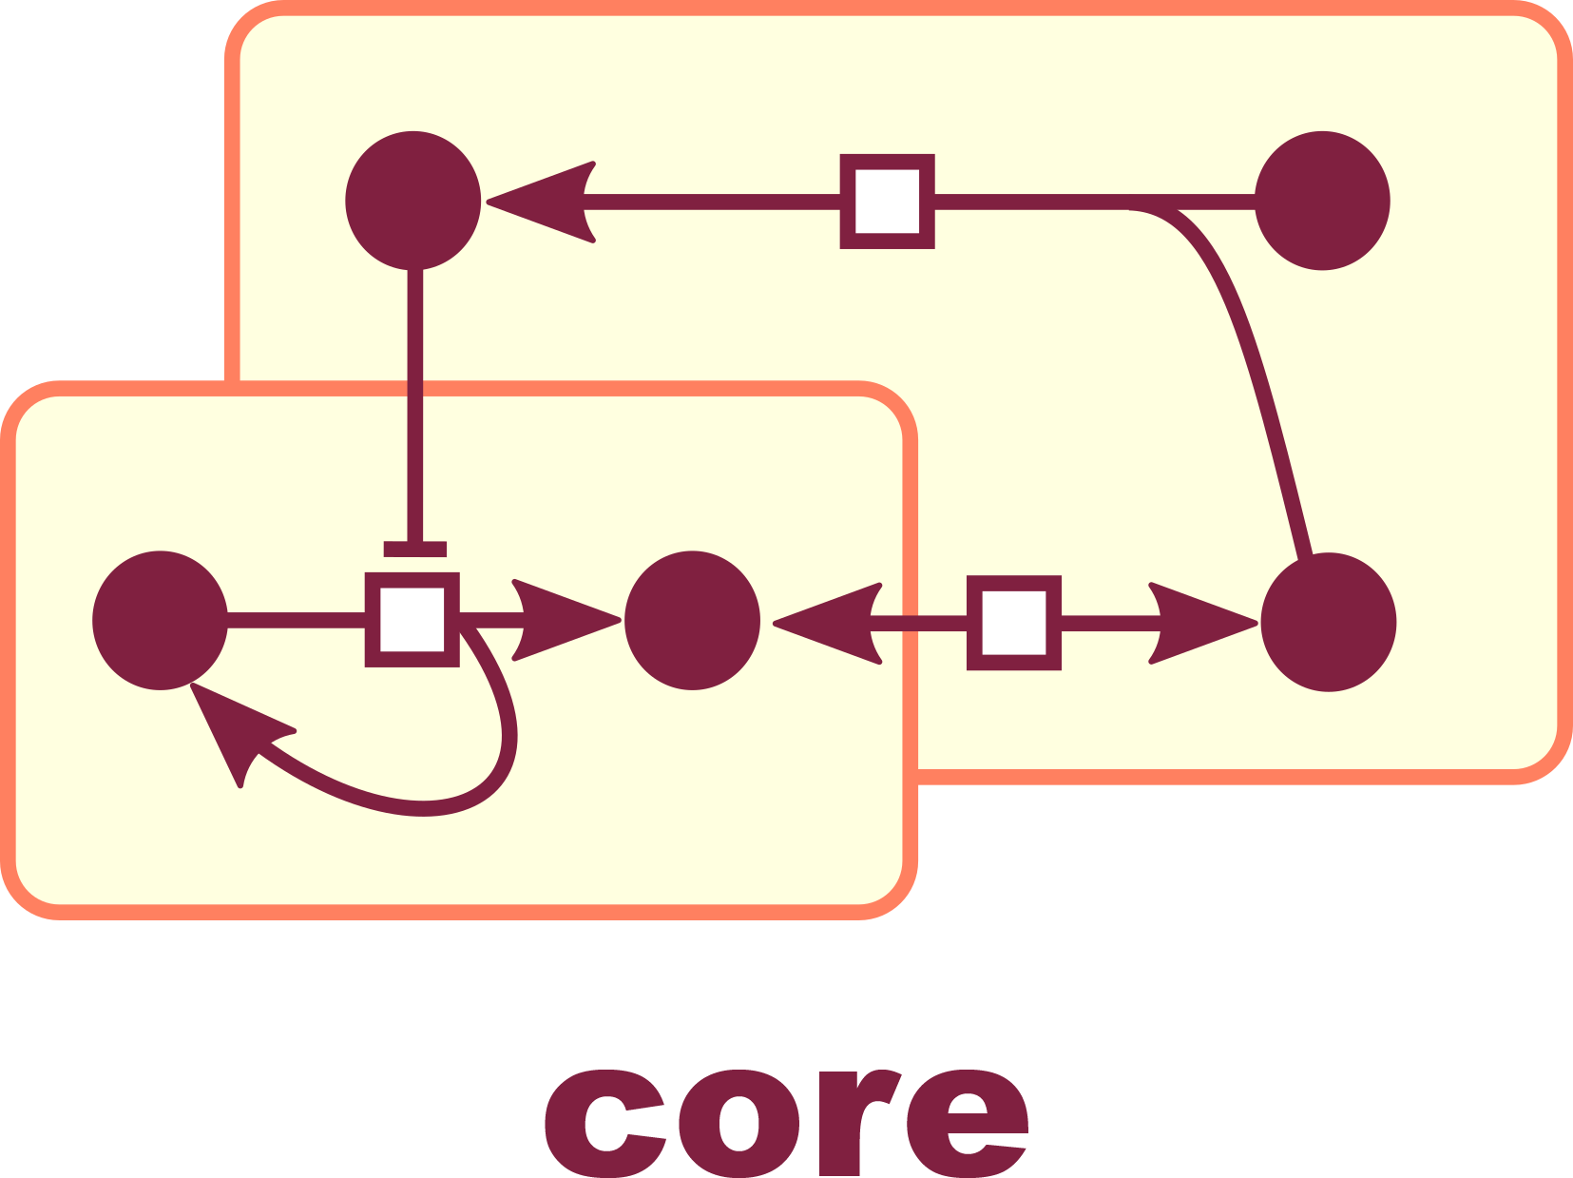
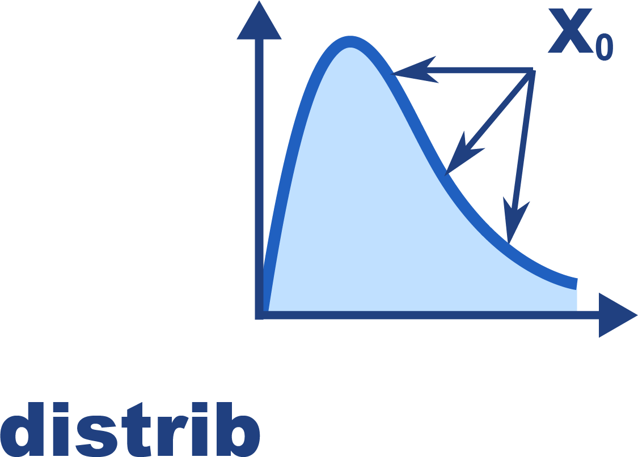

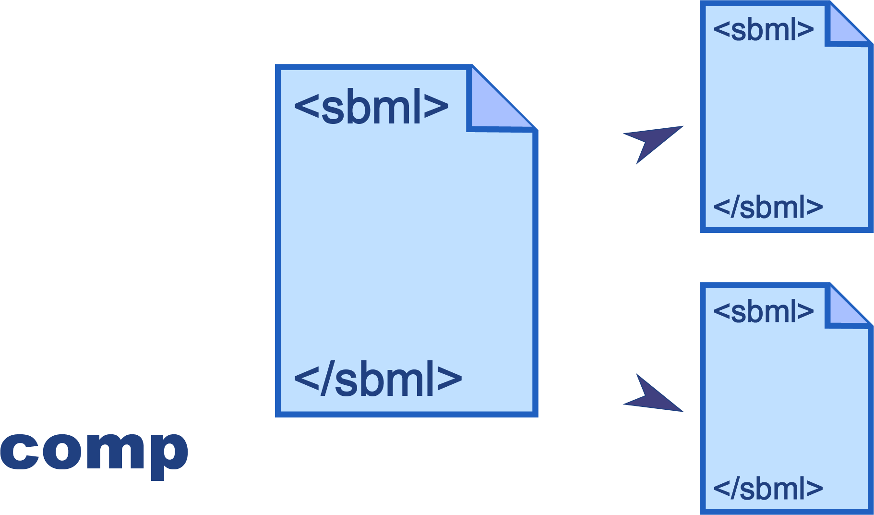
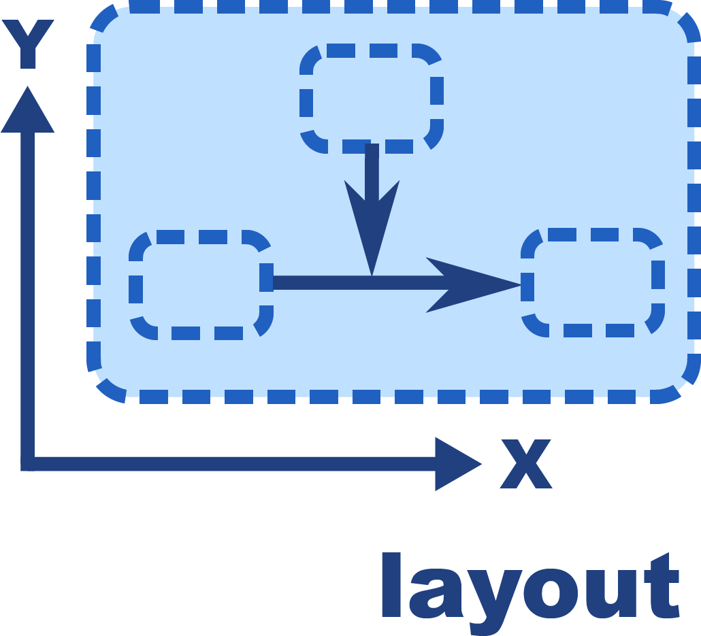
What is sbmlutils?
Collection of python utilities for programmatically developing SBML models https://github.com/matthiaskoenig/sbmlutils/ https://sbmlutils.readthedocs.io
Features
model creation, manipulation & merging
unit support
type annotations
annotation support
model reports
interpolations
file converters (XPP)
Packages
core, fbc, comp, distrib, layout

Slide 5
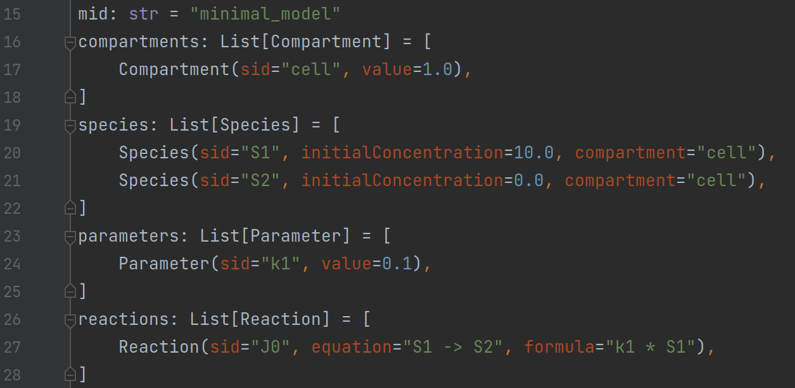
Model creation with sbmlutils
layer around libsbml
programatic generation (python)
type annotations, type hinting, auto-completion, documentation
validation with warnings/errors
model reports

Slide 6
Model annotations
object level annotations
every SBase can be annotation
restricted set of MIRIAM qualifiers
pattern based annotations
allowing to match objects based on regular expressions)
validation against MIRIAM resources
all identifiers are checked against MIRIAM regular expressions

Slide 7
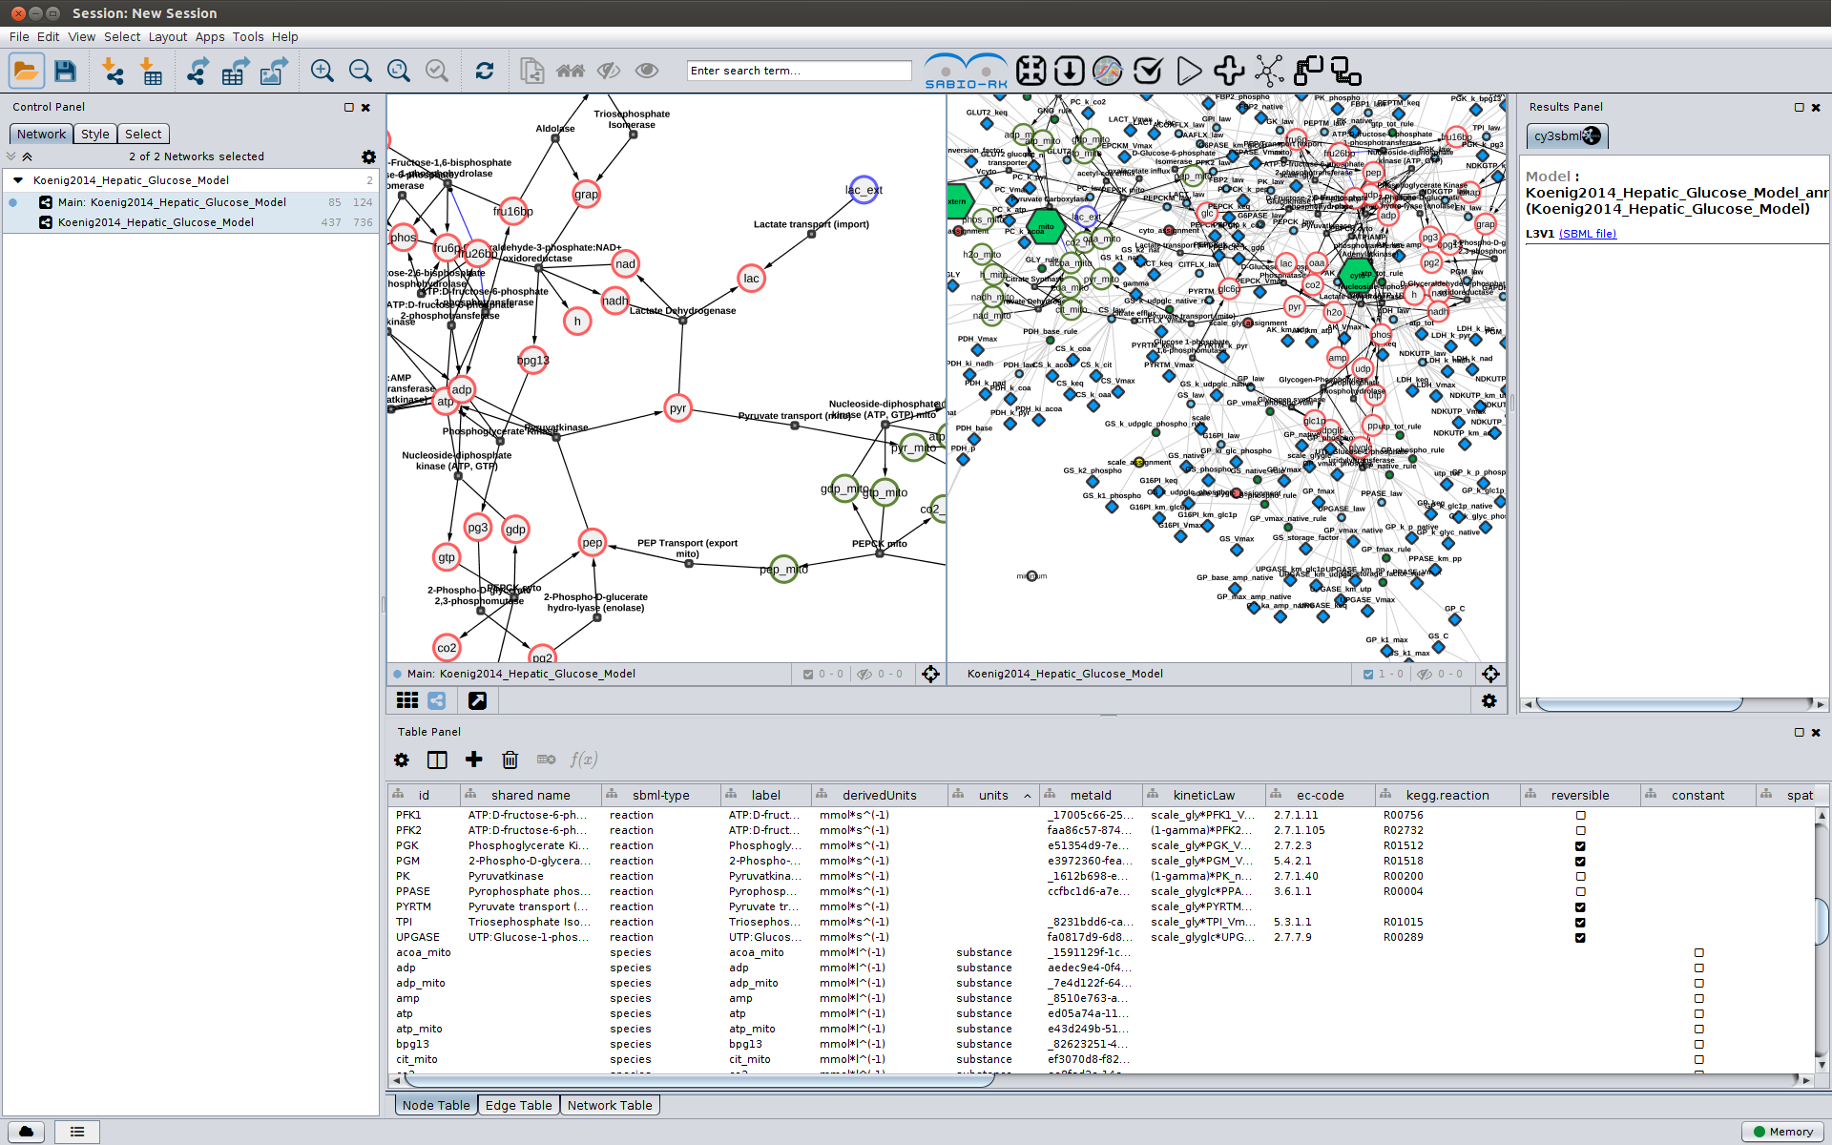
What is cysbml?
Cytoscape app for visualizing SBML models (ODE) https://github.com/matthiaskoenig/cysbml
Features
subgraphs & filtering
kinetic & reaction-species view
annotation support

Slide 8
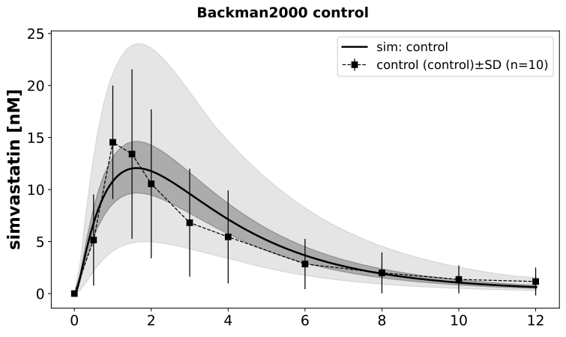
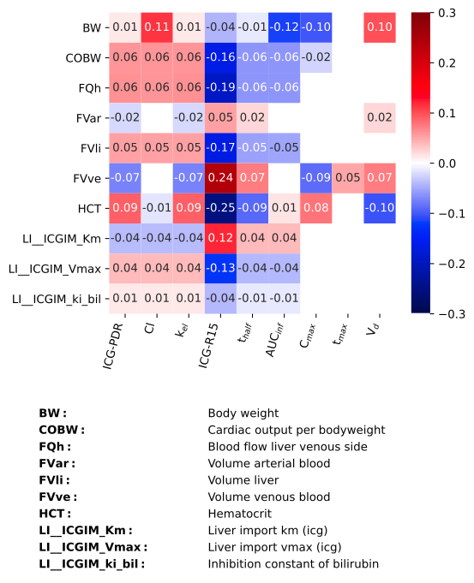
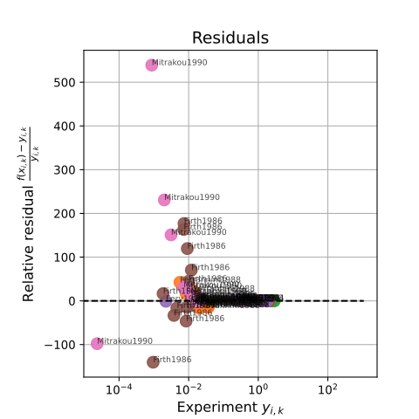
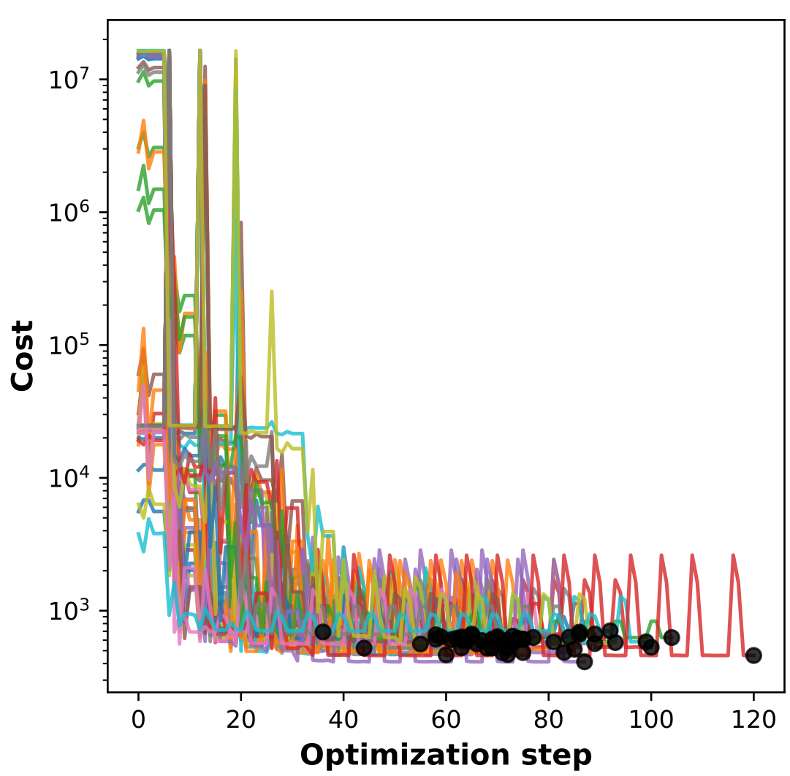
What is sbmlsim?
Collection of python utilities for simulating SBML models (ODE) https://github.com/matthiaskoenig/sbmlsim https://sbmlsim.readthedocs.io
Features
model simulation
data support
unit support (& conversion)
multi-core execution (ray)
simulation experiments (publications)
parameter scans
parameter fitting

