Slide 1








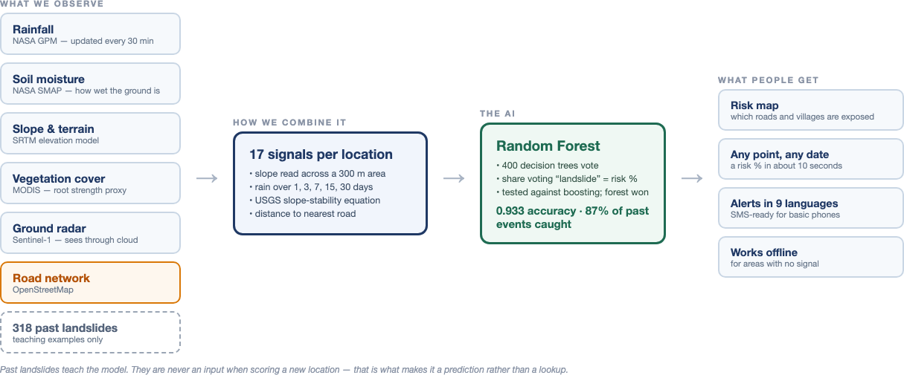









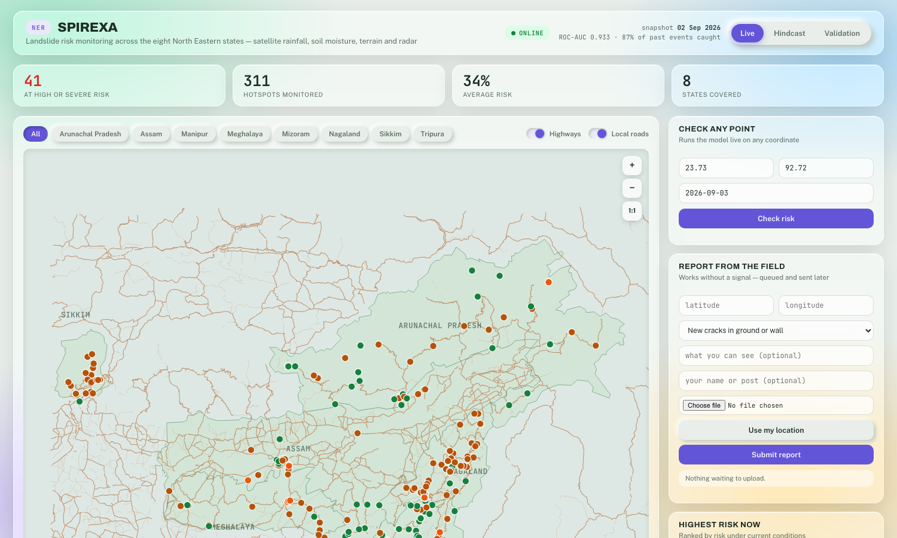
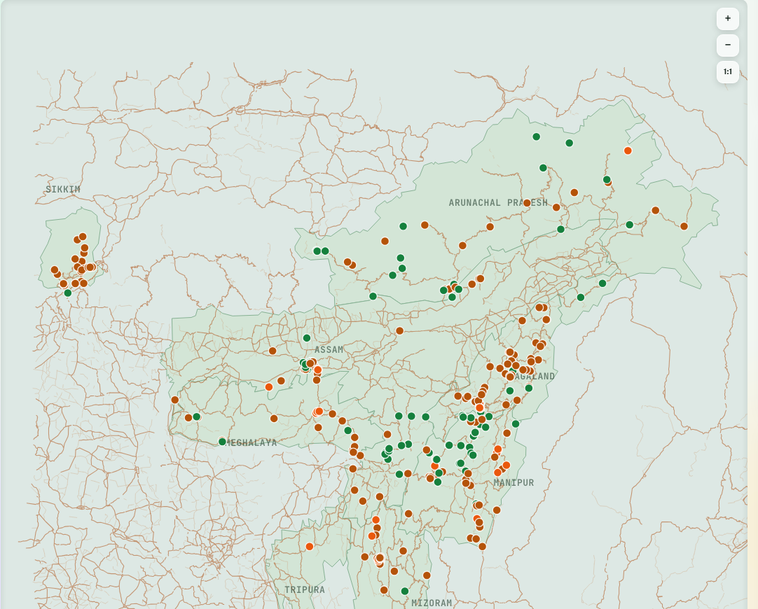
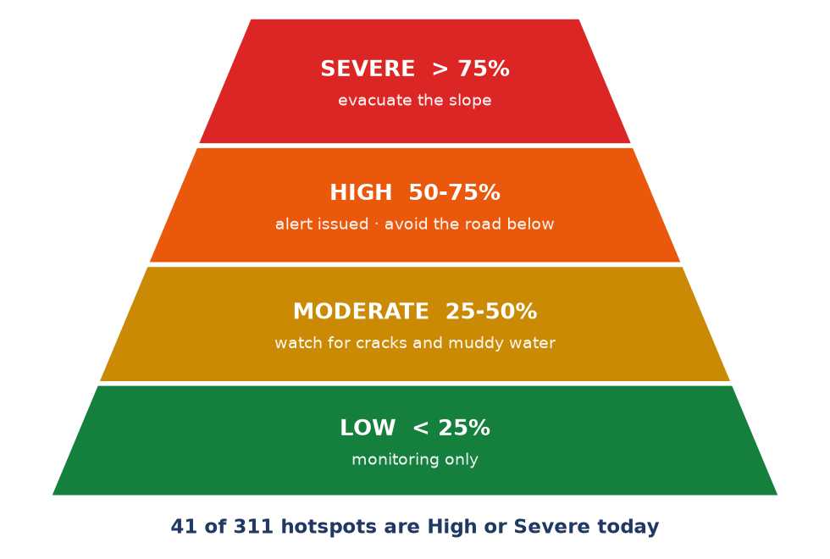



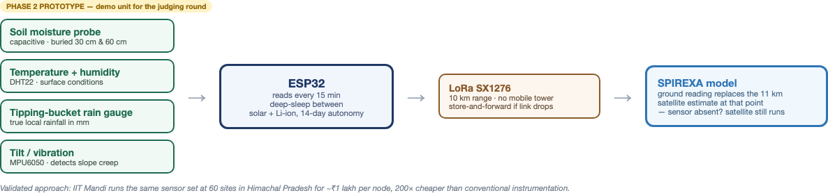

















AIC HUB 2026 – STUDENT PROJECT, PROTOTYPE & INNOVATION EXHIBITION
14th September, 2026
IIIT Allahabad
IIIT ALLAHABAD
SPIREXA — AI Landslide Early Warning System
SPIREXA
प्रज्ञानं ब्रह्म
Team SPIREXA · SIH 2026, PS 26001
Founder / Team Lead: Utkarsh & Team
|
IIITA:
□ Incubated Startup □ Student Startup ☑ Student Innovation □ Alumni Startup
01
PROBLEM / NEED
03
PROPOSED SOLUTION
06
KEY FEATURES / INNOVATION
What problem are you solving?
Brief overview of your product / technology / solution.
What makes your solution unique?
•
North-East India suffers frequent, high-fatality landslides every monsoon — roads, homes and lifeline infrastructure are cut off for days.
•
Give SPIREXA any coordinate and any date in the North-East — it returns a landslide risk percentage in about 10 seconds.
•
Trained on 318 real, documented NER landslides (2007–2025) — not a generic global model.
•
Monitoring today is reactive: action is taken only after a slope has already failed, not before.
•
A live GIS dashboard tracks 311 known danger spots across all 8 North-Eastern states, recalculated every day.
•
We caught a reporting bias: the model had learned “near roads” meant risk, not “steep and wet” — which under-warns remote villages.
•
One landslide at NHPC's Teesta-V station (Sikkim, Aug 2024) alone caused a loss of Rs 327 crore.
•
Automated alerts are generated in 9 regional languages, ready for SMS delivery to basic phones.
•
Terrain is read across a 300 m neighbourhood, not one point — coordinates usually mark where debris stopped, not the failure site.
•
329 deaths are recorded in the historical landslide events we studied for this project.
•
An offline-capable field app lets officers report hazards with no network signal.
•
USGS slope-stability physics is combined with machine learning, not either alone.
•
There is no region-specific, daily-updating early warning system for the North-East today.
•
Works offline, and alerts render in 9 regional languages automatically.
Add concept image / product illustration
What sets SPIREXA apart: region-specific training data, physics-informed features, and a caught-and-corrected reporting bias.
Rs 327 crore lost in a single landslide — NHPC Teesta-V, Sikkim, Aug 2024
04
HOW IT WORKS
07
APPLICATIONS / IMPACT
Where can it be used? What impact will it create?
Explain the working / workflow / architecture.
•
District administrations get a daily ranked watch-list instead of a phone call after the slope has already gone.
•
Remote villages receive warnings in their own language, on basic phones, with no internet required.
→
→
→
•
Road and power authorities see exactly which assets sit below an at-risk slope.
02
MOTIVATION / OPPORTUNITY
Satellites + Sensor
17 Features → ML
Risk Score
Alert Issued
•
Field officers get an offline reporting tool that syncs automatically when signal returns.
Why now: free satellite data + proven ML approach + a validated hardware precedent
Pipeline: 5 satellites + ground sensor → 17 features → Random Forest → risk % → alert, end-to-end in about 10 seconds.
•
Five satellite missions (rainfall, soil moisture, terrain, vegetation, radar) are now free and queryable in real time via Google Earth Engine.
From district control rooms to individual field officers — one system, ranked by urgency, in a language people actually read.
•
NASA's own global warning system, LHASA, proves that satellite data + machine learning is a viable approach at scale.
•
IIT Mandi has already proven low-cost ground sensors work in Indian mountain terrain, at ~Rs 1 lakh per site.
•
Smart India Hackathon Problem Statement 26001 explicitly calls for exactly this: an AI-based early warning system for NER.
08
CURRENT STATUS & FUTURE PLAN
•
No existing system combines region-specific ML, live satellite data, and field-level sensing in one platform.
05
PROTOTYPE / PRODUCT
Screenshots of the live system — not mockups.
Where are we now? What is next?
•
Working today: satellite pipeline, ML model, GIS dashboard, prediction API, 9-language alerts, offline field app.
•
In progress: an Arduino ground-sensor node feeding live rainfall and soil readings into the same dashboard.
•
Planned: SMS gateway integration — message logic is ready, only a paid account is missing.
•
Planned: a validation partnership with GSI or a state disaster management authority.
The building blocks already exist: free satellite data, a proven ML approach, a validated low-cost sensor design. No one has combined them for NER yet.
→
→
Software
working
Sensor
network
Official
adoption
09
DEMO / SUPPORTING MATERIAL
10
KEY METRICS / ACHIEVEMENTS
11
VISITOR NOTES / FOLLOW-UP
Demo video link:
Users / customers:
Visitor query:
Pitch deck link:
Pilot / deployment:
Interested person:
Product brochure:
Revenue / grant:
Organization:
Patent / paper:
TRL / stage:
Contact:
Media coverage:
Awards:
Follow-up action:
Demo requirement:
Validation data:
Remarks:
github.com/UtkarshCodecom/spirexa-ner — full source, live dashboard demo, and the Arduino sensor code
0.933 ROC-AUC (5-fold cross-validated) · 87% of 318 real historical landslides flagged in advance · 311 hotspots monitored daily · TRL-4 (validated in a simulated / lab environment, not yet field-deployed)
Use this space during exhibition for interaction notes, leads, and follow-up points
CONTACT & CONNECT
LOOKING FOR
GitHub:
github.com/UtkarshCodecom/spirexa-ner
□ Industry Collaboration
☑ Technology Partnership
LinkedIn:
□ Investment / Funding
☑ Pilot / Deployment Opportunities
Email:
yushkarsh@gmail.com
QR CODE — scan for the live project & source code
Phone:
☑ Mentorship
□ Talent / Internship
Address:
Innovate. Ignite. Impact.
|
Building Ideas. Creating Impact. Empowering Tomorrow.
|
#SPIREXA

