Slide 1

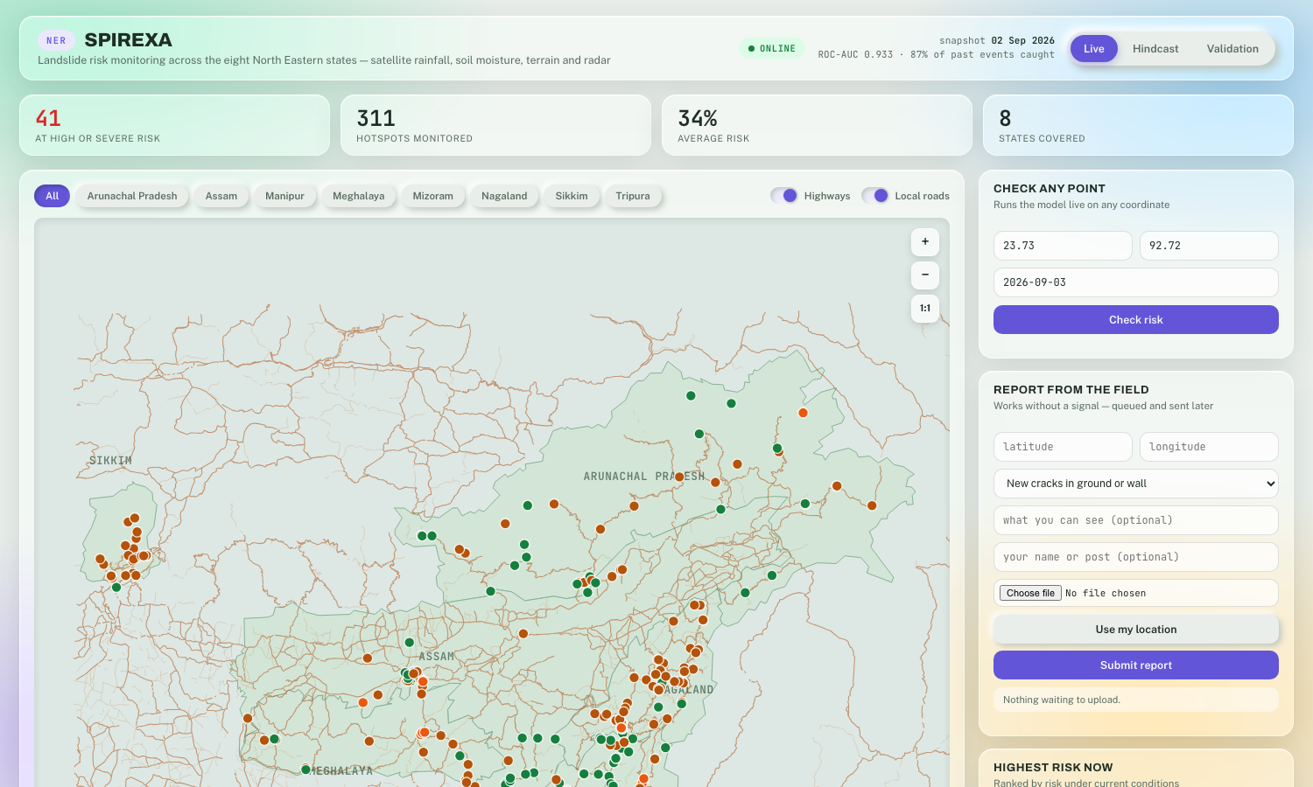


















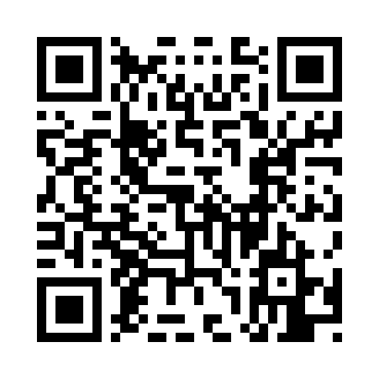

AIC HUB 2026
STUDENT PROJECT & INNOVATION EXHIBITION
SPIREXA
14th September, 2026 • IIIT Allahabad
SPIREXA — AI Landslide Warning
AI-based early warning
Team SPIREXA
Founder(s) / Team Members: Utkarsh (Team Lead) & Team
IIITA Connection:
□ Incubated Startup □ Student Startup ☑ Student Innovation □ Alumni Startup
Headquarters:
Website: github.com/UtkarshCodecom/spirexa-ner
Email: yushkarsh@gmail.com
Phone:
01
PROBLEM / NEED
04
APPLICATIONS / IMPACT
What problem are you solving?
Where can it be used? What impact will it create?
•
NER landslides cut off roads & homes every monsoon.
•
District control rooms get a daily ranked watch-list.
•
Warning today is reactive — only after a slope fails.
•
Remote villages get warnings in their own language.
•
NHPC Teesta-V (Aug 2024) alone: Rs 327 crore lost.
•
Field officers get offline hazard reporting.
02
OUR SOLUTION
05
CURRENT STATUS
Brief overview of your solution / product / technology.
•
Development Stage / TRL: TRL-4, lab-validated
•
Give any NER coordinate + date — risk % in ~10 seconds.
•
Prototype / Product: ML model + dashboard + Arduino sensor
•
Live GIS dashboard: 311 hotspots, recalculated daily.
•
IP / Patent (if any): None yet
•
Alerts auto-generated in 9 regional languages.
•
Achievements (if any): 0.933 ROC-AUC, 87% landslides flagged
•
Recognition / Awards (if any): None yet
03
KEY FEATURES / INNOVATION
06
FUTURE PLAN
What makes your solution unique?
What are your next milestones?
•
Trained on 318 real NER landslides (2007-2025).
•
Arduino ground-sensor node feeding the live dashboard.
•
Caught & fixed a road-proximity reporting bias.
•
SMS gateway integration (logic ready, account pending).
•
Physics (USGS slope-stability) + machine learning.
•
Validation partnership with GSI / state disaster mgmt.
07
HOW IT WORKS
08
LOOKING FOR
Brief workflow / architecture / working of your solution.
□ Industry Collaboration
□ Investment / Funding
☑ Mentorship
□ Other:
☑ Technology Partnership
☑ Pilot / Deployment
□ Talent / Internship
Input
→
Process
→
Solution
→
Alert
Website:
NOTES / ADDITIONAL INFORMATION
CONTACT &
CONNECT
LinkedIn:
Email:
QR CODE
Phone:
Scan to know more
(Website / Product Demo /
Video / Pitch Deck / etc.)
Innovate.
Ignite.
Impact.
|
Building
Ideas.
Creating
Impact.
Empowering
Tomorrow.
#SPIREXA

