Slide 1


SMART INDIA HACKATHON 2026
Problem Statement ID – SIH26001
Problem Statement Title- AI-Based Early Warning and Landslide Risk Monitoring System in NER
Theme- Disaster Management
PS Category- Software
Team ID-
Team Name (Registered on portal) - SPIREXA
Notes:
A working system, not a concept: live risk for 311 hotspots in all 8 NER states, validated against 318 real landslides.

Slide 2

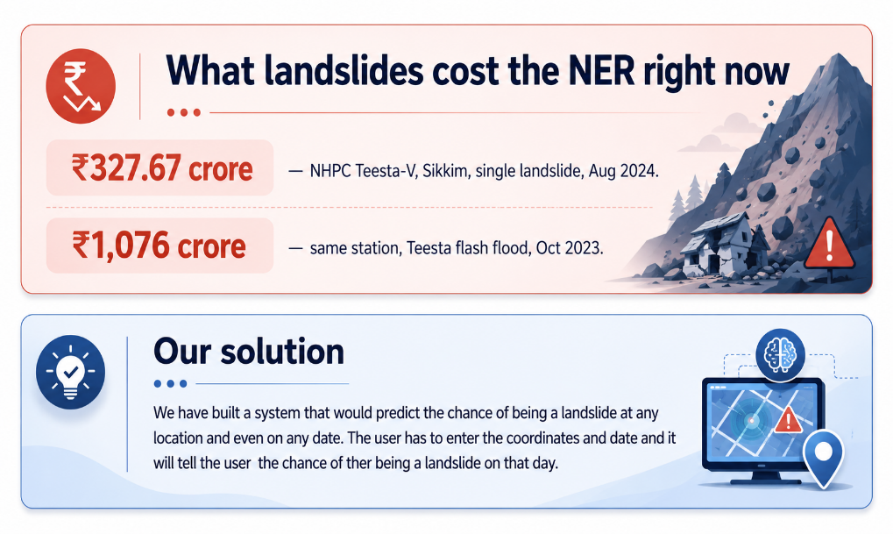
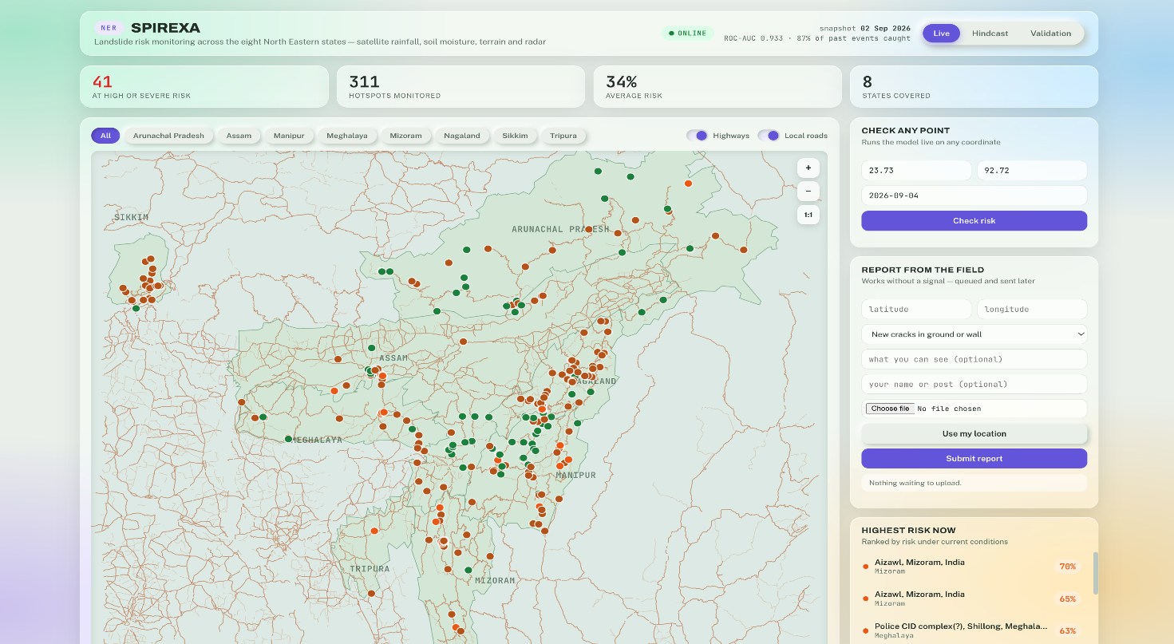
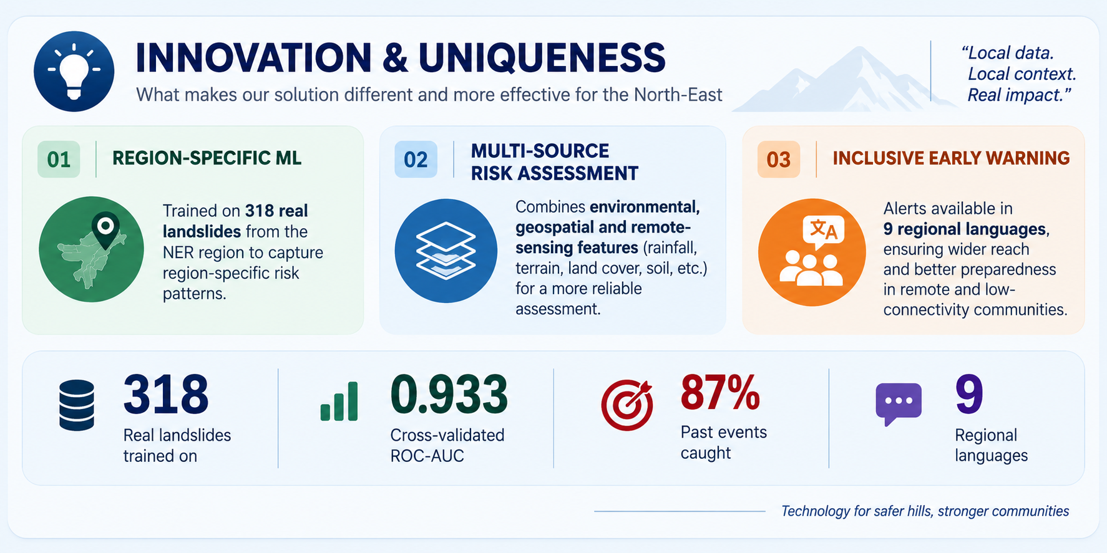
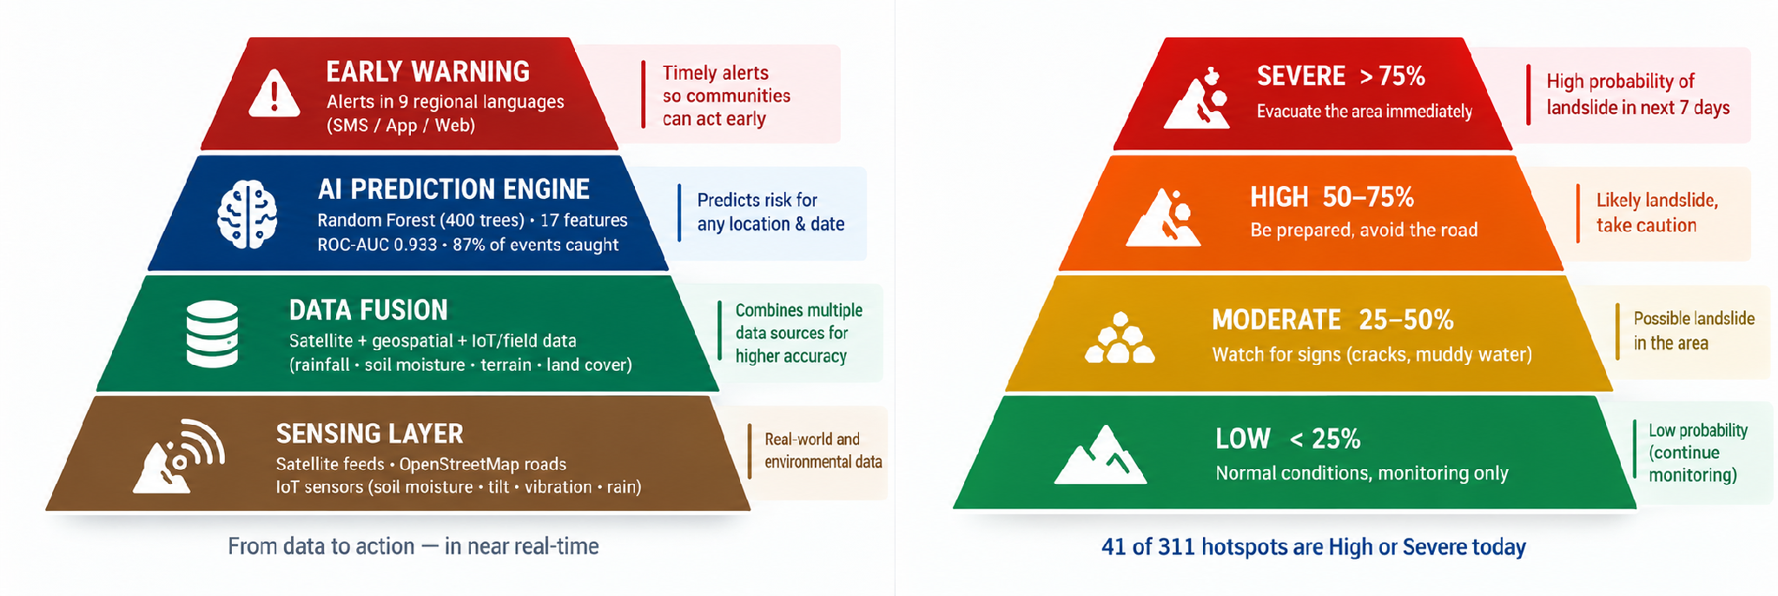
IDEA / PROPOSED SOLUTION
Live dashboard — running today
@SIH Idea submission- Template
2
Notes:
Open with the money: one landslide cost NHPC ₹327 crore at Teesta-V in Sikkim. Then show this runs today.

Slide 3
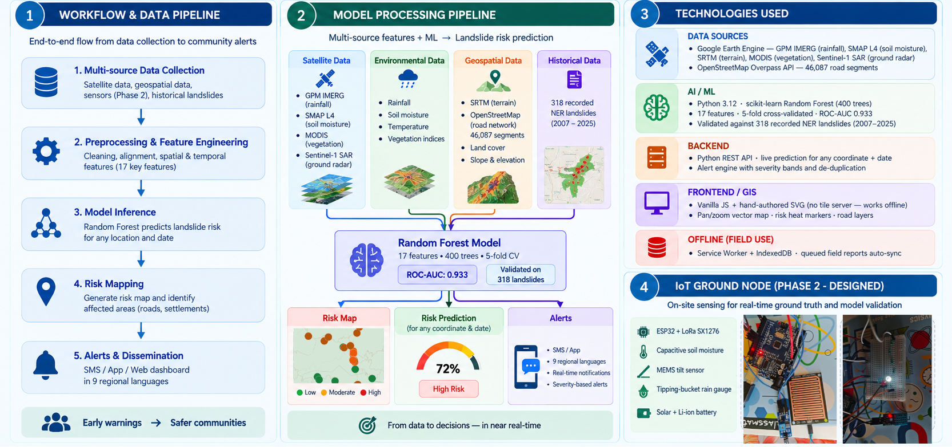
SPIREXA
TECHNICAL APPROACH
@SIH Idea submission- Template
3
Notes:
The IoT node is a demo unit, clearly labelled Phase 2. The satellite model runs without it.

Slide 4
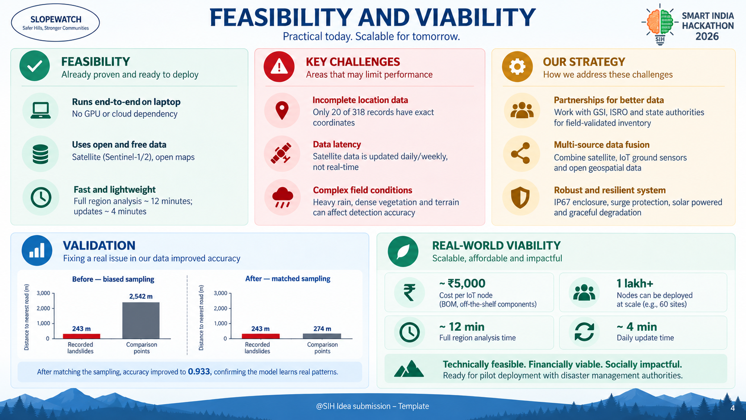
SPIREXA
FEASIBILITY AND VIABILITY
Feasibility — already proven
Potential challenges and risks
Strategies for overcoming them
Runs end-to-end today on a laptop — no GPU, no cloud bill.
All satellite data free for non-commercial use.
Full rebuild 12 min; daily refresh 4 min.
IoT node ≈ ₹5,000 — IIT Mandi proved ₹1 lakh units work at 60 sites.
Only 20 of 318 records have exact coordinates.
Satellite lag makes this a daily forecast, not minute-by-minute.
Soil moisture and radar do not exist before 2015.
Field hardware faces rain, lightning, animals and theft.
Partner with GSI for the field-validated inventory — the single biggest gain available.
IoT nodes give minute-level ground truth where satellites cannot.
IP67 enclosure, surge protection, solar sized for 14 sunless days.
System degrades gracefully — a dead node never breaks it.
Proven precedent — and where we differ
Why our numbers can be trusted — we broke our own model to fix it
IIT Mandi (Dr K. V. Uday, Dr Varun Dutt) runs an AI landslide warning system at 60 sites in Himachal Pradesh. Their nodes read soil moisture, rainfall, temperature, humidity and ground movement, warn up to 3 hours ahead at >90% accuracy, and cost about ₹1 lakh — roughly 200× cheaper than conventional instrumentation.
Why that matters to us: it proves the sensor set we are prototyping works in Indian mountain conditions.
Where we differ: their system watches 60 instrumented points. Ours watches the whole region from orbit — no hardware needed to cover a new village. The two are complementary: satellites decide where to look, ground nodes confirm what is happening there.
Adding road data pushed accuracy to 0.953. It was a bug.
Landslides get recorded when someone notices them — near roads. Our comparison points sat 10× farther away, so the model learned “near a road” instead of “steep and saturated”. Deployed, it would have told remote villages they were safe.
We matched the sampling, accuracy fell to 0.933, and rainfall became the top factor — exactly what the science predicts.
@SIH Idea submission- Template
4
Notes:
Lead the IIT Mandi point with respect — they proved the hardware. We add the regional satellite layer they cannot.

Slide 5
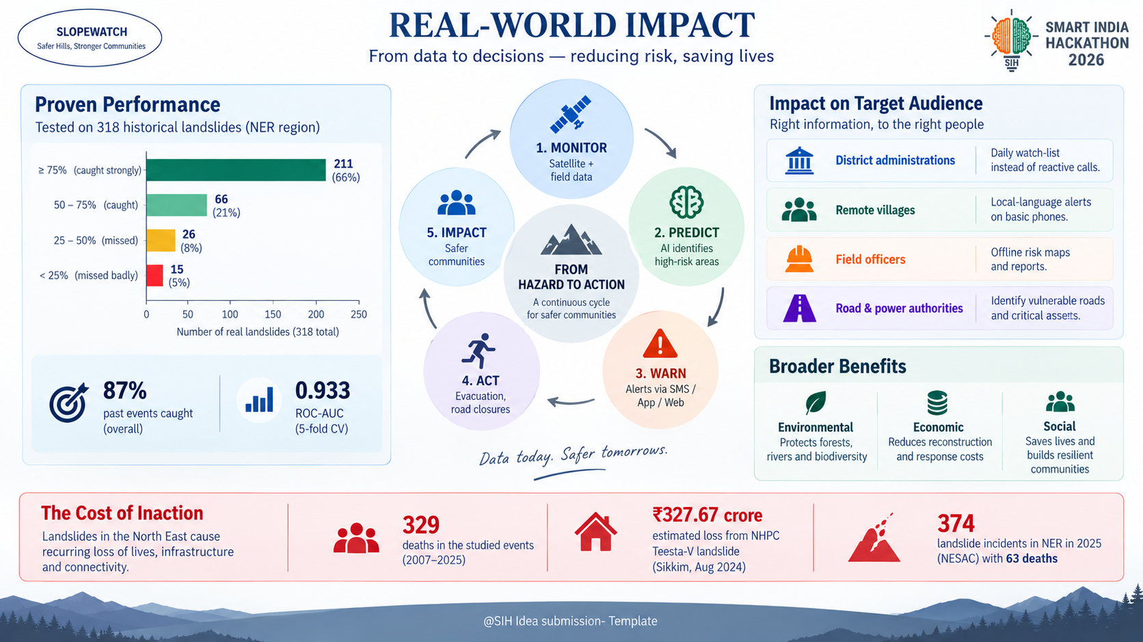
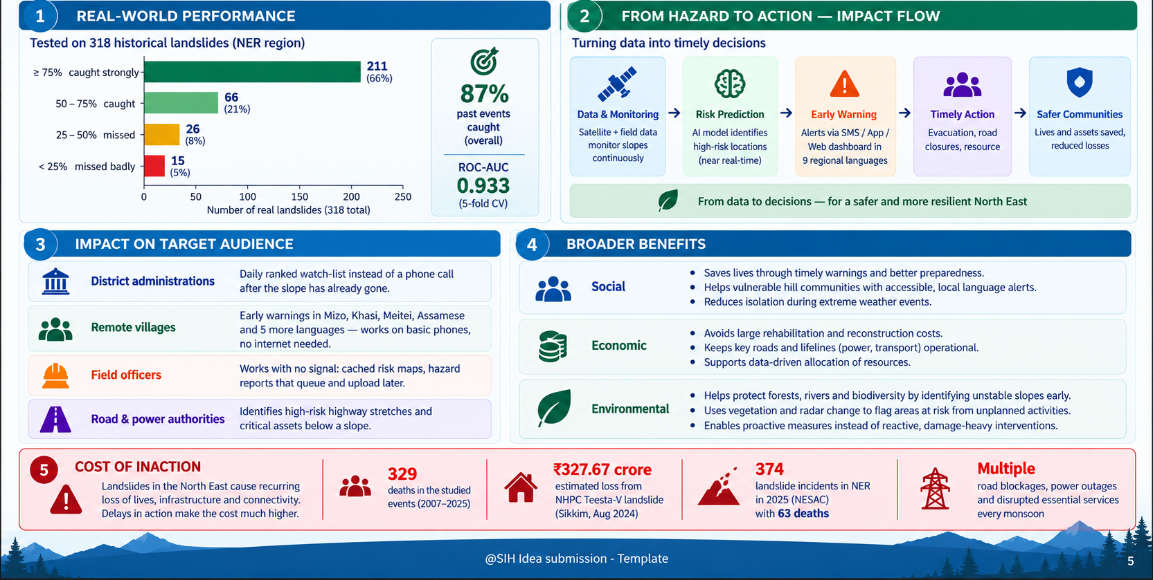
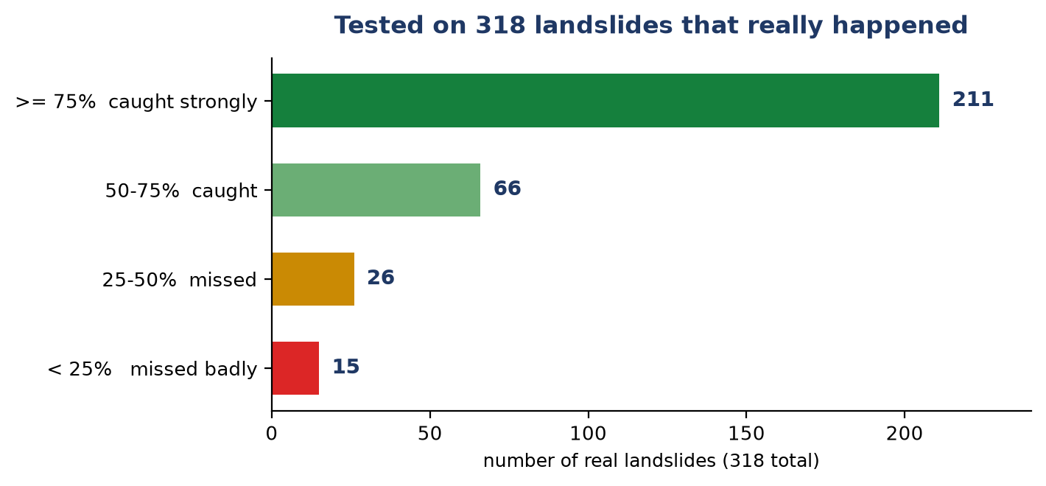
SPIREXA
IMPACT AND BENEFITS
Cost of
inaction
₹327 cr
NHPC Teesta-V
one landslide
Aug 2024
329
deaths in the
events
Potential impact on the target audience
Benefits — social, economic, environmental
District administrations
A daily ranked watch-list instead of a phone call after the slope has already gone.
Social
Warns the isolated villages a road-biased model would have missed. 329 deaths are recorded in the events we studied.
Remote villages
Warnings in Mizo, Khasi, Meitei, Assamese and five more — on basic phones, no internet.
Economic
A single Teesta-V style loss is ₹327 crore. Pre-emptive slope work costs a fraction of rebuilding. Free satellite data, no GPU.
Field officers
Works with no signal: cached risk map, hazard reports that queue and upload later.
Environmental
Flags slopes destabilised by unplanned hill-cutting, using vegetation loss and radar surface change.
Road & power authorities
Shows which highways and which assets sit below a slope at risk.
@SIH Idea submission- Template
5
Notes:
Every landslide in the left chart really happened; the model scored them without ever seeing them in training.

Slide 6
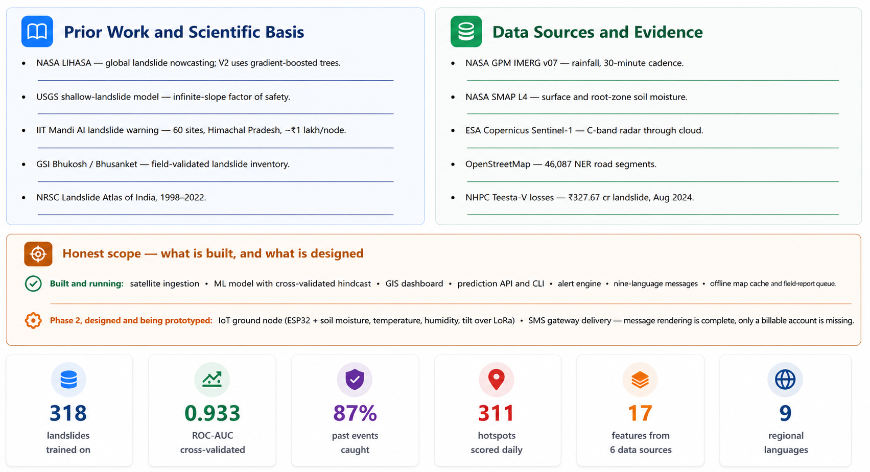
SPIREXA
RESEARCH AND REFERENCES
Data sources and evidence
->
->
NASA GPM IMERG v07 — rainfall, 30-minute cadence.
https://gpm.nasa.gov/data/imerg
->
->
NASA SMAP L4 — surface and root-zone soil moisture.
https://smap.jpl.nasa.gov/
->
->
ESA Copernicus Sentinel-1 — C-band radar through cloud.
https://sentiwiki.copernicus.eu/web/s1-mission
->
->
OpenStreetMap — 46,087 NER road segments.
https://www.openstreetmap.org/copyright
->
->
NHPC Teesta-V losses — ₹327.67 cr landslide, Aug 2024.
indiatodayne.in — Sikkim landslide, ₹327 cr loss to Teesta-V
318
0.933
87%
311
9
17
landslides
trained on
ROC-AUC
cross-validated
past events
caught
hotspots
scored daily
features from
6 data sources
regional
languages
@SIH Idea submission- Template
6
Notes:
Close on scope honesty. It reads as rigour and pre-empts the 'is this actually built?' question.

