Slide 1

Syncy
No more wincing at
“who was that?”
TEAM
Nodirbek
Utkarsh
Bhuvanesh
Anastasiya
Sadaf
Product & frontend
Backend & AI
Data & cost model
Research & go-to-market
Economics
Mentor: Bita
BCBT AI Entrepreneurship Hackathon
Notes:
[0:00–0:20] Open with the question: "Hands up if you have opened LinkedIn after an event and had no idea who someone was." Then: "We are Syncy." Name the team in one breath, then thank the mentor by name.

Slide 2
You meet 200 people a year.
A week later, most are just a name
THE PROBLEM
27 h
€2,780
5 / 10
In average to follow up properly:
8 minutes per contact for notes, profile, project and message
of billable time a year, at the €103 average freelancer hourly rate
people we asked lost a contact they meant to follow up
Hourly rate: Freelancer-Kompass 2026. 200 contacts a year and 8 minutes per contact are our estimates.
Notes:
[0:20–1:05] A consultant who goes to two events a month meets about 200 people a year. Doing the follow-up properly takes about 8 minutes each: write down what was said, find the profile again, decide which project they matter for, write a personal message. That is 27 hours a year, about €2,780 of billable time at the €103 average rate. Most people skip it, and the contact is lost. Read the survey count out loud (fill the bracket first). Then the solution in one sentence: scan, talk for 20 seconds, get a follow-up matched to your own projects.

Slide 3
THE PROBLEM
It is not only about the money, it is more about
the lost opportunities
Hourly rate: Freelancer-Kompass 2026. 200 contacts a year and 8 minutes per contact are our estimates.
Notes:
[0:20–1:05] A consultant who goes to two events a month meets about 200 people a year. Doing the follow-up properly takes about 8 minutes each: write down what was said, find the profile again, decide which project they matter for, write a personal message. That is 27 hours a year, about €2,780 of billable time at the €103 average rate. Most people skip it, and the contact is lost. Read the survey count out loud (fill the bracket first). Then the solution in one sentence: scan, talk for 20 seconds, get a follow-up matched to your own projects.

Slide 4
5 steps. 4 apps.
HOW SYNCY REMOVES THE FRICTION
TODAY
1
2
3
4
5
8 min
Connect on LinkedIn
Type notes on your phone
Find the profile again
Decide which project
Write the message
WITH SYNCY
1 Scan
2 Talk
3 Review and send
2 min
their LinkedIn or Xing QR
and create your note
AI card, project match, draft
1 app. 1 minute.
Notes:
[1:05–1:45] Today the follow-up is five manual steps across LinkedIn, a notes app, Notion and email. With Syncy it is three: scan, talk, review. The AI does four jobs: transcribes the memo, summarises it, matches the person to one of your own Notion projects with a reason, and drafts the follow-up. Be precise about Notion: we import your projects from Notion; the contacts live in Syncy. Nothing is sent without your review.

Slide 5
DEMO
LIVE
Scan → Talk → Follow up
Enter the event · scan QR · 20-second memo · AI card with project match · save · dashboard
Real AI calls. Invented demo people only. Backup: the 2-minute screen recording.

Slide 6
COST TO RUN
€0.11
€550
AI for 1 paying customer a year, at 200 contacts
infrastructure cost a year
AI per contact, 60-second voice memo
Fixed services, per year
API call | Usage (in + out) | Cost
Whisper transcription | 60 seconds | €0.00018
Summary | 800 + 120 tokens | €0.00014
Match + follow-up | 1,200 + 180 tokens | €0.00021
Total per contact |  | €0.00053
Service | Plan | Per year
Supabase | Pro, up to 100k MAU | $300
Vercel | Pro, one seat | $240
Domain | Cloudflare | $10
Email, Google sign-in | Free tiers | $0
Total fixed |  | $550
OpenRouter list prices, Oct 2026: GPT-6 Luna and Whisper Large V3 Turbo. The year-1 budget adds a 10× AI buffer and the free users. The MVP was built in 4 days.
Notes:
[3:50–4:25] Every contact makes three AI calls: transcription, summary, and the project match with the follow-up draft. At today’s list prices that is $0.00053 for a full 60-second memo. A paying customer with 200 contacts a year costs about 11 cents in AI. Fixed services are about $550 a year, and Supabase Pro carries up to 100,000 monthly active users. In the business plan we budget €2,000 for hosting and AI in year one, with a 10× buffer, against about €11,000 of revenue. Running cost is not our risk.

Slide 7
Target Users
Freelancers
Entrepreneurs
Business Professionals
Job seekers or Networking Professionals

Slide 8
Free to try. €9 a month to keep
PLANS
Free
Pro
Team (b2b)
€0
€9
€19
forever
a month, €108 a year
per seat a month
1 event and up to 3 contacts a month
AI summary and follow-up drafts
Unlimited contacts
Notion project import and matching
Contacts dashboard
Shared contacts across a team
Export to HubSpot or another CRM
One €5,000 client project pays for 46 years of Pro.
The €5,000 project is an illustrative example. The Team price is a hypothesis we set after the Pro pilots.
Notes:
[6:15–6:35] Free gets people to the first event: one event and up to 25 contacts a month. Pro is €9 a month, €108 a year, with unlimited contacts and the Notion project matching. The team plan at €19 a seat comes in 2028. One won client project of €5,000 pays for 46 years of Pro.

Slide 9
88% gross margin from 1,000 paying users
GROSS MARGIN
Paying users | Revenue a year | Cost per user a year | Gross margin
100 | €10,800 | €20.36 | 81%
500, year 1 target | €54,000 | €14.10 | 87%
1,000 | €108,000 | €13.45 | 88%
5,000 | €540,000 | €12.75 | 88%
10,000 | €1,080,000 | €12.67 | 88%
€108
revenue per paying user a year
€13.45
cost to serve them, at 1,000 users
8,000
total users at the end of year 1: 500 paying, 7500 free
Cost per user: AI at 10× list price, AI for 19 free users per payer, Stripe fees on monthly billing, hosting; net of VAT. Team and marketing are on the Ask slide.
Notes:
[6:35–7:05] Each paying user brings €108 a year. Serving them costs about €13 at 1,000 users, even with AI budgeted at ten times the list price and the free users they bring. That is 88% gross margin from 1,000 users on. At our year-one target of 400 paying users we sit between 81% and 87%, with about 8,000 users in total. Most of the €13 is Stripe fees on monthly billing and the free users, not our own AI.

Slide 10
FUNDING
€54k
€220k
yearly run-rate at year end
8,000
for the first 12 months, team of 4
users in total, 7,500 of them free
Dec 2026
Mar 2027
Aug 2027
2028
20 pilot users
Paid launch
500 paying users
Expansion
Across Europe
Survey: 10 people we know who go to events, a first signal, not proof. Targets from the Syncy business plan; 19 free users per paying user.
Notes:
[4:25–5:00] FILL THE BRACKETS FROM THE SURVEY BEFORE PRESENTING, and never round up. Say plainly: 10 people we know, a first signal, not proof. Then the plan: 20 pilot users in December, paid launch in June, 400 paying users by October 2027. That is about €11,000 of revenue in year one and a €43,000 yearly run-rate at the end (400 × €108). With 19 free users per payer we carry about 8,000 users in total.

Slide 11
USE OF FUNDS
Founder salaries €2,500 a month. Year-1 cost €228k minus about €11k revenue. At Berlin market salaries the plan needs about €480k.
Notes:
[5:00–5:40] We ask for €220,000 for the first 12 months with a team of four on €2,500 a month each. Year one costs about €228,000; we expect about €11,000 of revenue. Two thirds goes to the team, then contingency, setup and legal, marketing and events. Hosting and AI is only €2,000. The milestones: 20 pilots in December, paid launch in June, 400 paying users by October 2027, then the team plan and Austria and Switzerland in 2028. Break-even is about 2,100 paying users. AGREE BEFOREHAND which four people are paid and stay on full-time; investors will ask.

Slide 12

Syncy
No more wincing at
“who was that?”
Thank you. Questions?
Team Syncy · BCBT AI Entrepreneurship Hackathon · CIC Berlin
Notes:
[7:40–8:00] Close on the motto and the ask in one line: "€220,000 to prove consultants pay for a follow-up that knows their projects." Then stop and take questions. Likely questions: why €9, what stops folk or Popl adding project matching, what the survey showed, and who stays full-time.

Slide 13
18 hours and €1,890 back per person, every year
WHAT IT SAVES
8 → 2
 | Per contact | Per month | Per year
Time today | 8 min | 2.6 h | 27 h
With Syncy | 2 min | 0.7 h | 8 h
Time saved | 6 min | 2 h | 24 h
Value saved | €9 | €157 | €1,890
minutes per contact
17×
the €108 yearly price of Pro, paid back in billable time
Our estimates: 200 contacts a year (about 17 a month), €103 an hour. We time the 2 minutes live in the demo.
Notes:
[1:45–2:20] Per contact, Syncy cuts 8 minutes to about 2.5 minutes of checking and sending. That is 1.5 hours a month and 18 hours a year, worth about €1,890 of billable time. Pro costs €108 a year, so it pays back about 17 times. Careful: 27 hours is what follow-up costs today, not what we save. The saving is 18 hours. Both minute figures are estimates; the demo shows the real time from scan to saved contact.

Slide 14
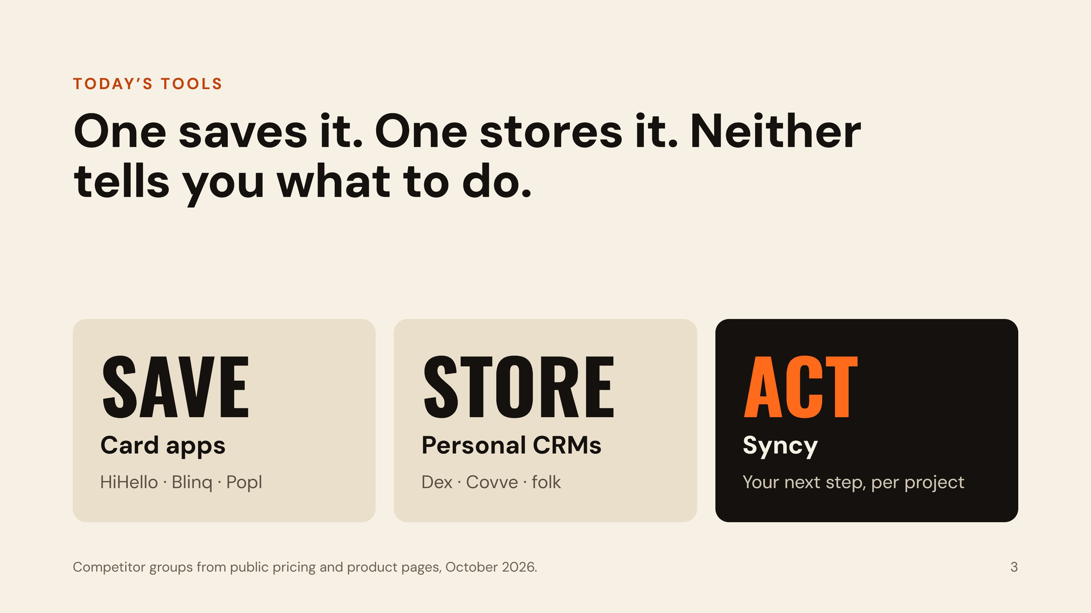
asdasdasd tools
One saves it. One stores it. Neither
tells you what to do.
SAVE
HiHello · Blinq · Popl
STORE
Dex · Covve · folk
ACT
Your next step, per project
Competitor groups from public pricing and product pages, October 2026.
3

Slide 15
COMPETITION
Tool | AI voice notes | Matches your projects | Follow-up draft | Built for | Price a month
Syncy | Yes | Yes, from your Notion | Yes | One consultant | €9
Popl | Yes, AI Recorder | Not seen | Yes, next steps | Event teams | Sales-led
folk | Yes | Not seen | Yes, recaps | Small-team CRM | €22–27 a seat
Blinq | Yes, AI Notetaker | Not seen | Not seen | Digital cards | $9.99
Dex | Voice mode | Not seen | Not seen | Personal CRM | $20
LinkedIn + notes | Manual | No | No | Everyone | €0
Desk research of vendor pricing and help pages, 25 Oct 2026. "Not seen" = not found there. List prices; they change.
Notes:
[5:40–6:15] Be honest here, it wins trust: Popl, folk and Blinq already offer AI voice notes, and folk and Popl give next steps. What none of them does is match a new contact to the projects you are actually working on. Our biggest competitor is free: LinkedIn plus a notes app. We win only by saving real time after every event. Re-check Dex and Popl the morning of the pitch for new features.

Slide 16
COST TO RUN
€0.11
€550
€2k vs €54k
AI for one paying customer a year, at 200 contacts
fixed services a year
Year 1 Budget
Year 1 Revenue
AI per contact, 60-second voice memo
Fixed services, per year
API call | Usage (in + out) | Cost
Whisper transcription | 60 seconds | €0.00018
Summary | 800 + 120 tokens | €0.00014
Match + follow-up | 1,200 + 180 tokens | €0.00021
Total per contact |  | €0.00053
Service | Plan | Per year
Supabase | Pro, up to 100k MAU | €300
Vercel | Pro, one seat | €240
Domain | Cloudflare | €10
Email, Google sign-in | Free tiers | €0
Total fixed |  | €550
OpenRouter list prices, Oct 2026: GPT-6 Luna and Whisper Large V3 Turbo. The year-1 budget adds a 10× AI buffer and the free users. The MVP was built in 4 days.
Notes:
[3:50–4:25] Every contact makes three AI calls: transcription, summary, and the project match with the follow-up draft. At today’s list prices that is $0.00053 for a full 60-second memo. A paying customer with 200 contacts a year costs about 11 cents in AI. Fixed services are about $550 a year, and Supabase Pro carries up to 100,000 monthly active users. In the business plan we budget €2,000 for hosting and AI in year one, with a 10× buffer, against about €11,000 of revenue. Running cost is not our risk.

Slide 17
One contact costs $0.00053 in AI. A customer’s whole year costs 11 cents
COST TO RUN
AI per contact, 60-second voice memo
Fixed services, per year
API call | Usage (in + out) | Cost
Whisper transcription | 60 seconds | $0.00018
Summary | 800 + 120 tokens | $0.00014
Match + follow-up | 1,200 + 180 tokens | $0.00021
Total per contact |  | $0.00053
Service | Plan | Per year
Supabase | Pro, up to 100k MAU | $300
Vercel | Pro, one seat | $240
Domain | Cloudflare | $10
Email, Google sign-in | Free tiers | $0
Total fixed |  | $550
$0.11
$550
€2k vs €11k
AI for one paying customer a year, at 200 contacts
fixed services a year; $790 if email needs Resend Pro
year-1 hosting and AI budget against year-1 revenue
OpenRouter list prices, Oct 2026: GPT-6 Luna and Whisper Large V3 Turbo. The year-1 budget adds a 10× AI buffer and the free users. The MVP was built in 4 days.
Notes:
[3:50–4:25] Every contact makes three AI calls: transcription, summary, and the project match with the follow-up draft. At today’s list prices that is $0.00053 for a full 60-second memo. A paying customer with 200 contacts a year costs about 11 cents in AI. Fixed services are about $550 a year, and Supabase Pro carries up to 100,000 monthly active users. In the business plan we budget €2,000 for hosting and AI in year one, with a 10× buffer, against about €11,000 of revenue. Running cost is not our risk.

Slide 18
DEMAND
WHAT THE SURVEY SAYS
[5 / 10]
often forget who someone was
[8 min]
Average time spent on sorting contacts after an event.
[6 / 10]
would pay €9 a month
Survey: 10 people we know who go to events, a first signal, not proof. Targets from the Syncy business plan; 19 free users per paying user.
Notes:
[4:25–5:00] FILL THE BRACKETS FROM THE SURVEY BEFORE PRESENTING, and never round up. Say plainly: 10 people we know, a first signal, not proof. Then the plan: 20 pilot users in December, paid launch in June, 400 paying users by October 2027. That is about €11,000 of revenue in year one and a €43,000 yearly run-rate at the end (400 × €108). With 19 free users per payer we carry about 8,000 users in total.

Slide 19
FUNDING
YEAR 1 PLAN
Dec 2026
20 pilot users
Jun 2027
Paid launch
Oct 2027
400 paying users
€11k
€43k
8,000
revenue in year 1
yearly run-rate at year end
users in total, 7,600 of them free
Survey: 10 people we know who go to events, a first signal, not proof. Targets from the Syncy business plan; 19 free users per paying user.
Notes:
[4:25–5:00] FILL THE BRACKETS FROM THE SURVEY BEFORE PRESENTING, and never round up. Say plainly: 10 people we know, a first signal, not proof. Then the plan: 20 pilot users in December, paid launch in June, 400 paying users by October 2027. That is about €11,000 of revenue in year one and a €43,000 yearly run-rate at the end (400 × €108). With 19 free users per payer we carry about 8,000 users in total.

Slide 20
THE ASK
€220k
for the first 12 months, team of 4
Break-even at about 2,100 paying users. This round buys the proof that people pay.
Founder salaries €2,500 a month. Year-1 cost €228k minus about €11k revenue. At Berlin market salaries the plan needs about €480k.
Notes:
[5:00–5:40] We ask for €220,000 for the first 12 months with a team of four on €2,500 a month each. Year one costs about €228,000; we expect about €11,000 of revenue. Two thirds goes to the team, then contingency, setup and legal, marketing and events. Hosting and AI is only €2,000. The milestones: 20 pilots in December, paid launch in June, 400 paying users by October 2027, then the team plan and Austria and Switzerland in 2028. Break-even is about 2,100 paying users. AGREE BEFOREHAND which four people are paid and stay on full-time; investors will ask.

Slide 21
Three scenarios for the year-3 revenue run-rate
YEAR 3
Conservative
Base
Upside
€324k
€972k
€2.16M
3,000 paying users
9,000 paying users
20,000 paying users
Germany, Notion users only
DACH, adds Google Drive and Sheets
EU expansion
€285k gross profit
€855k gross profit
€1.9M gross profit
Break-even is about 2,100 paying users. Even the conservative case clears it by year 3.
Model outputs, not forecasts. €108 a year per paying user, 88% gross margin. User counts are set to span the range.
Notes:
[7:05–7:40] Three scenarios for where we are in year three. Conservative: 3,000 paying users in Germany, €324,000 a year. Base: 9,000 users across DACH once we add Google Drive and Sheets, about €970,000. Upside: 20,000 users with EU expansion, €2.16 million. Break-even is about 2,100 paying users, so even the conservative case clears it. These are model outputs, not forecasts.

