Slide 1

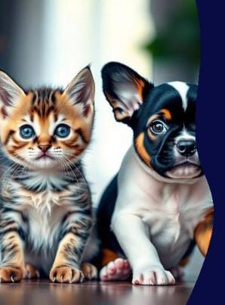
Image Classification Of Cats and Dogs
using CNN
Presented by:
Utkarsh Saxena
B.Tech(CSE)
MIT, Moradabad

Slide 2
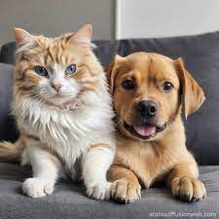
Dataset & Preprocessing
Dataset: Kaggle’s “Dogs vs Cats” dataset (25,000 labeled images).
Download Method: Used opendatasets to directly fetch dataset from Kaggle.
Directory Structure:
/train: contains cat and dog images
/test: used for validation
Image Loading: Used image_dataset_from_directory() from Keras with:
image_size=(256, 256)
batch_size=32
label_mode='int'
Preprocessing:
Normalized pixel values to range [0, 1] using tf.cast()
Applied .map() function to transform training and validation datasets

Slide 3
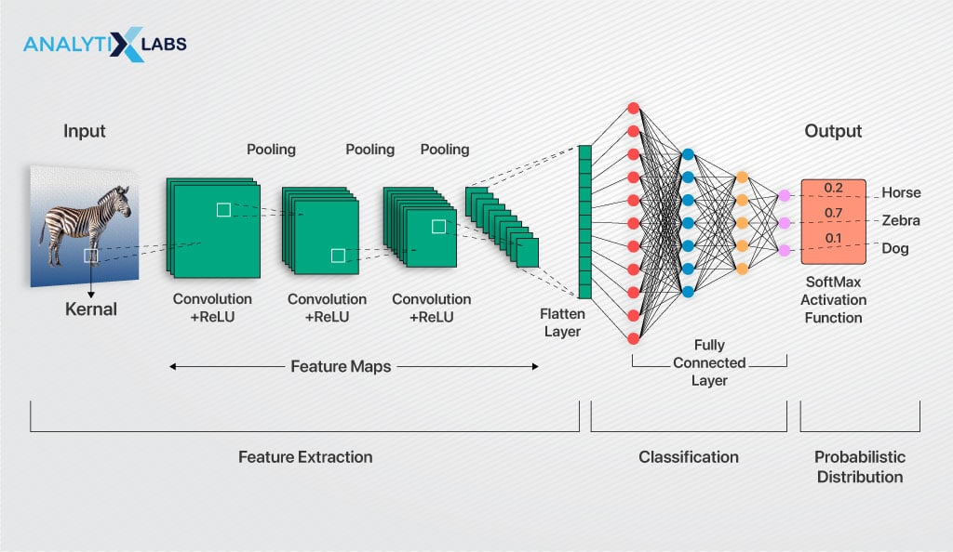
CNN Model Architecture

Slide 4
Layer Type | Details | Purpose
Input Layer | Input shape = (256, 256, 3) | Accepts RGB image
Conv2D | 32 filters, kernel size (3x3), ReLU activation | Feature extraction
BatchNormalization | After Conv2D | Normalizes and speeds up training
MaxPooling2D | Pool size (2x2) | Reduces feature map size
Conv2D | 64 filters, kernel size (3x3), ReLU activation | Deeper feature extraction
BatchNormalization | After Conv2D | Stabilizes learning
MaxPooling2D | Pool size (2x2) | Downsamples features
Conv2D | 128 filters, kernel size (3x3), ReLU activation | High-level feature extraction
BatchNormalization | After Conv2D | Enhances stability
MaxPooling2D | Pool size (2x2) | Reduces dimensions
Flatten | Converts 2D to 1D | Prepares for dense layers
Dense | 128 neurons, ReLU activation | Fully connected layer
Dropout | Dropout rate 0.1 | Prevents overfitting
Dense | 64 neurons, ReLU activation | Second dense layer
Dropout | Dropout rate 0.1 | Adds regularization
Output (Dense) | 1 neuron, Sigmoid activation | Binary output: Dog (1), Cat (0)

Slide 5
Model Compilation & Training
Training Details
Function Used: model.fit()
Epochs: 3
Batch Size: 32
Validation Data: Used a separate test set for validation
Goal: Maximize classification accuracy (Cat vs Dog)
Why These Choices?
Adam Optimizer: Fast and adaptive learning
Binary Crossentropy: Best suited for binary classification
Validation Set: Helps monitor overfitting

Slide 6
Accuracy and Loss Visualization
Training Progress Evaluation
Plot Type | Description
Accuracy | Shows how well the model predicts over time
Loss | Measures model error during training
What We Did?
Used matplotlib.pyplot to visualize:
Training vs Validation Accuracy
Training vs Validation Loss
Extracted values from history.history dictionary
Observations
Accuracy increased with each epoch
Loss decreased, indicating improved learning
Validation curves followed training trends → minimal overfitting

Slide 7
Image Prediction Logic
Steps to Predict an Image:
Step | Action
1. Load | Used cv2.imread() to read image file (e.g., dog.webp)
2. Resize | Resized image to (256x256) using cv2.resize()
3. Reshape | Converted to (1, 256, 256, 3) for model input
4. Normalize | Scaled pixel values to [0, 1]
5. Predict | Used model.predict() to get output value
6. Interpret | If output ≥ 0.5 → Dog, else → Cat

Slide 8
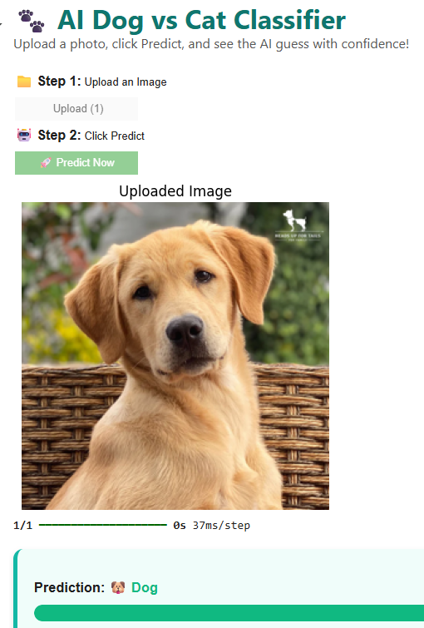
Interactive UI in Colab
Interface Design
Used ipywidgets for buttons and layout
Styled using HTML + CSS for a clean look
Output displayed in a "card-style box" with confidence bar
User Experience
Simple 2-step process:
Upload Image
Click “🚀 Predict Now”
Real-time prediction with visual feedback

Slide 9
Conclusion
In this project, we successfully developed a Convolutional Neural Network (CNN) model to classify images of cats and dogs with high accuracy. The model was trained using the Kaggle “Dogs vs Cats” dataset and achieved reliable performance in just 3 epochs. To enhance usability, an interactive user interface was built using ipywidgets in Google Colab, allowing users to upload an image and receive real-time predictions along with a confidence percentage. The trained model was saved in both .h5 and .keras formats, making it ready for future use. Overall, this project provides a solid foundation for further improvements and potential deployment as a web or mobile application.

