Slide 1
MRI Pulse Sequence Programming
Ex1.16: B0 Distortion correction in EPI

Slide 2
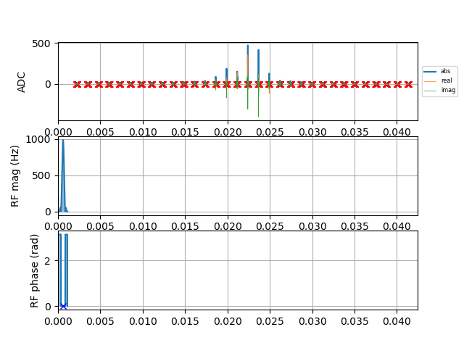
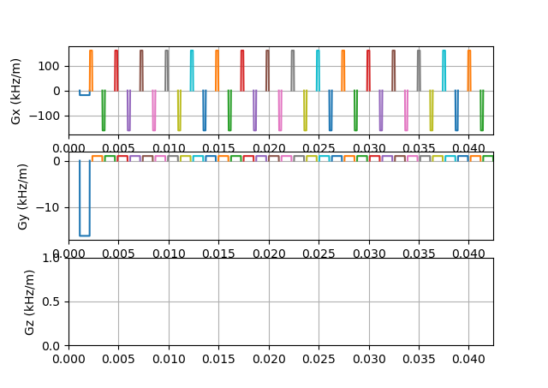
Echo Planar Imaging
Unlike conventional MR techniques, EPI requires a single excitation pulse and whole k-space
is sampled in a continuous trajectory.
Since the decay of signal is governed by T2 and field inhomogeneity, the acquisition should be
complete within 50ms-100ms.
Advantage- Complete use of spin magnetization and Signal-to-noise ratio is high.
Disavantage- Makes the system vulnerable to inhomogeneities

Slide 3
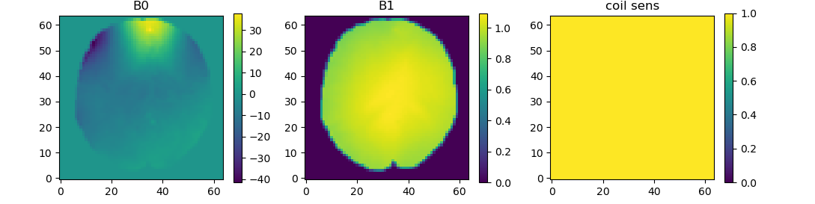
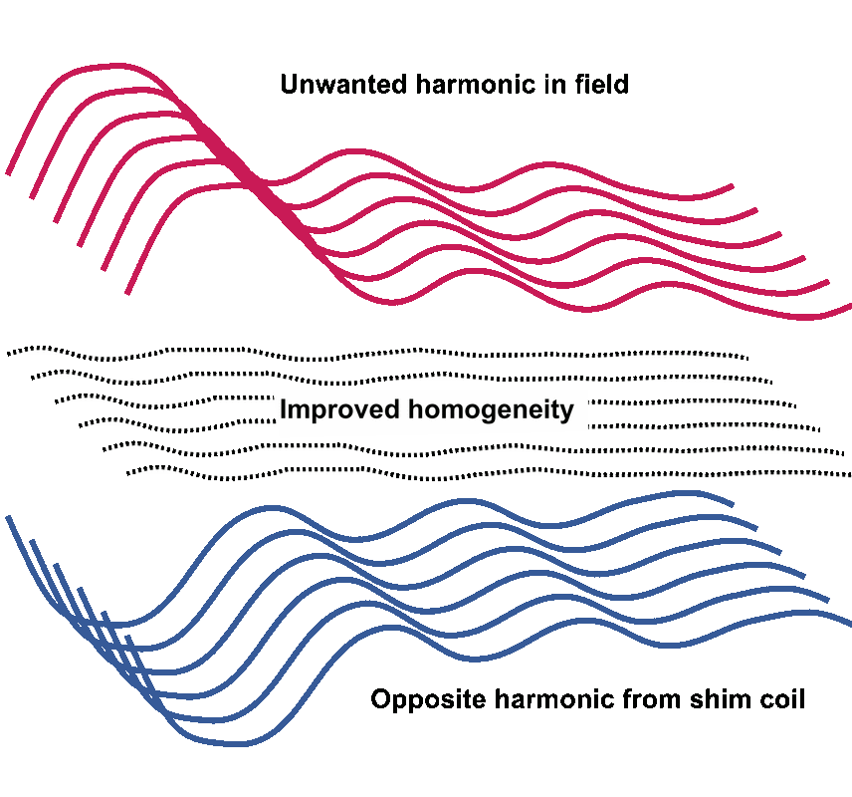

Causes for B0 Distortion
The causes are:
Main cause is residual magnetic field inhomogeneity, due both to the external room temperature shim coils not being optimally set and high order internal magnetic field inhomogeneities in the sample, which cannot always easily be shimmed out using external coils.
Inhomogeneous B0
Homogeneous B0

Slide 4
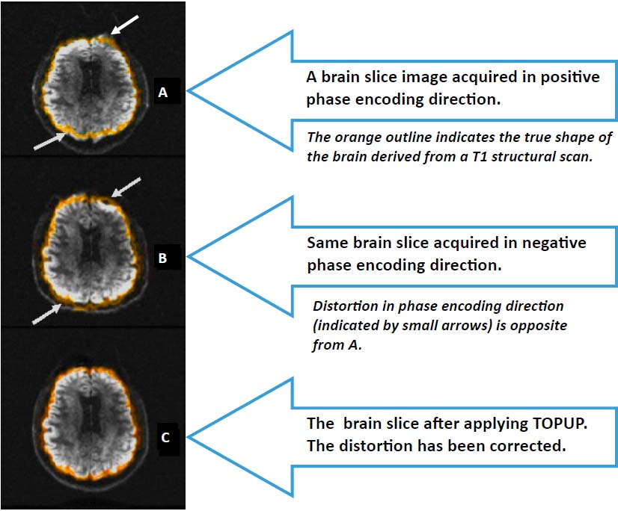
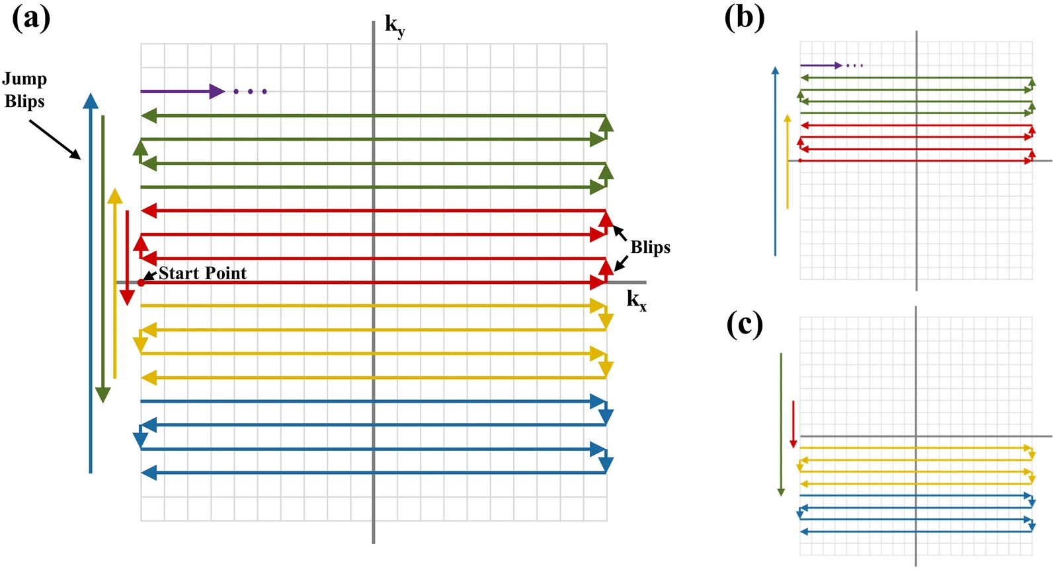
Methodology
Blips up and blips down in a single k-space, using 2 different k-spaces in my code
Toolbox: FSL
1. 1. Hwang, SH., Lee, HS., Choi, S.H. et al. Distortion correction using topup algorithm by single k-space (TASK) for echo planar imaging. Sci Rep 13, 18751 (2023).
2. fmri.ucsd.edu/Howto/3T/DTI-TOPUP.html

Slide 5
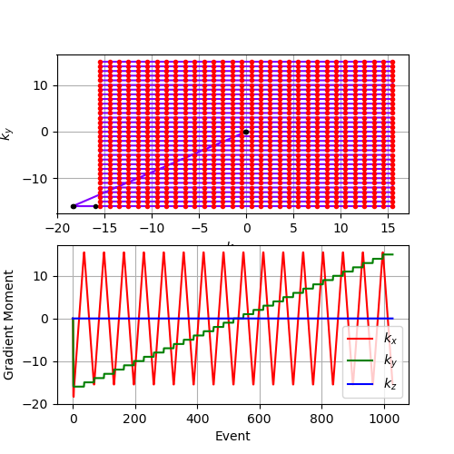
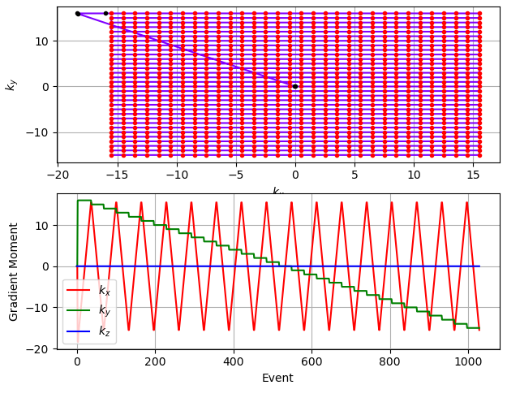
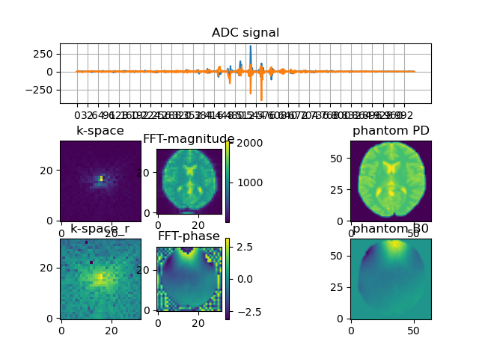
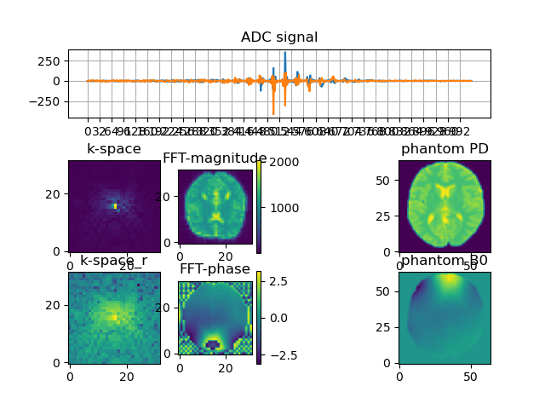
Positive-Encoding(+ve blips)
Negative-Encoding(-ve blips)
Sign reversal of the effects of ΔB0

Slide 6
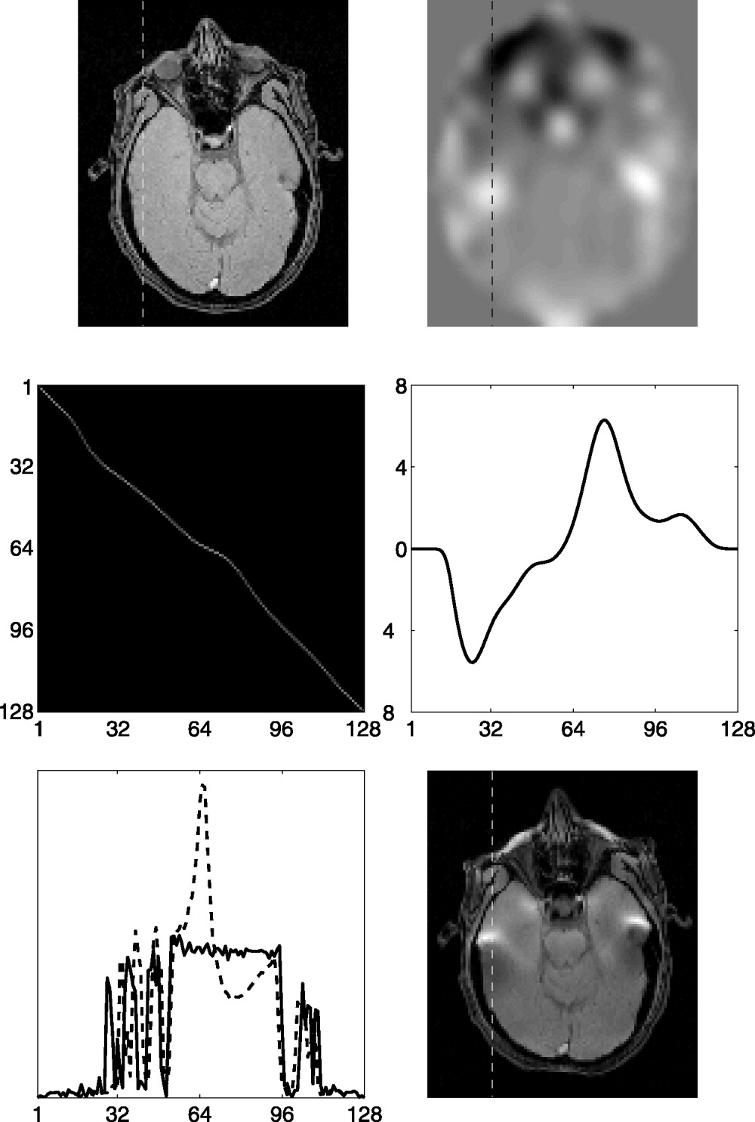
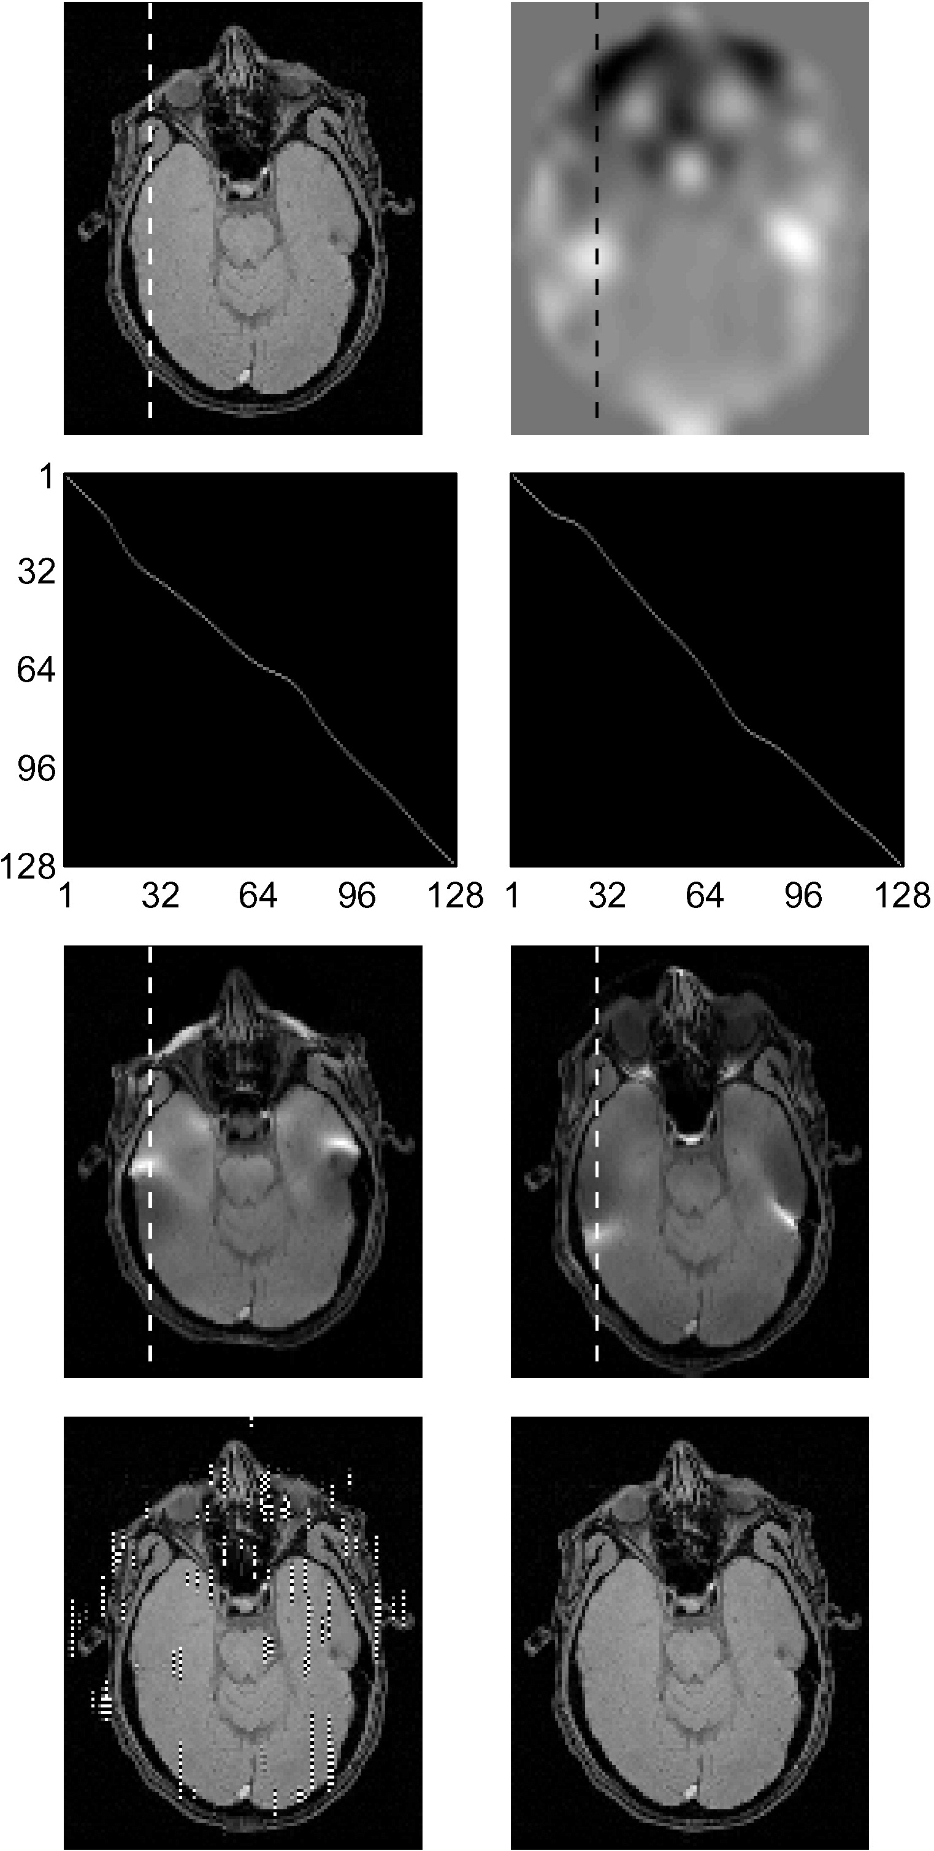
Approach: Top-Up Distortion Algorithm
1. Jesper L.R. Andersson, Stefan Skare, John Ashburner, How to correct susceptibility distortions in spin-echo echo-planar images: application to diffusion tensor imaging,

