Slide 1
Tick it now

Slide 2
agenda
Introduction
Project Overview
Key Features
Technology Stack
Architecture Diagram
Customer Workflow
Impact and Benefits
Challenges and Solutions
Future Enhancements
Conclusion

Slide 3
Introduction
Problem Statement:
Difficulty in finding and booking movie tickets.
Lack of customer-friendly platforms.
Need for smooth navigation and payment integration
Solution:
A robust platform for booking movie tickets easily.
Integration of multiple features for a seamless customer experience.

Slide 4
Project Overview
Objective:
Provide a customer-friendly platform for booking movie tickets.
Allow users to view available shows, select seats, make payments and view tickets.
Scope:
Frontend: React application with an engaging UI/UX..
Backend: Spring Boot REST API for handling data and transactions.

Slide 5

Key Features
For Customers:
Search and browse movies..
Select seats and view show timings.
Make payment and view tickets.
For Admin:
Manage movies, shows, and bookings
Analytics and reporting features.
Role-based access control.

Slide 6
Technology Stack
Frontend:
React
Tailwind CSS for styling
Backend:
Spring Boot
RESTful APIs
Database:
MySQL

Slide 7
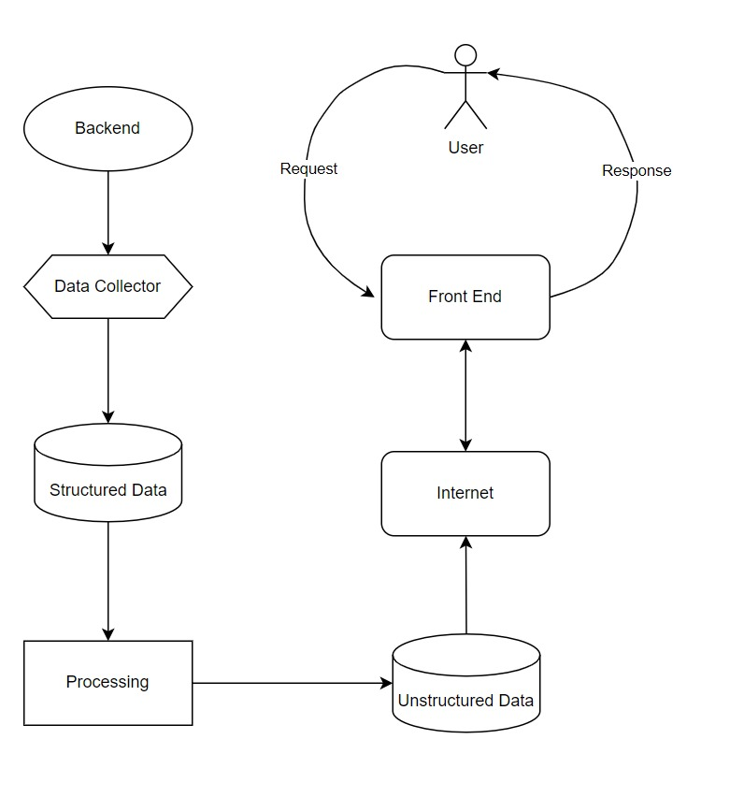
Architecture Diagram

Slide 8
Customer Workflow
Step 1: Customer logs in/signs up.
Step 2: Customer searches for a movie.
Step 3: Customer selects a movie, showtime, and seats.
Step 4: Customer completes payment and receives an e-ticket.
Step 5: Admin manages movies and showtimes.

Slide 9

Impact and Benefits
For Users:
Easy and quick booking process.
Convenient access to showtimes and seat availability.
For Admin:
Streamlined movie and booking management.
Better insights with data analytics.
Overall Impact:
Improved customer experience and increased ticket sales.

Slide 10

Challenges and Solutions
Challenge: Handling customer sessions and role-based routing.
Solution: Implemented secure session storage and routing mechanisms..

Slide 11
Future Enhancements
Expand the platform to include more cities and theaters.
Develop a mobile application for broader accessibility.
Integrate additional features like movie reviews and give ratings.
Advanced analytics for Admin.

Slide 12
Conclusion
The movie ticket booking platform offers a seamless and efficient way to book tickets.
It addresses key customer and admin needs while ensuring a smooth and engaging experience.

Slide 13
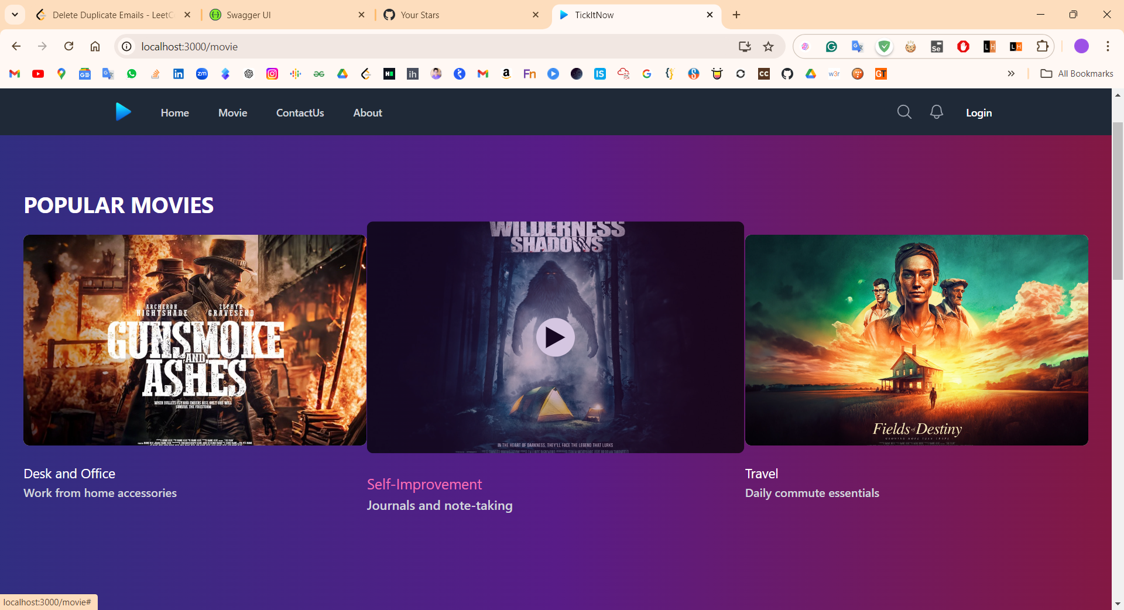

Slide 14
Thank you !
farazpatwegar@gmail.com
utkarshachinde09@gmail.com

