Slide 1
MVP1 Learning
Team Showcase
April 3, 2022

Slide 2
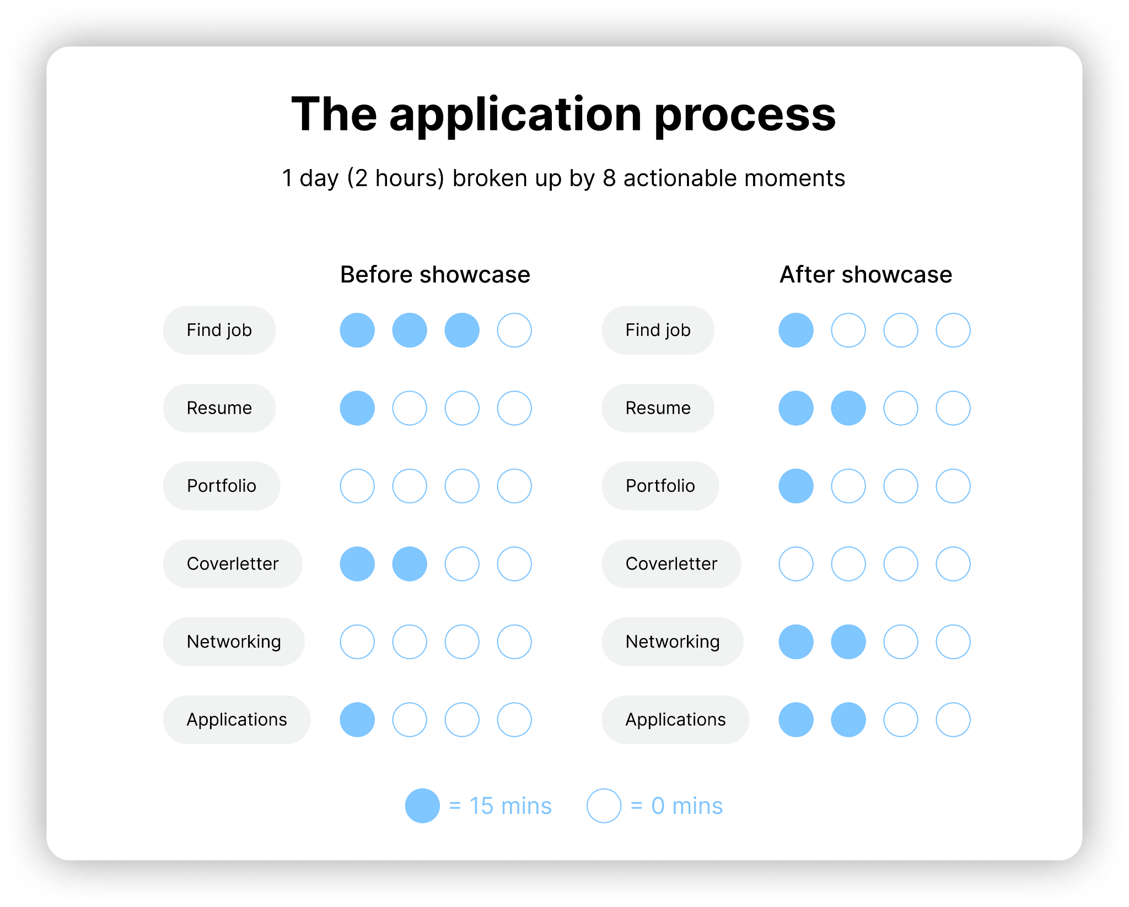
Primary Concept
We propose targeting applicants and recruiters in the early stages of the recruiting process by breaking it up into segmented chunks that result in transparent feedback, and by doing so will create a process that is seamless and beneficial for both parties:
Recruiters: Be transparent about your hiring process and help prepare applicants to create an equitable hiring ground. Receive vetted applicants based on the criteria created with Showcase in advance. Have the opportunity to cycle through potential candidates. Opportunity to share the process with in house employees to get their thoughts and perspectives .
Applicants: Receive feedback to work off of and learn throughout the process before spending time working on applications and material that you are either unprepared for, or not being asked to do. Prepare yourself for future applications by having a “gallery” of content built that is ready to be showcased. Receive feedback that stems directly from the company you are targeting via mock interviews with AI/ML.

Slide 3
Applicants’ Perspective
Transparent View: With a psychologically safe environment for trial and error, users receive feedback to work off of and learn throughout the process. They may also benefit from a wide range of exposure to opportunities and cultures, allowing them to either immediately benefit (ex. Quickly hired), or benefit over time (ex. Quickly learn)
Reciprocity of time: Following a Segmented process of application based on a company's hiring process will eliminate the need for spending time on the wrong things. It will also eliminate the need for waiting just to learn they are not accepted and not receiving actionable feedback or constructive criticism about why they were not selected
Base Profile: The creation of a base profile of applicants to be shared amongst a large group of jobs will limit the time spent working on different aspects of their desired jobs, and remove opportunities that do not work for them. A sense of personalization about their soft skills (communication, teamwork), personal preferences (full time, location, team size), languages, hard skills (and confidence level for each skill), numerical years of experience, work experience, etc. will provide a steady stream of data for both parties to utilize

Slide 4
Recruiters’ Perspective
Quick View: Provide quick and simple mechanics to reject or progress an applicant with a swiping motion many are familiar with. With each decision, profiles are grouped together as rejections or progressions as the user continues to move onto the next stage of the process.
Real-time results: Send out decisions immediately following the recruiter action(swipe left/right), eliminating the chance of distrust and animosity between both parties and reducing the amount of work recruiters have to do.
Like-minded feedback: Utilizing AI and ML, applicants will receive a report of similarities and possibly differences of other applicants who received the same decision as them, providing a flow of information that may help applicants learn and iterate their own material for the future while eliminating the need for a significant investment of time by the companies.

Slide 5
Applicants’ Testing
Goals: Determine whether receiving feedback from a companies inner values and workings are a consideration for an applicant. Test whether previous examples of applications “carry over” into another companies application. Determine whether participants would want a second chance and to learn from their mistakes.
Setup: Create 1 generic job description, 1 generic interview question ( ex. tell me about yourself), 3 fake companies, and a fake persona profile and values that all that applicants must “hit” to be considered when moving onto the next round of their process (for each company).
Performing: Participants spend 2 minutes reading their persona and generic job description before spending 1 minute reading Company 1’s background brief. They then have 2 minutes to answer a quick question and once completed, explain how that process felt and whether they believe they were hired or not. They are then presented with the values and key points of Company 1, are told the result of the interview, and are asked if they would want to retry. They then repeat the process for Company 2 and 3.

Slide 6
Recruiters’ Testing
Goals: Determine whether there are commonalities amongst applicant profiles leading to rejection or acceptance, while also validating whether a swiping mechanism that is employed during every stage of a hiring process is beneficial. Also determine whether recruiters find automated responses based off of automated feedback more beneficial, or if they would prefer to include their own thoughts.
Setup: Participants are presented a form that houses created profiles of applicants Using the common swiping mechanism, participants are asked to swipe left or right on a profile. With left swipes, participants are rejecting a candidate but with right swipes, participants are moving the candidate to the next stage of the interview process. With each action taken by the participant, we will pool rejections together and show the participants the collected “deck” of rejected profiles. If they find patterns in each rejection, we may consider that as validation for any current AI or ML finding patterns and similarities. We will then simulate emails to applicants, therefore, replicating the platform’s automated email behavior. The form’s ease of accepting or rejecting a candidate profile can be assessed to validate the MVP concept. Additionally, response emails sent out to the applicants can be used to validate whether the applicants are satisfied with the transparency that this concept provides.

Slide 7
Detailed Documentation
Link to document
We have a running document with other thoughts and concepts as we attempt to create a solution that benefits both parties: applicants and recruiters
Link to MVP Prototype for Recruiters Side
Quick snippet (Marlon)
Create a valued exchange of time between applicants and recruiters

Slide 8
Feedback r2
“What does transparency mean?”
When pointed to answer the question, they said: recruiter being accurate and reliable with the role itself and team culture. Would find value with knowing why they were rejected
“Do companies really want this? Feels like the barriers are there right now - some of the board descriptions are just dummy (what do they mean by dummy?) (just up for show)”
“When talking to recruiters, would device are they using for their current process and how many screens would they use? They believe it would be more likely to use the computer (they may be more likely to use their computer over a phone)
30 second pitch only gave opportunity of the operation of the service, not the value created and how it is improving people lives
Should focus on how its improving the experiences of both applicants and recruiters
Currently sounding like a pitch about prototype and not the experience

