Slide 1
DayCare Management By Ajay Mohandas – 001426741 Utkarsha Pampatwar - 001424931

Slide 2
INTRODUCTION
Implemented a web application using C# to maintain Day Care facility
Designed a MVC model for the application and persisting data using CSV files
Entities involved in Day Care Facility are as follows
Student
Teacher
Group (Teacher + Student)
Rules (for each group)
Classroom (Group + Rules)
Immunization Rules
Immunization Record
Enrollment Rules

Slide 3
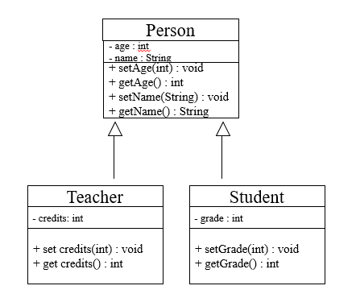
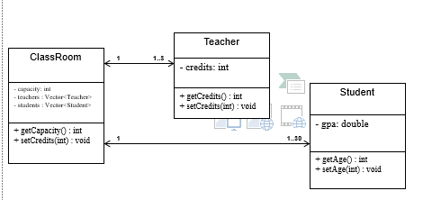
CLASS DIAGRAM

Slide 4
FEATURES
Below are few common features of the application
View Rules for the Day Care Management Facility
Add Student
Add Teacher
View Student records
View Teacher records
Track student immunization records
Unique Feature in the application are as follows
CSV files are stored in the Application Domain Registry and hence new developer does not have to worry about file location path
Immunization Records are calculated as per students birth records and provided in Northeastern Guidelines for immunization requirements
Designed the classes as per Factory design pattern
Created an Admin component

Slide 5
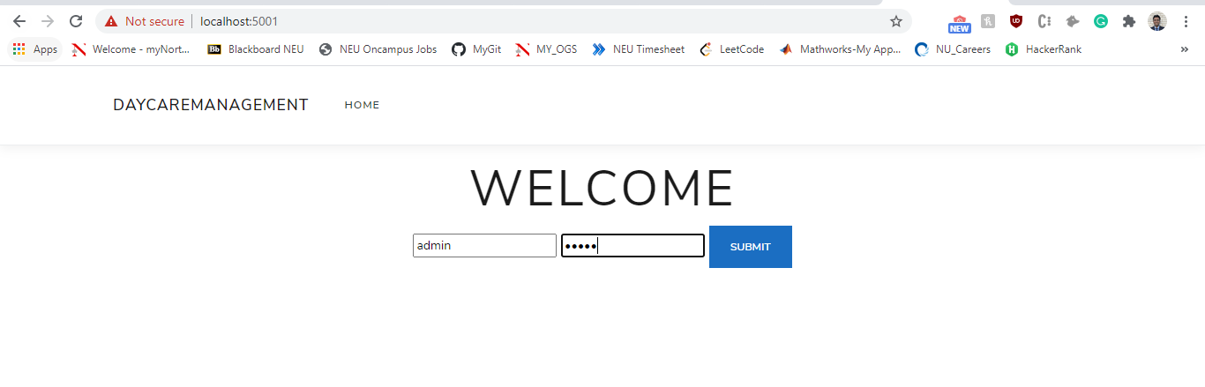
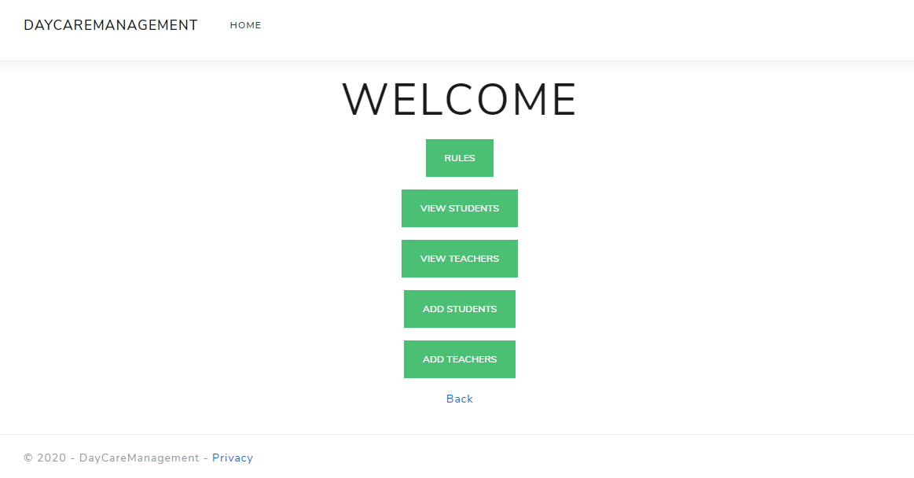
OUTPUT

Slide 6
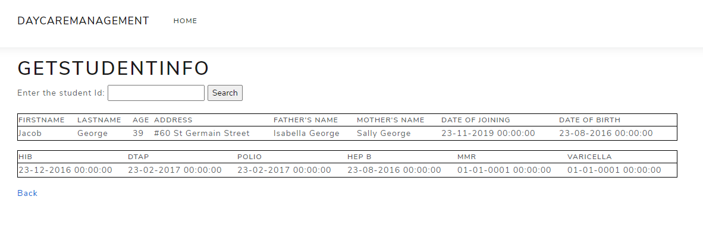
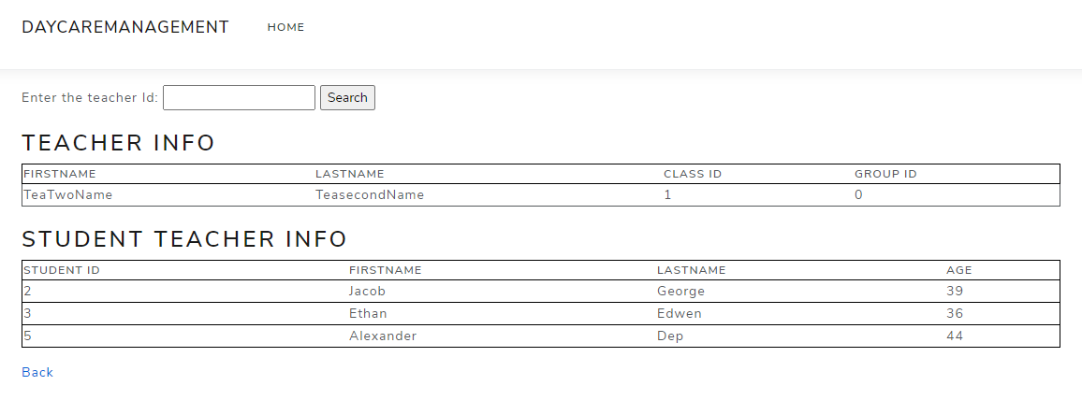

Slide 7
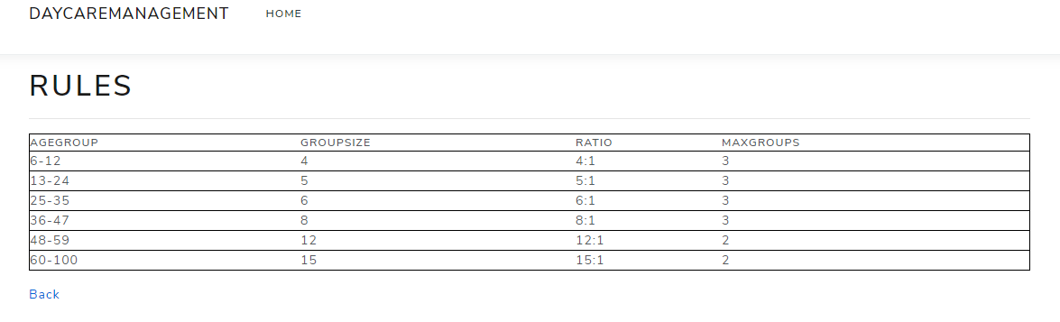

Slide 8
THANK YOU

