Slide 1
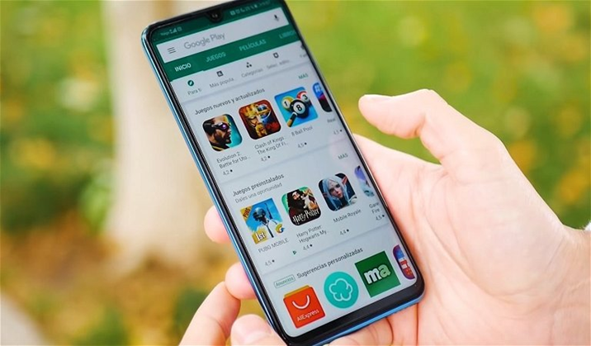
Group 6 :
Google Playstore
Vijay, Utkarsha, Tarunika, ajith

Slide 2
Why create visualizations for Google PlayStore Application?
Understanding market trends
Identifying opportunities
Improving app performance
Communicating insights
Enhancing user engagement
Identifying competitors
Improving marketing efforts
Creating visualizations for Google Play Store data can help us gain a deeper understanding of the app market, improve app performance, and make more informed decisions about how to allocate resources and develop new features.

Slide 3
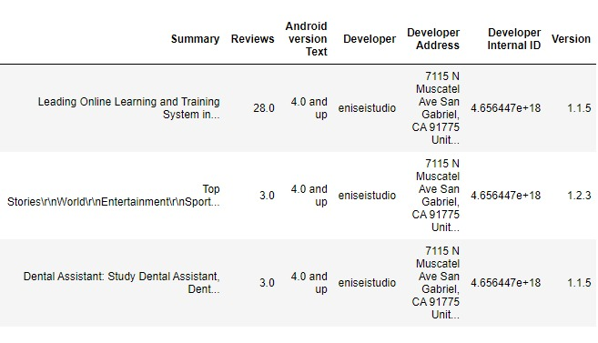
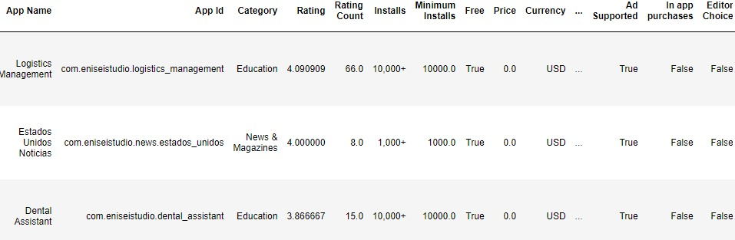
DATA SET

Slide 4

Introduction
Dataset taken from Kaggle as it is freely accessible and provides good quality data.
We have created 5 data visualizations based on the information provided on kaggle.
Visualization 1 – Average App rating by Year
Visualization 2 – Ratings vs Reviews
Visualization 3 – PlayStore Data HeatMap
Visualization 4 – Percentage of Apps Vs Price in USD
Visualization 5 – Total Playstore Apps per category
Visualization 6 – Category Vs Installations

Slide 5
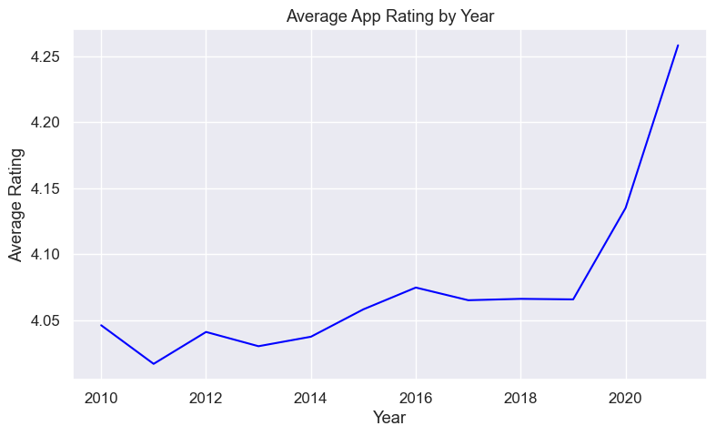
LINE GRAPH
The line graph shows the average ratings for the applications from the year 2010 to year 2020. From the line graph, we can conclude that the ratings for all the applications of the google playstore was highest from the year 2020.
Notes:
In this visual, we can understand the percentage of different employee roles in Cook County. We have filtered the data so we can see where the job or Bureau count is over 1000 to better analyze it. The majority of the pie is the Bureau of Health at 24.61% and Sheriff at 23.72%. This allows us to understand that these two categories make the majority of Cook County with the Chief Judge following at 11.11%. There are also a lot of smaller slices showcasing how many different types of employees are needed in the Bureau to run Cook County.

Slide 6
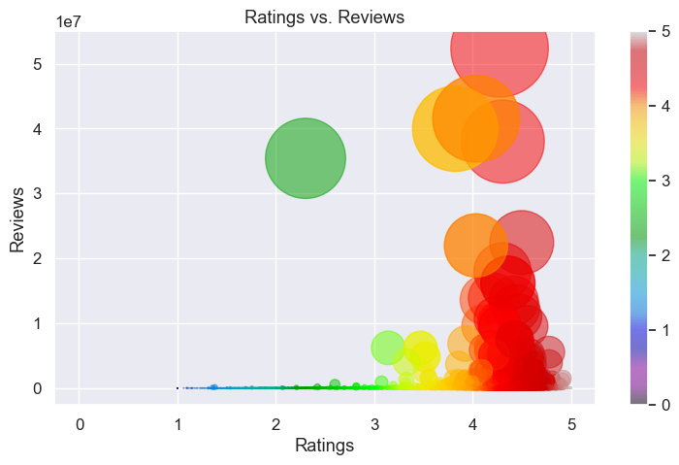
SCATTER PLOT
This scatter plot graph shows the trend between ratings and reviews of applications.
The applications which has more reviews tend to have higher ratings and vice versa.
The median number of reviews have an avg of rating 3

Slide 7
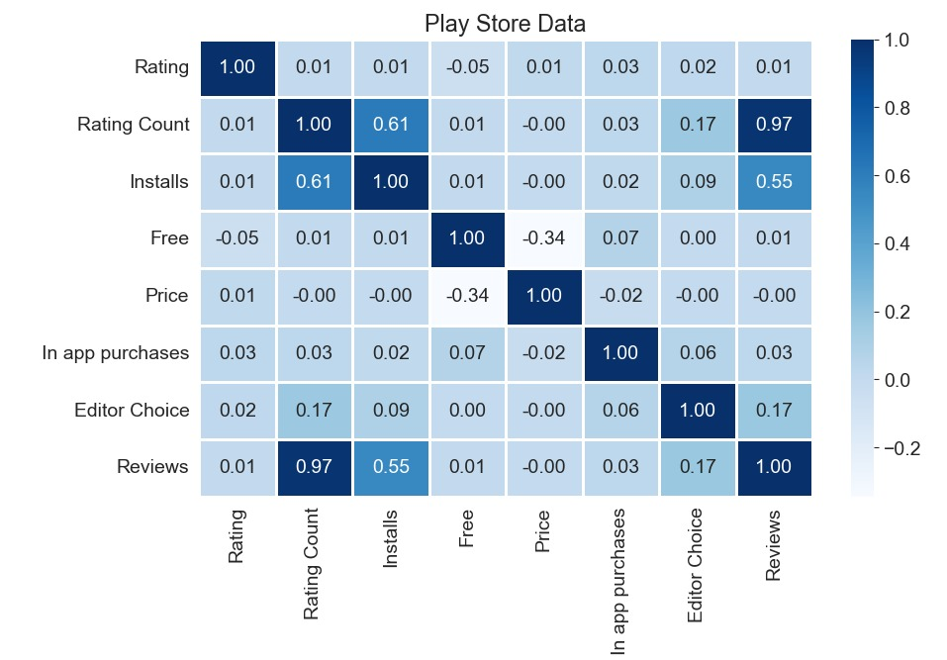
HEAT MAP
Heat map is for better Visualization
Heat-Map shows the co-relation between columns of the data.
For example, we can see that there is a relatively strong correlation between the number of Reviews and the number of Installs, which makes sense as more popular apps are likely to have more reviews and more installs.

Slide 8
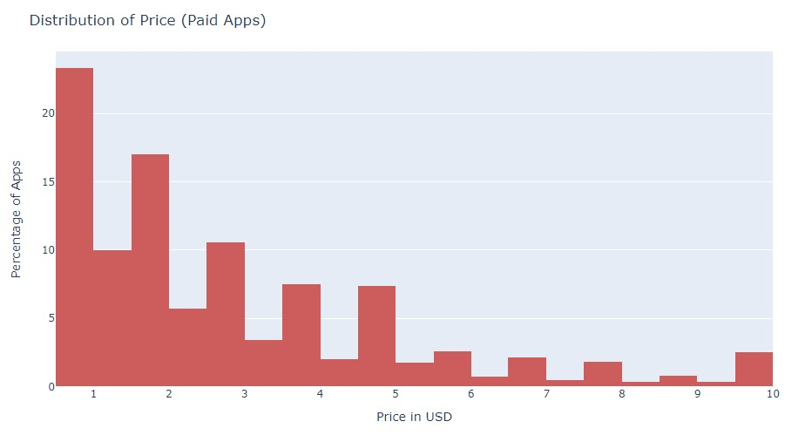
HISTOGRAM
The histogram represents the Percentage of Apps Vs Price in USD
When the price is less the number of installations are more and vice versa.

Slide 9
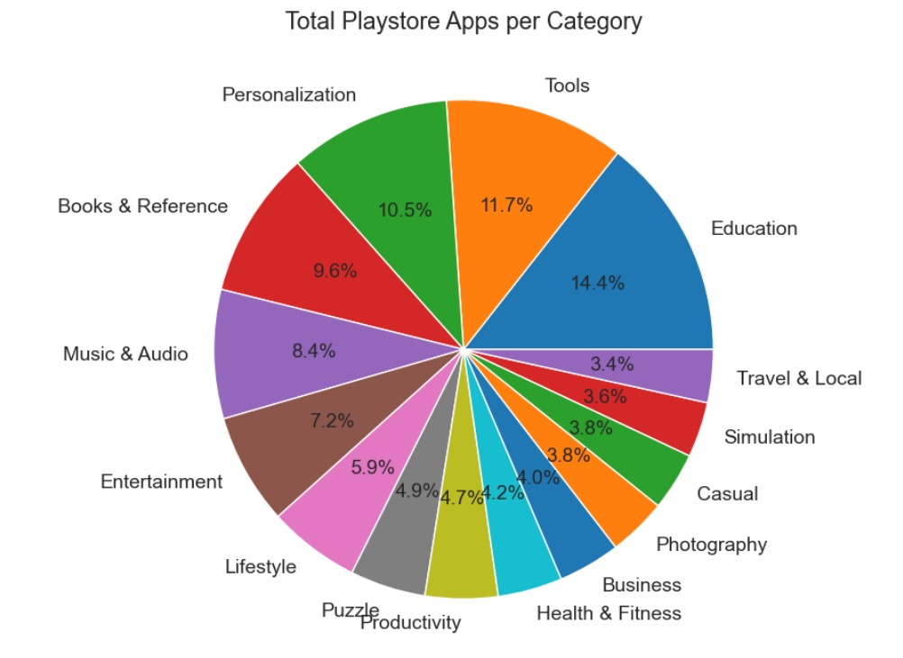
PIE CHART
The pie chart explains the top 15 total number of categorized applications in Play store.
Education, books and references are almost one fourth of total applications.
Applications in Tools category such as adobe, fast scanner etc takes the second position.

Slide 10
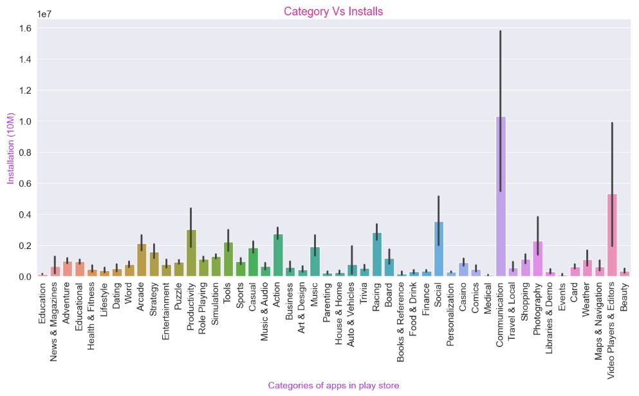
BAR CHART

Slide 11
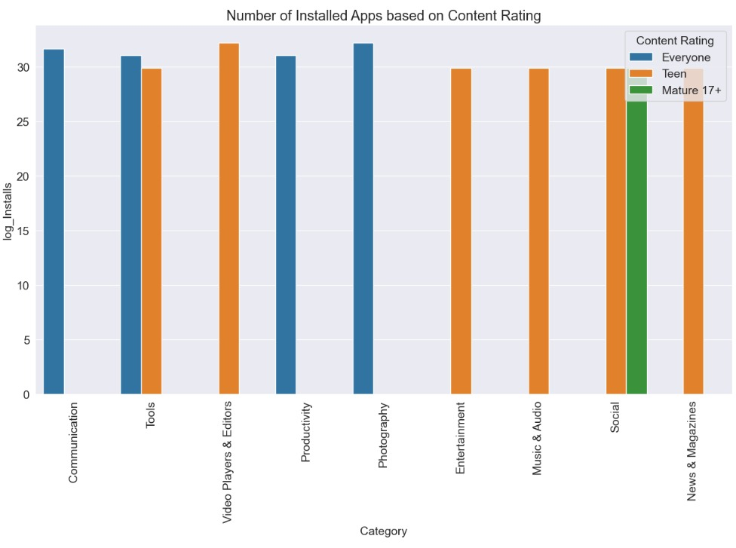
BAR CHART
It explains about the number of installations based on content rating.
The most number of installations are from Communication, Photography and Productivity are from all the people with different age groups.

Slide 12
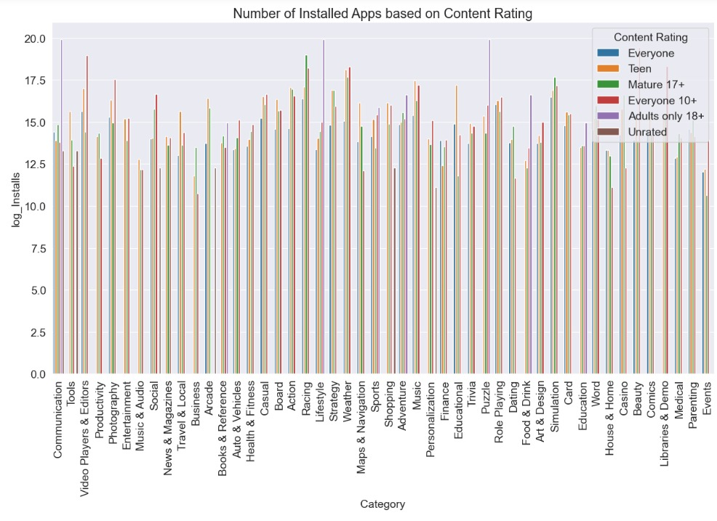
BAR CHART

Slide 13
CONCLUSION
Some key findings from the dataset include:
The most popular app categories are Tools, Entertainment, Education, and Business.
The average rating for apps is around 4.2, with the majority of apps having ratings between 3.5 and 4.5.
The highest-rated app category is Communication followed by Tools and the least among the top 15 categories is Travel and Local apps.
Even with most number of apps in Education category there are less installations.
During Covid the installation of google applications is increased, so the usage of applications from communication category spiked and most of the teenagers reviews and rated the most of the applications.
Notes:
Through the above analyses and data visualizations, we achieved an overview of Cook County's public job market and the prevalent pay trends between 2016 and 2018. First, we can see that the job market is considerably diverse, with a large skew toward public health and security, as the Bureau of Health and the Sheriff's department account for more than half of the employee population. The market is also diverse in the type of employment offered to employees. As we can see from the scatter plot, most of the public jobs in Cook County are lower-paying "dead-end" jobs that promise career stability over growth. However, there are also positions with higher skill requirements that, like private-sector jobs, offer significant career and pay growth potential. There also exists a market for commission-based employment, although this is just an assumption that cannot be concretely proven with the current information provided by the dataset.
Regarding quarterly base pay, we can see that there is a significant pay gap between the general average and the highest-paying positions because of the difference in the type of employment. However, most employees would be able to enjoy a quarterly base pay of around $16,000 to $18,000. We also observe a consistent trend of higher base pay for Q2 and Q4 each year, meaning that employees typically would enjoy higher salaries around that time. Given the trends across the years, we can see that, like the private sector, public jobs are also affected by economic downturns such as the 2018 market crash.
All in all, if one is looking for a position in the public sector of Cook County, he or she can expect to find jobs in all sectors of the economy. Among these positions, most would be low-paying "dead-end" jobs, but there are opportunities for significantly high-growth jobs as well. The average expected quarterly base pay for the majority would be around $16,000 to $18,000, which does increase considerably depending on the department and position. Employees can also expect higher pay during the second and fourth quarters of the year during their employment. While the public sector offers excellent stability, employees should still expect pay cuts during economic downturns.

Slide 14
SUGGESTIONS
The dataset includes information on app installs, ratings, and reviews, but it would be useful to have more detailed information on app usage, such as the number of times users open an app, how long they spend using it, and which app features they use most frequently.
The dataset includes information on whether an app is free or paid, but it does not include revenue data for individual apps. Adding revenue data, such as the amount of money generated from in-app purchases or advertising, could help app developers and marketers optimize their monetization strategies.
In addition to rating and review data, it could be useful to have more information on app performance metrics such as app load time, app crashes, and app errors. This information could help app developers identify and address technical issues and improve the overall user experience.
Notes:
Need more information on what type of employee they are like part-time, full-time, commission-based, working hours, and hourly pay rate because we can better visualize the data. Bonuses earned by employees can give more information about the total pay an employee will get and a better understanding of the average base pay of an employee. Should have other fields other than base pay that can be graphed like the number of dependants in the household of an employee and the cost of living of an individual. The Employee taking leaves pay cut for the leaves, and paid leaves will give more information about the annual package. The holiday calendar can give an idea about zero working hours for an employee, the experience of the individual employee, and projects on hold and in progress also helps visualization to be more accurate and proper.
In [ ]:
​

Slide 15
Thank you

