Slide 1



Employee Attrition Prediction
Using IBM HR Analytics Data ML Classification Techniques
Presented by: GROUP 1
1.Vaishnavi Rai(202401100400205)
2. Shikha Tomar(202401100400174)
3.Saksham Singh(202401100400161)
4.Yashash Tyagi(202401100400218)
5.Utkarsh Pandey(202401100400203)
6.Sujal Kumar(202401100400193)

Slide 2

Employee Attrition Prediction with Machine Learning
This presentation explores predicting employee attrition. We use IBM HR Analytics data. The goal is to identify factors influencing employee turnover.

Slide 3

Data Overview
1,470
Employees
Total records analyzed.
35
Features
Categorical and numerical attributes.
84%
Active
Employees remaining with the company.
16%
Attrited
Employees who left the company.

Slide 4

Data Preprocessing and Feature Engineering
Handle Missing Values
Impute any missing data points.
1
Encode Categorical Variables
Apply One-Hot Encoding.
2
Feature Scaling
Use Standardization for consistent ranges.
3
Address Class Imbalance
Utilize SMOTE oversampling technique.
4

Slide 5
Model Selection and Training
Model Types
Data Splitting
Tuning & Evaluation
Logistic Regression Random Forest Gradient Boosting
Training Set: 80% Test Set: 20%
GridSearchCV for hyperparameters Accuracy, Precision, Recall, F1-
score, ROC AUC

Slide 6
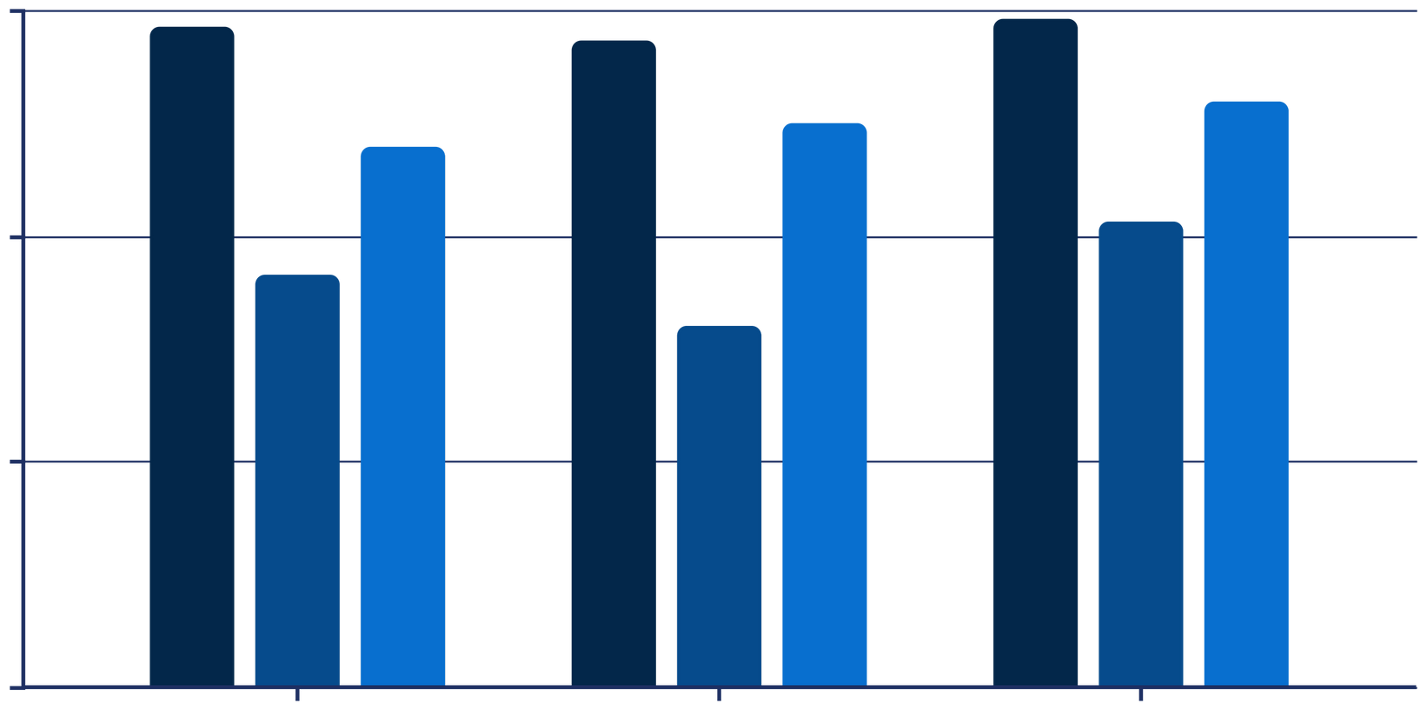
Model Evaluation and Comparison
0.9
0.6
0.3
0
Logistic Regression
Random Forest
Gradient Boosting
Accuracy
F1-Score
ROC AUC
Gradient Boosting achieved the highest ROC AUC score. This indicates superior predictive capability. It also outperformed other models in F1-score.

Slide 7
Feature Importance Analysis
1
Overtime
Importance: 0.12, highest impact.
2
Job Level
Importance: 0.09, significant factor.
3
Monthly Income
Importance: 0.08, third most impactful.
4
Age
Importance: 0.07, a key demographic.
5
Years At Company
Importance: 0.06, tenure matters.

Slide 8



Actionable Insights
Work-Life Balance
High overtime correlates with attrition.
Career Advancement
Low job level is a driver.
Employee Engagement
Younger employees and short tenure are risks.
Competitive Salaries
Lower income increases attrition risk.

Slide 9

Conclusion
Effective Prediction
ML models accurately forecast attrition.
Key Insights
Feature importance reveals critical factors.
Proactive HR
Analytics enables strategic retention.

