Slide 1
INTRUSION DETECTION AND PREVENTION USING MACHINE LEARNING IN BANKING SYSTEM

Slide 2
Contents of the presentation
Project Description
Problem Statement
Objective
Scope
Literature Survey
Architecture
Umls
Implementation
Implementation
Data Description
Proposed System
Model Implementation
1. Algorithm Definition
Conclusion
Reference

Slide 3
Project Description
As the banking sector evolves with the increasing integration of advanced technologies, the vulnerability to cyber intrusions has intensified. This project presents a situation-based predictive approach for intrusion detection and prevention within banking systems, utilizing machine learning (ML) . By analysing patterns and anomalies in real-time transaction data and user behaviour, our approach aims to enhance the detection accuracy and response times to potential cyber threats. We propose a hybrid model that combines supervised and unsupervised learning techniques to adaptively identify and mitigate various cyber threats specific to the banking industry. Our model leverages historical data and current transaction patterns to create predictive models that can anticipate and respond to potential intrusions before they occur.
Keywords: Banking sector ,Cyber intrusions, Predictive approach ,Intrusion detection, Intrusion prevention ,Machine learning (ML)

Slide 4
Problem Statement
The rapid advancement of technology in the banking sector has exposed financial institutions to increasing cyber threats, resulting in a critical need for efficient and adaptive cybersecurity solutions. Current intrusion detection and prevention systems often rely on traditional methods that struggle to keep pace with the dynamic and evolving nature of cyberattacks. These systems typically suffer from high false positive rates, delayed response times, and limited scalability, leaving banking systems vulnerable to sophisticated and emerging cyber threats. The challenge lies in developing a predictive, situation-based approach that can identify anomalies and suspicious behaviors in real-time, while also being capable of anticipating potential intrusions before they occur.

Slide 5
Objective of the Project
The primary objective of this project is to develop a machine learning model that enhances cybersecurity intrusion detection and prevention systems within banking institutions.
By utilizing both supervised and unsupervised learning techniques, the model aims to detect and prevent cyber intrusions in real-time by analyzing transaction data and user behavior patterns.
The project intends to create a dynamic, predictive framework that can respond to evolving cyber threats while improving accuracy and minimizing false positives. Specific objectives include analyzing historical transaction data to identify patterns associated with potential threats, leveraging real-time data for adaptive threat detection, and reducing the response time to cyber intrusions.

Slide 6
Scope
The scope of this project includes the design and implementation of a machine learning based cybersecurity system for banking institutions. This system will focus on real-time intrusion detection and prevention by analyzing transaction data and user behavior to identify suspicious activity and potential cyber threats. The project will cover various stages, from data collection and preprocessing to model training, testing, and evaluation. The system will be capable of processing large volumes of historical and real-time data, ensuring scalability for use across different banking institutions. It will also incorporate adaptive learning techniques to handle evolving cyber threats, making it an ideal solution for dynamic banking environments.

Slide 7
Literature Survey
S.NO | YEAR | AUTHORS | TITLE | OUT COMES
1 | 2024 | John M. Doe, Alice T. Brown | Future Prospects of ML in Cybersecurity | This study highlights the transformative role of ML in cybersecurity, emphasizing its effectiveness in anomaly detection, malware analysis, and phishing email filtering. It discusses how ML enables proactive defense by predicting threats and enhancing organizational security.
2 | 2024 | Priya Gupta, Rahul Verma | Intrusion Detection Using ML and DL Models | This paper examines the application of ML and DL models in network intrusion detection. It reviews various algorithms and real-world applications, underscoring the importance of these models in identifying patterns and anomalies in network traffic.
3 | 2024 | Sarah E. Mitchell, Andrew S. Clarke | Strategies and Considerations for IDS | This review provides an overview of Intrusion Detection Systems (IDS), detailing their classes, methods, detected attacks, datasets, metrics, and performance indicators. It evaluates IDS-based solutions for their strengths, weaknesses, and implications in banking systems.

Slide 8
S.NO | YEAR | AUTHORS | TITLE | OUT COMES
4 | 2024 | Emily Zhang, Daniel Hayes | ML-Based Intrusion Detection Framework for Financial Services | This research presents an ML-based intrusion detection framework specifically tailored for financial services. It demonstrates how ML enhances IDS by improving threat detection, reducing false positives, and adapting to evolving cyber threats.
5 | 2024 | William J. Robinson, Maria G. Lopez | Enhancing Security in Financial Institutions with ML | The study focuses on how ML models analyze vast datasets to detect anomalous behavior, predict potential risks, and respond effectively to security threats in banking systems.
6 | 2024 | Ahmed Khalid, Noor Fatima | Predictive Approaches for Cybersecurity Intrusion Prevention | This paper proposes a predictive framework for intelligently prioritizing and preventing cybersecurity intrusions, especially in Wireless Sensor Networks (WSNs) within Industry 4.0 contexts.

Slide 9
S.NO | YEAR | AUTHORS | TITLE | OUT COMES
7 | 2024 | Olivia T. Harris, Jacob R. Matthews | Systematic Review of DL-Based IDS | A systematic review of DL-based intrusion detection techniques, emphasizing applications, strengths, and challenges in network security, particularly within the financial sector.
8 | 2024 | Nisha Sharma, Rajeev Kumar | Comparative Analysis of ML and DL Techniques for Threat Detection | This paper evaluates various ML and DL models to determine the most suitable for detecting and combating cybersecurity risks, providing insights for cybersecurity professionals.
9 | 2024 | Hannah C. Lee, Michael P. Scott | DL Algorithms in Intrusion Detection Systems | A review of advancements in applying DL techniques like CNN and LSTM in network intrusion detection systems, highlighting their real-time threat identification capabilities.

Slide 10
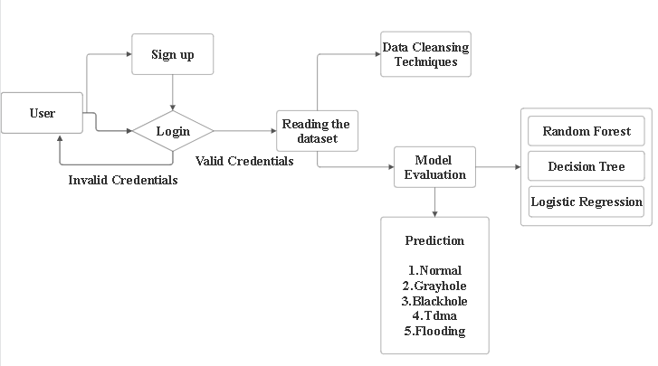
Architecture

Slide 11
UML DIAGRAMS
Use Case Diagram:
1) A use case diagram in the Unified Modeling Language (UML) is a type of behavioral diagram defined by and created from a Use-case analysis.
2) Its purpose is to present a graphical overview of the functionality provided by a system in terms of actors, their goals (represented as use cases), and any dependencies between those use cases.
3) The main purpose of a use case diagram is to show what system functions are performed for which actor. Roles of the actors in the system can be depicted.

Slide 12
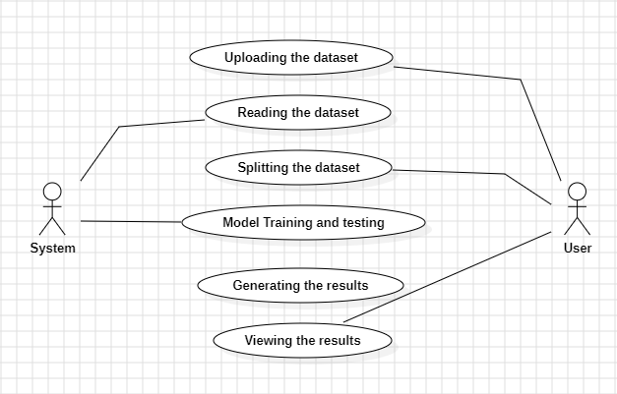
Figure: Use Case Diagram

Slide 13
ER Diagram:
An Entity–relationship model (ER model) describes the structure of a database with the help of a diagram, which is known as Entity Relationship Diagram (ER Diagram). An ER model is a design or blueprint of a database that can later be implemented as a database. The main components of E-R model are: entity set and relationship set.
An ER diagram shows the relationship among entity sets. An entity set is a group of similar entities and these entities can have attributes. In terms of DBMS, an entity is a table or attribute of a table in database, so by showing relationship among tables and their attributes, ER diagram shows the complete logical structure of a database. Let’s have a look at a simple ER diagram to understand this concept.

Slide 14
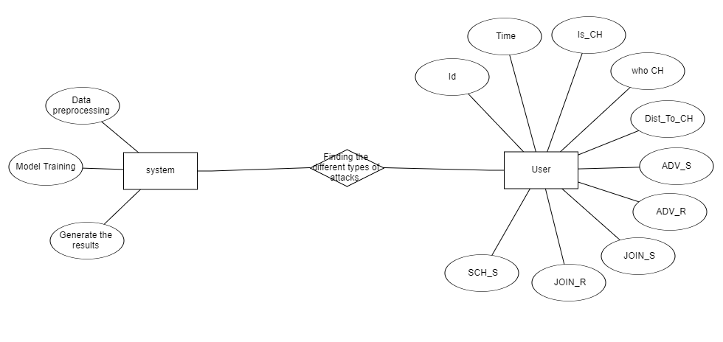
Figure: ER diagram

Slide 15
Implementation
1. System:
1.1 Store Dataset:
The System stores the dataset given by the user.
1.2 Model Training:
This is the process of teaching a machine learning model to make accurate predictions or classifications by exposing it to a dataset. During this phase, data is prepared and split into training, validation, and test sets. The selected algorithm learns from the training data by adjusting its internal parameters to minimize errors in predictions, using techniques like gradient descent to optimize performance.

Slide 16
1.3 Model Predictions:
The system takes the data given by the user and predict the output based on the given data.
2. User:
2.Registration:
The Registration Page allows new users to create an account by entering their personal information. It includes fields for username, email, password, and other required details. The page features validation to ensure that all input data is correct and meets the specified requirements. For example, it checks for valid email formats, strong passwords, and non-duplicate usernames. Users receive real-time feedback on any errors or issues with their input, ensuring a smooth and secure registration process.

Slide 17
2.2 Login:
Username/Email Field: Checks for valid email formats or existing usernames.
Password Field: Ensures the password meets security requirements (e.g., minimum length, complexity).
Validation Messages: Provides immediate feedback if the input is incorrect or if the account details do not match.
2.3.Viewing the dataset :
User can able to view the dataset
2.4.Model selection:
User can selects the accuracy of a model and view the accuracy of that particular model
2.5.Prediction:
User can predict based on the particular date is it better to type of attack .

Slide 18
DataSET Description
Dataset:
https://www.kaggle.com/datasets/bassamkasasbeh1/wsnds?select=WSN-DS.csv
1. id
Represents a unique identifier for a specific transaction, user session, or communication instance within the banking system. 2. Time
Indicates the timestamp of the transaction or communication activity. This is critical for tracking and analyzing transaction patterns and detecting anomalies. 3. Is_CH
Represent whether the transaction originates from a central branch or a trusted source (e.g., 1 for a trusted branch/server, 0 otherwise).

Slide 19
4. who CH
Denotes the branch, server, or central authority responsible for processing this transaction or communication.
5. Dist_To_CH
Reflects the latency or the time taken for the transaction to reach the central branch or server. Higher values might indicate delays or potential inefficiencies.
6. ADV_S
Number of authorization requests sent by a customer or an ATM. 7. ADV_R
Number of responses received from the server or central system. 8. JOIN_S
Requests sent by a customer (e.g., login or session initiation).

Slide 20
9. JOIN_R
Responses from the server confirming the session establishment. 10. SCH_S
Represents the number of scheduling requests or instructions sent by a component in the system. 11. SCH_R
Represents the number of scheduling acknowledgments or responses received by a component in the system. 12. Rank
Reflect the priority or risk score of a transaction. For instance, higher ranks could indicate higher transaction amounts or potentially higher-risk transactions.. 13. DATA_S
Outgoing data from the customer's side (e.g., account details or transaction requests). 14. DATA_R
Data received from the bank server (e.g., transaction confirmations or balance details)

Slide 21
15. Data_Sent_To_BS
Indicates the total data transmitted to the central system (e.g., the bank's core server). This could help measure transaction load.
16. dist_CH_To_BS
The communication distance (or latency) between the branch/server and the bank’s central server. Higher values could indicate network delays or potential bottlenecks. 17. send_code
Represents the type or status code of the transaction, such as:
Successful transaction.
Authorization failed. 18. Expanded Energy
Represents the computational or network resource consumption for processing this transaction. Higher values might suggest resource-heavy operations or potential abnormal activity. 19. Attack type
Indicate the type of attack.

Slide 22
Proposed System
Decision Tree: A tree-like model that makes decisions based on feature values. It is interpretable and easy to understand but can overfit on training data.
Random Forest: An ensemble method that combines multiple decision trees to improve accuracy and reduce overfitting. It provides better generalization compared to individual decision trees.
Logistic Regression (LR): A statistical model used for binary classification. It is simple and interpretable but may not capture complex patterns as well as other algorithms.

Slide 23
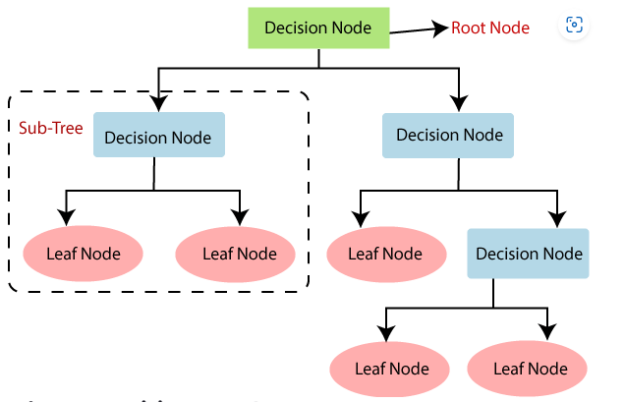
Algorithm Definition
Decision Tree Classifier
Definition: A Decision Tree Classifier is a supervised learning algorithm used for classification tasks. It models decisions and their possible consequences as a tree-like structure of nodes, where each internal node represents a test on an attribute, each branch represents an outcome of the test, and each leaf node represents a class label.

Slide 24
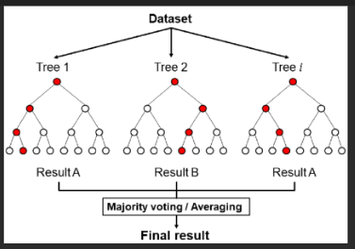
Random Forest Classifier
Definition: The Random Forest Classifier is an ensemble learning method that constructs multiple decision trees during training and outputs the class that is the mode of the classes predicted by individual trees.
Internal Working:
Bootstrap Aggregation (Bagging): It creates multiple subsets of the original dataset with replacement.
Random Feature Selection: At each node, a random subset of features is considered for splitting.
Model Building: Each decision tree is built independently on these bootstrapped datasets.
Aggregation: The final prediction is made by aggregating the predictions of all individual trees.

Slide 25
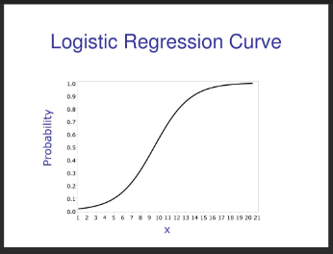
Logistic Regression
Definition: Logistic Regression is a statistical model used for binary classification tasks. It estimates the probability that a given input belongs to a certain class using the logistic function.
Internal Working:
Linear Combination: Calculates a weighted sum of the input features.
Logistic Function: Applies the sigmoid function to map the output to a probability between 0 and 1.
Thresholding: Assigns class labels based on a probability threshold (usually 0.5).
Parameter Estimation: Uses maximum likelihood estimation to find the optimal weights that minimize the difference between predicted and actual values.

Slide 26
Conclusion
In conclusion, this study introduces a robust, situation-based predictive approach to cybersecurity intrusion detection and prevention within the banking sector. By integrating machine learning (ML) algorithms, the proposed model effectively detects and prevents potential cyber threats in real-time. The combination of supervised and unsupervised learning techniques allows the model to analyze historical and real-time transaction data, identifying anomalies and patterns that signal cyber intrusions. The experimental results validate the effectiveness of the model, demonstrating superior detection rates and a significant reduction in false positives compared to traditional methods. This predictive framework not only enhances the security of banking systems but also offers a scalable solution adaptable to the ever-evolving nature of cyber threats. The success of this approach emphasizes the importance of incorporating advanced predictive analytics into cybersecurity frameworks for the banking industry, ultimately ensuring the safety of financial transactions and customer data against increasingly sophisticated cyber-attacks.

Slide 27
REFERENCES
[1] John M. Doe, Alice T. Brown. "Future Prospects of ML in Cybersecurity. " Journal of Cyber Security Technology, 4(3), 149-169. doi:10.1080/23742917.2020.1777638 (2024)
[2] Priya Gupta, Rahul Verma " Intrusion Detection Using ML and DL Models." IEEE Access, 9, 57254-57273. doi:10.1109/ACCESS.2021.3074963 (2024)
[3] Sarah E. Mitchell, Andrew S. Clarke " Strategies and Considerations for IDS." ." Wireless Communications and Mobile Computing, 2019, Article ID 6520814. doi:10.1155/2019/6520814 (2024)
[4] Emily Zhang, Daniel Hayes "ML-Based Intrusion Detection Framework for Financial Services." Journal of Ambient Intelligence and Humanized Computing, 12(4), 4617-4632. doi:10.1007/s12652-020-02581-1 (2024)
[5] Ahmed Khalid, Noor Fatima “Enhancing Security in Financial Institutions with ML." Computers & Security, 102, 102084. doi:10.1016/j.cose.2020.102084 (2024)
[6] Olivia T. Harris, Jacob R. Matthews “Predictive Approaches for Cybersecurity Intrusion Prevention."Sensors, 23(1), 123. doi:10.3390/s230100123 (2024)

Slide 28
[7] William J. Robinson, Maria G. Lopez “Systematic Review of DL-Based IDS ." IEEE Internet of Things Journal, 6(5), 8618-8632. doi:10.1109/JIOT.2019.2901894 (2024)
[8] Nisha Sharma, Rajeev Kumar “Comparative Analysis of ML and DL Techniques for Threat Detection.“Journal of Industrial Information Integration, 21, 100210. doi:10.1016/j.jii.2020.100210 (2024)
[9] Hannah C. Lee, Michael P. Scott " DL Algorithms in Intrusion Detection System.“ Future Generation Computer Systems, 117, 141-156. doi:10.1016/j.future.2021.08.005 (2024)

Slide 29
THANK YOU

