Slide 1
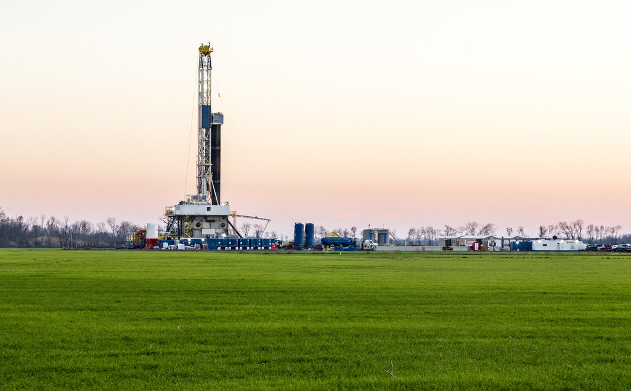
Chemical Engineering Thermodynamics COURSE PROJECT
Study of EOR of natural gas via Nitrogen induced fracking
GROUP 04:
Srivats J (B21CH032)
Umashankar Prajapati (B21CH033)
Utkarsh Gupta (B21CH034)
Vivek Sharma (B21CH036)
Yejjala Venkata Surya Prasad (B21CH037)
Yogesh Kumar (B21CH038)
Amitesh Rana (B21CH039)
https://www.flickr.com/photos/danielfoster/11586288744
https://www.flickr.com/photos/danielfoster/11586288744

Slide 2
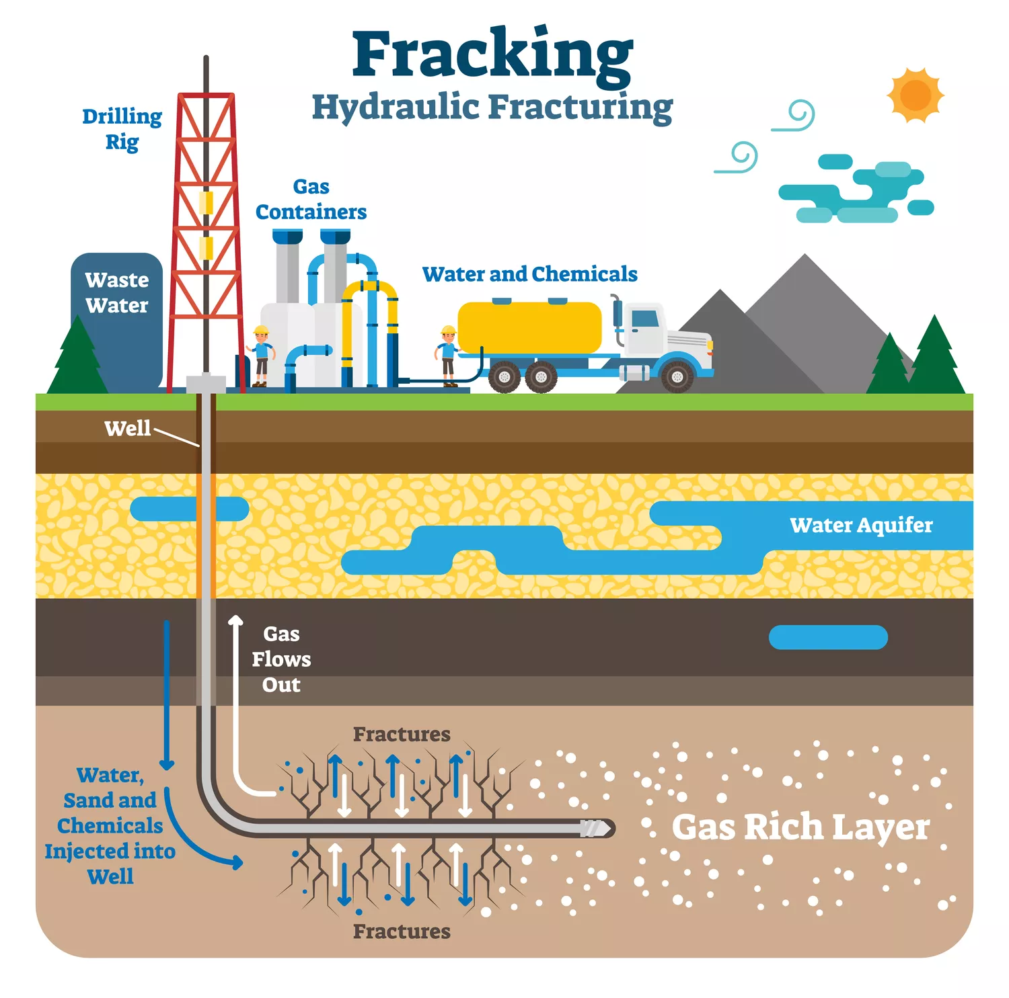
What is “Fracking”?
“Fracking”, or hydraulic fracturing, is a technique used to extract oil and natural gas from deep underground rock formations, typically shale. By injecting a high-pressure mixture of water, sand, and chemicals, the rock fractures, releasing the trapped hydrocarbons. While it has revolutionized the energy sector, offering increased gas and oil reserves, it also raises significant environmental concerns, such as water contamination, excessive water use, and induced seismic activity.
https://www.investopedia.com/terms/f/fracking.asp

Slide 3
Why we use Nitrogen:
Inert Nature: Nitrogen's inertness prevents unwanted chemical reactions, ensuring safety in various applications.
Reduced Corrosion: Unlike water, nitrogen doesn't corrode pipes or equipment, reducing maintenance costs.
Environmental and Safety Benefits: Using nitrogen can minimize water usage in processes like fracking and ensures an oxygen-free environment in tank purging, reducing fire risks.

Slide 4
What is Enhanced Oil Recovery (EOR)?
Enhanced oil recovery (EOR), also known as “tertiary recovery,” is the process of extracting oil that has not already been retrieved through the primary or secondary oil recovery techniques
Primary oil recovery is limited to hydrocarbons that naturally rise to the surface, or those that use artificial lift devices, such as pump jacks. Secondary recovery employs water and gas injection, displacing the oil and driving it to the surface.

Slide 5
Excess Free Energy
Using Redlich Kwong Equation
P = RT/(V-b) - a/(sqrt(T)*V*(V+b))
where:
p is the gas pressure
R is the gas constant,
T is temperature,
V is the molar volume (V/n),
a = 0.42748R^2*Tc^(2.5)/Pc
b = 0.08664*R*Tc/Pc

Slide 6
Using Maxwell Equation
dU = dQ-PdV
dG = -SdT + VdP , where (G = H - TS)
At constant Temperature.
dG = VdP
dG = RT*dP/P = RT*dln(P) - (1) (Ideal Condition)
dG = RTd(ln(f)) - (2) (Real Condition)
where f = fugacity Therefore for ideal gas f = P

Slide 7
On subtracting (1) from (2)
d(G - G ig ) = RTd(ln(f/P)) = RTdlnɸ , where ɸ = fugacity coefficient
d(ln(ɸ)) = (V- Vig)dP/RT
d(ln(ɸ))=[ Vdp - Vigdp ]/RT
=[ d(PV) - Pdv - Vig*dP ]/RT =[ d(PV/RT) - P/RTdv - (Vig/RT)dP ]
A = aP/(sqrt(T)*(RT)^2) , B = bP/RT
ln(ɸ) = (Z-1) - ln(Z - B) + (A/B)ln(Z/Z+B)
Put V = ZRT/P in RKE (Changing RKE in terms of Z)
z 3 - z 2 + z(A-B-B^2) - AB = 0

Slide 8
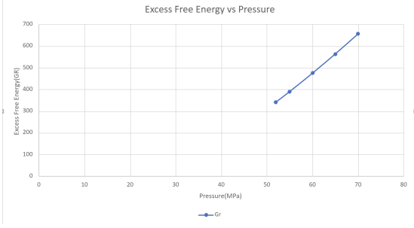

Slide 9
As we can see from the graph, the G E is increasing with increasing pressure at constant temperature. And we can see from the calculation table also as Z is increasing there is an increase in excess free energy. It suggests that the system is becoming less stable at higher pressures.
This increase in excess free energy implies that the system is deviating further from its equilibrium state, which can have various implications depending on the specific conditions and components involved. It might indicate a tendency for phase transitions or other changes in the system's behavior.

Slide 10
Isentropic Heat Change (ΔT)
The process is given to be isentropic. Therefore, ΔS = 0.
Since the Nitrogen used is in its liquid state, the following equation is used for it’s entropy:- dS = Cp.(dT/T) − βVdP
β = Volume expansivity, Cp= Specific Heat and V= Volume of Liquid
β=-(dV/dT)/Vo
(T2/T1)=(P2/P1)^(1-1/k) (T2 for Ideal condition)
ΔS = ⟨Cp⟩.ln(T2/T1) − ⟨β⟩⟨V⟩(P2−P1) = 0

Slide 11
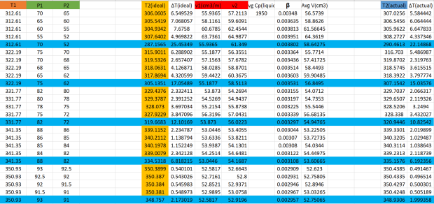
T2 = T1 * exp[⟨β⟩⟨V⟩(P2−P1) / ⟨Cp⟩]
∴ ΔT = T1 - T2 = T1 * (1 - exp[⟨β⟩⟨V⟩(P2−P1) / ⟨Cp⟩] )

Slide 12
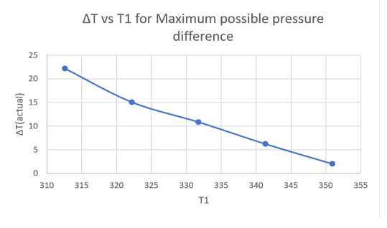

Slide 13
At a constant initial temperature (T1), a decrease in initial pressure (P1) leads to larger increases in both temperature change (ΔT) and volume change (ΔV) for a given pressure difference (ΔP).
Despite expectations, raising the initial temperature doesn't ensure greater expansion of liquid Nitrogen under isentropic conditions; in fact, it's the opposite. However, at the same temperature, a reduced initial pressure does result in more significant liquid Nitrogen expansion.

Slide 14
CONCLUSION
In fracturing, higher excess free energy with increasing pressure can signal decreased efficiency and controllability, potentially necessitating operational adjustments for maintaining process integrity.
Elevating temperature in fracking can induce thermal stress, damage surrounding areas, reduce the viscosity of the liquid, and possibly produce undesired gaseous N2.

Slide 15
THANKYOU !!

