Slide 1



Minor Project-1
03/12/2021

Slide 2
GROUP-4
MENTOR
Mrs. Richa Choudhary
(Assistant Professor)
NAME SAP Id
ADITI KUNWAR 500075300
DIWAS PANDEY 500075832
UTKARSH SINGH 500076133
VANSHIKA SRIVASTAVA 500077085

Slide 3

Title- Linux Shell scripting with supplement Cryptography Algorithm commands.

Slide 4
CONTENTS
ACKNOWLEDGEMENT 8. PROJECT TIMELINE
ABSTRACT 9. PROJECT DEVELOPMENT METHODOLOGY
INTRODUCTION 10. FLOW CHART
PROBLEM STATEMENT 11. PROCEDURE
MOTIVATION 12. ADVANTAGES OF PROJECT
LITERATURE REVIEW 13. RISKS AND ASSUMPTIONS
OBJECTIVES 14. REFERENCES

Slide 5
ACKNOWLEDGEMENT
We express our deep gratitude and appreciation to those who agreed to participate in this project, for their time expended and courage in sharing their insights with fledging students.
Special thanks to Dr. Bhagwant Singh for invigilating and giving us this wonderful opportunity of working on our minor project-1 and also for the time spent on correcting our mistakes and continuous support.
We are immeasurably enriched by working under the mentorship of Mrs. Richa Choudhary, who has great level of knowledge and who has an art of encouraging, correcting, and directing us in every situation possible.
At times our studies carried out at great cost to those closest to us. We all thank our families and fellow batch mates for their best understanding and support.
We acknowledge to all the people who are involved in this beautiful journey of project and will be supporting us till the completion.

Slide 6
ABSTRACT
The issue of time saving, security and portability are the alarming things to get insights on. These things are must asked to get in use by any organisation and company. Today’s banking system has brought core banking for the user's convenience, which is a set of services, where authentication plays main role. But these days, because of tremendous realization and growth in the field of hacking it is not safe to rely on internet to keep credentials and confidential data.
Secure transmission of messages has been a major goal since ages, for which cryptography is used. Cryptography is the technique which is utilized for secure communication over the network. Cryptography is used to protect data from unauthorized access. The need and importance of secure information communication, particularly text, image and video transmission has made cryptography to take a larger space in current research era. Improvement of pictorial information for betterment of human perception.
A shell script can provide a convenient variation of a system command where special environment settings, command options, or post processing apply automatically, but in a way that allows the new script to still act as a fully normal LINUX command. The various dialects of shell scripts are considered to be scripting languages. Typical operations performed by shell scripts include file manipulation, program execution, and printing text. The C shell is a command processor typically run in a text window, allowing the user to type commands. The C shell can also read commands from a file, called a script. The C shell is used primarily for interactive terminal use, and less frequently for scripting and operating system control. It has interactive keyboard shortcuts in form of special control-key sequences for special effects such as job control.

Slide 7
INTRODUCTION
Shell Scripting is a program to write a series of commands for the shell to execute. It can combine lengthy and repetitive sequences of commands.
A C++ shell is a user interface that allows the user to interact with the operating system services. Shell takes human-readable commands from the user and translates them into kernel-friendly commands. It's a command language interpreter that can read commands from keyboards or files, and execute them.
Cryptographic Algorithms are the most frequently used privacy protection method in the IOT domain. Many cryptographic tools have been applied in practice. Cryptographic algorithms are used for important tasks such as data encryption, authentication, and digital signatures. The major types of Cryptography algorithms are:
DES (Data Encryption Standard) first came into use in 1976 in the United States and has since been used by a variety of parties globally. DES is a block cipher based on symmetric key cryptography and uses a 56-bit key.
AES (Advanced Encryption Standard) is a set of symmetric block ciphers endorsed by the US government through NIST, and now used by a variety of other organizations. AES uses three different ciphers: one with a 128-bit key, one with a 192-bit key, and one with a 256-bit key, all having a block length of 128 bits.
RSA (Rivest, Shamir, Adleman) algorithm is asymmetric cryptography algorithm. Asymmetric actually means that it works on two different keys i.e. Public Key and Private Key.

Slide 8
PROBLEM STATEMENT
To implement Linux commands in C++ and also use Cryptography Algorithms as Linux commands to encrypt the data.

Slide 9
MOTIVATION
Motivation for Linux Shell scripting in C++ is by running Linux commands in Windows, we can make GUI and CLI based works get done in one system rather than two systems.
Motivation for implementing Cryptography algorithms is to maintain the integrity, confidentiality and authenticity of sensitive information. Relying on standardized and mathematically secure algorithms is mandatory to prevent data disclosure, data tampering or repudiation.

Slide 10
LITERATURE REVIEW
By implementing Linux commands in C++ and also using Cryptography algorithms as Linux commands in addition for encryption of data is coming out to be useful in many aspects and situations.
This project increases system’s portability, security and reliability. Moreover the time complexity of implementation of cryptography as a Linux command tends to be less than the ordinary implementation of the same. Hence, this project’s overall use is for betterment of user based on security and complexity purpose.

Slide 11
OBJECTIVES
Linux Shell Scripting in C++ Language with implementing a bunch of commands.
Implementation of major three Cryptography Algorithms as Linux commands.

Slide 12




PROJECT TIMELINE
26 September
26 November
10 December
START
>HALF
END
70% PROJECT
40% PROJECT

Slide 13

PROJECT DEVELOPMENT METHODOLOGY
Project Management Methodology is a strictly defined combination of logically related practices, methods and processes that determine how best to plan, develop, control and deliver a project throughout the continuous implementation process until successful completion and termination.
Programming Methodology is the approach to analyzing such complex problems by planning the software development and controlling the development process.
The top-down approach to programming is also called modular programming.

Slide 14

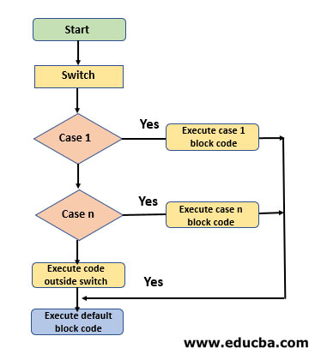
FLOW CHART – Linux Shell Scripting

Slide 15
PROCEDURE OF CRYPTOGRAPHY ALGORITHM
Cryptography operates by a sender’s transmittal of an encrypted message in a systematic manner that conceals its original meaning that is then recovered by the receiver who decrypts the transmission to get the original message. Numerous cryptosystems operate algorithms that are utilized in the method of cryptography to preserve security. These systems are outlined on a group of specific parameters, known as a key.
A key is a string of bits that is used by the cryptographic algorithm or algorithms during the process of encrypting and decrypting the data. A cryptographic key is like a key for a lock i.e., only with the right key you can open the lock.
The encrypted message together with the key serves as the input for the receiver when applying the decrypting algorithm.
The algorithms used to encrypt and decrypt data that is transferred over a network typically come in two categories: secret-key cryptography and public-key cryptography.
Both secret-key cryptography and public-key cryptography depend on the use of cryptographic key or pair of keys.

Slide 16
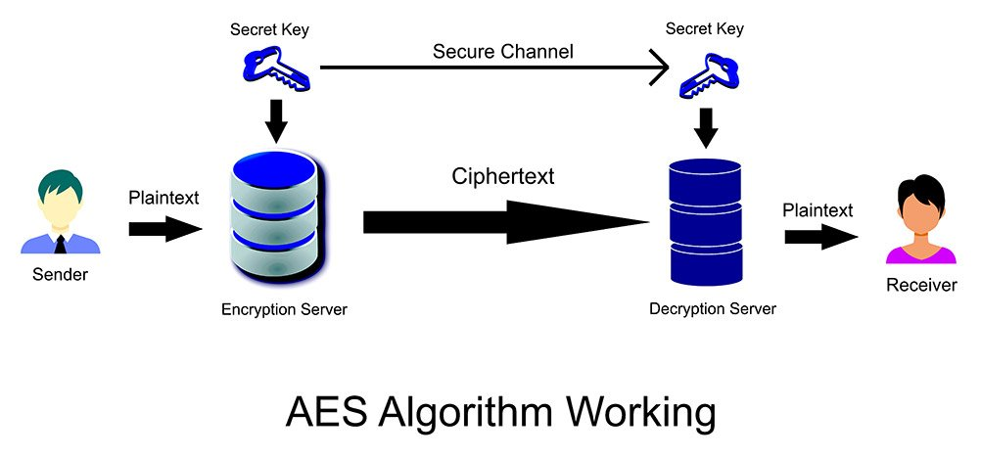
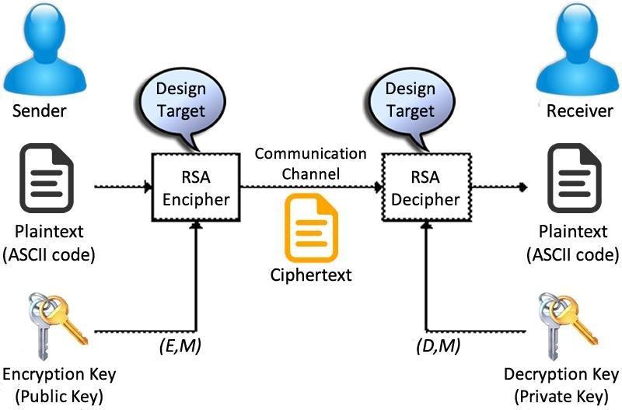
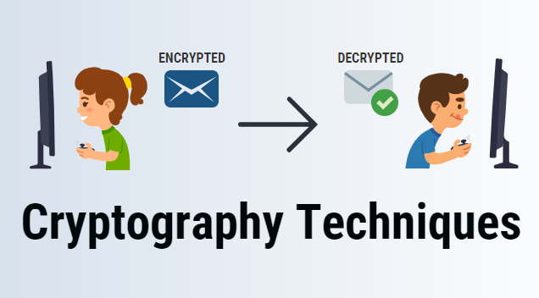
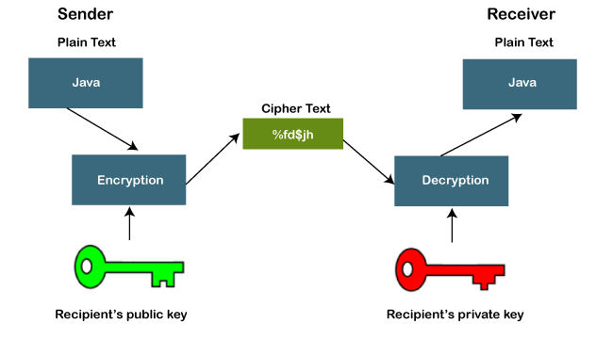
AES Algorithm
RSA Algorithm
DES Algorithm

Slide 17
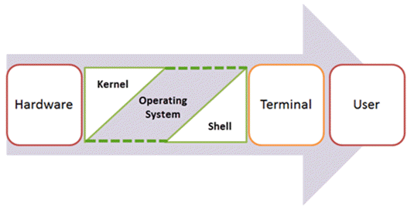
PROCEDURE OF LINUX SHELL SCRIPTING
Shells are interactive that mean, they accept command as input from users and execute them. However some time we want to execute a bunch of commands routinely, so we have type in all commands each time in terminal. As shell can also take commands as input from file we can write these commands in a file and can execute them in shell to avoid this repetitive work. These files are called Shell Scripts or Shell Programs.
A shell script comprises following elements –
Shell Keywords – if, else, break etc.
Shell commands – cd, ls, echo, pwd, touch etc.
Functions
Control flow – if..then..else, case and shell loops etc.

Slide 18






ADVANTAGES OF -
SHELL SCRIPTING
Run sequence of commands as a single command
Portable as it can be executed in any windows or Unix like operating systems
Automate the frequently performed operations
Interactive debugging
Easy to use

Slide 19



ADVANTAGES OF –
CRYPTOGRAPHY
Confidentiality
Authentication
Data Integrity
Non-repudiation

Slide 20



RISKS AND ASSUMPTIONS of Linux Shell scripting
Linux shell scripting cons: 1.Prone to costly errors, a single mistake can change the command which might be harmful.
2.Slow execution speed.
3.Design flaws within the language syntax or implementation.
4.Not well suited for large and complex task.
5.Provide minimal data structure unlike other scripting languages.

Slide 21

RISKS AND ASSUMPTIONS of Cryptography Algorithm Implementation
Most obvious risk is the danger of lost keys. Should a key become lost, either corrupted or deleted or even accidentally thrown away, any data encrypted with that key is also lost.
here is no "undelete" or "data recovery" program that can undo the encryption. weaknesses in key management tools and procedures can put overall security at risk.

Slide 22
REFERENCES
https://www.ijser.in/archives/v1i3/SjIwMTM0MQ==.pdf
https://ijirt.org/master/publishedpaper/IJIRT101640_PAPER.pdf
https://www.geeksforgeeks.org/introduction-linux-shell-shell-scripting/

Slide 23
THANK YOU

