Slide 1

StayHome.com

Slide 2

Developing a Seamless Homestay Booking Website with MERN Stack: A Comprehensive Guide

Slide 3
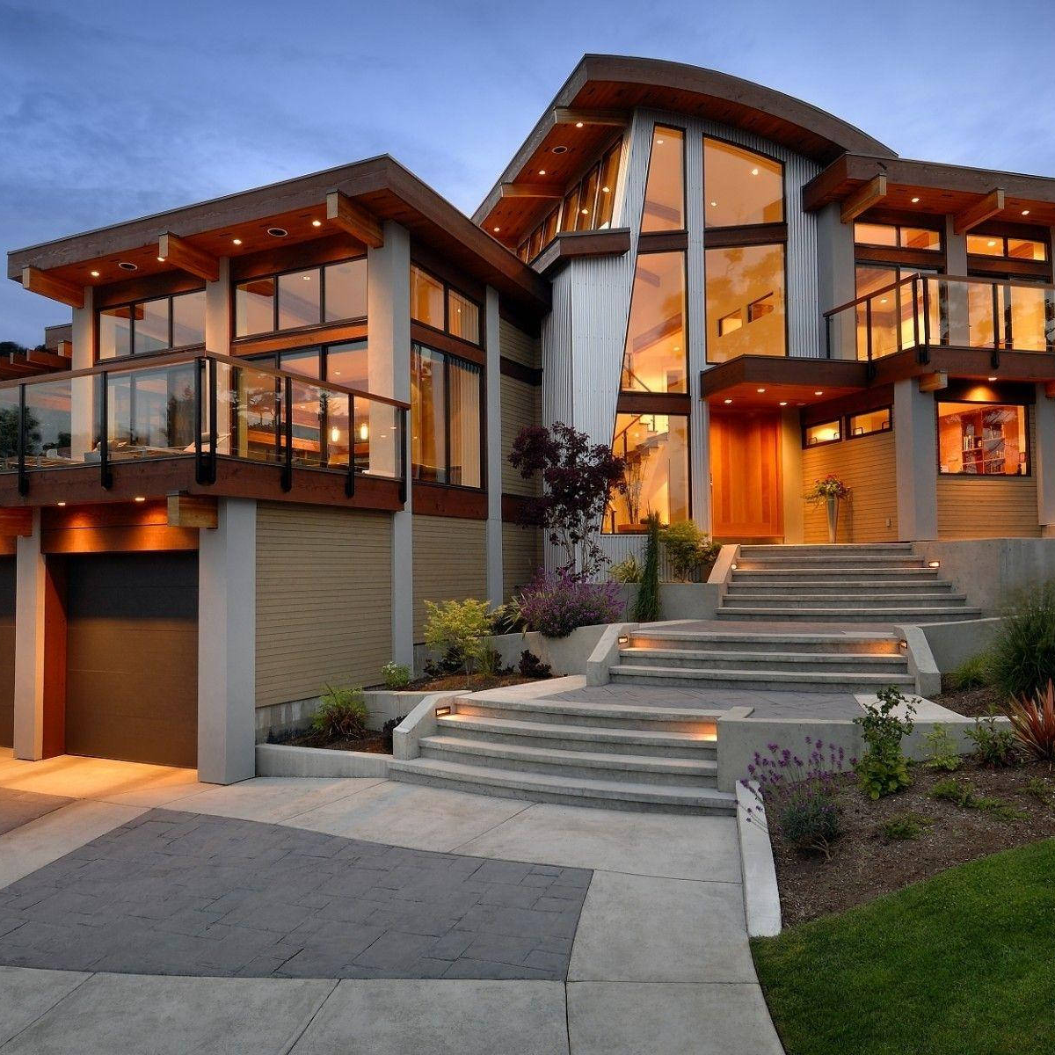
Unlocking the World
Discover unique and affordable accommodations worldwide, hosted by locals. Experience the culture like a local and create unforgettable memories. Book your stay now!

Slide 4

Introduction
This presentation will provide a comprehensive guide to building and deploying a seamless homestay booking website with MERN Stack. You will learn the key components of the MERN Stack and how they work together to create a powerful and efficient web application. By the end of this presentation, you will have a clear understanding of how to craft a successful homestay booking website.

Slide 5
MERN Stack Overview
MERN Stack is an acronym for MongoDB, Express.js, React.js, and Node.js. MongoDB is a NoSQL database, Express.js is a web application framework, React.js is a front-end JavaScript library, and Node.js is a server-side JavaScript environment. Together, these technologies form a powerful and efficient web development stack.

Slide 6

Building the Back-End with Node.js and Express.js
The back-end of your homestay booking website will be built using Node.js and Express.js. You will use Node.js to create a server-side environment and Express.js to build a web application framework. This will allow you to handle HTTP requests and responses and interact with your MongoDB database.

Slide 7

Creating a MongoDB Database
Your homestay booking website will use a MongoDB database to store user data, booking information, and other important data. You will need to create a MongoDB database and configure it to work with your Node.js and Express.js back-end.

Slide 8

Building the Front-End with React.js
The front-end of your homestay booking website will be built using React.js. You will use React.js to create a user interface that is responsive and easy to use. You will also use React.js to handle user interactions and update the state of your application.

Slide 9
Google Photos API Integrations
Google Photos is a photo sharing and storage service developed by Google. It was announced at the Google I/O conference on May 28, 2015. It allows users to store, share, and edit photos and videos. The service also provides a suite of tools for developers to build photo-sharing applications.
The Google Photos API provides a set of tools that developers can use to build applications that enable users to share and edit photos and videos. The API lets developers create, view, and edit albums, photos, and videos; upload and download photos and videos; and search for photos and videos.
Albums, photos, and videos can be shared with other users, and users can add comments to photos and videos. The API also provides a set of tools for developers to build photo-sharing applications.

Slide 10
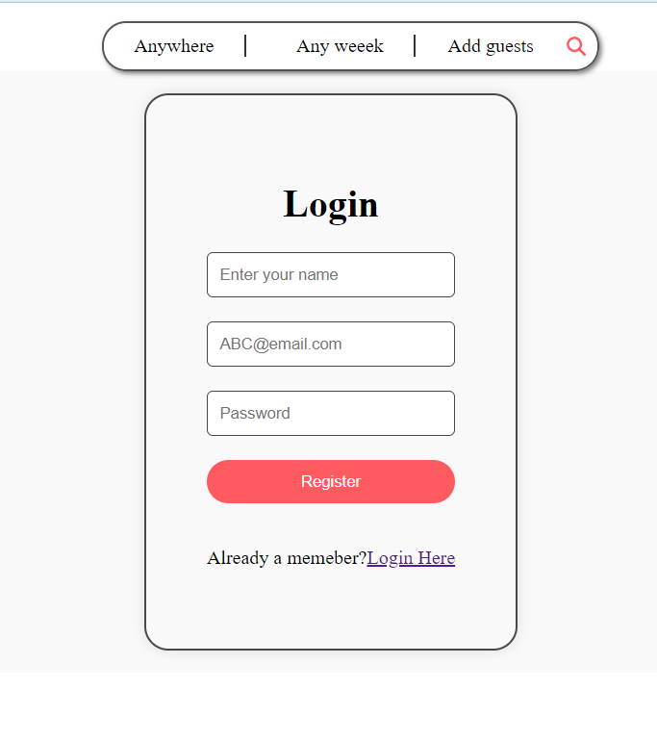
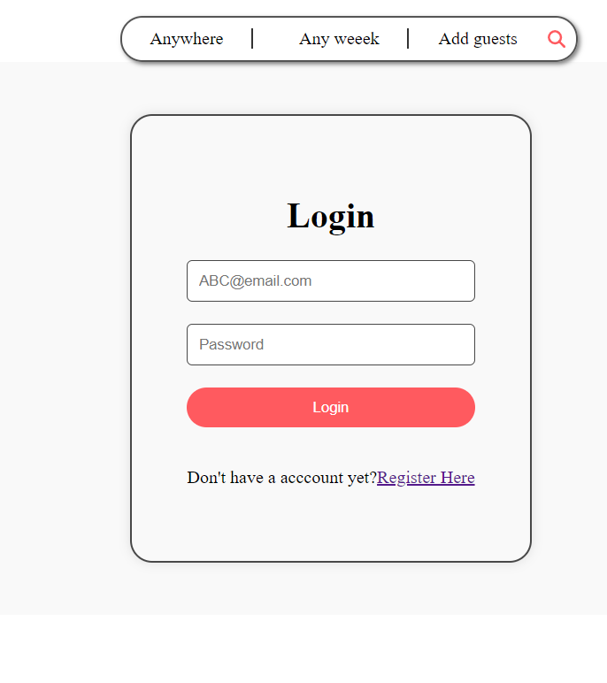
Screenshots

Slide 11

Conclusion
In conclusion, building a homestay booking website with MERN Stack requires a solid understanding of the key components of the stack, as well as a clear vision of your website's design and functionality. By following the steps outlined in this presentation, you can create a powerful and efficient homestay booking website that meets the needs of your users.

