Slide 1
Factor Analysis on Air Line data
Presented By :-
Utkarsh Mishra - 934

Slide 2
Agenda
To identify the passenger satisfaction level
Identifying the hidden factor
Estimating the factor
K-Means

Slide 3
Factor Analysis
Factor analysis takes a large number of variables and reduces or summarizes it to represent them in different smaller factors, those factors are made up of the initial set of variables.
A common usage of factor analysis is in developing scale/questionnaires for measuring constructs that are not directly observable in real life.

Slide 4
Variable
Gender: Gender of the passengers (Female, Male)
Customer Type: The customer type (Loyal customer, disloyal customer)
Age: The actual age of the passengers
Type of Travel: Purpose of the flight of the passengers (Personal Travel, Business Travel)
Class: Travel class in the plane of the passengers (Business, Eco, Eco Plus)
Flight distance: The flight distance of this journey
Inflight wifi service: Satisfaction level of the inflight wifi service (0: Not Applicable; 1-5)
Departure/Arrival time convenient: Satisfaction level of Departure/Arrival time convenient
Ease of Online booking: Satisfaction level of online booking
Gate location: Satisfaction level of Gate location
Food and drink: Satisfaction level of Food and drink
12. Online boarding: Satisfaction level of online boarding
13. Seat comfort: Satisfaction level of Seat comfort
14. Inflight entertainment: Satisfaction level of inflight entertainment
15. On-board service: Satisfaction level of On-board service
16. Leg room service: Satisfaction level of Leg room service
17. Baggage handling: Satisfaction level of baggage handling
18. Check-in service: Satisfaction level of Check-in service
19. Inflight service: Satisfaction level of inflight service
20. Cleanliness: Satisfaction level of Cleanliness
21. Departure Delay in Minutes: Minutes delayed when departure
22. Arrival Delay in Minutes: Minutes delayed when Arrival
23. Satisfaction: Airline satisfaction level (Satisfaction, neutral or dissatisfaction)

Slide 5
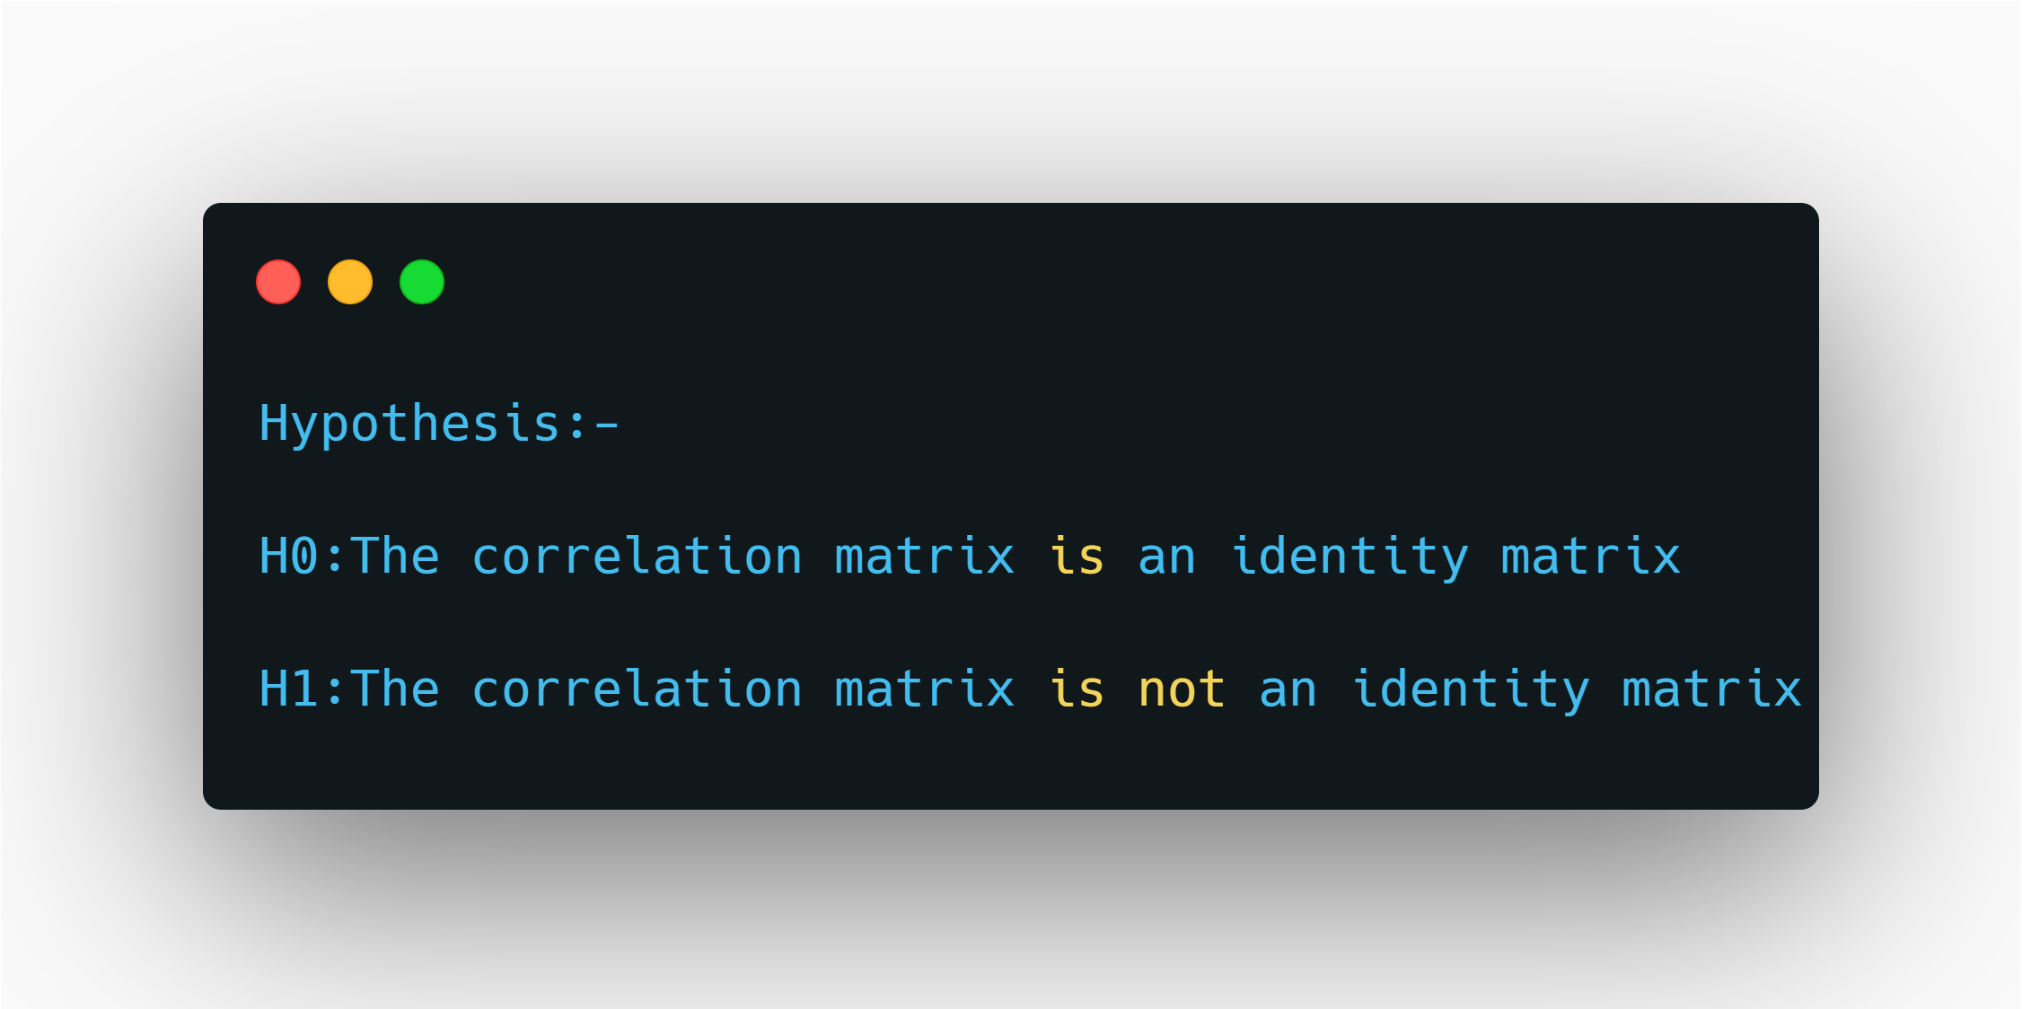
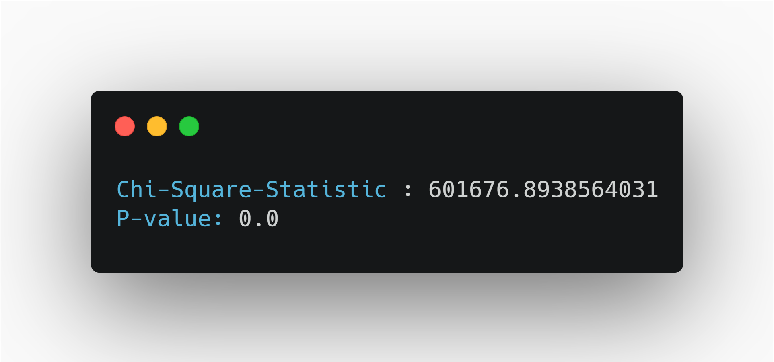
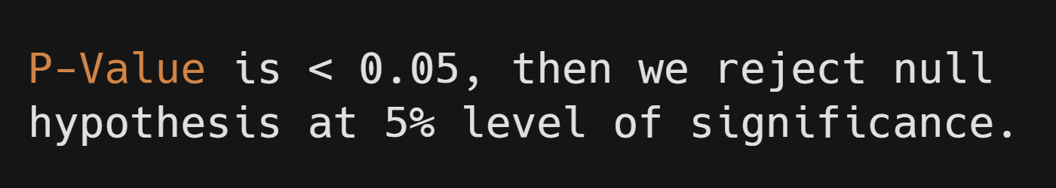
Factorability
Bartlett’s test of Sphericity
Bartlett’s test of sphericity is a test statistic used to examine the hypothesis that the variables are uncorrelated in the population. In other words, the population correlation matrix is an identity matrix; each variable correlates perfectly with itself (r = 1) but has no correlation with the other variables (r = 0).

Slide 6
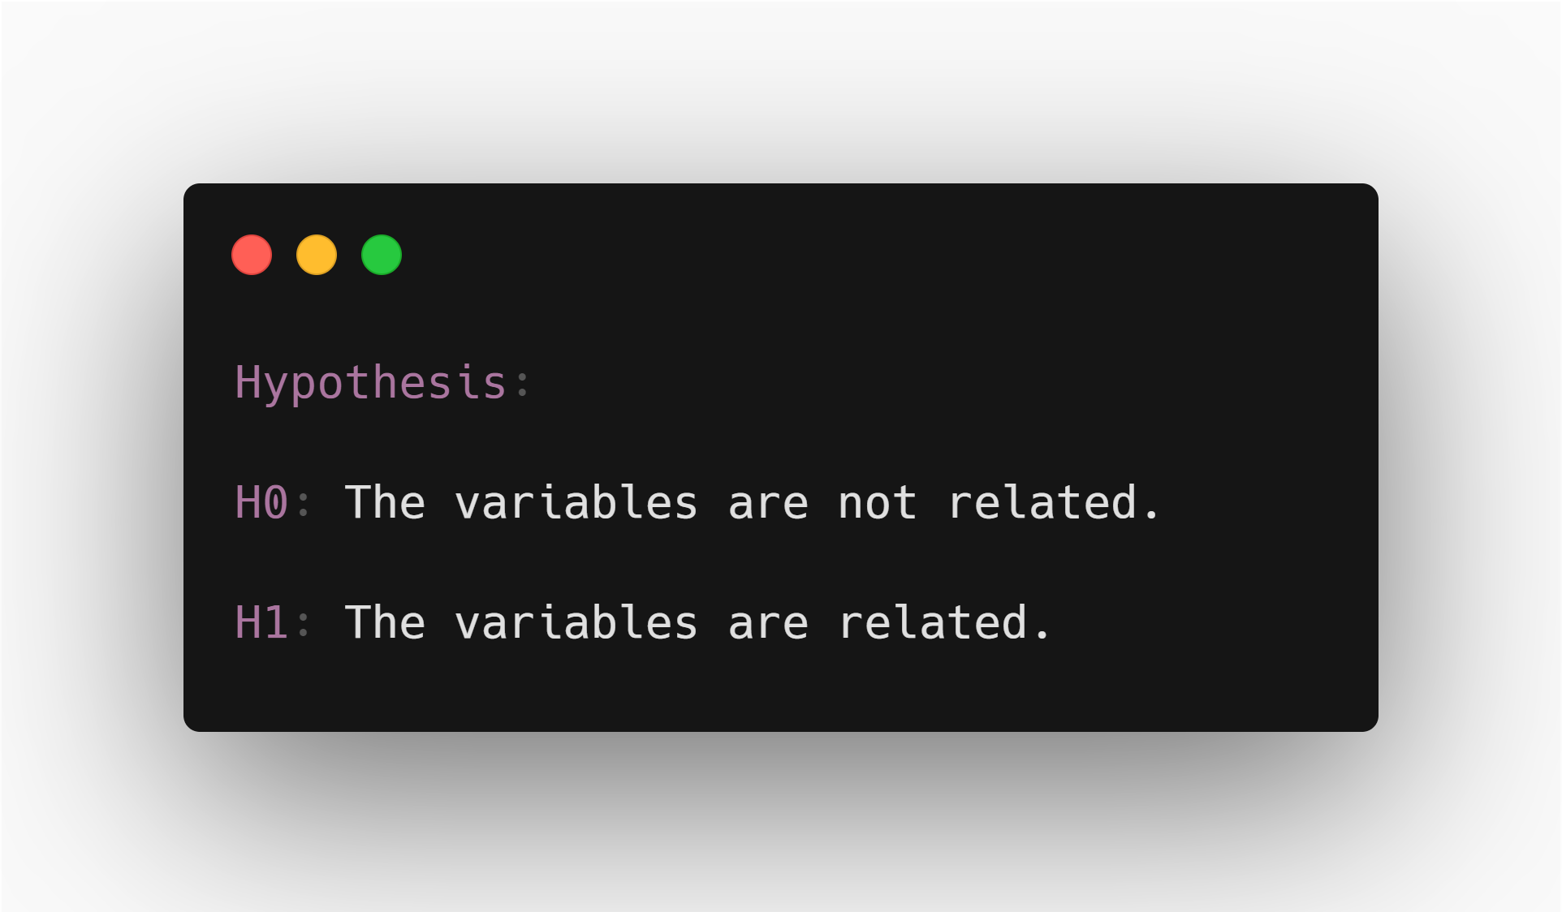
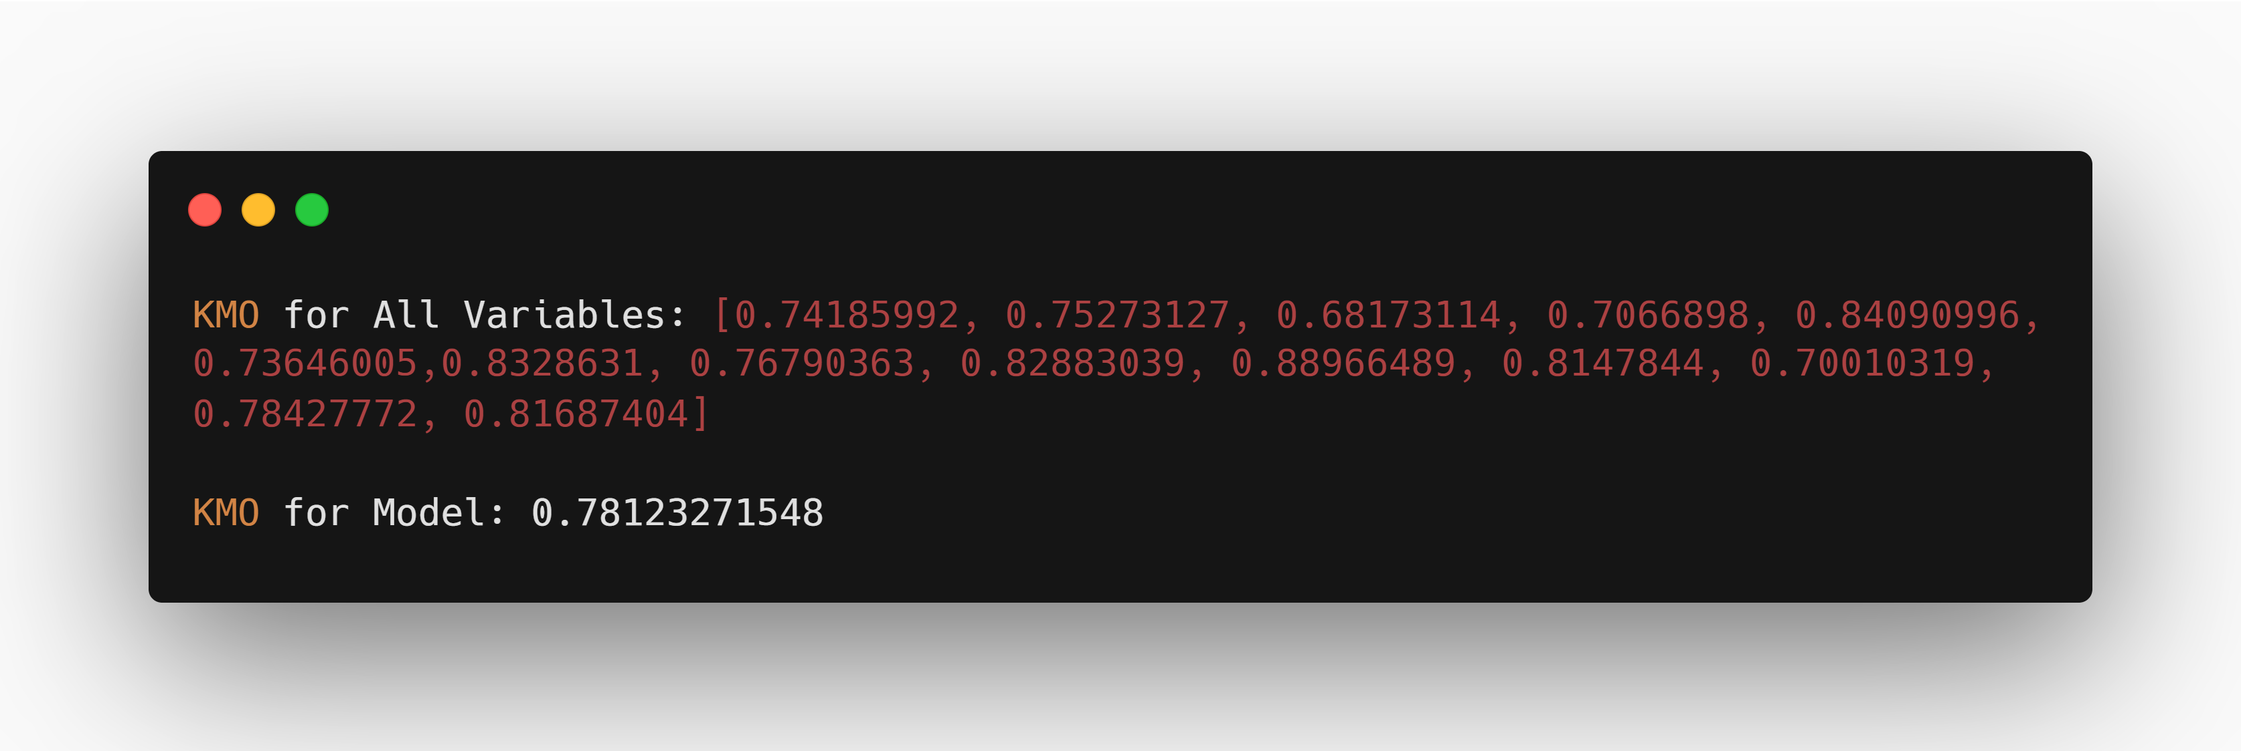
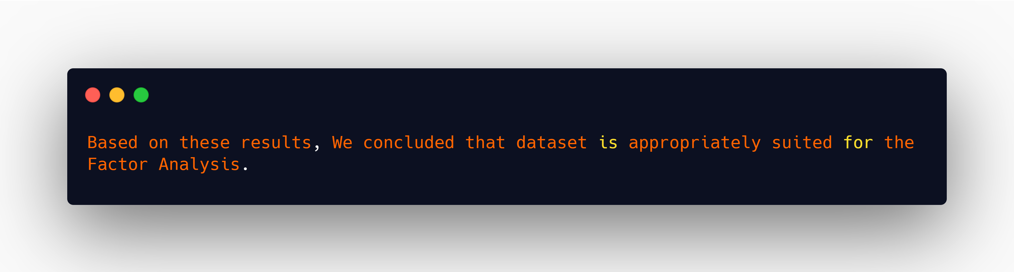
Factorability
Kaiser-Meyer-Olkin (KMO) measure of sampling adequacy
The Kaiser-Meyer-Olkin (KMO) measure of sampling adequacy is a statistics used to examine the appropriateness of factor analysis based on the sample of the study. A high value of statistic (from 0.5 – 1) indicates the appropriateness of the factor analysis for the data in hand, whereas a low value of statistic (below 0.5) indicates the inappropriateness of the factor analysis.

Slide 7
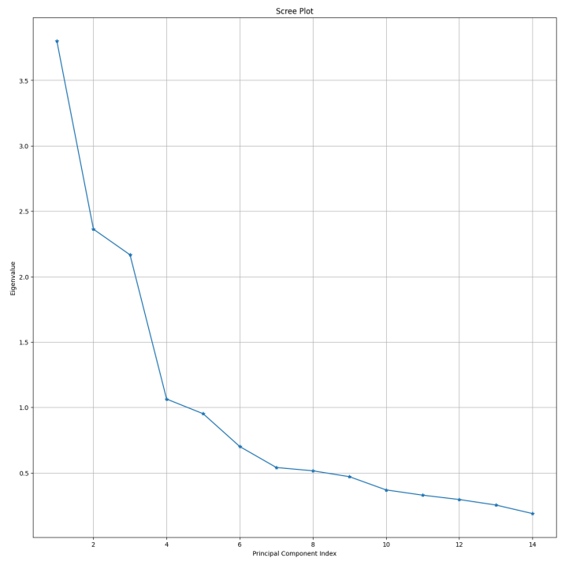
NUMBER OF FACTOR
Screen Plot : It is a plot of eigenvalues and factor number according to the order of extraction. This plot is used to determine the optimal number of factors to be retained in the final solution.

Slide 8
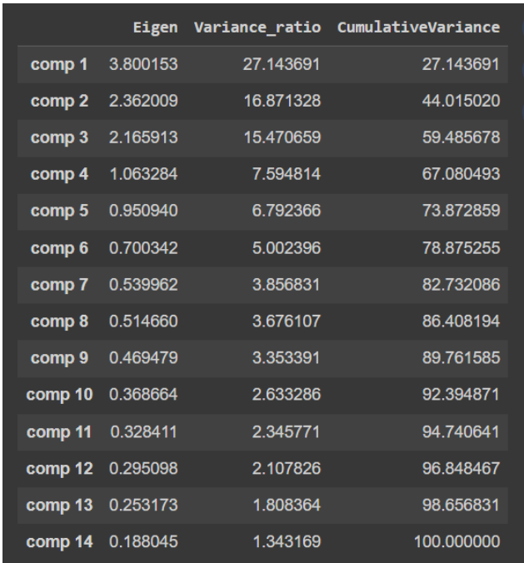
NUMBER OF FACTOR
Percentage of Variance Criteria : The number of factors should be included in the model for which cumulative percentage of variance reaches a satisfactory level. The general recommendation is that the factors explaining 60%–70% of the variance should be retained in the model.
Eigen Value : An eigenvalue is the amount of variance in the variable taken for the study that is associated with a factor. According to eigenvalue criteria, the factors having more than one eigenvalue are included in the model.

Slide 9
Rotation
Rotation: solves this kind of interpretation difficulty. The main objective of rotation is to produce a relatively simple structure in which there may be a high factor loading on one factor and a low factor loading on all other factors.
Varimax Rotation:
Minimizes the correlation between factors. Makes it possible to identify a variable with a factor. Components are always orthogonal—each component explains non-redundant information

Slide 10
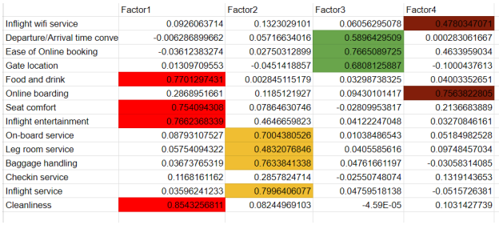
Varimax Rotation

Slide 11
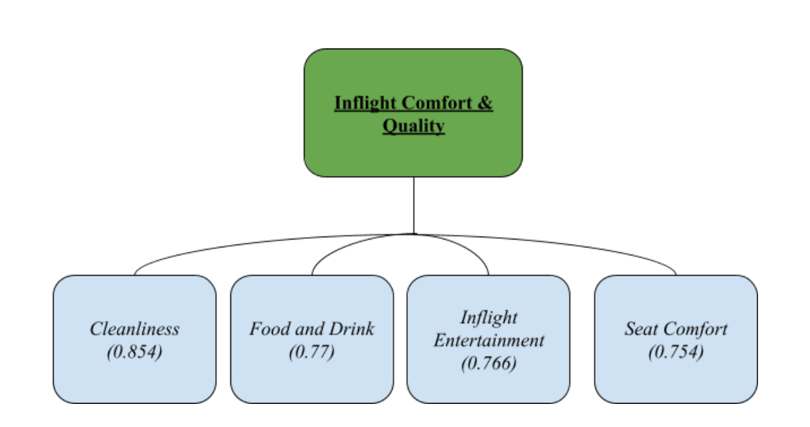
Factor Fitting

Slide 12
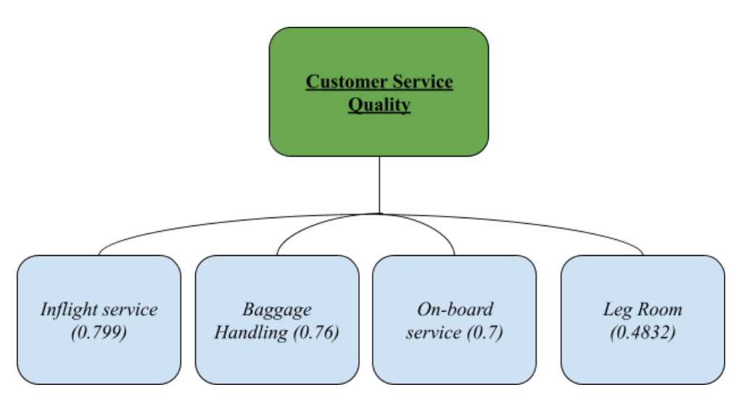
Factor Fitting

Slide 13
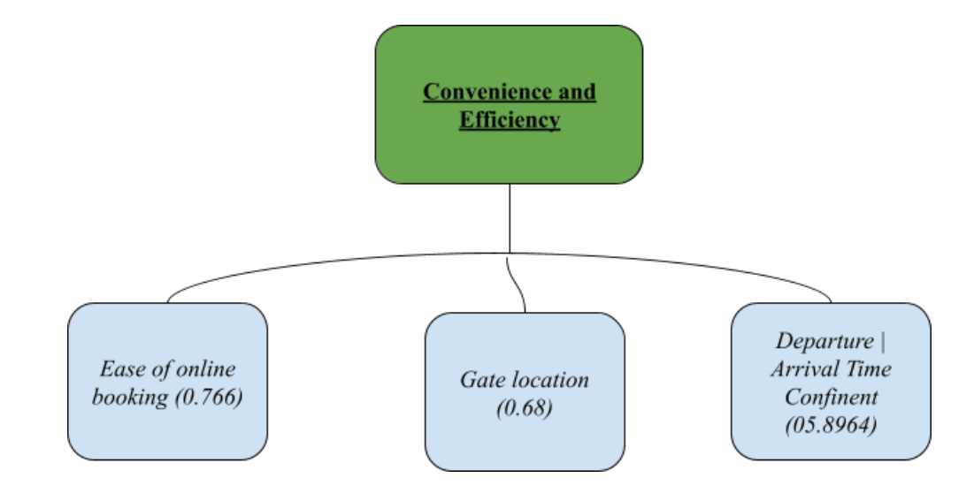
Factor Fitting

Slide 14
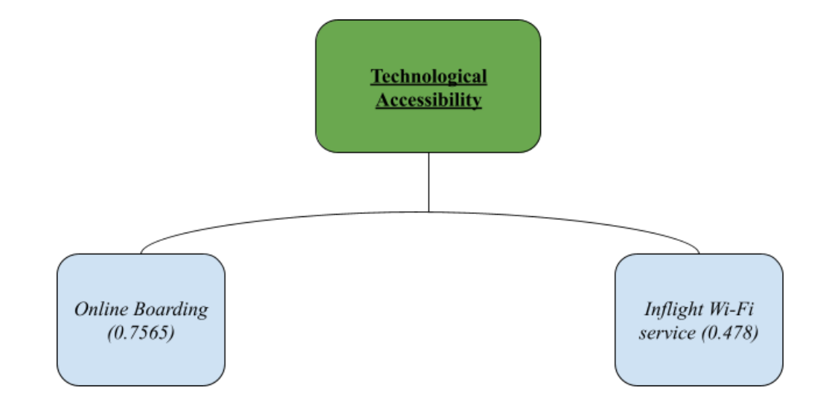
Factor Fitting

Slide 15
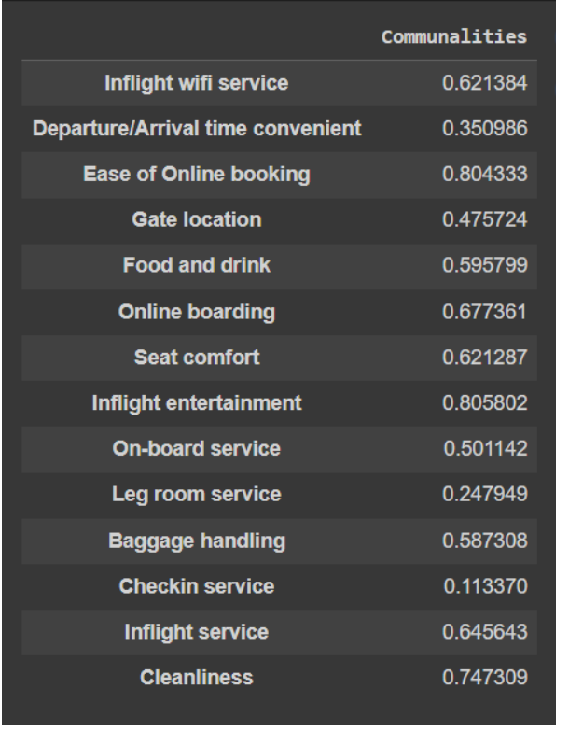
Communality
Communality : is the amount of variance a variable shares with all the other variables being considered.

Slide 16

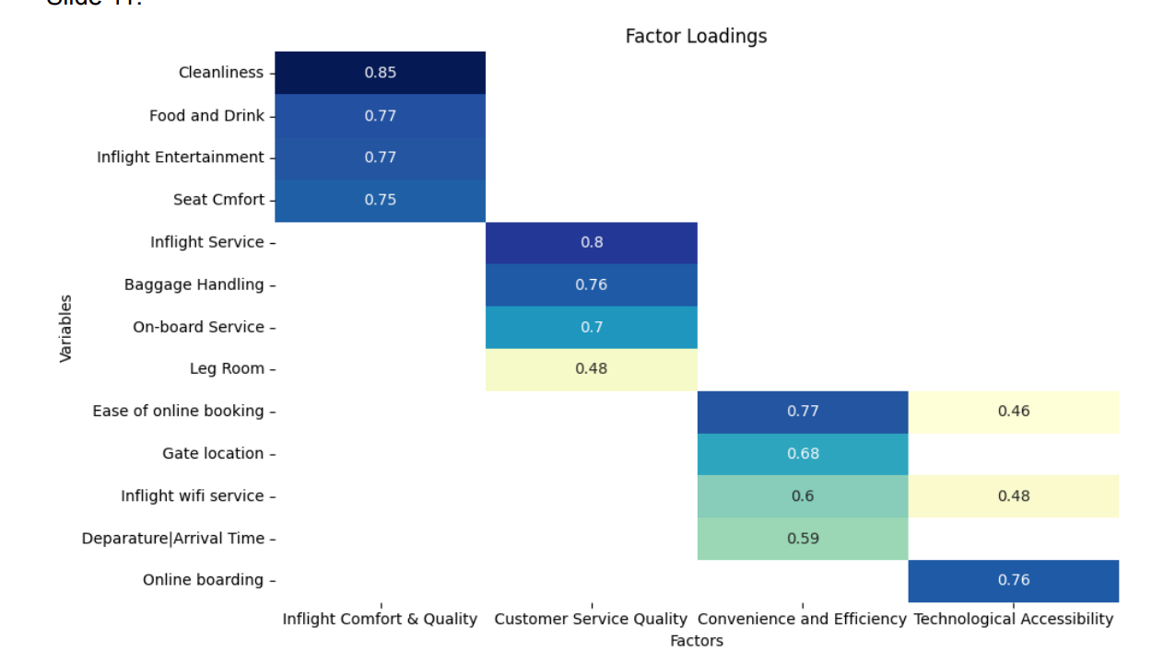

Slide 17

Logistic Regression
Logistic Regression is a statistical method used for analyzing a dataset in which there are one or more independent variables that determine an outcome. It's mainly used for binary classification problems, where the outcome is a categorical variable with two possible values, like yes/no or 1/0.
Where,
pi is the probability of the event occurring (e.g, the probability of being "Satisfied").
β0 is the intercept term.
β1 , β2 , β3 ,…, βk are the coefficients associated with each independent variable X1 , X2 , X3 ,…, Xk

Slide 18
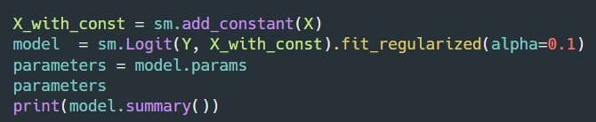
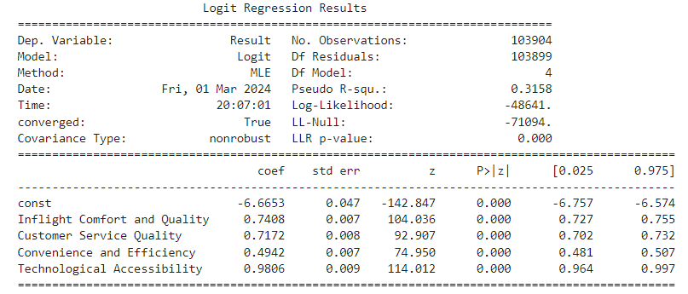
H0 : The coefficient β_{i} is equal to zero
i.e. β1 = β2 = β3 = β4 = 0
H1 : The coefficient βi is not equal to zero
i.e β1 = β2 = β3 = β4 ≠ 0

Slide 19
All the variables have p-value < 0.05
So, we Reject H0 and conclude that the coefficient βi is not equal to zero.
Hence, We reject H0, it typically indicates that there is evidence to suggest that the model coefficients are not equal to zero for at least one predictor variable.
This suggests that the predictor variables have some explanatory power in predicting the outcome variable.

Slide 20
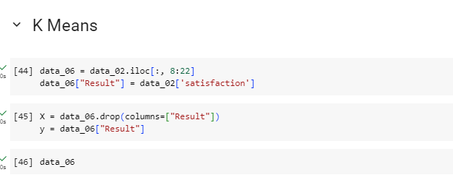
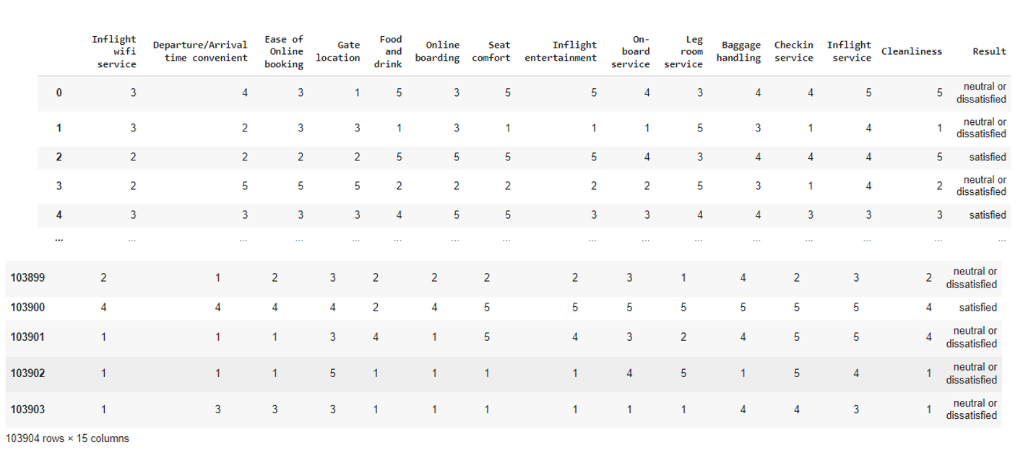
K-MEANS
It aims to group data points into clusters based on their similarity, with the objective of minimizing the within-cluster variance.

Slide 21
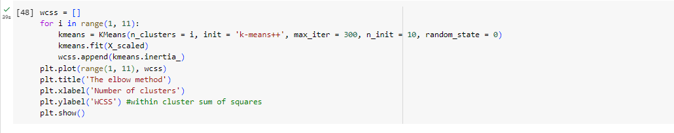
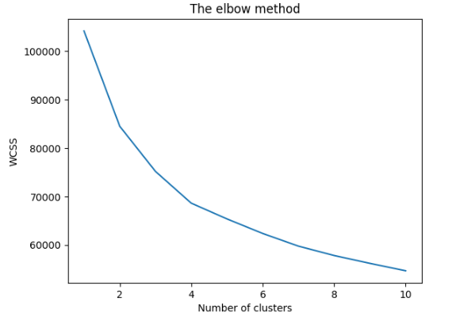

Slide 22
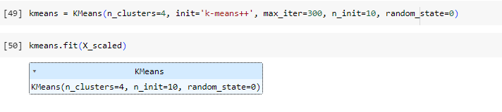
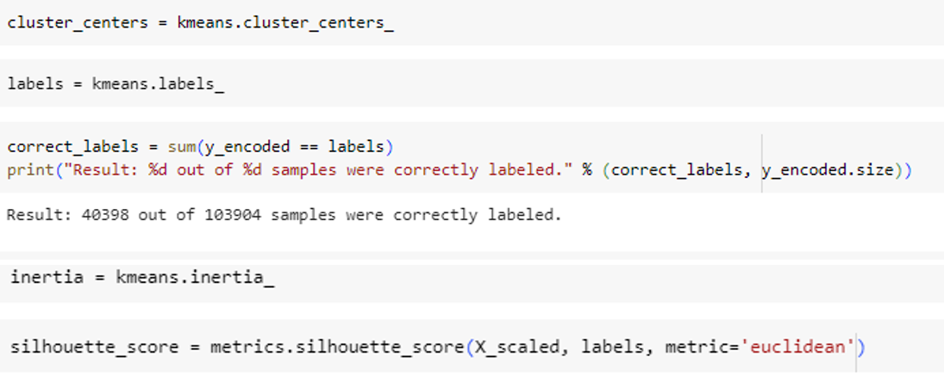

Slide 23
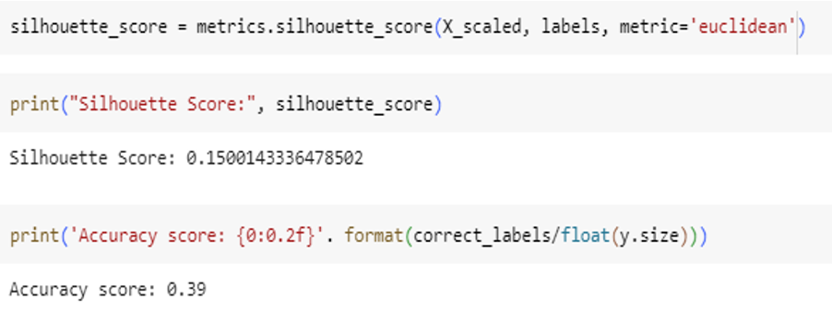

Slide 24
CONCLUSION
Factor Analysis
Principal Component Analysis (PCA), identifies 4 principal components that explain a significant portion of the variance, representing key dimensions of airline satisfaction.
Inflight Comfort & Quality
Customer Service Quality
Convenience and Efficiency
Technological Accessibility

Slide 25
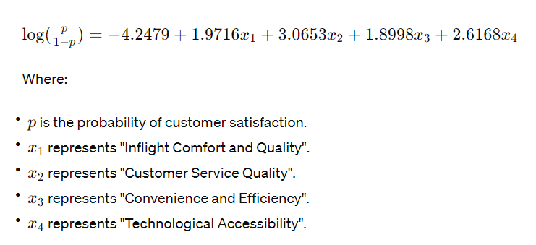
CONCLUSION
Logistic regression
The coefficients obtained from the logistic regression model provide insights into the magnitude and direction of these effects.
Using the coefficients obtained from the logistic regression analysis, we can write the full logistic regression model as :
log$\left(\frac{p}{1−p}\right)=−6.6653+0.7408 x1+0.7172 x2+0.4942 x3+ 0.9806 x4$

Slide 26
CONCLUSION
K-Means Clustering
The clustering results, as measured by the silhouette score, suggest meaningful separation between clusters and potential actionable insights for targeted interventions.
These clusters offer valuable insights into customer preferences and behavior, enabling targeted marketing strategies, personalized service offerings, and tailored interventions to enhance overall customer satisfaction and loyalty.
By understanding the unique needs and preferences of each cluster, airlines can optimize resource allocation, improve customer engagement, and drive business growth.

Slide 27
THANK YOU

