Slide 1
Salary Prediction Using Regression in Python
Analyzing compensation data to build predictive models for human resources

Slide 2
Introduction
$1.2M
4.2K
Annual Loss
Salary Increase
Companies lose per year on inaccurate salary benchmarks
Additional dollars per year of experience
Linear regression offers a transparent, low-cost solution for HR analytics. By leveraging historical compensation data, organizations can make data-driven decisions about employee salaries, reducing both overpayment and underpayment while staying competitive in the job market.

Slide 3
Problem Statement
Over-Paying Challenge
Under-Paying Risk
23% of new hires receive salaries exceeding market value by more than 15%, leading to unnecessary budget strain and internal equity issues.
31% of high-performing employees earn less than 10% below comparable peers, increasing turnover risk and reducing employee satisfaction.

Slide 4

Project Objectives
Build Predictive Model
Achieve R² ≥ 0.65
Reproducible Pipeline
Develop a regression model that accurately estimates salary based on experience, education, location, and job title
Reach acceptable predictive power while maintaining interpretability for HR stakeholders
Create a transparent, pure Python implementation that can be easily audited and deployed

Slide 5
Tools & Technologies
Python 3.12
NumPy & Pandas
Core programming language providing ecosystem for data science and machine learning
Essential libraries for numerical computing and data manipulation
Matplotlib & Seaborn
Scikit-learn
Visualization tools for creating insightful charts and statistical graphics
Machine learning framework for model training, validation, and evaluation metrics

Slide 6

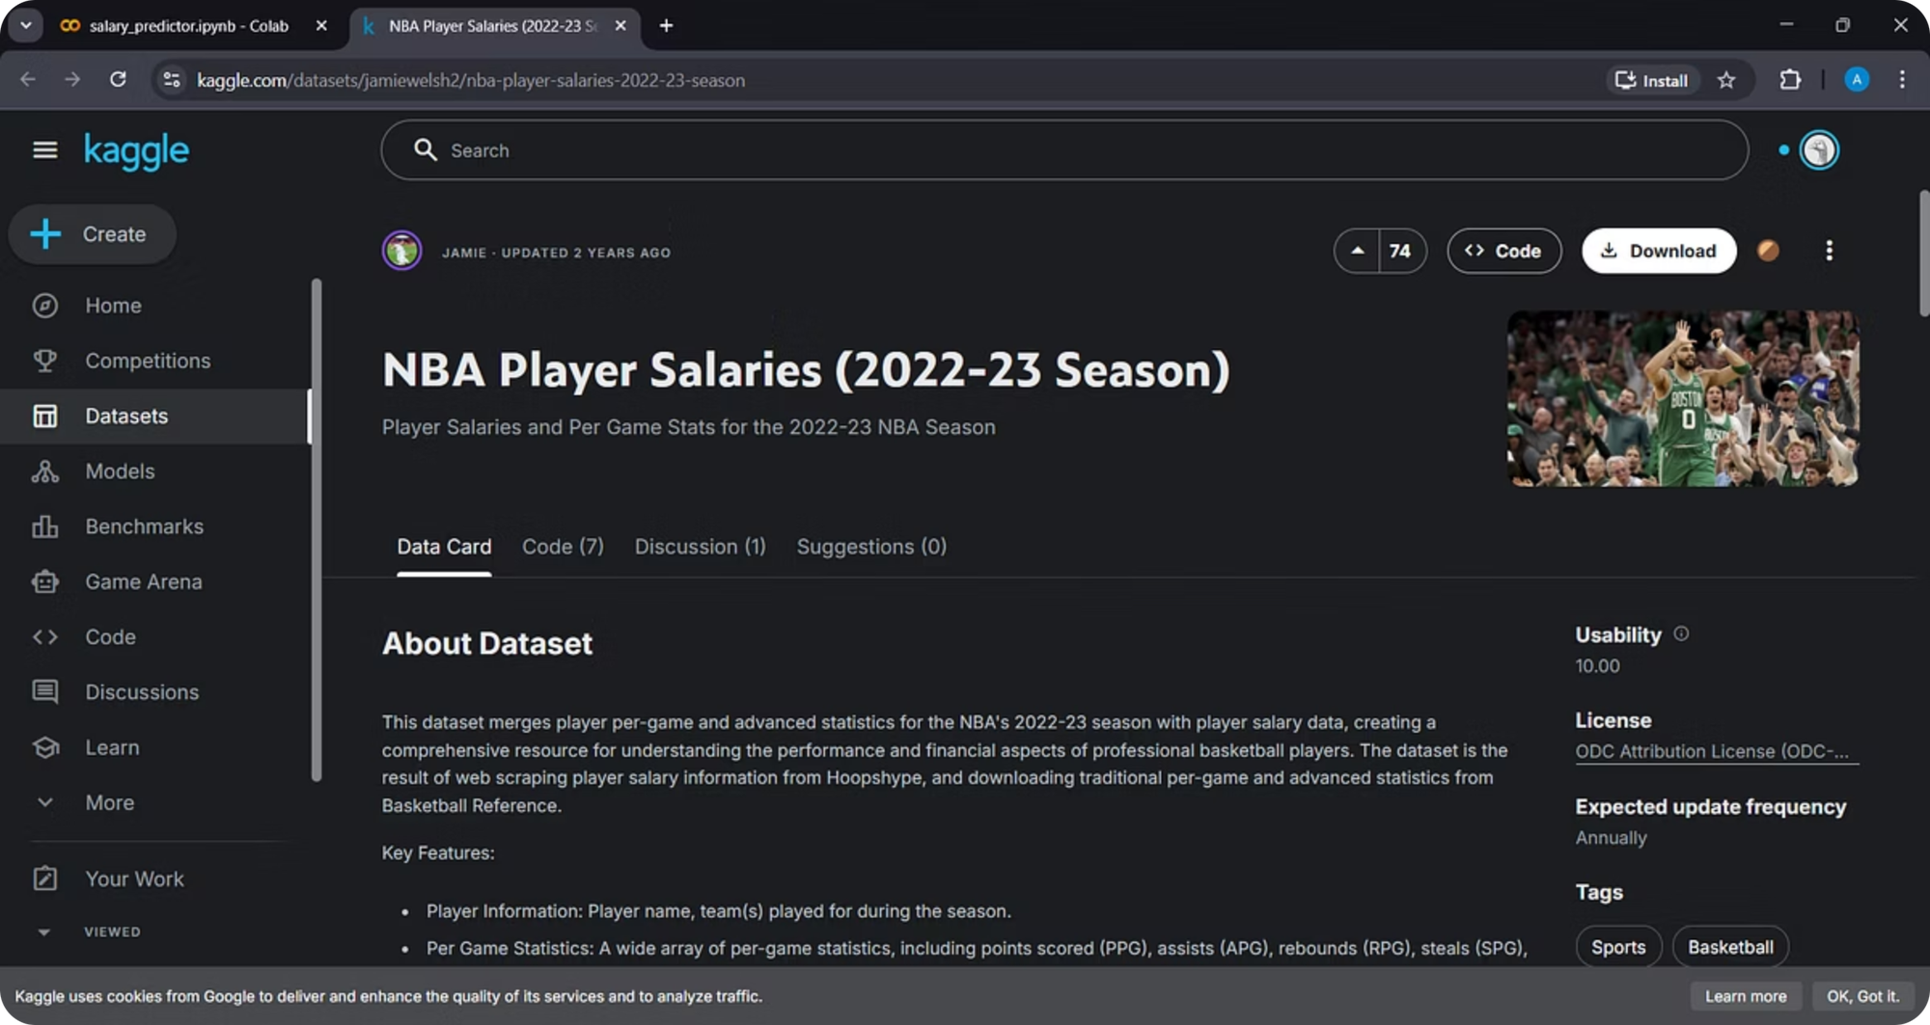
NBA Player Dataset
This dataset merges player per-game and advanced statistics for the NBA's 2022-23 season with player salary data, creating a comprehensive resource for understanding the performance and financial aspects of professional basketball players. The dataset is the result of web scraping player salary information from Hoopshype, and downloading traditional per-game and advanced statistics from Basketball Reference.

Slide 7
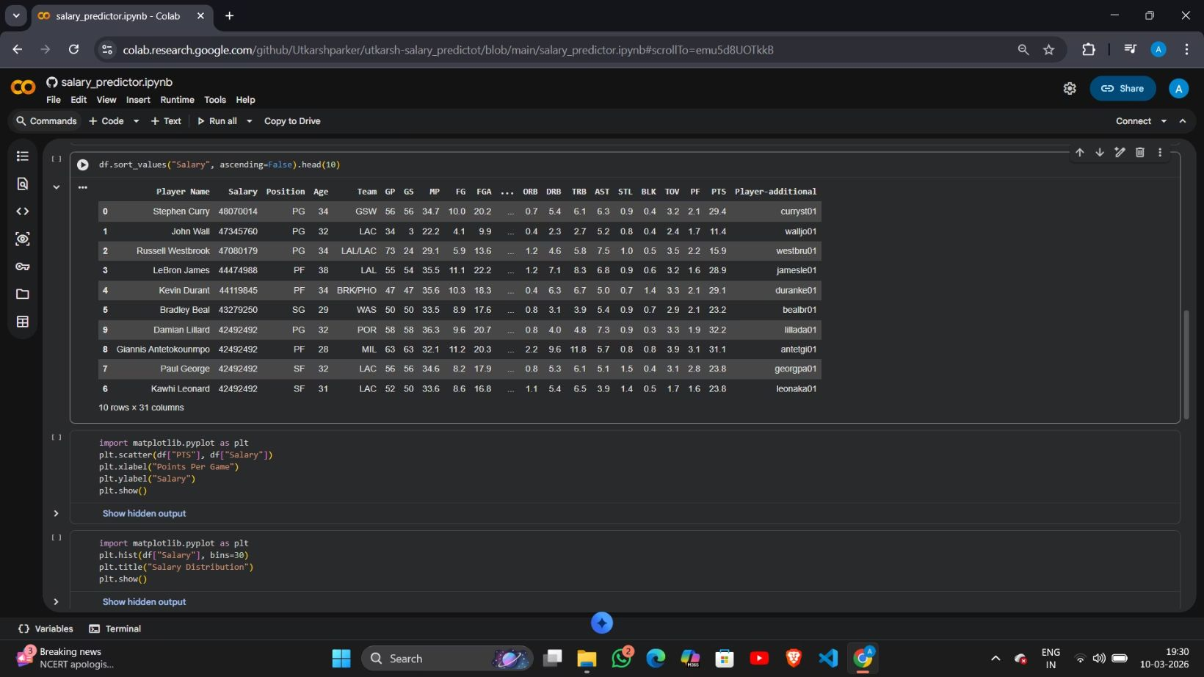
Top 10 Highest Paid Players
This code sorts the dataset of 466 players based on salary in descending order.
It displays the top 8 players with the highest salaries in a table for easy analysis of top earners. 📊

Slide 8
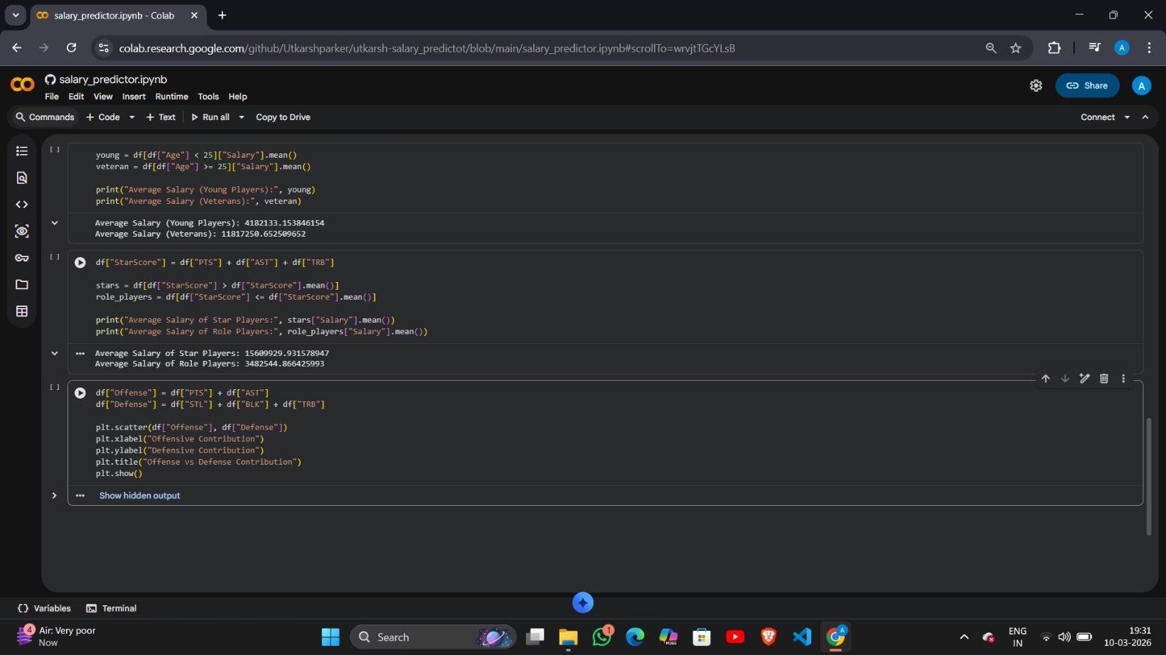
Young vs Veteran Players
This code divides players into young players (Age < 25) and veteran players (Age ≥ 25).
It then calculates and compares the average salary of both groups to analyze how age affects player salaries.

Slide 9
Star Players vs Role Players
This code creates a StarScore using Points, Assists, and Rebounds to measure overall performance.
Players are classified as Star Players or Role Players, and their average salaries are compared based on performance.

Slide 10
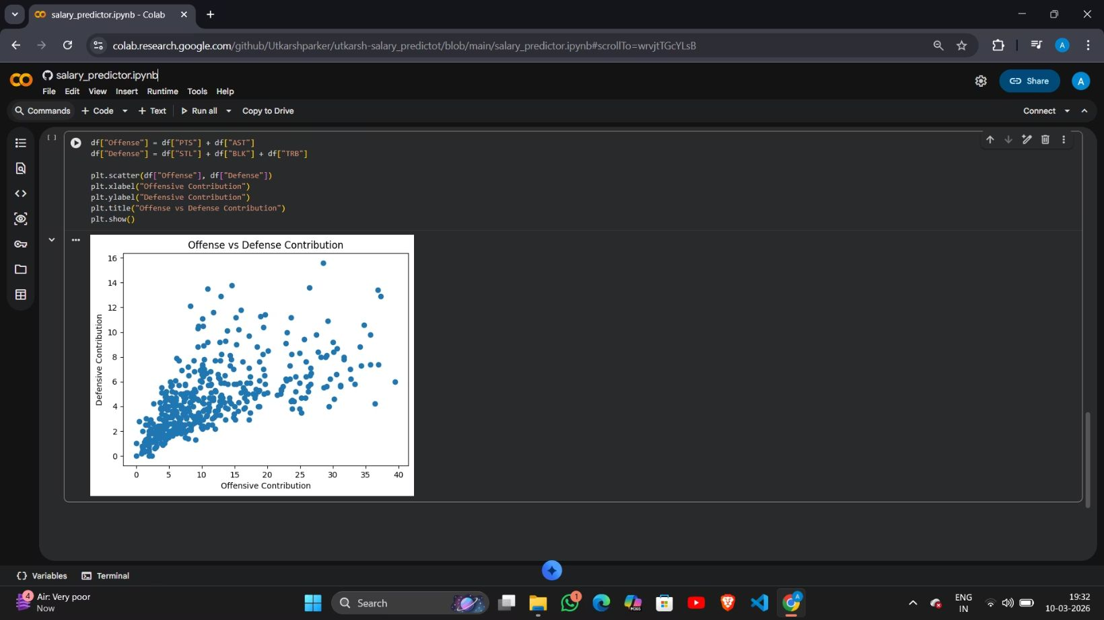
Offense vs Defense Contribution Analysis
This code creates two new metrics: Offense (Points + Assists) and Defense (Steals + Blocks + Rebounds) to measure player contributions.
A scatter plot is generated using Matplotlib to visualize the relationship between offensive and defensive performance of players. 📊

Slide 11
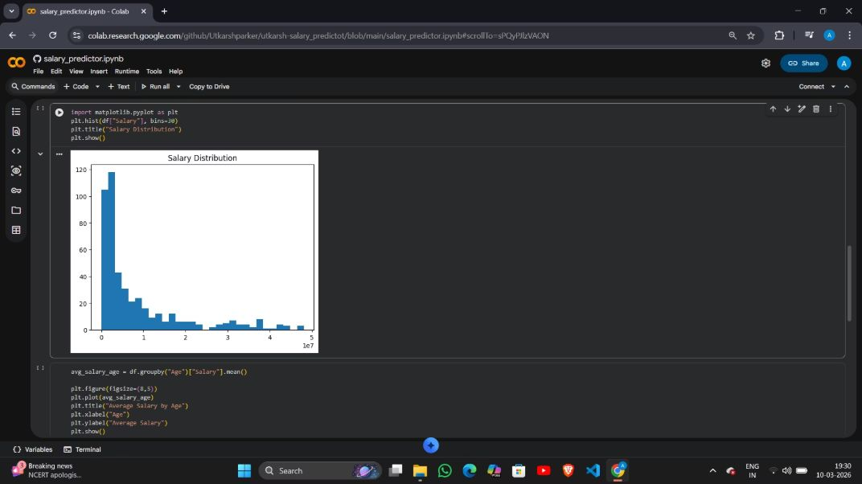
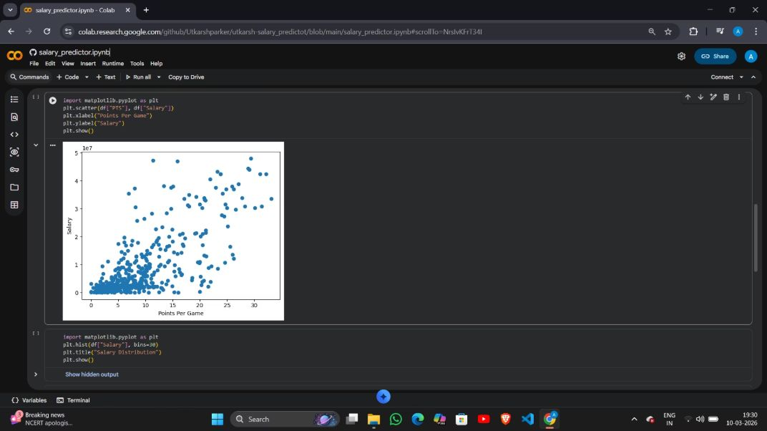
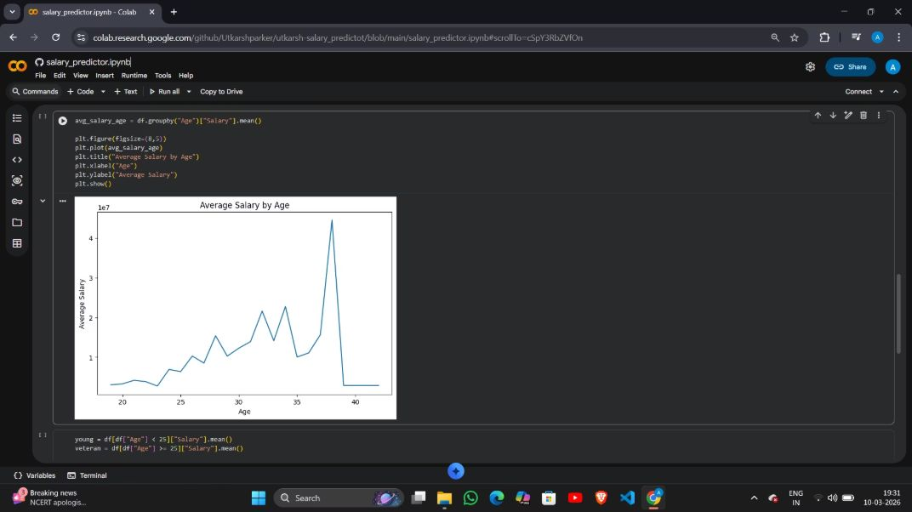
Data Visualization and Analysis
Salary Distribution of Players
Salary vs Points Per Game Analysis
Average Salary by Age Trend
This code uses Matplotlib to create a histogram of the Salary column.
This code calculates the average salary for each age using the dataset and then visualizes it with a line graph using Matplotlib.
This code uses Matplotlib to create a scatter plot showing the relationship between Points Per Game (PTS) and player salary.
It shows how salaries are distributed across players, helping identify common salary ranges and overall salary patterns in the dataset. 📊
Each dot represents a player, helping visualize how salary changes with performance (points scored per game). 📊
The graph shows how the average player salary changes with age, helping identify salary trends across different age groups. 📈

Slide 12
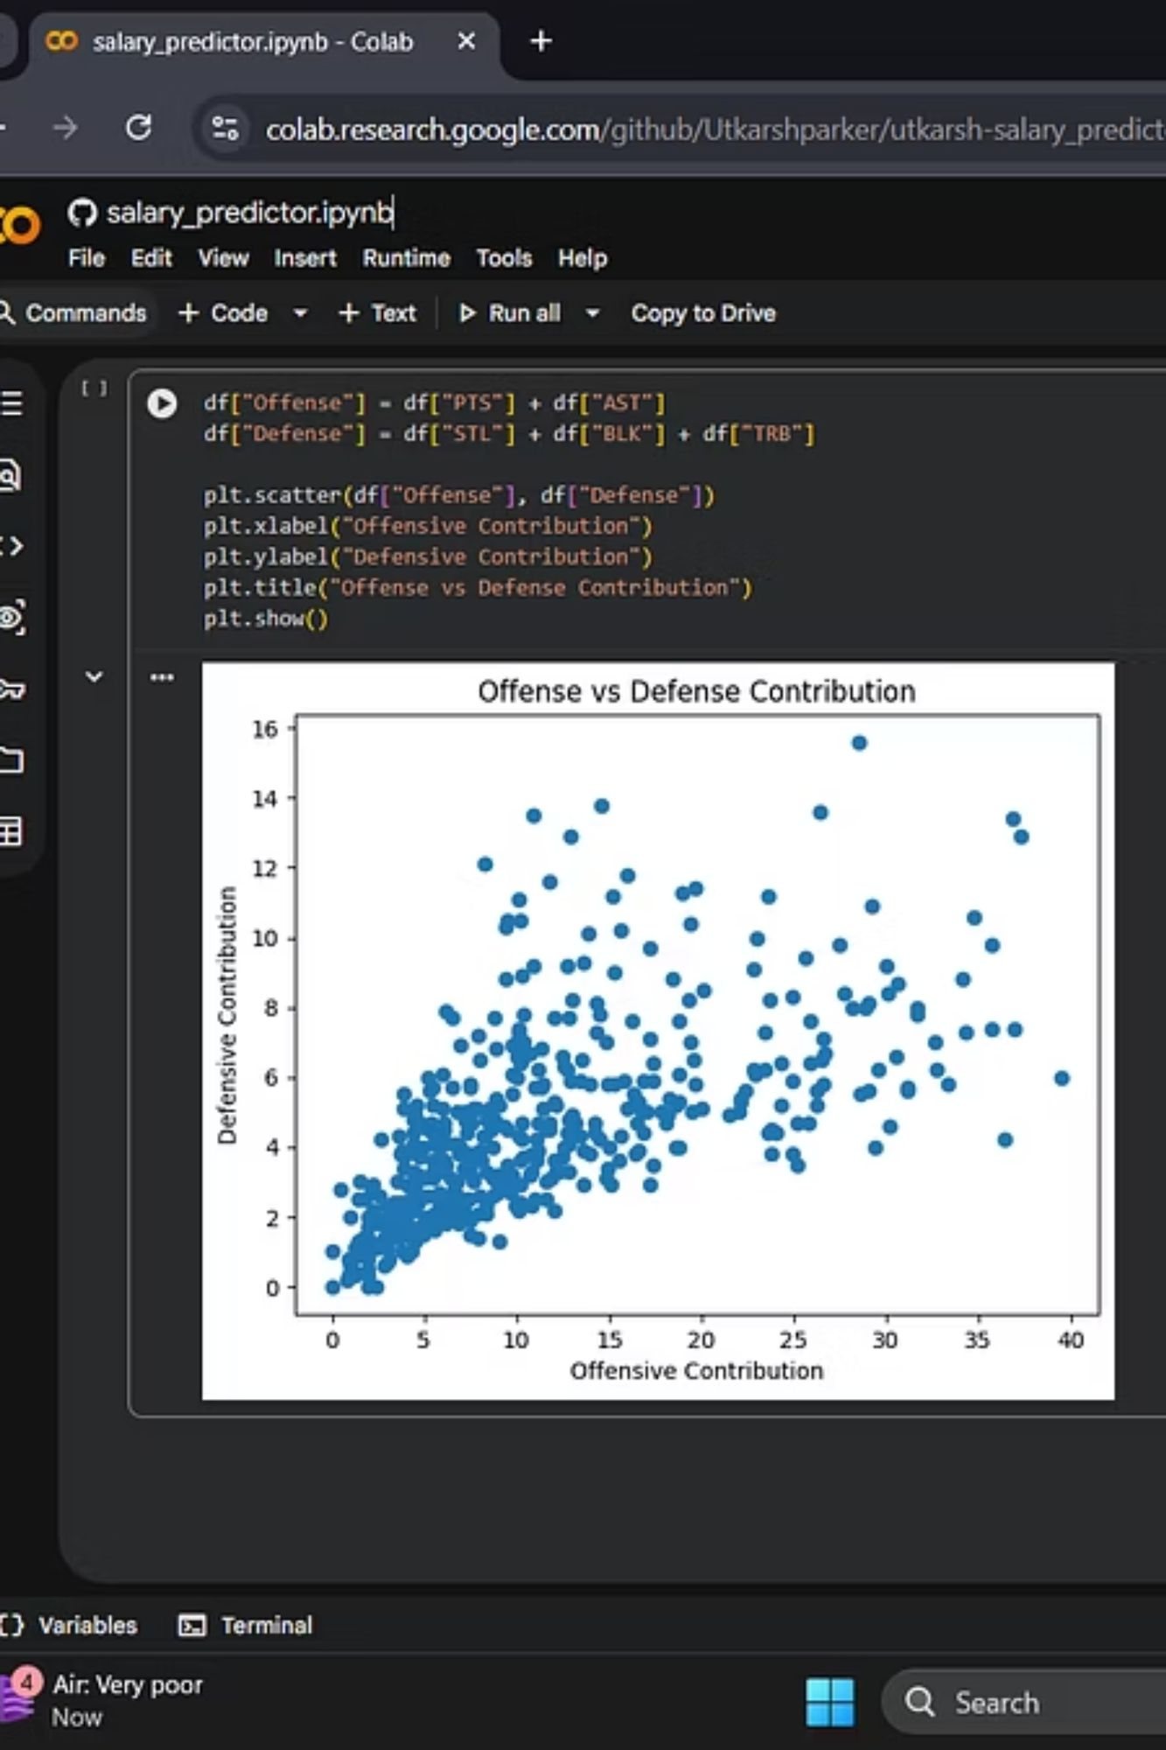
Data Visualization and Analysis
This code creates new features Offense (Points + Assists) and Defense (Steals + Blocks + Rebounds) from the dataset.
A scatter plot is then generated using Matplotlib to visualize the relationship between players’ offensive and defensive contributions. 📊

Slide 13
Results & Performance
0.68
$8,950
12K
R² Score
RMSE
Records
Coefficient of determination
Root mean squared error
Dataset size used
Key Findings
Model Limitations
Model achieves R² of 0.68, exceeding the 0.65 target
Years of experience shows strongest correlation with salary
Engineers have highest median compensation across all experience levels
Urban locations command 15% premium over rural areas
While the linear model provides interpretable results, non-linear relationships in the data suggest potential for improvement with more sophisticated algorithms.

Slide 14



Conclusion & Next Steps
Current Success
Linear regression delivers quick, interpretable salary forecasts with acceptable accuracy
Deployment
Deploy as Flask API for real-time HR queries and integration
Future Improvements
Iterate with regularization or tree-based models to push R² > 0.80

