Slide 1
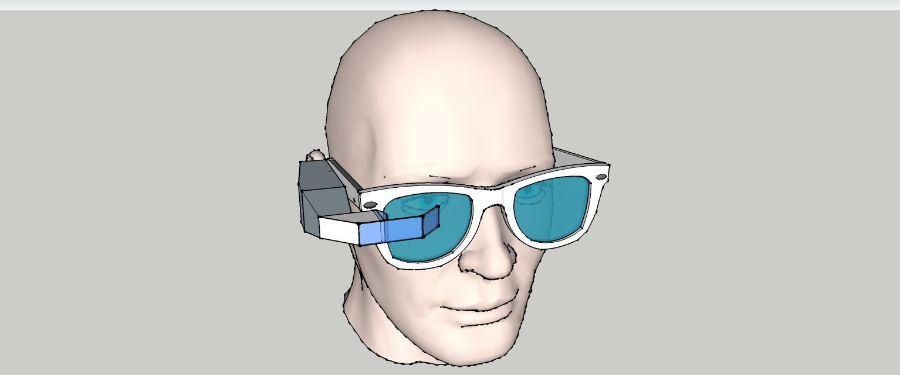
INNOVISION
VISUALIZING THE DIGITAL WORLD

Slide 2
AIM OF OUR PROJECT
To save the time of users using large electronic appliances.
Users using multimeter, will be able to see the notification just in front of their eyes.
When the device is connected with his/her smartphone, all the notifications coming on phone like phone calls ,emails, messages, will be in front of eyes.

Slide 3
Used COMPONENTS
NANO CH340 Arduino
Long range Bluetooth module
Crisped Oled display
Ultra fast Charging module
reflectors
Powerful rechargable Battery

Slide 4
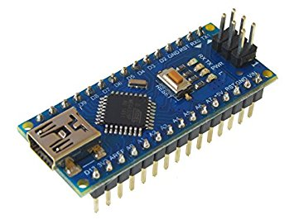
NANO ARDUINO
An Arduino is an open-source microcontroller development board. In plain English, you can use the Arduino to read sensors and control things .This allows you to upload programs to this board which can then interact with things in the real world. With this, you can make devices which respond and react to the world at large.

Slide 5
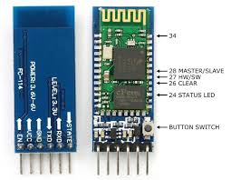
Bluetooth module(hc05)
HC-05 module is an easy to use Bluetooth SPP (Serial Port Protocol) module, designed for transparent wireless serial connection setup. Serial port Bluetooth module is fully qualified Bluetooth V2.0+EDR (Enhanced Data Rate) 3Mbps Modulation with complete 2.4GHz radio transceiver and baseband.

Slide 6
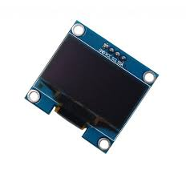
Oled display
An organic light-emitting diode (OLED) is a light-emitting diode (LED) in which the emissive electroluminescent layer is a film of organic compound that emits light in response to an electric current. This layer of organic layers is situated between two electrodes; typically, at least one of these electrodes is transparent.

Slide 7
SOFTWARES & LIBRARIES USED
NIGHTLY ARDUINO IDE
LCD ASSISTANT
U8GLIB
ARDUINO LIBRARY
BITMAP LIBRARY
ADAFRUIT-GFX-LIBRARY
CH341SER DRIVER
ANDROID APPLICATIONS
I2C MASTER
SOFTWARE SERIAL

Slide 8
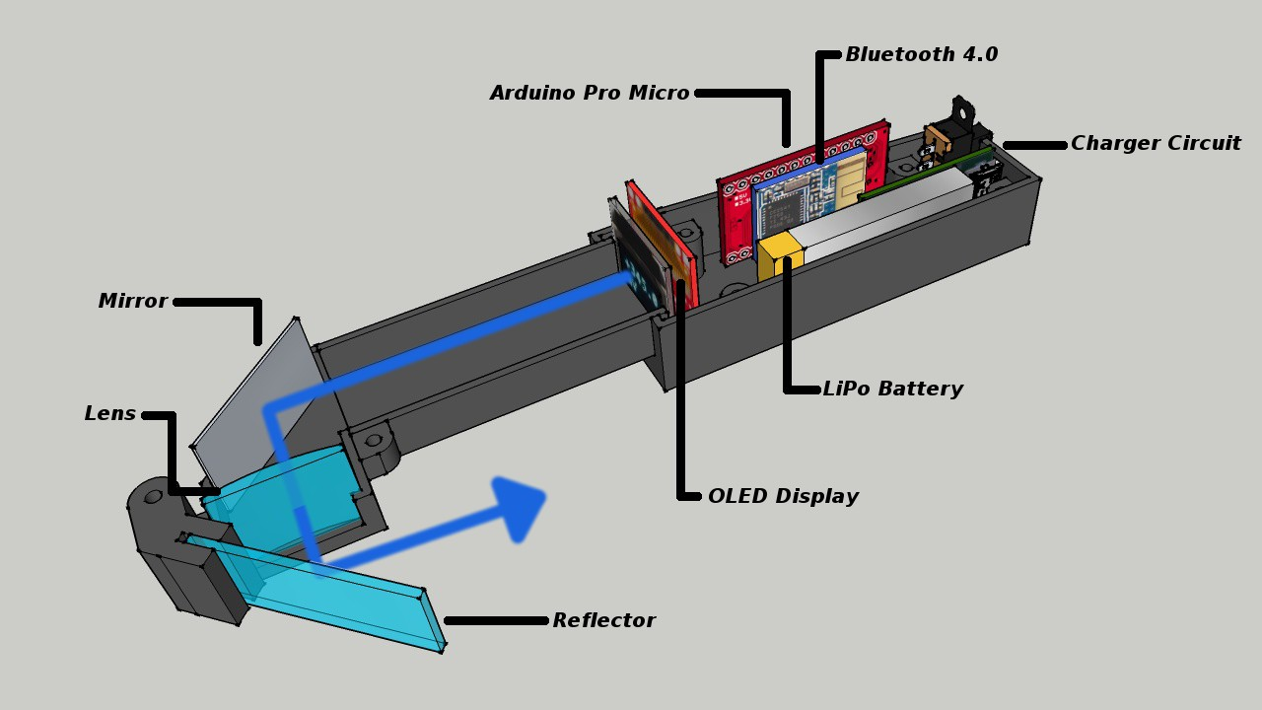
model

Slide 9
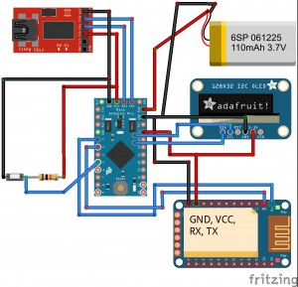
circuit

Slide 10

video

Slide 11
TEAM MEMBERS
MENTOR:SHAILI GUPTA
Utkarsh upadhyay
Upendra singh
Kushagra srivastava
Suraj kr. jaiswal

Slide 12
THANKING YOU!
For giving us your precious time and such a great opportunity to implement our thinking skills in real world .
-TEAM INNOVISION

