Slide 1





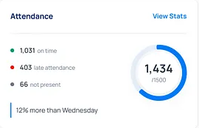
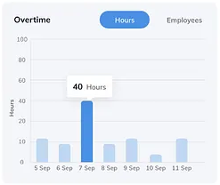
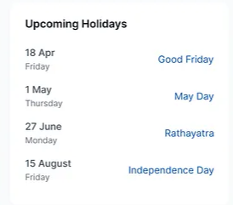
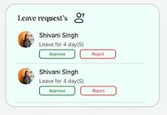
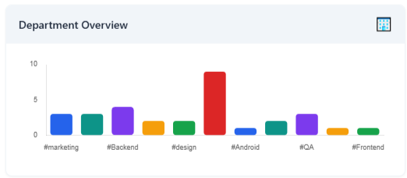
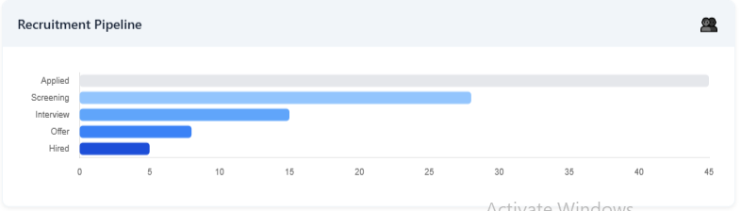

KPI card of Avg attendance this week in %
KPI card of Avg leaves this week in %
KPI card of New hires this month in number
KPI card of Exits employee in numbers
KPI card of Employees satisfaction rate in %
KPI card of Upcoming Birthday
The sidebar as it is like before
Today
2 Half day
12% more than Yesterday
Today

Slide 2
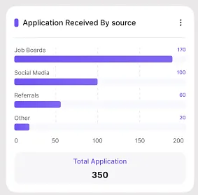

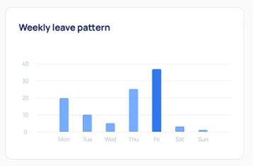
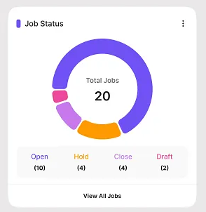
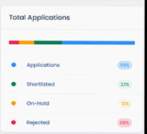
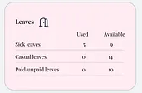

Slide 3
Key KPIs to Display
Attendance Rate (%) – (Present / Total Employees) over selected time period.
On-time Arrival % – (Employees who arrived on time / Present employees).
Late Arrival Count – No. of employees arriving late (daily/weekly).
Early Leave Count – Employees leaving before standard shift end.
Average Check-in Time & Check-out Time.
Average Working Hours (per employee / per department).
Absenteeism Rate (%) – (Absent employees / Total employees).
Department-wise Attendance % (comparison metric).
Suggested Charts & Visualizations
1. Daily/Weekly Trend
Line Graph: Daily attendance rate (Present %, Absent %, Late %).
Helps HR see patterns (e.g., Mondays high absenteeism, Fridays early leaves).
2. Department/Team Breakdown
Stacked Bar Chart: Present vs Absent vs Late for each department/team.
Heatmap: Days vs Departments → highlights departments with consistent lateness/absence.
3. Check-in & Check-out Patterns
Box Plot or Violin Plot: Distribution of check-in times → shows spread of punctuality.
Line/Bar Graph: Average check-out time by department/day.
4. Late Coming Analysis
Histogram: How late people usually come (5 min, 15 min, 30 min, 1 hr+).
Top 10 Frequent Late Comers (table or horizontal bar).
5. Absenteeism Analysis
Pie Chart: Reasons for absence (if categorized – e.g., Sick Leave, Casual Leave, Unplanned).
Trend Line: Absenteeism % over time.
6. Overtime & Half-days
Already you have overtime bar graph in overview.
In detail tab:
Scatter Plot: Overtime hours vs employees (to see overworked staff).
Half-day Trend Graph: Half-days per department per month.
7. Employee Drill-down Table
Searchable/filterable data table with:
Employee Name
Department
Check-in Time
Check-out Time
Total Working Hours
Late? (Y/N)
Half-day? (Y/N)
Overtime Hours
🧭 Suggested Layout
Top KPI cards (Attendance %, Absenteeism %, Late arrivals, Avg. working hours).
Trend Graphs (line chart for daily/weekly attendance).
Department-wise Charts (stacked bar, heatmap).
Behavioral Analysis (late arrival histogram, check-in/out distribution).
Absenteeism & Overtime trends.
Employee Drill-down Table at bottom for details.

Slide 4
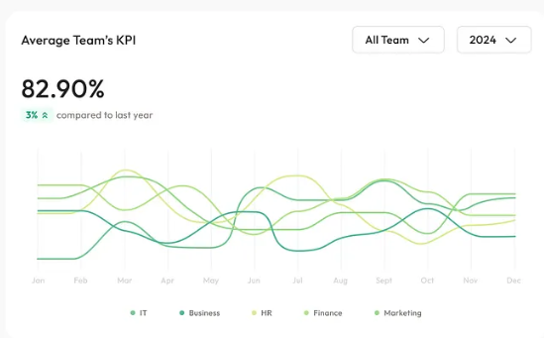
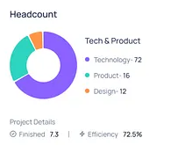
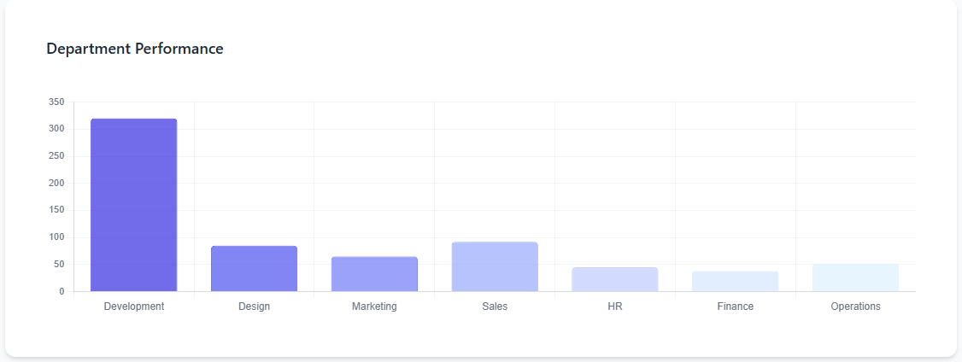
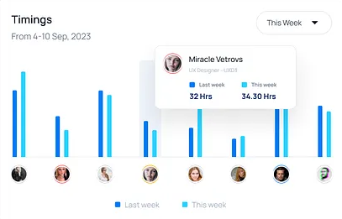
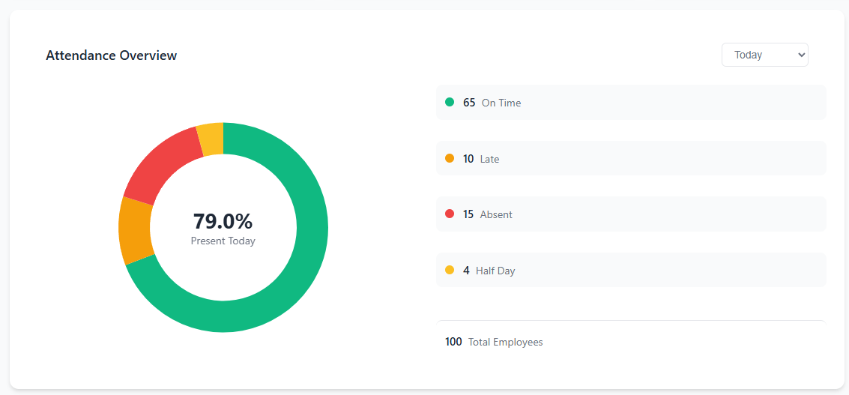
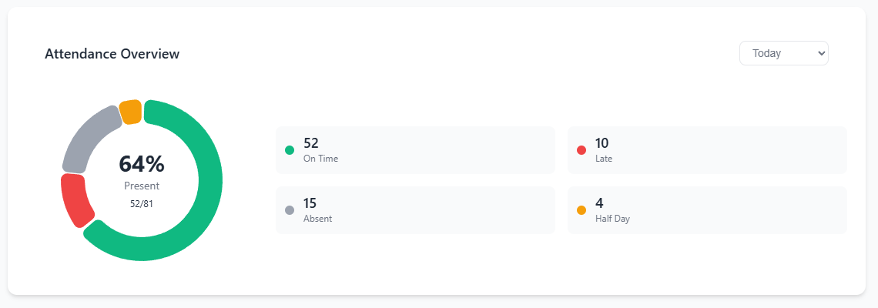

Slide 5
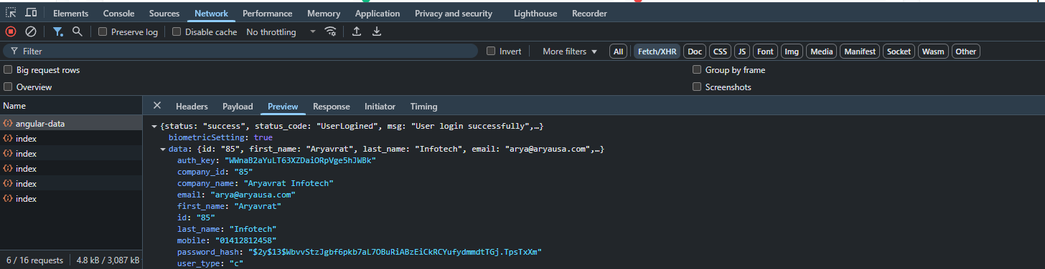

Slide 6
Date Range
09-01-2025 to 09-12-2025

