Slide 1



Media Recommender System
Utkarsh Yadav
20CSU118

Slide 2
Introduction
Media Recommendation System A user-friendly platform that suggests movies based on preferences, showing details like story, posters, cast, and IMDb ratings. It uses advanced algorithms to provide personalized recommendations efficiently.

Slide 3
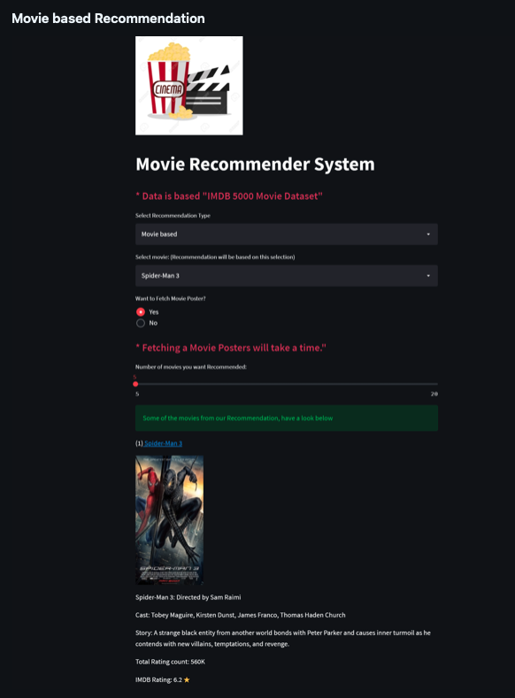
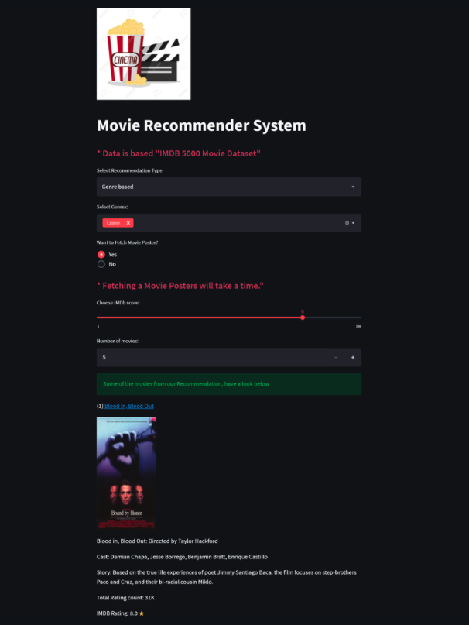

Slide 4

Technical Feasibility
Language: Python
Framework: Streamlit
APIs: IMDb or TMDB API
IDE: Microsoft VS code

Slide 5




Existing Solutions
Netflix: Personalized recommendations using user watch history.
IMDb: Top-rated movies based on global reviews, but no personalization.
Amazon Prime: Suggests movies by viewing history, integrated with streaming.
Google: General movie suggestions based on searches and trends.

Slide 6
Gaps in Existing Solutions
Limited Personalization:
Many systems rely solely on viewing history, ignoring diverse preferences.
Lack of Detailed Information:
Limited insights on movie storylines, cast, and directors.
No Unified Platform:
No single solution combines recommendations, ratings, and detailed movie data.
Dependency on Extensive User Data:
Platforms like Netflix require significant user activity for accurate suggestions.
Interface Complexity:
Some platforms have non-intuitive or cluttered UIs, reducing user engagement.

Slide 7
Problem Statement
Users struggle to find relevant movies due to overwhelming options. Existing platforms lack detailed information, seamless personalization, and a simple, unified interface for recommendations.
Objective
To develop a unified and user-friendly system that provides:
Personalized movie recommendations.
Comprehensive movie details (story, cast, IMDb ratings).
A simple and responsive interface for seamless exploration.

Slide 8
Design Methodology
Research: Analyzed platforms (Netflix, IMDb) and identified user needs.
Data Collection: Used IMDb/TMDB APIs for movie data.
Algorithms: Implemented content-based, collaborative, and hybrid filtering.
Testing: Ensured accuracy, responsiveness, and API integration.
Deployment: Hosted on Heroku/AWS for user access.

Slide 9
Outcomes
Personalized Recommendations: Accurate movie suggestions based on user preferences and behavior.
Comprehensive Movie Details: Includes storylines, posters, cast, directors, and IMDb ratings.
Responsive Interface: User-friendly design accessible across devices.
Efficient System: Seamless data integration and real-time recommendation generation.
Enhanced User Experience: Simplifies movie exploration and decision-making.

Slide 10
Thankyou

