Slide 1


Assignment No. 2 COUNTRY REPORTS
Name: Utkarsha Wasudeo Kurekar
PRN: 19020448107
Course: MBA(E) 19-21 B_Weekend
Subject: Global, Political and Business Economy
Semester: II
Country: Italy

Slide 2
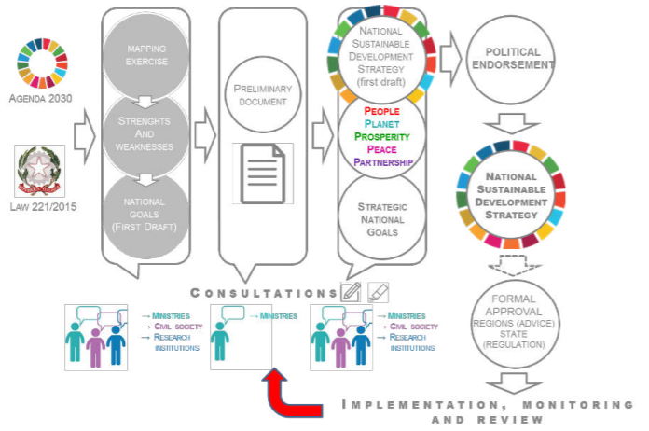
Actions of APEX body for sustainable growth of ITALY- “National Sustainable Development Strategy 2017/2030” (NSDS) a sustainable growth plan to economic, environmental & social programming. More than 200 NGOs contributes to reflect the vision of the 2030 Agenda into the NSDS
The NSDS’s five core areas:
People: Fight poverty and social exclusion, eliminating territorial gaps, promote health.
Planet: Create resilient communities and territories, protect landscapes.
Prosperity: Fund and promote sustainable research and innovation, ensure full employment and high quality training
Peace: Promote a non-violent and inclusive society, ensure legality and justice.
Partnership: Governance, rights and combat inequalities, environment, climate change and energy for development.

Slide 3
Italy ranks 50th country in the world in terms of GDP per capita of $38,200 estimated in 2017.
Industrial growth rate is-2.1% per year.
Iran-Italy relations:
In 2005, Italy was the third largest trading partner of Iran with 7.5% of all exports to Iran,
Kazakhstan-Italy relations:
In 2017, the trade between Kazakhstan and Italy amounted to $9.6 billion, which is an increase of 13.5% compared to 2016
Foreign trade of Italy with South Korea
Bilateral Trade in 2014
Exports 3,473,000,000 US dollars
Imports 6,260,000,000 US dollars
Bilateral Investments in 2014
South Korea's Investment in Italy 654,000,000 US
Italy's Investment in South Korea 539,000,000 USD

Slide 4
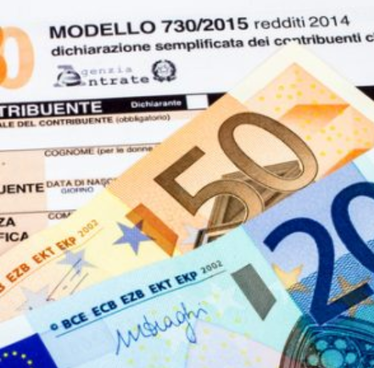
Special tax regimes for new resident:
Workers and Entrepreneurs; will be liable to pay tax on only 30% of their income.
Inbound professors and researchers; 90% exemption of their taxable basis on income.
Retired individuals moving to the South of Italy; will be granted a 7% flat tax on all foreign-source income produced.
High net worth individuals and families; they are allowed substitutive taxation equal to EUR100,000 on a yearly.
Example: sale of share holdings,
Professional sportsmen; Athletes can be subject to taxation only on the 50% of the income received from the activity performed in Italy for a 5-years period.

Slide 5





Italian chamber of commerce:-
The Chambers of Commerce, Industry and Agriculture these
are functionally independent public bodies. Within their territorial boundaries they are
responsible for functioning of general interest of country for the friendly business system, based on the principle of subsidiarity pursuant to article 118 of the Constitution.

Slide 6

Italian Industry: Confindustria, is the Italian employer’s federation and national chamber of commerce, founded in 1910.
Around 1,50,000 companies, accounting for approximately 5,438,513 employees are part of Confindustria. It aims to help in assisting Italy's economic growth.
It is a member of IOE( International Organisation of Employer) and ANIMA.
Also Confindustria is a founding member of ISTUD (Istituto Studi Direzionali)
They are aimed at guaranteeing the central importance of companies, Italy's economic, social and civil development. Confindustria contributes to social well-being and progress, and from this standpoint guarantees increasingly diversified, efficient and modern services.

Slide 7
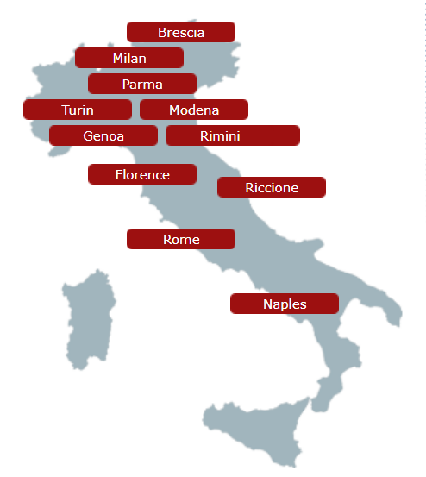


Logistics services in ITALY-
Promote the competitiveness of Italian logistics infrastructure
It creates a competitive logistics land-use regulation.
Logistics services in Italy facilitates industrial and trade activities, both in the domestic market and in foreign trade, through the development of
necessary infrastructure and logistics services.
Castanini was established over 40 years ago in Genoa, 480 months professional experience
Since 1977 Adriatic Air cargo has been working in the international shipment field

Slide 8
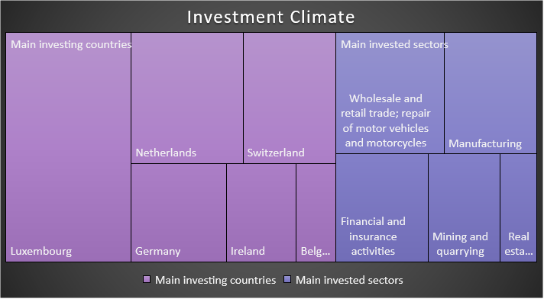
Investment climate:
According to the World Investment Report 2019 of UNCTAD, FDI inflows stood at USD 24.3 billion in 2018, up from USD 22 billion in 2017.
Current stock are at USD 431 billion, 22.2% of GDP.
Italy comes in less performing countries in Europe,
with a ratio of around 1% in the period 2013-2018.
The main investing countries to Italy are France, the US, the United Kingdom and Germany’.
Foreign Direct Investment | 2016 | 2017 | 2018
FDI Inward Flow (million USD) | 28,449 | 21,969 | 24,276
FDI Stock (million USD) | 352,634 | 428,022 | 431,020
Number of Greenfield Investments*** | 181 | 201 | 171
FDI Inwards (in % of GFCF****) | 9.2 | n/a | n/a
FDI Stock (in % of GDP) | 18.7 | n/a | n/a

Slide 9
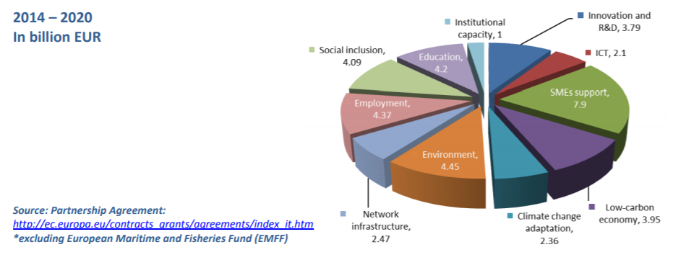
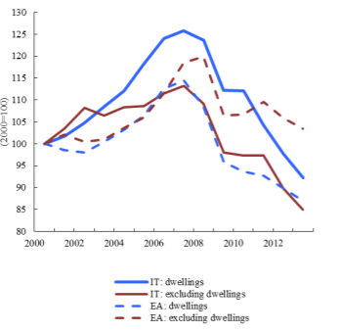
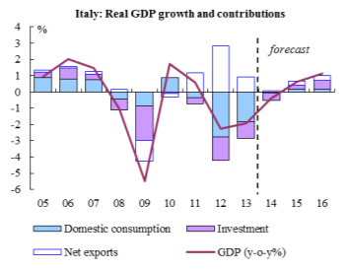
Investment & Contributions charts:
Investment funding in different sectors
Investment by type of goods
Investment growth & contribution

Slide 10

Why to Investment Italy:
Strengths
Italy has a strong industrial sector (19% of GDP in 2017) and diversified export ecosystem.
Skilled workforce & Italian SMEs are very competitive with exports.
trade shows like, Expo 2015 that attract buyers from all over the world. Expo 2015 Witnessed 20 million visitors
The government is pursuing strategic economic repositioning: the reformist government in 2015-16 has created new opportunities in various sectors and has already begun to withdraw from several low-potential sectors such as energy and telecommunications.
Weakness
High procedural costs and slow administrative
A fragile banking system
Corruption and organized crime
Labour costs are high and productivity has barely increased over the past 15 years.
Impose heavy taxes.
Political instability, with a divided populist government
FDI measures of Government:
Tax credits, including 25% for private investments in R&D 15% for investments in machinery and capital goods.
Patent box – partial tax exemption on income derived from patents.
Enhanced R&D tax credit
Extension of the tax incentives provided to technological start-ups and innovative SMEs
In September 2016, the Government launched a three-year industrial plan, ‘Industria 4.0’, aimed at boosting private investment in research and development. The Government also plans to implement tax cuts on investment in 2017

Slide 11
Financial Institutions and Banks in Italy:
The top banks in Italy are:
1. Unicredit SpA- Founded in 1988, with over 8500 branches.
Total assets: 836.79 billion euros est.(2017)
2. Intesa Sanpaolo- associated with 13 million customers. In 2010, Intesa Sanpaolo was ranked 26th in the Forbes Global 2000 list.
Total assets: 796.86 billion euros (2017)
There are 3 types of credit institutions & banks in Italy-
Commercial banks- These are national, chartered, cooperative & private banks.
Savings bank- Regional basis banks.
Investment institutions- On issue of bonds, long term credits.
3. Cassa Depositi e Prestiti- founded in 1870 The Italian Ministry of Economy and Finance owns 83% of this bank’s share capital
Total assets: 419.55 billion euros (2017)

Slide 12
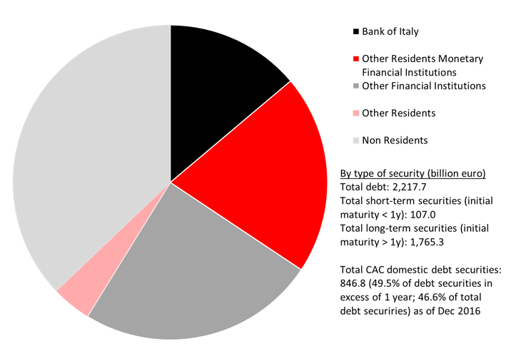
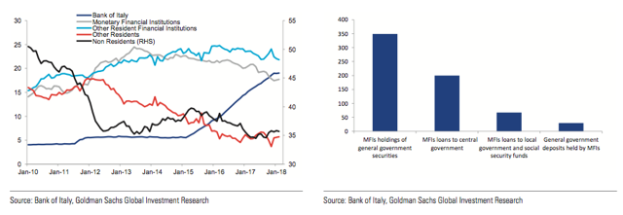
Italian banks are exposed to the Italian sovereign via BTPs holding (euros 348bn) and loans(euros 267bn)
Italexit is not a solution for Italy’s financial problems
Italexit would not result in exit from the European Union: Exiting the Monetary Union would automatically imply exit from the European Union, and thus the Single Market.
This would compound the negative economic implications and further exacerbate problems.
Foreigners hold about 37% of the total stock of Italian government securities
Holders of Italian debt

Slide 13

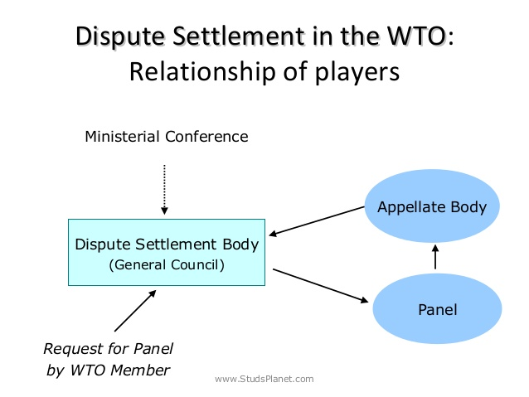
Dispute settlement: 1. European Union and certain Member States — Certain Measures Affecting the Renewable Energy Generation Sector
Complaint was drafted by-China
Respondents- European Union; Italy; Greece
Agreements cited- Articles I, III:1, III:4 and III:5 of the GATT 1994; Articles 3.1(b) and 3.2 of the SCM Agreement; and Articles 2.1 and 2.2 of the TRIMs Agreement

Slide 14

Dispute settlement:
The WTO has one of the most active international dispute settlement mechanisms in the world.
2. Anti-Dumping Duties on Light Commercial Vehicles from Germany and Italy
Complaint was drafted by-European Union
Respondents- Russian Federation
Third parties- China; India; Japan; Korea, Republic of; United States; Brazil; Turkey; Ukraine
Agreements cited- Articles 1, 2.2, 2.3, 2.4, 3.1, 3.2, 3.4, 3.5, 4.1, 6.2, 6.4, 6.5, 6.5.1, 6.8, 6.9, 6.10, 9.2, 9.3, 12.2, 12.2.2, 18.4 and Annex II of the Anti‑Dumping Agreement; Article VI of the GATT 1994.

Slide 15

Thank you
Grazie
Buona giornata

