Slide 1
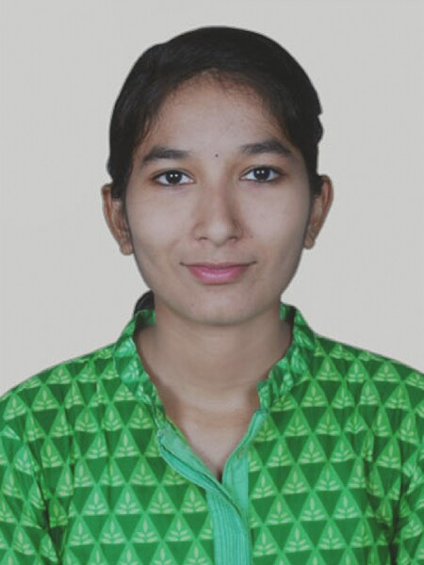
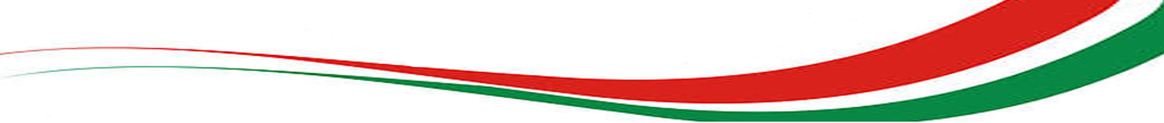
Assignment No. 1 COUNTRY REPORTS
Name: Utkarsha Wasudeo Kurekar
PRN: 19020448107
Course: MBA(E) 19-21 B_Weekend
Subject: Global, Political and Business Economy
Semester: II
Country: Italy

Slide 2
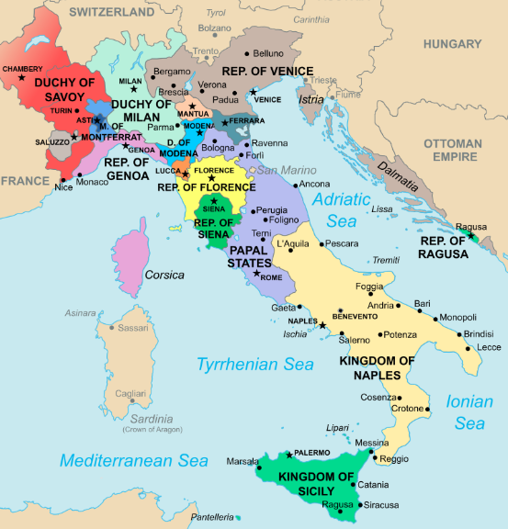
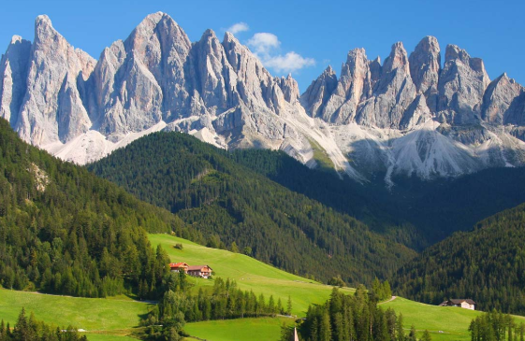
History & Geography :
Italy came from the latin word “italia” representing “land of young cattle”
Most of the Italy Dolomite mountains which extend across northern Italy are part of the Alps mountain range.
Italy covers-
Total area: 301,340 km2
(i.e. 116,350 sq mi),
Land: 294,140 km2( i.e. 113,570 sq mi)
Water :7,200 km2(i.e. 2,780 sq mi).
Latitudes: 35° and 48° N,
Longitudes: 6° and 19° E.
Highest Point: Mont Blanc (4810m)
Lowest Point: Jolanda di Savoia (-3.44m)
Italy is a projecting out of Mediterranean Sea. It is a boot-like shape kicking the island of Sicily.

Slide 3
Socio-Cultural & Biz-Cultural:

Slide 4
Legal aspects:
The Constitution is:
In written form.
Composed of 139 Articles.
Rigid: modification requires a complex process of reform unlike the passing of ordinary laws.

Slide 5
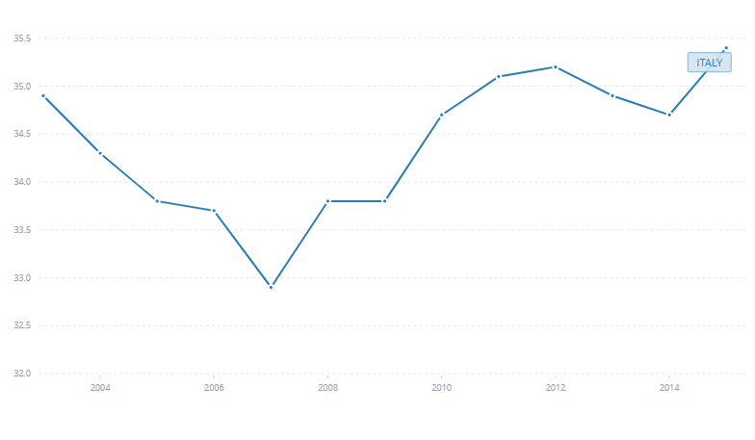
Economic Paradigms:
The highest value for GINI Index in Italy was 35.40 for 2015. and lowest was 32.90 in 2007.

Slide 6
:

Slide 7
Political:

Slide 8
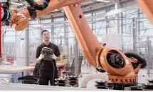
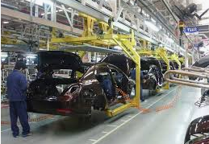
Technological:
Agricultural development: Project-Pomì in quota
The project consists of the collection of data from land and tomato crops using drones. The cameras collect the various wavelengths reflected by the ground and create a map that shows the state of the plants, thus identifying the areas in need of water.
If the results meet our expectations, we are planning on using this method on the majority of our partners.
Industry: Italy is the 6th in the world market for robots and it is 10th largest producers of leading technologies
Italian companies now employ 172 robots per 100,000 workers
man-machine interfaces (10.2% growth over 2017), RFID applications (+10.3%), industrial wireless solutions (+15.5%), and industrial networking solutions (+25.5%).
The market for industrial automation in Italy is sizeable and growing: in 2018 it was valued at € 5.3 billion, with 7.1% growth over 2017

Slide 10
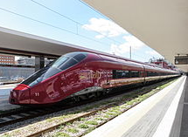
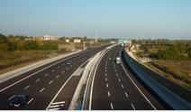
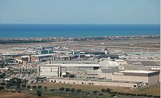
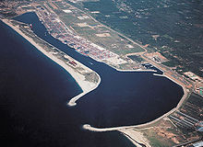
Infra-Stuctural: Transport-
Italy has world's 13th largest rail network spread across 12.46 km² per kilometer. Italian railways are subsidised by the government
Italy's road network is also widespread, with a total length of about 487,700 km. Italy is one of the countries with the most vehicles per capita, with 690 per 1000 people
Italy has a total as of 130 airports. Italy is the fifth in Europe by number of passengers by air transport, with about 148 million passengers
Italy has 2,400 km (1,491 mi) of navigable waterways for various types of commercial traffic. Commuter ferry boats operate on Lake Garda and Lake Como to connect towns and villages at both sides of the lakes

Slide 11
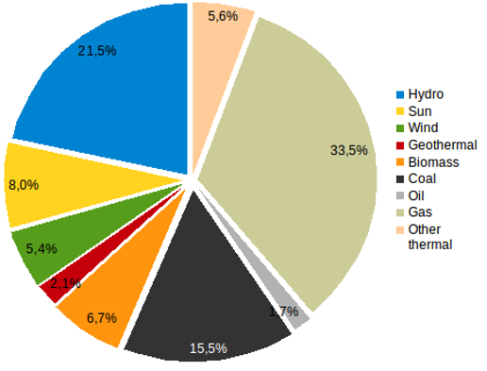
Infra-Stuctural: Energy-
Italy is an importer country for electricity:
The country imported 46,747.5 GWh and exported 3,031.1 GWh in 2014.
Italy has no nuclear power since it was banished in 1987 by referendum.
Italy exports 18% of precision machinery, 13% of clothing, footwear, luxury vehicles, metal and metal products
Italy managed to create it’s niche marketplace around the world with brands like Armani, Lamborghini, Prada, FIAT, Valentino, Lancia, Alfa Romeo and Maserati
Due to hilly regions and mountains it is difficult for agriculture. It also lacks of natural resources like oil, minerals, metals and so on.

Slide 12
Infra-Stuctural: Media & Education-
Post offices and telegraph offices operated by Radiotelevisione Italiana (RAI), a government corporation of Italy. Until 1976, RAI had a broadcasting monopoly.
In 1999 there were 25 million telephones and 20.5 million mobilephones, 135 AM and 28 FM radio stations and 6,317 television stations.
In 2000, there were 878 radios and 494 television sets per 1,000 people.
In 2001 there were about 180 personal computers for every 1,000 people, with 93 Internet service providers serving about 19 million users.
University of Bologna – the oldest university in Italy.
Italy has a 3-cycle education system :-
1st cycle: Bachelor degree (3yrs) - single-cycle degrees
2nd cycle: Master degree(2yrs) - 1st level vocational masters
3rd cycle: Doctorate(5-6yrs) - specialization school and 2nd Level vocational masters
The share of tertiary-educated 25-64 year-olds was 19% in 2018, compared to 28% among 25-34 year-olds.

Slide 13
WTO & IMF:
Italy has been a WTO member since 1 January 1995 and IMF since 1947.
Currently Italy has a 3.02% vote share in IMF.
According to IMF, Italy proposed budget had deficit of 2.4% of GDP.
This deficit in GDP can cause financial crisis, recession lasting till 2020s also this could jeopradise the value of the euro.

Slide 14
Climatic:

Slide 20
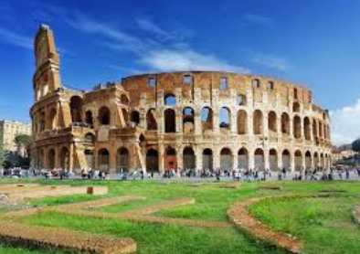
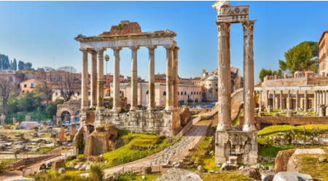
Attractions of Italy
The Roman Forum, this may require a little imagination to understand exactly what this area once looked like in histiroic ages
Colosseum, the huge Amphitheater built by the Roman Empire. It was used for public spectacles and shows, Underneath it were two stories of tunnels, rooms, cells, and passages for gladiators, workers, wild animals, and storage.

Slide 21
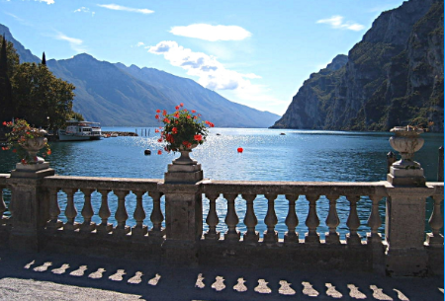
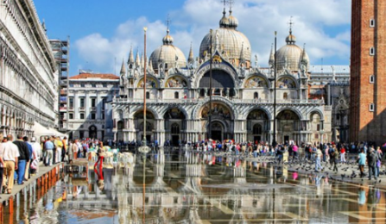
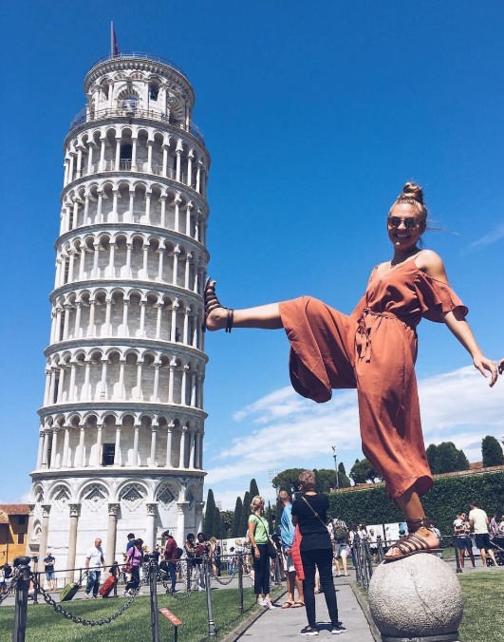
Construction of Leaning Tower began in the 1100s and completed in 3 stages over 199years, after construction progessed tower began to sink, which led to its leaning.
Lake Garda largest lake in Italy. It is known for its crystal clear water
St. Mark's Basilica. The building is piece of Art. Tourists will find themselves in the famous square, Piazza San Marco, in front of the basilica, looking at the main west-facing facade.

Slide 22
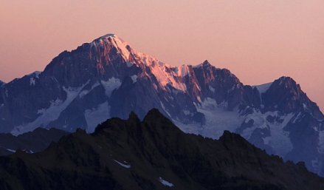
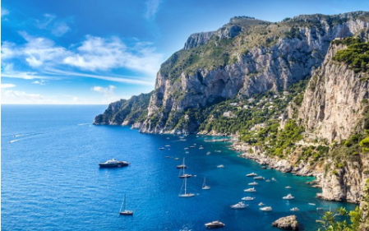
Mont Blanc(Monte Bianco), the highest mountain in Italy and Western Europe.
The Blue Grotto is only one of the sea caves that cut its cliffs, and the best way to see these, along with the three signature rocks off the south coast known as the Faraglioni

Slide 23
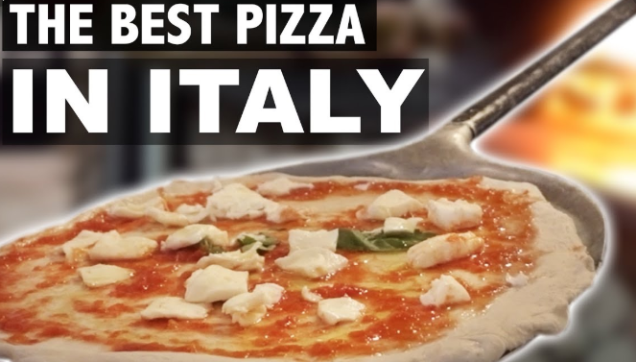
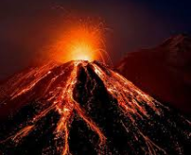
Interesting Facts:
Italy is the 5th most populous and most visited country in Europe. Italy attracts 46million foreign visitors in a year.
Rome the capital city of Italy is around 3000years old.
Italy is the birth place of most beloved food dish called pizza & pasta
Sonia Gandhi belonged to Italy.
There are in total 14 volcanos, 3 of them Etna, stromboli, vesuvious are active volcanos
Italy's last king ruled for just 36 days
Well-known artists and authors Dante, Da Vinci, and Michelangelo are from Italy
In 2012, the town of Falciano del Massico in Campania it was made illegal for residents to die because it’s town’s cemetery was full.
World’s most Fashion designers such as Armani, Versace, Prada, hail from Italy.

