Slide 1
Water Quality Classification & Public Health Analytics
Machine Learning-Driven
Environmental Insights
Utkrisht Agrawal

Slide 2
Project Overview
Objective:
Predict water quality categories (Class A–E) using
real monitoring data from Maharashtra.
Use Case:
Provide analytical support for public health,
regulatory policy, and environmental monitoring.

Slide 3
Motivation
Safe water is critical for health
Poor quality water leads to diseases and environmental damage.
Early detection prevents disease
Predicting and classifying water quality aids policymakers and health authorities.

Slide 4
Dataset Summary
Source: MPCB water monitoring (Maharashtra)
Key Features: pH, DO, BOD, COD, TDS,
Turbidity
Target: Water_Class (A–E, water quality
categories)

Slide 5
Water Quality Classes
Class | Designated Use | Key Criteria
A | Drinking water source (after disinfection) | Low BOD, high DO, low coliform
B | Outdoor bathing (organized) | Moderate BOD/DO, controlled coliform
C | Drinking water source (conventional treatment) | Higher BOD tolerated, treatment required
E | Irrigation, industrial cooling, controlled waste | Relaxed standards

Slide 6
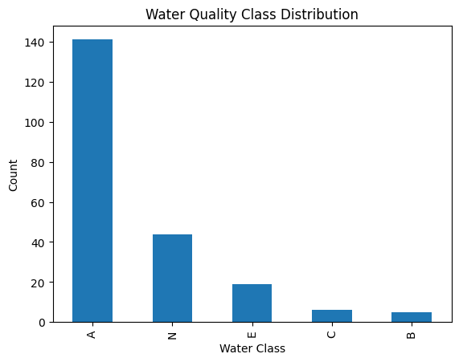
EDA – Water Quality Class Distribution

Slide 7
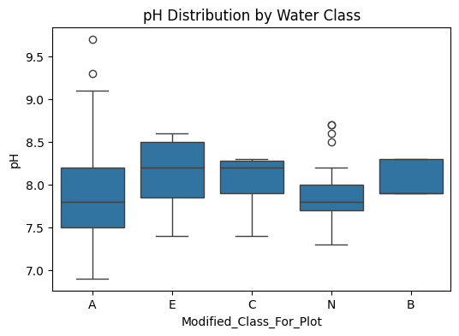
EDA – pH Distribution by Water Class

Slide 8
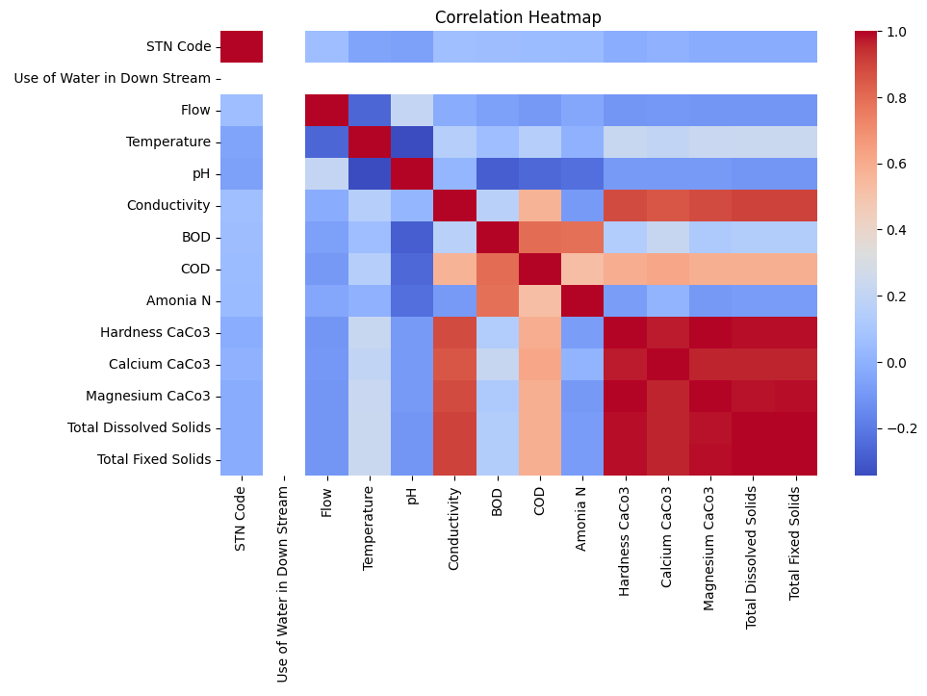
EDA – Correlation Heatmap

Slide 9
EDA Insights
Water Quality Class Distribution: Most water samples are classified as Class C and Class A, with relatively fewer samples in Classes B and E, and a notable share labeled as No Information (N).
pH Distribution by Water Class: pH values across all water quality classes remain largely consistent within a slightly acidic to slightly alkaline range (≈7.0–8.5), indicating limited variation by class. There are some outliers in certain classes, suggesting occasional variations in pH, but the central tendency for all classes remains consistent.
Correlation Analysis: Strong positive correlations among mineral-related parameters (such as Conductivity, Hardness, and Total Dissolved Solids) indicate that these measures tend to increase together, reflecting underlying water chemistry patterns.

Slide 10
Models Evaluated
Logistic Regression
Logistic Regression was used as a baseline model to establish a simple, interpretable benchmark for multi-class water quality classification.
Random Forest Classifier
Random Forest was employed to capture complex, non-linear relationships among water quality parameters and improve classification performance across all classes.
Extra Trees Classifier
Extra Trees was applied as an ensemble-based approach to validate model robustness and assess whether increased randomness could further enhance classification performance.

Slide 11
Evaluation Metrics
Evaluation Focus:
Confusion Matrix
Macro F1-score (best choice for imbalanced multi-class)
Cross-validation

Slide 12
Model Performance Summary
Model | Strengths | Weaknesses | Mean CV F1
Logistic Regression | Simple | Severe majority bias, poor minority recall | lowest
Random Forest | Strong non-linear learning | Slight gender class imbalance | Best: ~0.52
Extra Trees | Validated patterns | Slightly lower F1 than Random Forest | ~0.50

Slide 13
Confusion Matrix Insights
Logistic Regression:
Mostly predicts Class A → majority bias.
Random Forest balanced predictions
Better minority class predictions (Class B, C, E), more balanced.
Extra Trees confirms trend
Similar to RF, confirms data-driven limits.

Slide 14
Performance Interpretation
Random Forest best balances precision and recall
Class imbalance remains a challenge
Model plateau suggests need for more data or feature engineering

Slide 15
Public Health Impact
Poor water quality (higher BOD, COD, low DO) indicates contamination
Identifying risk zones enables targeted remediation
Data-driven insights help plan interventions (cleaning, monitoring) earlier

Slide 16
Actionable Recommendations
For Environmental Agencies
Prioritize sampling in areas with low DO and high BOD/COD
Deploy real-time monitoring sensors
For Policymakers
Use predictive classification to issue warnings
Allocate resources for cleanup and sanitation
For Public Health
Alert communities in Class C and Class E zones
Reduce exposure risks proactively

Slide 17
Limitations & Future Work
Current model limited by class imbalance
More data needed for rare classes
Future enhancements:
Ensemble + deep learning
Incorporate geographic & temporal data

Slide 18
Conclusion
pH levels remain largely consistent across all classes, indicating that pH alone is not a strong discriminator of water quality categories.
Machine learning provides meaningful water quality classification
Random Forest identified as best model
Results can guide healthier environments and informed decisions

Slide 19
Thank You

