Slide 1
GIT
UTKU ZORER

Slide 2

WHAT IS GIT?
Version control system
Free
Open-source
Simultaneous projects
[1]

Slide 3
PROS AND CONS
Performance
Security
Flexibility
Standardized
[1]
Takes time and effort to master

Slide 4
HOW DOES GIT WORK?
Mapping values [2]
SHA1 [3]
To better understand, one should know basic commands.

Slide 5
BASIC GIT COMMANDS
Init
Clone
Add
Commit
Status
Log
Diff
[4]

Slide 6

Git init
Creates an empty .git repository
Used when one starts a new Project
[5]

Slide 7
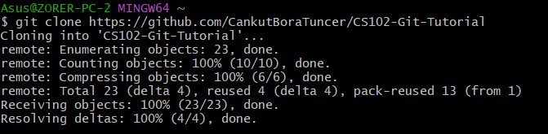
Git clone
Copy of an existing repository [4]

Slide 8
Git add
Adds changes to the current work directory
[4]

Slide 9

Git commit
Takes a snaphot of the current changes
Acts as a «safe point»
Building blocks for the Project timeline
[6]

Slide 10
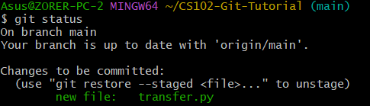
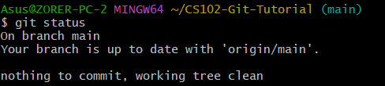
Git status
Fetches the current state of the Project in detail
Lists changes that are whether commited or not
[7]

Slide 11
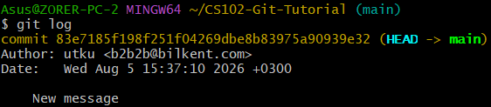
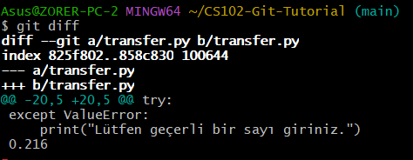
Git log and Git diff
Git log:
Shows the whole history of changes in the timeline
Git diff:
Shows the differences in distinct commits, branches, or the working directories
[4]

Slide 12
Conclusion
Overall, git is an open-source version control system that is widely used contemporarily. It enables distinct users to collaborate on a project by providing them a fully controlled timeline of that specific project. It is challenging for newcomers of different aspects in the industry. However, it comes handy for managing and operating large scale projects efficiently.

Slide 13
REFERRENCES
[1] “What is Git?” [Online]. Available: https://www.atlassian.com/git/tutorials/what-is-git. Accessed: August 5, 2026.
[2] “How Git Internally Works” [Online]. Available: https://octobot.medium.com/how-git-internally-works-1f0932067bee. Accessed: August 5, 2026.
[3] “Secure Hash Algorithms” [Online]. Available: https://brilliant.org/wiki/secure-hashing-algorithms/#sha-1. Accessed: August 5, 2026.
[4] “Git Basics” [Online]. Available: https://schulich.libguides.com/c.php?g=722465&p=5349840. Accessed: August 5, 2026.

Slide 14
REFERRENCES
[5] “Git Init” [Online]. Available: https://www.geeksforgeeks.org/git/what-is-git-init/. Accessed: August 5, 2026.
[6] “Git commit” [Online]. Available: https://www.atlassian.com/git/tutorials/saving-changes/git-commit. Accessed: August 5, 2026.
[7] “GİT NEDİR VE TEMEL GİT KOMUTLARI NELERDİR?” [Online]. Available: https://medium.com/@hazallgultekin/git-nedir-ve-temel-git-komutları-nelerdir-fc9be54348f2. Accessed: August 5, 2026.
[8] “CS102-Git-Tutorial” [Online]. Available: https://github.com/CankutBoraTuncer/CS102-Git-Tutorial. Accessed: August 5, 2026.

Slide 15
Thanks for listening

