Slide 2
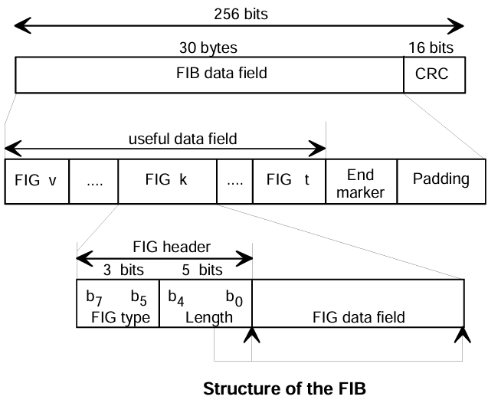
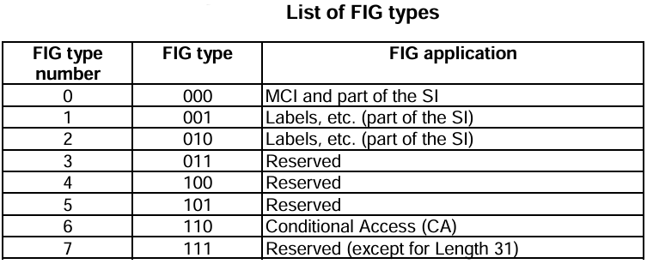
Fast Information Group (FIG)
FIG header: contain the FIG type and the length:
FIG type: this 3-bit field shall indicate the type of data contained in the FIG data field.
Length: this 5-bit field shall represent the length in bytes of the FIG data field and is expressed as an unsigned binary number in the range 1 to 29
FIG Data Field: This part contains the actual data or main content that the FIG carries. The structure and content of this part depend on the specific application or use case.

Slide 3
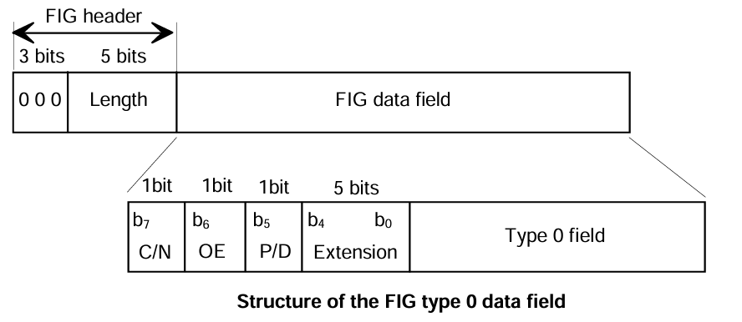
MCI and SI: FIG type 0 data field
The FIG type 0 is used to signal the current and future multiplex configuration, a multiplex reconfiguration, time and date and other basic Service Information - SI.
Current/Next (C/N) (according to the Extension):
MCI:
0: current configuration
1: next configuration
Service Information Version (SIV) - the type 0 field carries information for a database. The database may be large and require more than one FIG to transport:
0: start of database;
1: continuation of database.
CEI – used when a change to the database needs to be signaled:
0: change event;
1: control function.

Slide 4
MCI and SI: FIG type 0 data field
Other Ensemble (OE) (according to the Extension), whether the information is related to this or another ensemble:
0: this ensemble;
1: other ensemble (or FM or AM or DRM service).
P/D:
0: 16-bit SId, used for programme services;
1: 32-bit SId, used for data services.
Extension: this 5-bit field, expressed as an unsigned binary number

Slide 5
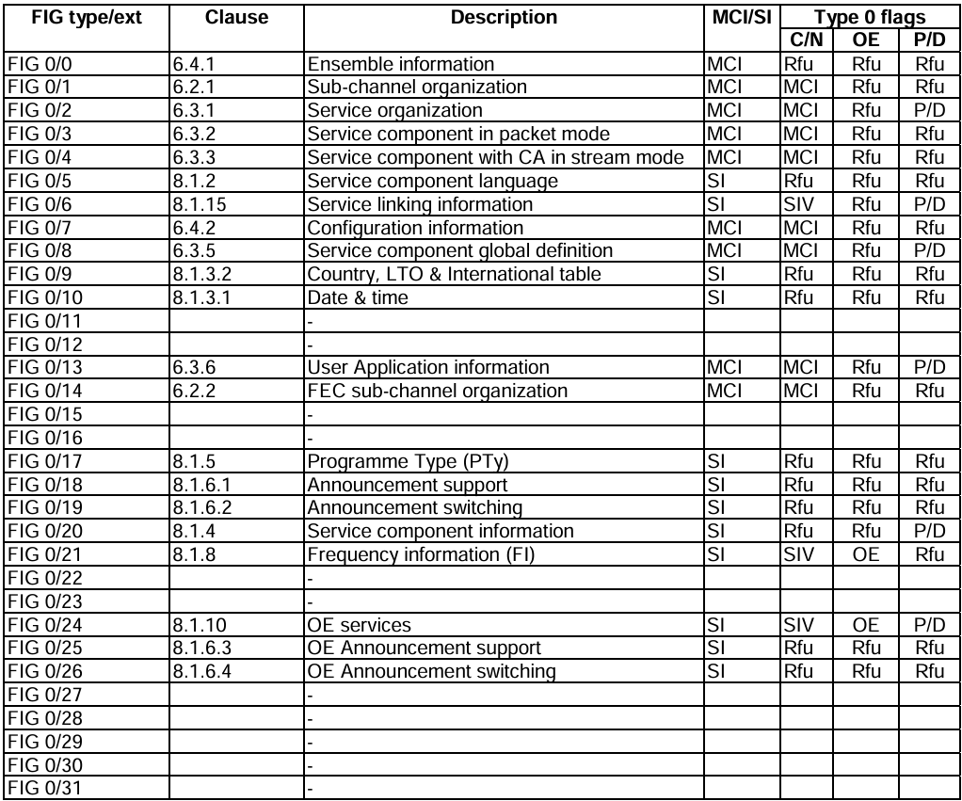
MCI and SI: FIG type 0 data field

Slide 6
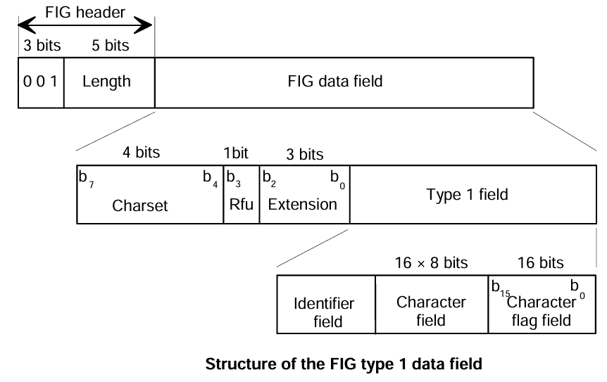
Labels: FIG type 1 data field
Charset: this 4-bit field shall identify a character set to qualify the character information contained in the FIG type 1 field.
Extension: this 3-bit field, expressed as an unsigned binary number, shall identify one of 8 interpretations of the FIG type 1 field.
Identifier field: this field is defined individually for each extension of the FIG type 1 field.
Character field: this 16-byte field shall define the label. It shall be coded as a string of up to 16 characters.
Character flag field: this 16-bit flag field shall indicate which of the characters of the character field

Slide 7
Extended labels: FIG type 2 data field
The FIG type 2 is used to signal extended labels of up to 16 characters and up to 32 bytes in length, using either UTF-8
or UCS-2 encoding

Slide 8
