Slide 1
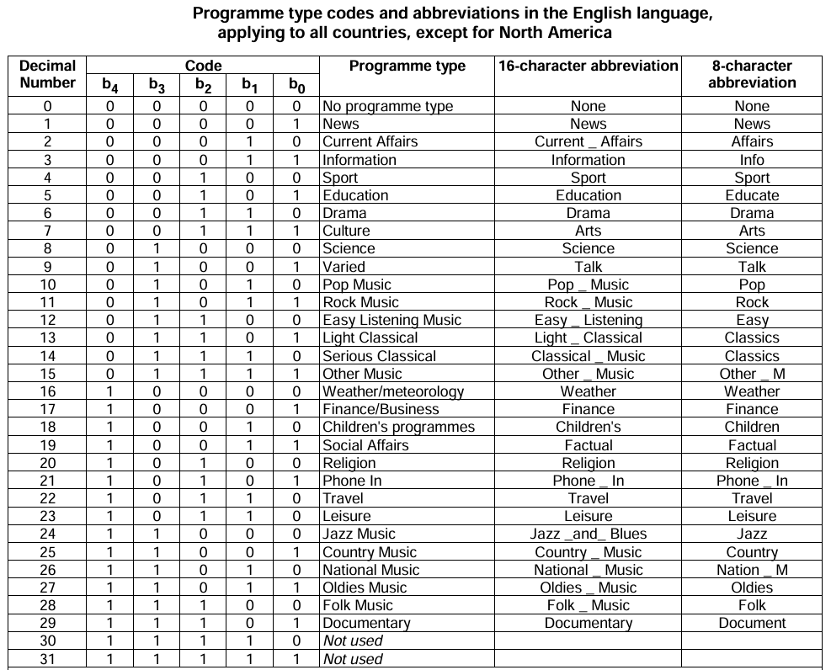

Slide 2
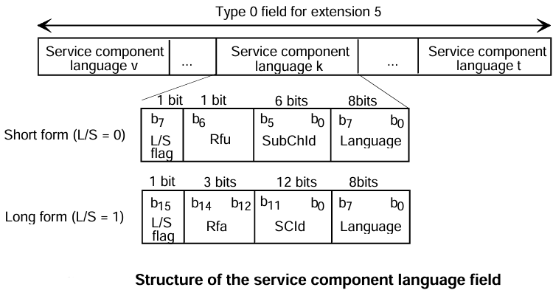
Service component language (FIG 0/5)
The service component language feature is used to signal a language associated with a service component: the spoken language of an audio component or the language of the content of a data component.
This information can be used for user selection or display.

Slide 3
Service component language (FIG 0/5)
L/S flag: this 1-bit flag shall indicate whether the service component identifier takes the short or the long form:
0: short form;
1: long form.
Short form:
SubChId (Sub-channel Identifier): this 6-bit field shall identify the sub-channel in which the service component is carried;
Language: this 8-bit field shall indicate the language of the audio or data service component.
Long form:
SCId: this 12-bit field shall identify the service component
Language: see above.
The FIG 0/5 has a repetition rate of once per second.

Slide 4
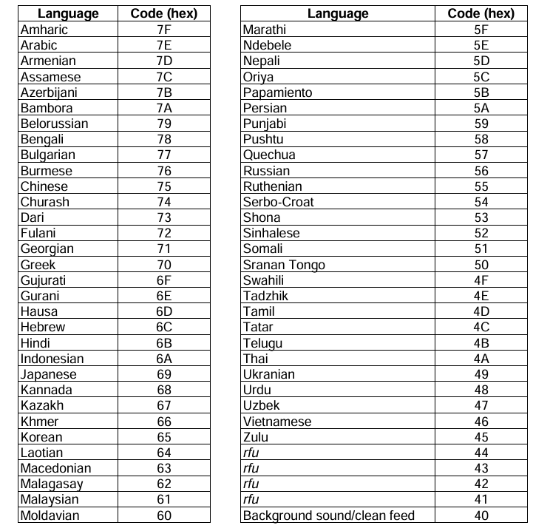
Service component language (FIG 0/5)

Slide 5
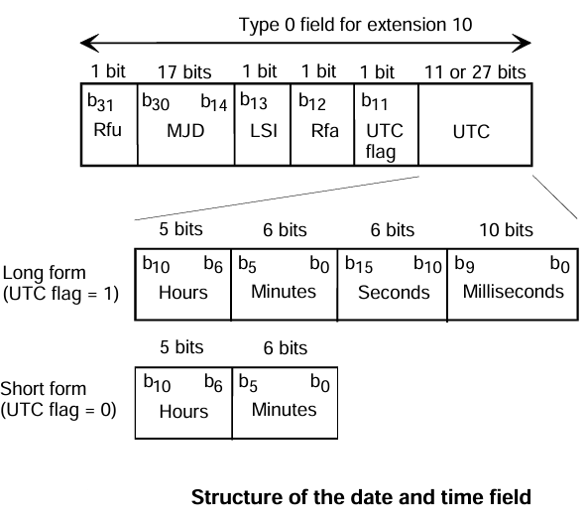
Date and time (d&t) (FIG 0/10)
The date and time feature is used to signal a location-independent timing reference in UTC format.
MJD (Modified Julian Date): this 17-bit binary number shall define the current date according to the Modified Julian coding strategy. As an example, MJD 58 000 corresponds to 2017-09-04.
LSI (Leap Second Indicator): this 1-bit flag shall be set to "1" for the period of one hour before the occurrence of a leap second.
UTC flag: this 1-bit field shall indicate whether the UTC takes the short form or the long form:
0: UTC short form (legacy support only);
1: UTC long form.

Slide 6
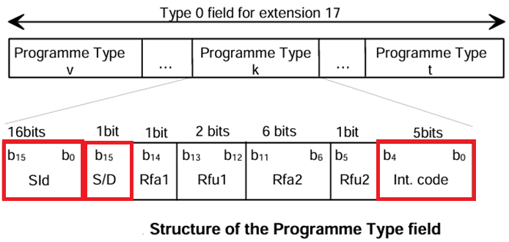
Programme Type (FIG 0/17)
The Programme Type (PTy) feature allows programme contents to be categorized according to their intended audience.
SId (Service Identifier): this 16-bit field shall identify the service
Int. (International) code: this 5-bit field shall specify the basic Programme Type (PTy) category.

Slide 7
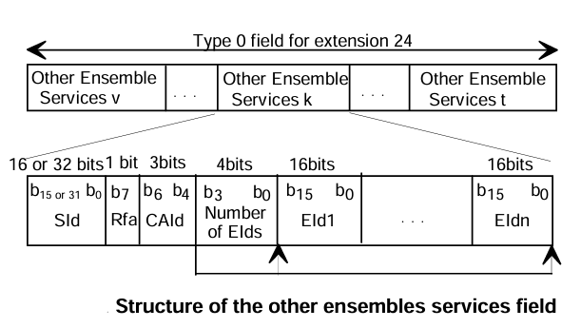
OE Services (FIG 0/24)
The OE Services feature is used to identify the services currently carried in other DAB ensembles.
SId (Service Identifier): this 16-bit or 32-bit field shall identify a service.
Number of EIds: this 4-bit field, expressed as an unsigned binary number.
EId (Ensemble identifier): this 16-bit code shall identify the ensemble.

Slide 8
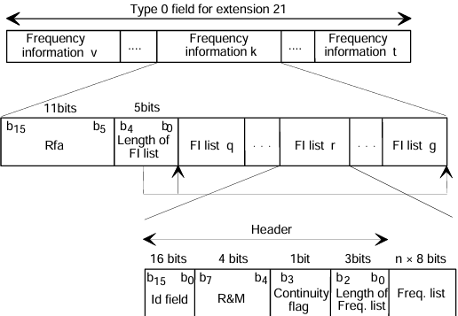
Frequency Information (FIG 0/21)
When the FI applies to the tuned ensemble, or to a Primary service component from the tuned ensemble carried via FM with RDS, AM with AMSS or DRM, the OE flag shall be set to "0".
When the FI applies to other ensembles, or to services not in the tuned ensemble carried via FM with RDS, AM with AMSS or DRM, the OE flag shall be set to "1".
Length of FI list: this 5-bit field, expressed as an unsigned binary number, shall represent the length in bytes of the field containing FI list q to FI list g (maximum 26 bytes).
FI (Frequency Information) list:

