Slide 1
Git

Slide 2
Table of contents
What is Git?
Characteristics of Git
Git Workflow
Example

Slide 3

What is Git
Git is a distributed version control system, which tracks changes in computer files, primarily used for coordinating development work by the programmers during software development process. It permits many developers to work on the same project simultaneously without interfering with each other's work.

Slide 4
Characteristics of Git
Version Control − It is helpful in managing and tracking changes made to files over time. Git maintains history of all changes and thus allows to revert to previous versions, if needed.
Distributed − Since Git is distributed version control system, it lets each developer have a complete copy of all files and their entire change history on their local machine. This results in flexible collaboration of work among the developers.
Branching − Branches are an important feature of Git that are lightweight and easy to create, merge, and delete. These branches help in isolating the work while adding new features or fixing bugs. Developers can work on different features simultaneously without impacting the main codebase.

Slide 5
Characteristics of Git
Merging − Changes from one branch to another branch can be merged into the main branch, using tools of Git.
Remote Repositories − Git allows developers to push their local changes to a remote repository, like GitHub or BitBucket. Collaboration on projects is made easy by Git.
Committing − The changes made in the code is saved as commits in Git, which are nothing but snapshots of the project at a given time. Commits are identified a unique alphanumeric ID, which lists who made the change and when.
External Vendors − External vendors such as GitHub, GitLab, and BitBucket are platforms that host the Git repositories. They provide additional features such as, issue tracking, code review, and project management

Slide 6
Git Workflow
Clone − The first step is cloning a remote repository to your local machine. It creates a local copy of the project's files and history on your computer.
Branch − After having a clone of the repository, you can create a new branch to work on a specific task or feature. Branching isolates the local changes from main codebase until it can be merged.
Work − Changes that are made to the files in your branch, such as adding new features, fixing bugs, or making alterations.
Commit − As changes are made, you periodically commit them to your local repository. Each commit is represented as a snapshot of the project at a particular time.
Pull − To incorporate the changes made by other developers, you can pull the latest changes from the remote repository.
Merge − Once your work is completed and tested, you can merge the changes into the main branch. This integrates your changes with the rest of the project.
Push − The last step is to push your changes or local commits to the remote repository, so that your work is shared with other team members.

Slide 7
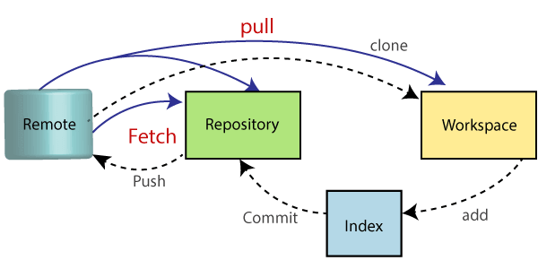
Example
Workflow

Slide 8
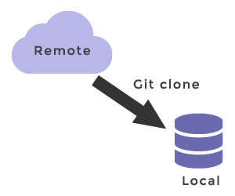
Example
Git clone:
robot@zubuntu:~$ git clone https://github.com/Utoixx/git_demo.git
Cloning into 'git_demo'...
remote: Enumerating objects: 3, done.
remote: Counting objects: 100% (3/3), done.
remote: Total 3 (delta 0), reused 3 (delta 0), pack-reused 0 (from 0)
Receiving objects: 100% (3/3), done.
robot@zubuntu:~$ cd git_demo/
robot@zubuntu:~/git_demo$ ls
README.md

Slide 9
Example
Add source code, create commit, push to remote repos:
robot@zubuntu:~/git_demo$ git add main.cpp
robot@zubuntu:~/git_demo$ git commit -m "add source code file"
[main fd7dac0] add source code file
1 file changed, 7 insertions(+)
create mode 100644 main.cpp
robot@zubuntu:~/git_demo$ git push origin main
Username for 'https://github.com': quoctuan2000bg@gmail.com
Password for 'https://quoctuan2000bg@gmail.com@github.com':
Enumerating objects: 4, done.
Counting objects: 100% (4/4), done.
Delta compression using up to 4 threads
Compressing objects: 100% (3/3), done.
Writing objects: 100% (3/3), 368 bytes | 368.00 KiB/s, done.
Total 3 (delta 0), reused 0 (delta 0), pack-reused 0
To https://github.com/Utoixx/git_demo.git
8feec96..fd7dac0 main -> main

Slide 10
Example
Git push conflict because this commit conflict with another commit
robot@zubuntu:~/git_demo$ git push origin main
Username for 'https://github.com': quoctuan2000bg@gmail.com
Password for 'https://quoctuan2000bg@gmail.com@github.com':
To https://github.com/Utoixx/git_demo.git
! [rejected] main -> main (fetch first)
error: failed to push some refs to 'https://github.com/Utoixx/git_demo.git'
hint: Updates were rejected because the remote contains work that you do
hint: not have locally. This is usually caused by another repository pushing
hint: to the same ref. You may want to first integrate the remote changes
hint: (e.g., 'git pull ...') before pushing again.
hint: See the 'Note about fast-forwards' in 'git push --help' for details.

Slide 11
Example
Use “git pull --rebase” to get newest code from remote repo, then we need handle conflict
robot@zubuntu:~/git_demo$ git pull --rebase
remote: Enumerating objects: 5, done.
remote: Counting objects: 100% (5/5), done.
remote: Compressing objects: 100% (3/3), done.
remote: Total 3 (delta 0), reused 0 (delta 0), pack-reused 0 (from 0)
Unpacking objects: 100% (3/3), 1.02 KiB | 1.02 MiB/s, done.
From https://github.com/Utoixx/git_demo
05e606f..ba8702e main -> origin/main
Auto-merging main.cpp
CONFLICT (content): Merge conflict in main.cpp
error: could not apply 2b5dc37... 2nd commit
hint: Resolve all conflicts manually, mark them as resolved with
hint: "git add/rm <conflicted_files>", then run "git rebase --continue".
hint: You can instead skip this commit: run "git rebase --skip".
hint: To abort and get back to the state before "git rebase", run "git rebase --abort".
Conflict code:
#include<stdio.h>
int main(int argn, char* argc[]){
printf("hello world!\n");
<<<<<<< HEAD
//This line written by another dev
=======
//this line written by me
>>>>>>> 2b5dc37 (2nd commit)
return 0;
}

Slide 12
Example
Source code after fix conflict, then use “git rebase –continue” + “git push” to push into remote repo :
#include<stdio.h>
int main(int argn, char* argc[]){
printf("hello world!\n");
//This line written by another
//this line written by me
return 0;
}
robot@zubuntu:~/git_demo$ git add .
robot@zubuntu:~/git_demo$ git rebase --continue
[detached HEAD 80f9146] 2nd commit after fix conflict
Successfully rebased and updated refs/heads/main.
robot@zubuntu:~/git_demo$ git push origin main
Enumerating objects: 8, done.
Counting objects: 100% (8/8), done.
Delta compression using up to 4 threads
Compressing objects: 100% (6/6), done.
Writing objects: 100% (6/6), 719 bytes | 719.00 KiB/s, done.
Total 6 (delta 3), reused 0 (delta 0), pack-reused 0
remote: Resolving deltas: 100% (3/3), completed with 1 local object.
To https://github.com/Utoixx/git_demo.git
ba8702e..80f9146 main -> main

Slide 13
Example
Create new branch and switch into new branch
robot@zubuntu:~/git_demo$ git checkout add_feature
Switched to branch 'add_feature'
robot@zubuntu:~/git_demo$ ls
main.cpp README.md
robot@zubuntu:~/git_demo$ nano main.cpp
robot@zubuntu:~/git_demo$ git add .
robot@zubuntu:~/git_demo$ git commit -m "add new feature"
[add_feature c8811b6] add new feature
1 file changed, 1 insertion(+), 1 deletion(-)
robot@zubuntu:~/git_demo$ git push origin add_feature
Enumerating objects: 5, done.
Counting objects: 100% (5/5), done.
Delta compression using up to 4 threads
Compressing objects: 100% (3/3), done.
Writing objects: 100% (3/3), 308 bytes | 308.00 KiB/s, done.
Total 3 (delta 1), reused 0 (delta 0), pack-reused 0
remote: Resolving deltas: 100% (1/1), completed with 1 local object.
remote: Create a pull request for 'add_feature' on GitHub by visiting:
remote: https://github.com/Utoixx/git_demo/pull/new/add_feature
To https://github.com/Utoixx/git_demo.git
* [new branch] add_feature -> add_feature
robot@zubuntu:~/git_demo$

Slide 14
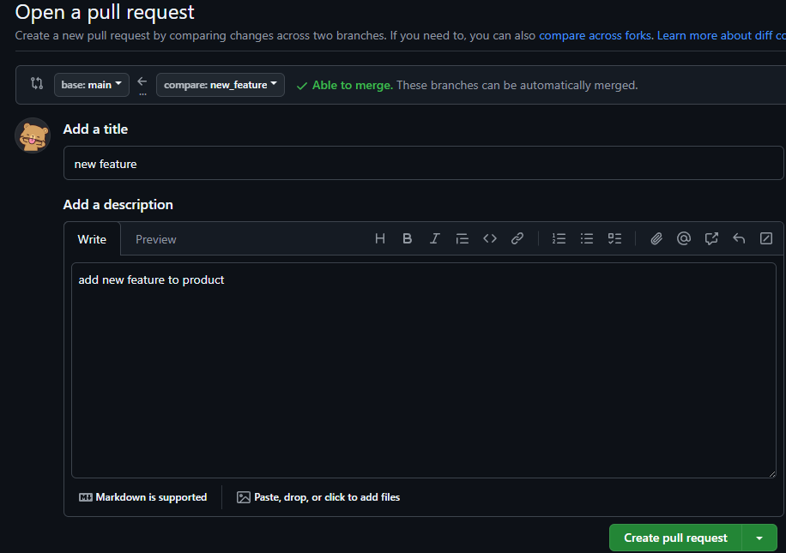
Example
Create pull request

Slide 15
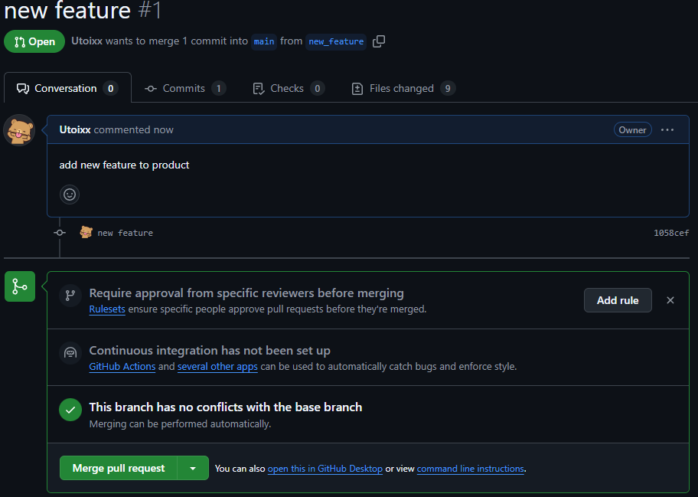
Example

