Slide 1
UML

Slide 2
Table of contents
Introduction
UML Diagram
Example

Slide 3

Introduction
UML, short for Unified Modeling Language, is a standardized modeling language consisting of an integrated set of diagrams, developed to help system and software developers for specifying, visualizing, constructing, and documenting the artifacts of software systems, as well as for business modeling and other non-software systems.
The UML is a very important part of developing object-oriented software and the software development process.
The UML uses mostly graphical notations to express the design of software projects. Using the UML helps project teams communicate, explore potential designs, and validate the architectural design of the software.

Slide 4
UML Diagram
UML is that there are a lot of different diagrams (models) to get used to. The reason for this is that it is possible to look at a system from many different viewpoints. A software development will have many stakeholders playing a part:
Analysts
Designers
Coders
Testers
QA
The Customer
Technical Authors
All of these people are interested in different aspects of the system, and each of them require a different level of detail. For example, a coder needs to understand the design of the system and be able to convert the design to a low-level code. By contrast, a technical writer is interested in the behavior of the system as a whole, and needs to understand how the product functions.

Slide 5
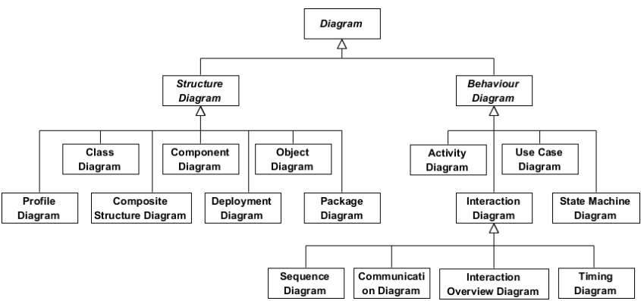
UML Diagram
Structure diagrams show the static structure of the system and its parts on different abstraction and implementation levels and how they are related to each other.
Behavior diagrams show the dynamic behavior of the objects in a system, which can be described as a series of changes to the system over time.

Slide 6
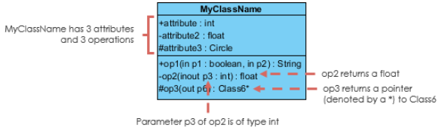
UML Class Diagram
UML Class Notation
Class Name:
The name of the class appears in the first partition.
Class Attributes:
Attributes are shown in the second partition.
The attribute type is shown after the colon.
Attributes map onto member variables (data members) in code.
Class Operations (Methods):
Operations are shown in the third partition. They are services the class provides.
The return type of a method is shown after the colon at the end of the method signature.
The return type of method parameters are shown after the colon following the parameter name. Operations map onto class methods in code

Slide 7
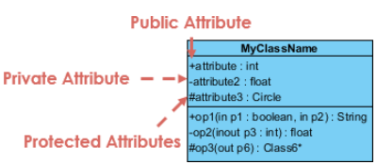
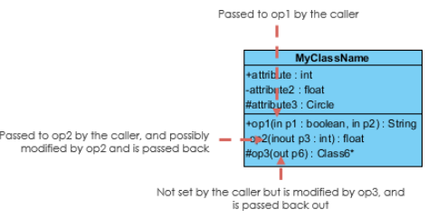
UML Class Diagram
Class Visibility
The +, - and # symbols before an attribute and operation name in a class denote the visibility of the attribute and operation:
+ denotes public attributes or operations
- denotes private attributes or operations
# denotes protected attributes or operations
Parameter Directionality
Each parameter in an operation (method) may be denoted as in, out or inout which specifies its direction with respect to the caller. This directionality is shown before the parameter name.

Slide 8
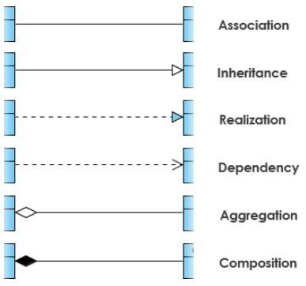
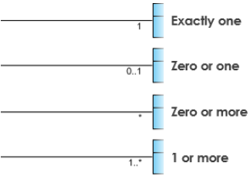
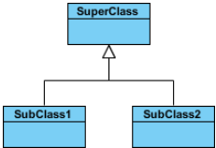
UML Class Diagram
Relationships between classes
Association
Association is basically a set of links that connects the elements of a UML model. It also describes how many objects are taking part in that relationship:
one to one
one to many
many to many
Inheritance (or Generalization)
Generalization can be defined as a relationship which connects a specialized element with a generalized element. It basically describes the inheritance relationship in the world of objects.
Relationships
Inheritance
Association

Slide 9


UML Class Diagram
Relationships between classes
Aggregation is a type of association.
It represents a "part of" relationship.
Class2 is part of Class1.
Many instances (denoted by the *) of Class2 can be associated with Class1.
Objects of Class1 and Class2 have separate lifetimes.
Composition
A special type of aggregation where parts are destroyed when the whole is destroyed.
Objects of Class2 live and die with Class1.
Class2 cannot stand by itself.
Relationships

Slide 10
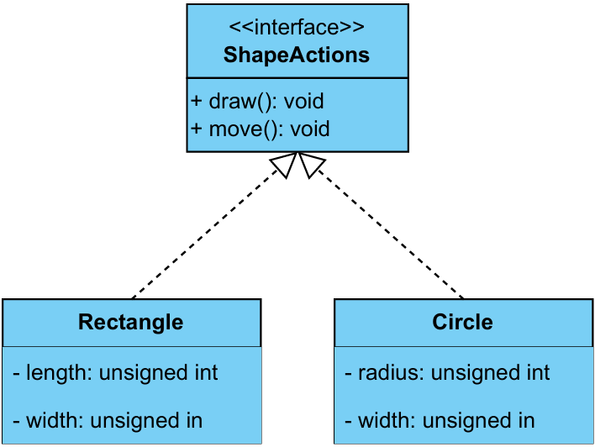
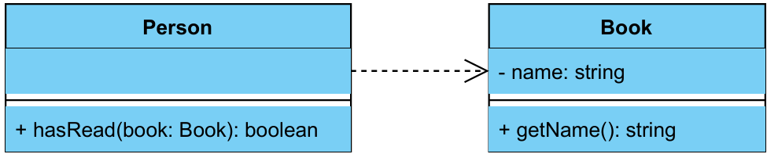
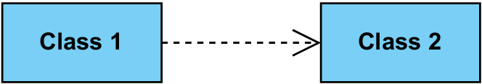
UML Class Diagram
Relationships between classes
Realization
Is a relationship between the blueprint class and the object containing its respective implementation level details.
This relationship exists in case of interfaces.
Dependency
A special type of association.
Exists between two classes if changes to the definition of one may cause changes to the other (but not the other way around).
Class1 depends on Class2
Realization
Dependency

Slide 11
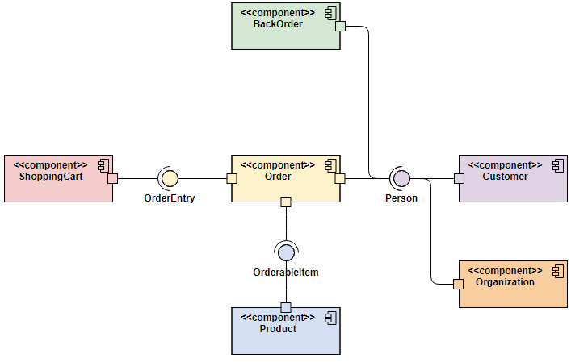
UML Component Diagram
A type of structural diagram that represents the architecture of a system by showing its components, their relationships, and how they interact to achieve the system's functionality
It focuses on the physical aspects of the system, like the software's modules, libraries, or other components and their dependencies.

Slide 12

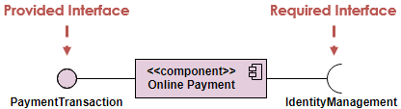
UML Component Diagram
Component Diagram Notations
Component
A component is drawn as a rectangle with optional compartments stacked vertically. A component can be represented as just a rectangle with the component's name and the component stereotype text and/or icon. The component stereotype's text is "<<component>>" and the component stereotype icon is a rectangle with two smaller rectangles protruding on its left side.
Component Interfaces
Provide Interface
Provided interfaces define "a set of public attributes and operations that must be provided by the classes that implement a given interface".
Required Interface
Required interfaces define "a set of public attributes and operations that are required by the classes that depend upon a given interface".

Slide 13
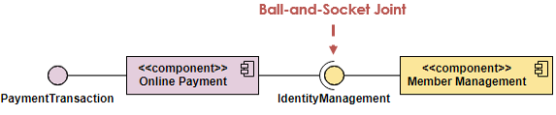
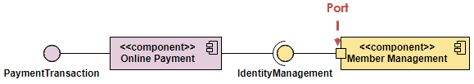
UML Component Diagram
Component Diagram Notations
Component Assemblies
Components can be "wired" together using to form subsystems, with the use of a ball-and-socket joint.
Port
A port (definition) indicates that the component itself does not provide the required interfaces (e.g., required or provided). Instead, the component delegates the interface(s) to an internal class.

Slide 14
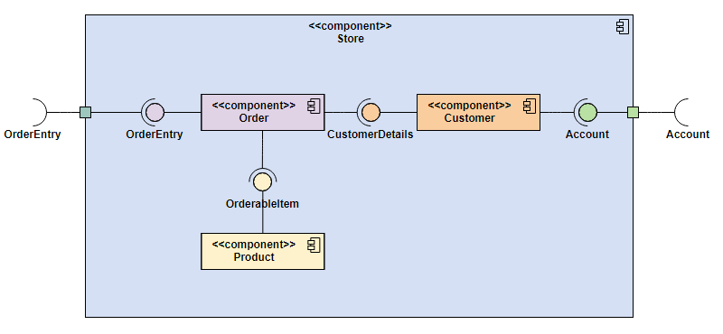
UML Component Diagram
Example

Slide 15
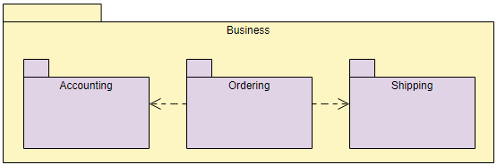
UML Package Diagram
Package diagram shows the arrangement and organization of model elements in middle to large scale project that can be used to show both structure and dependencies between sub-systems or modules:
To group elements
To provide a namespace for the grouped elements
A package may contain other packages, thus providing for a hierarchical organization of packages.
UML elements can be grouped into packages.

Slide 16
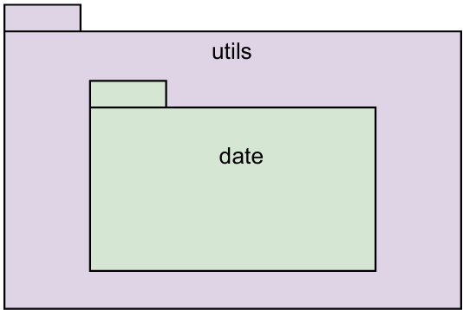
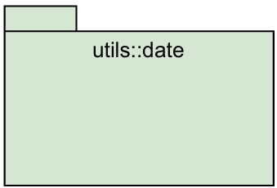
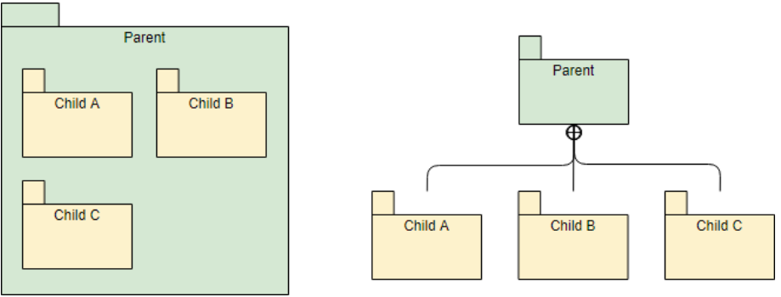
UML Package Diagram
Package Diagram Notations
Nested and Hierarchical Packages
A package can be represented as a hierarchical structure with nested packages.
A package can also have a fully qualified name
Package Containment

Slide 17
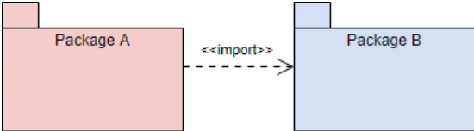
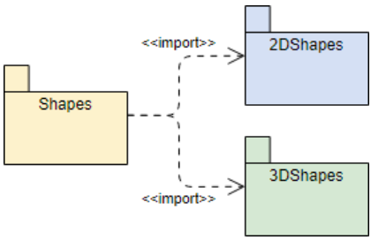
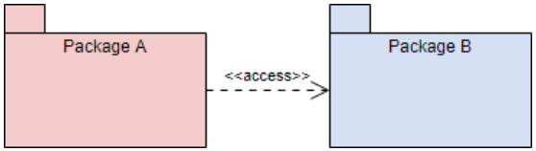
UML Package Diagram
Dependency
<<import>> - one package imports the functionality of another package.
<<access>> - one package requires help from functions of another package.

Slide 18
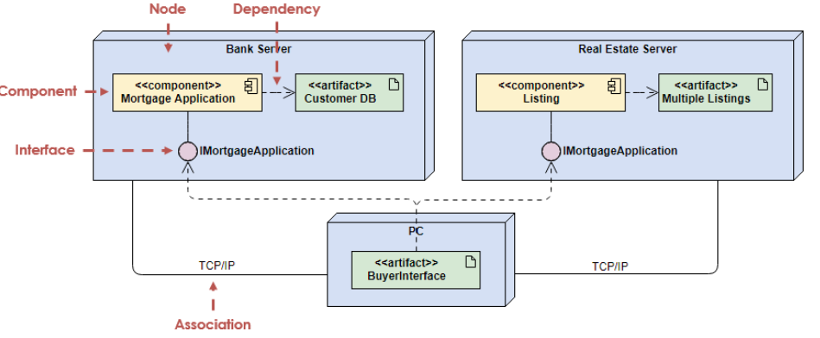
UML Deployment Diagram
In the UML, deployment diagrams is used to visualize the static aspect of these physical nodes and their relationships and to specify their details for construction.
Deployment diagrams are one of the two kinds of diagrams used in modeling the physical aspects of an object-oriented system.
A deployment diagram shows the configuration of run time processing nodes and the components that live on them.

Slide 19


UML Deployment Diagram
Deployment Diagram Notations
Component
A component is a grouping of classes that work together closely. Components can be classified by their type.
Node
A node is a run-time physical object that represents a computational resource, generally having memory and processing capability. You can model node types and node instances.
Dependency
A dependency indicates that one model element (source) depends on another model element (target), such that a change to the target element may require a change to the source element in the dependency.
Connection
A connection depicts the communication path used by the hardware to communicate usually indicates the method i.e. TCP/IP.

Slide 20
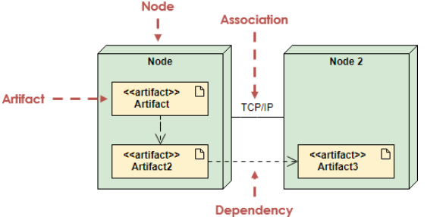
UML Deployment Diagram
Deployment Diagram Notations
Artifact
Artifacts represent concrete elements in the physical world that are the result of a development process.
Examples of artifacts are executable files, libraries, archives, database schemas, configuration files, etc.

Slide 21
UML Deployment Diagram
When to Draw Deployment Diagram?
To model embedded systems
A collection of hardware that interfaces with the physical world.
A set of controls devices such as motors, actuators, and displays.
A set of external stimuli such as sensor input, movement, and temperature changes.
You can use deployment diagrams to model the devices and processors that comprise an embedded system.
To model client/server systems
A client/server system is a common architecture focused on making a clear separation of concerns between the system's user interface (which lives on the client) and the system's persistent data (which lives on the server).
A Client/server systems are about the physical distribution of your system's software components across the nodes.
You can model the topology of such systems by using deployment diagrams.
To model fully distributed systems
A distributed systems are often hosts to multiple versions of software components, some of which may even migrate from node to node.
A distributed systems requires you to make decisions that enable the continuous change in the system's topology.
You can use deployment diagrams to visualize the system's current topology and distribution of components to reason about the impact of changes on that topology.

Slide 22
UML Deployment Diagram
A Deployment model can be developed by following the steps below.
Firstly, identify the nodes that represent your system's client and server processors and then highlight those devices that are relevant to the behavior of your system.
For example, you'll want to model special devices, such as credit card readers, badge readers, and display devices other than monitors, because their placement in the system's hardware topology are likely to be architecturally significant.
Provide visual cues for these processors and devices via stereotyping.
Model the topology of these nodes in a deployment diagram.
Similarly, specify the relationship between the components in your system's implementation view and the nodes in your system's deployment view.

Slide 23
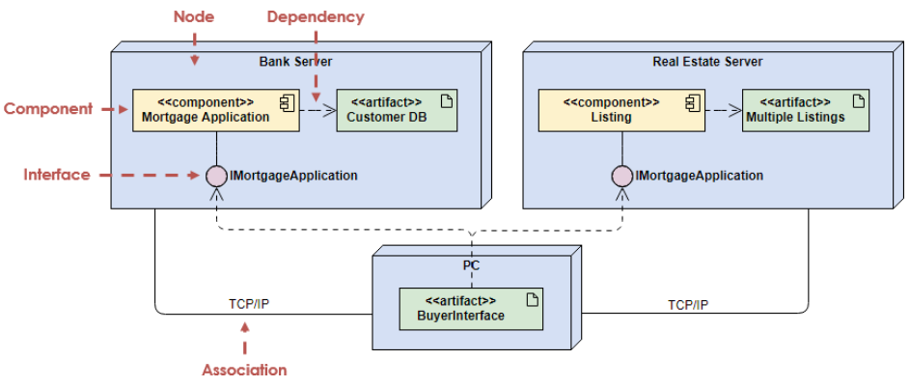
UML Deployment Diagram
Example:

Slide 24
UML Object Diagram
An object diagram's purpose is to document the instances of a class diagram at a specific point in time.
Object diagrams are used to:
Show how components interact
Object diagrams illustrate how objects and their relationships interact at runtime.
Verify class diagrams
Object diagrams can be used as test cases to check the accuracy and completeness of class diagrams.
Discover facts
Object diagrams can be used to discover facts about specific model elements and their links.
Illustrate examples
Object diagrams can be used to illustrate specific examples of the classifiers that are required.
Model test cases
Object diagrams can be used to model test cases to validate the class diagram.

Slide 25


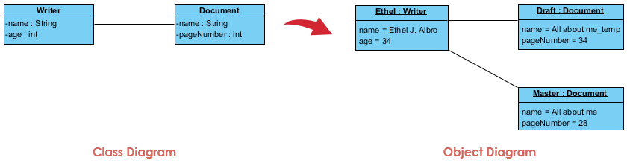
UML Object Diagram
Basic Object Diagram Symbols and Notations
Object Names:
Every object is actually symbolized like a rectangle, that offers the name from the object and its class underlined as well as divided with a colon.
Object Attributes:
Similar to classes, you are able to list object attributes inside a separate compartment. However, unlike classes, object attributes should have values assigned for them.
Links:
Links tend to be instances associated with associations.
Example

Slide 26
UML Use Case Diagram
A use case is a list of actions or event steps typically defining the interactions between a role of an actor and a system to achieve a goal.
A use case is a useful technique for identifying, clarifying, and organizing system requirements.
A use-case diagram can help provide a higher-level view of the system, providing the simplified and graphical representation of what the system must actually do.
A use case (or set of use cases) has these characteristics:
Organizes functional requirements
Models the goals of system/actor (user) interactions
Describes one main flow of events (main scenarios) and possibly other exceptional flows (alternatives), also called paths or user scenarios

Slide 27
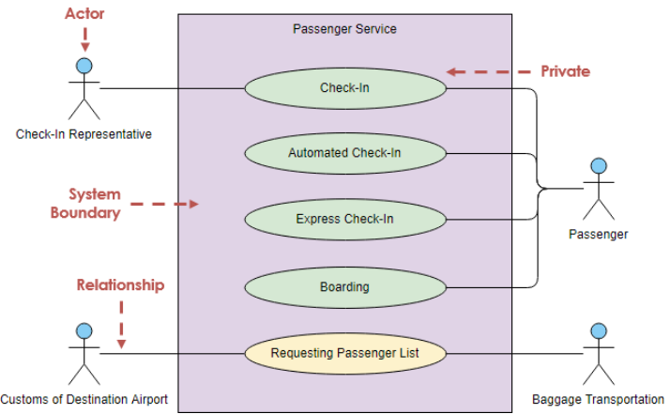
UML Use Case Diagram
Use Case Diagram Notations
Actor
Actors are usually individuals involved with the system defined according to their roles. The actor can be a human or other external system.
Use Case
A use case describes how actors uses a system to accomplish a particular goal. Use cases are typically initiated by a user to fulfill goals describing the activities and variants involved in attaining the goal.
Relationship
The relationships between and among the actors and the use cases.
System Boundary
The system boundary defines the system of interest in relation to the world around it.

Slide 28
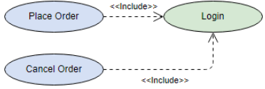

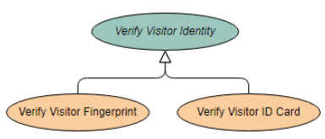
UML Use Case Diagram
Structuring Use Cases
<<include>> Use Case
The time to use the <<include>> relationship is after you have completed the first cut description of all your main Use Cases. You can now look at the Use Cases and identify common sequences of user-system interaction.
<<extend>> Use Case
An extending use case is, effectively, an alternate course of the base use case. The <<extend>> use case accomplishes this by conceptually inserting additional action sequences into the base use-case sequence.
Abstract and generalized Use Case
The general use case is abstract. It can not be instantiated, as it contains incomplete information. The title of an abstract use case is shown in italics.

Slide 29
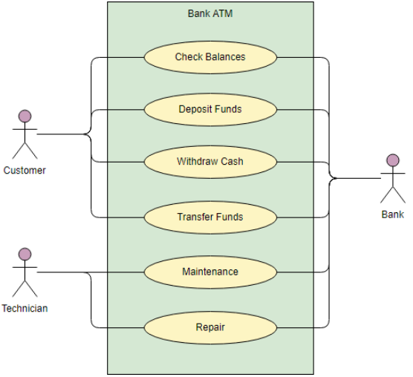
UML Use Case Diagram
Example: ATM

Slide 30
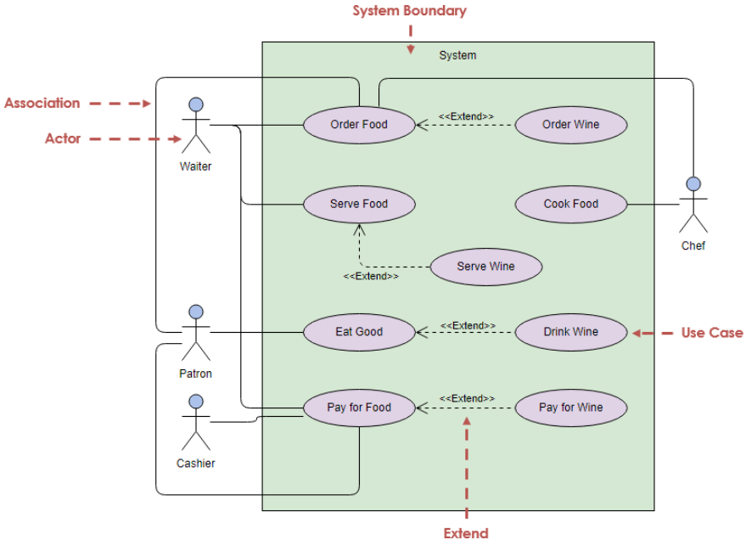
UML Use Case Diagram
Example: restaurant system

Slide 31
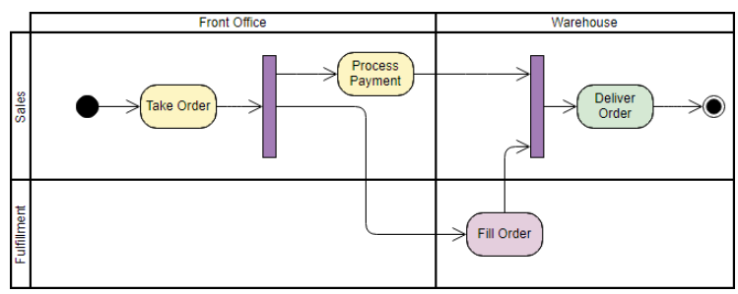
UML Activity Diagram
Activity Diagrams can be used to describe how activities are coordinated to provide a service at different levels of abstraction.
The great strength of activity diagrams lies in the fact that they support and encourage parallel behavior. This makes them a great tool for workflow modeling and, in principle, for multithreaded programming.
Activity diagrams can also define a link to an object by labeling an activity with an object name or by using swim lanes, which enable an activity diagram to be structured based on responsibilities.

Slide 32
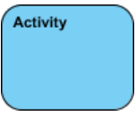


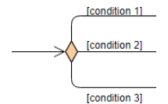
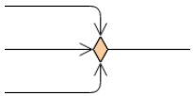
UML Activity Diagram
Activity Diagram Notations
Activity
Is used to represent a set of actions
Action
A task to be performed
Object Node
Represent an object that is connected to a set of Object Flows
Decision Node
Represent a test condition to ensure that the control flow or object flow only goes down one path
Merge Node
Bring back together different decision paths that were created using a decision-node.
Activity
Action
Object Node
Decision Node
Merge Node

Slide 33
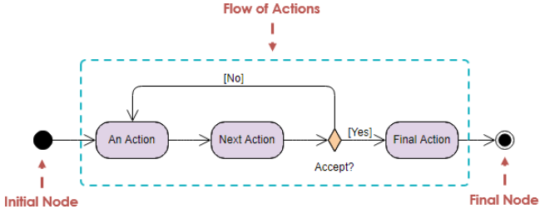

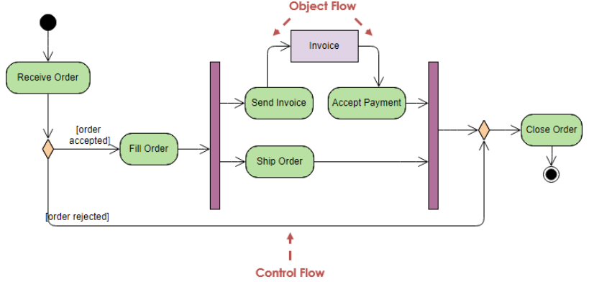
UML Activity Diagram
Activity Diagram Notations
Initial and Final Node
Initial Node (Start State)Portrays the beginning of a set of actions or activities
Final Node (End State): Stop all control flows and object flows in an activity (or action)
Object Node
Represent an object that is connected to a set of Object Flows
Control Flow
Action flows or Control flows are also referred to as paths and edges. They are used to show the transition from one activity state to another. An activity state can have multiple incoming and outgoing action flows. We use a line with an arrow head to depict a Control Flow.
Object Flow
Show the flow of an object from one activity (or action) to another activity (or action).

Slide 34
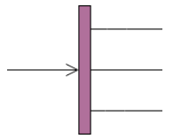
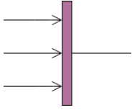
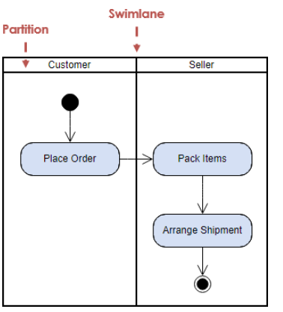
UML Activity Diagram
Activity Diagram Notations
Fork Node
A fork node is a control node that splits a flow into multiple concurrent flows.
A fork node has one incoming edge and multiple outgoing edges.
Join Node
A join node is a control node that synchronizes multiple flows.
A join node has multiple incoming edges and one outgoing edge.
Swimlane and Partition
A way to group activities performed by the same actor on an activity diagram or to group activities in a single thread
Fork Node
Join Node
Swimlane and Partition

Slide 35
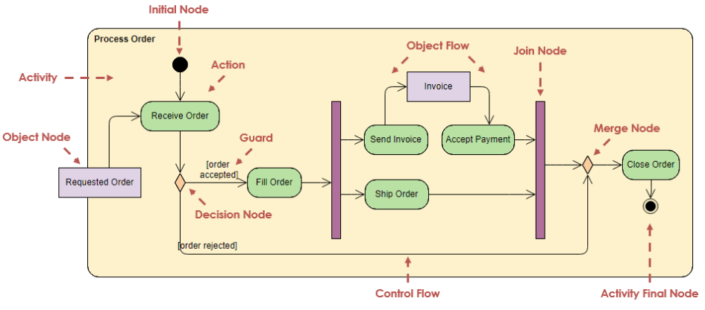
UML Activity Diagram
Example: Shipping Process

Slide 36
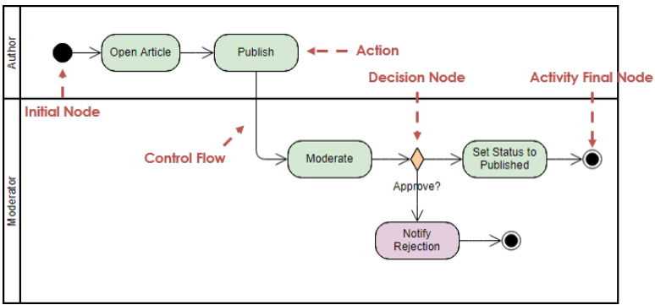
UML Activity Diagram
Example: Article Submission Process

Slide 37
UML Sequence Diagram
A sequence diagram shows the interactions between objects in a system, specifically illustrating the order in which messages are exchanged between them, essentially depicting the flow of communication and actions over time between different objects within a system.
Key points about sequence diagrams:
Visualizing object interactions:
They provide a clear picture of how different objects within a system communicate with each other, including the sequence of messages sent and received.
Understanding system behavior:
By depicting the order of events, sequence diagrams help developers and analysts understand how a system functions, especially for specific use cases.
Identifying potential issues:
By visualizing the interaction flow, sequence diagrams can help identify potential bottlenecks or errors in communication between objects.
Documenting system design:
They act as a valuable documentation tool to capture the detailed interactions within a system, making it easier to understand for developers and stakeholders.

Slide 38

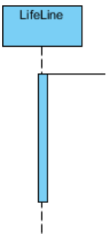
UML Sequence Diagram
Sequence Diagram Notation
Actor
A type of role played by an entity that interacts with the subject (e.g., by exchanging signals and data)
Represent roles played by human users, external hardware, or other subjects.
Note that:
An actor does not necessarily represent a specific physical entity but merely a particular role of some entity
A person may play the role of several different actors and, conversely, a given actor may be played by multiple different person.
Lifeline
A lifeline represents an individual participant in the Interaction.
Activations
A thin rectangle on a lifeline, represents the period during which an element is performing an operation.
The top and the bottom of the of the rectangle are aligned with the initiation and the completion time respectively

Slide 39
UML Sequence Diagram
Sequence Diagram Notation
Actor
a type of role played by an entity that interacts with the subject (e.g., by exchanging signals and data)
represent roles played by human users, external hardware, or other subjects.
Note that:
An actor does not necessarily represent a specific physical entity but merely a particular role of some entity
A person may play the role of several different actors and, conversely, a given actor may be played by multiple different person.
Lifeline
A lifeline represents an individual participant in the Interaction.
Activations
A thin rectangle on a lifeline) represents the period during which an element is performing an operation.
The top and the bottom of the of the rectangle are aligned with the initiation and the completion time respectively

Slide 40
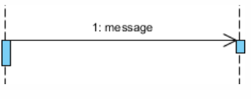
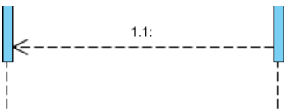
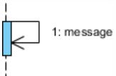
UML Sequence Diagram
Sequence Diagram Notation
Call Message
A message defines a particular communication between Lifelines of an Interaction.
Call message is a kind of message that represents an invocation of operation of target lifeline.
Return Message
A message defines a particular communication between Lifelines of an Interaction.
Return message is a kind of message that represents the pass of information back to the caller of a corresponded former message.
Self Message
A message defines a particular communication between Lifelines of an Interaction.
Self message is a kind of message that represents the invocation of message of the same lifeline.

Slide 41
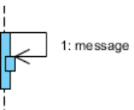
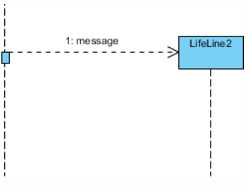
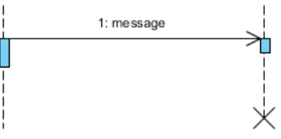
UML Sequence Diagram
Sequence Diagram Notation:
Recursive Message
A message defines a particular communication between Lifelines of an Interaction.
Recursive message is a kind of message that represents the invocation of message of the same lifeline. It's target points to an activation on top of the activation where the message was invoked from.
Create Message
A message defines a particular communication between Lifelines of an Interaction.
Create message is a kind of message that represents the instantiation of (target) lifeline.
Destroy Message
A message defines a particular communication between Lifelines of an Interaction.
Destroy message is a kind of message that represents the request of destroying the lifecycle of target lifeline.

Slide 42
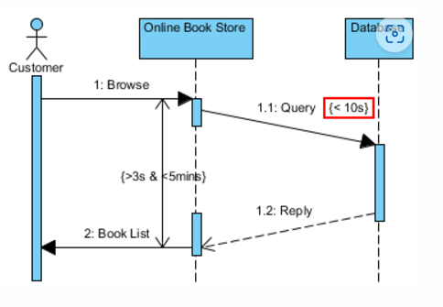

UML Sequence Diagram
Sequence Diagram Notation:
Duration Message
A duration message defines a particular communication between lifelines of an interaction, which shows the distance between two-time instants for a message invocation.
Note
A note (comment) gives the ability to attach various remarks to elements. A comment carries no semantic force, but may contain information that is useful to a modeler.

Slide 43

UML Sequence Diagram
Sequence Diagram Notation:
Sequence Fragments
A sequence fragment is represented as a box, called a combined fragment, which encloses a portion of the interactions within a sequence diagram
The fragment operator (in the top left cornet) indicates the type of fragment
Operator | Fragment Type
alt | Alternative multiple fragments: only the one whose condition is true will execute.
opt | Optional: the fragment executes only if the supplied condition is true. Equivalent to an alt only with one trace.
par | Parallel: each fragment is run in parallel.
loop | Loop: the fragment may execute multiple times, and the guard indicates the basis of iteration.
region | Critical region: the fragment can have only one thread executing it at once.
neg | Negative: the fragment shows an invalid interaction.
ref | Reference: refers to an interaction defined on another diagram. The frame is drawn to cover the lifelines involved in the interaction. You can define parameters and a return value.
sd | Sequence diagram: used to surround an entire sequence diagram.

Slide 44
UML Sequence Diagram
Sequence Diagram for Modeling Use Case Scenarios
A scenario is one path or flow through a use case that describes a sequence of events that occurs during one particular execution of a system which is often represented by a sequence diagram.

